Slide 1
AUTHENTICITY
rules

Slide 2
The Gravity Rule
Know Your Self

Slide 3
The Iceberg Rule
Know Your Content

Slide 4
The YourSpace Rule
Know Your Audience

Slide 5
The Surgeon Rule
Know Your Tools

Slide 6
The 7-Iron Rule
Know Your Flow

Slide 7
The Mask Rule
Know Your Enemies

Slide 8
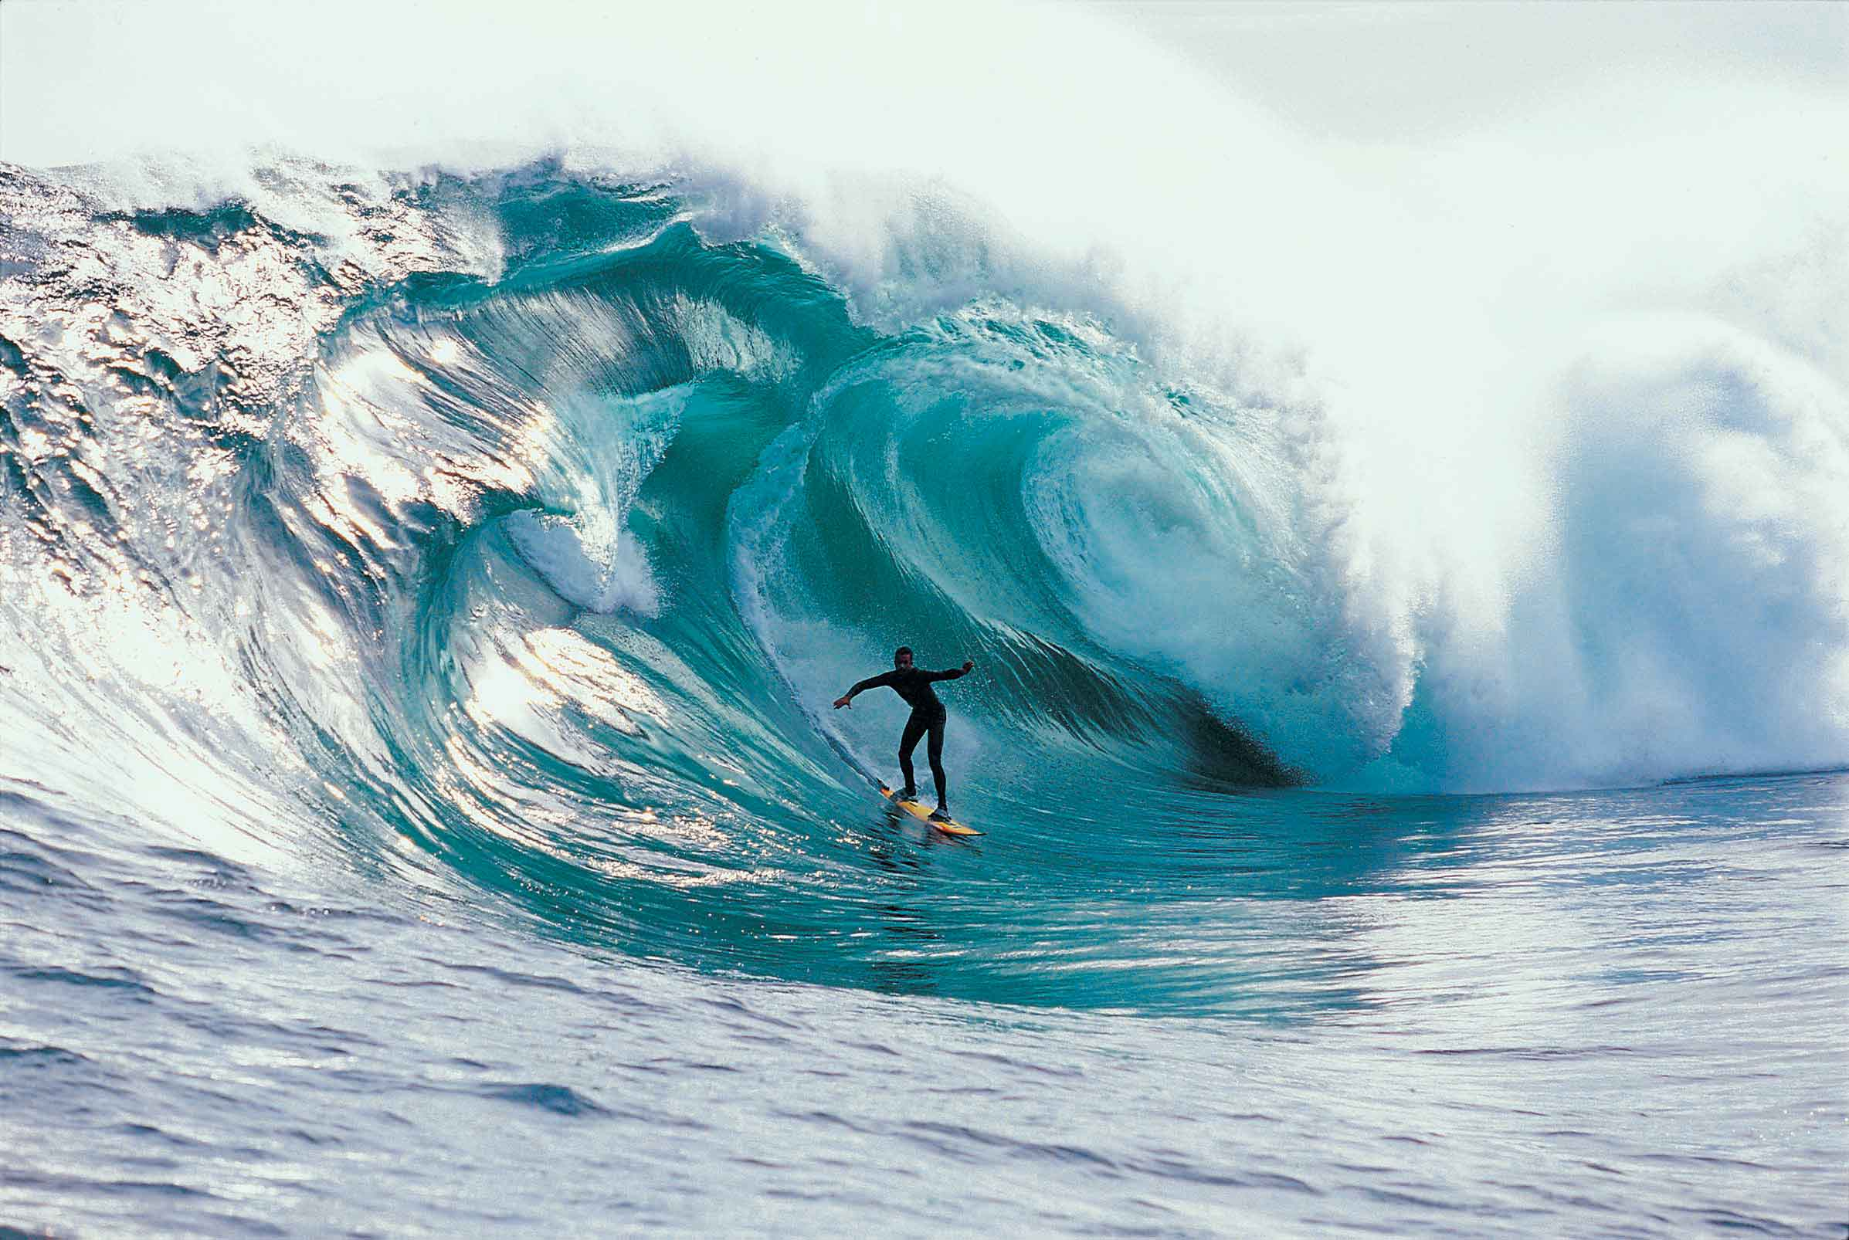
The Mavericks Rule
Know Your Difference-Makers

