Slide 1
Remember the Alamo
Baby Chef and Dad!

Slide 2
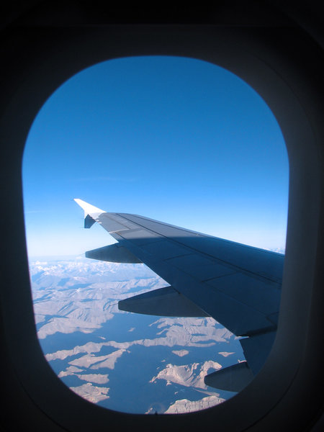
The Flight

Slide 3
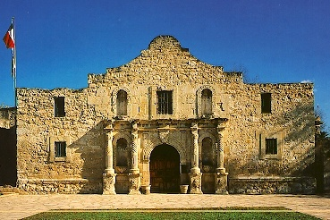
The Alamo!!!

Slide 4
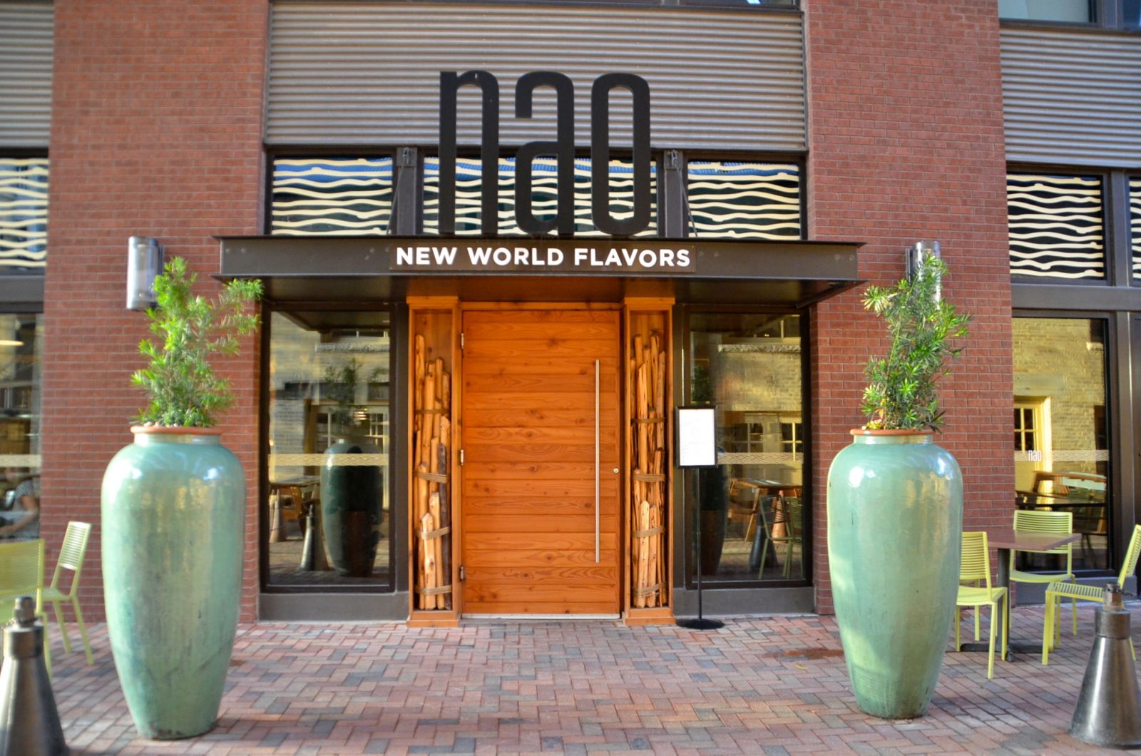
The CIA

Slide 5
The Hotel

Slide 6
Total Cost
Type of Expense | Cost of Expense | Total
Plane Ticket | United Airlines $567 | $567
Rental Car | Enterprise Full Size SUV $112 Daily (2 Days) | $ 224
Hotel | Wyndham SA $122 (1 night) | $122
Alamo Ticket | Ticket for Dad $10 | $10
The CIA meal | Meal for 1 and Baby $100 | $100
Souvenirs | $50 | $50
Meals | $50 | $50
Gas for car to and from OKC | $50 | $50
Tips | $20 | $20
TOTAL |  | $1,193+tax

