Slide 1
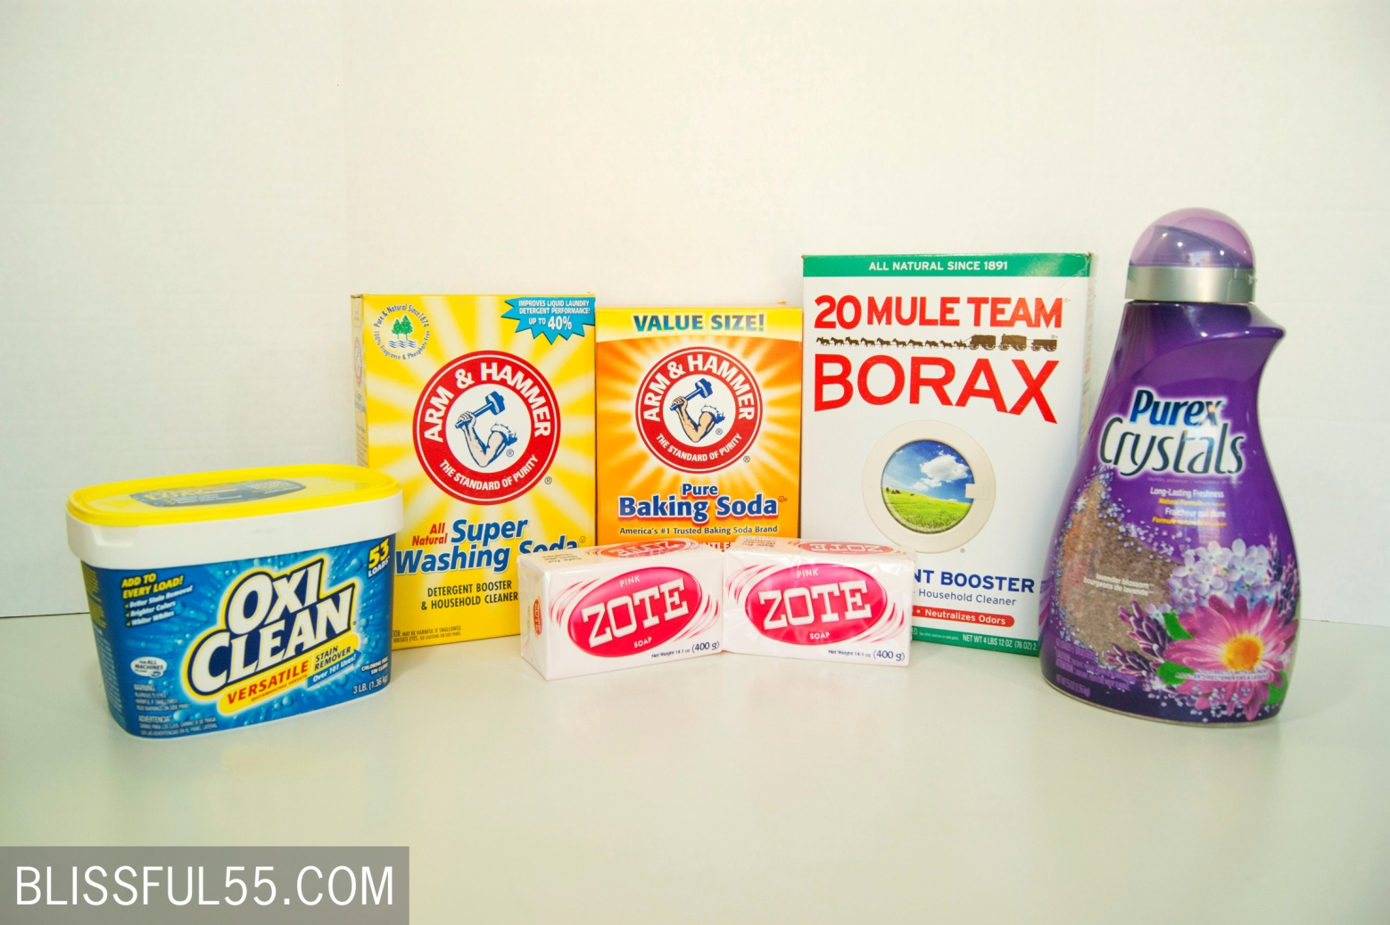
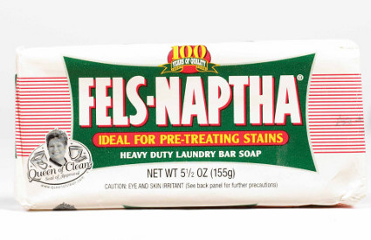
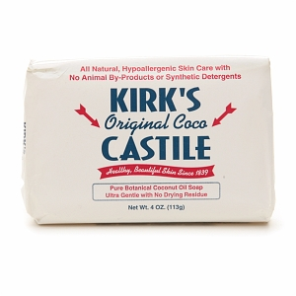
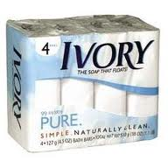

Slide 2
Homemade Laundry Detergent
1 (4 lb 12 oz) box of Borax
1 (3 lb 7 oz) box of Super Washing Soda
2 bars of Fels-Naptha soap*
OPTIONAL:
1 (3 lb) container of OxyClean
1 (4 lb) box of Baking Soda
1 (55 oz) bottle of Purex Crystals fabric softener
You will also need:
1-2 LARGE bowls*
Large, long-handled spoon
Grater
----------------------
Container to take detergent home in

