Slide 1
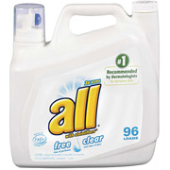
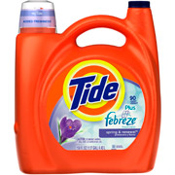
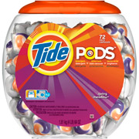
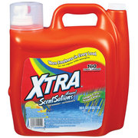
$10.77
96 loads
$17.97
90 loads
$7.98
160 loads
$17.97
72 loads

Slide 2
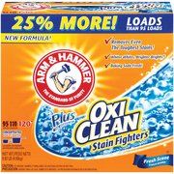
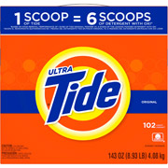
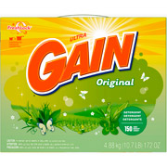
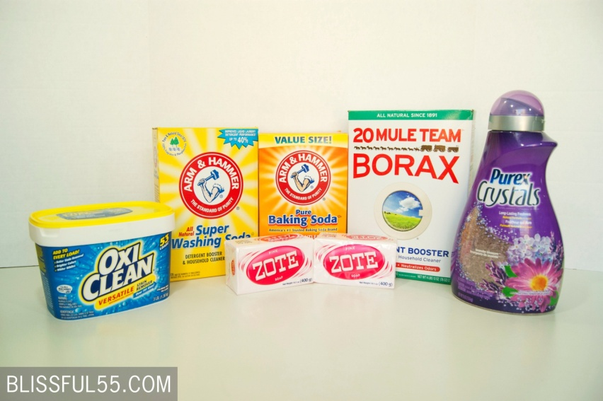
$13.47
120 loads
$17.97
102 loads
$19.47
150 loads
Borax $3.38
Washing Soda $3.24
Bar soap $2.64
Baking Soda $2.24
Purex Crystals $8.96
OxiClean $7.52
$27.98
312 oz
1 tbsp=0.5 oz
624 loads

