Slide 1
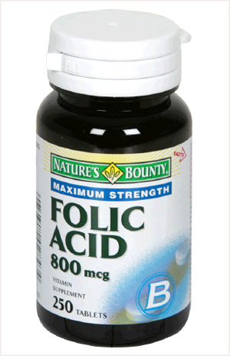
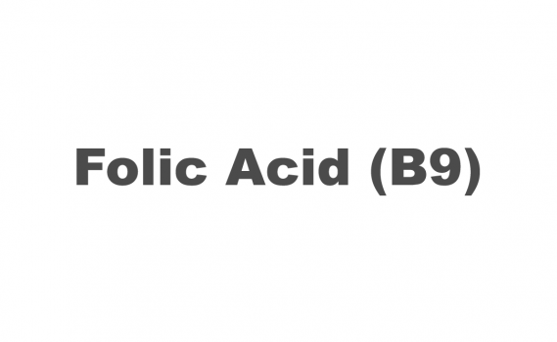
Folate
By: Sheridan W.
6th hr.

Slide 2
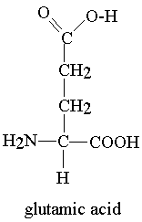
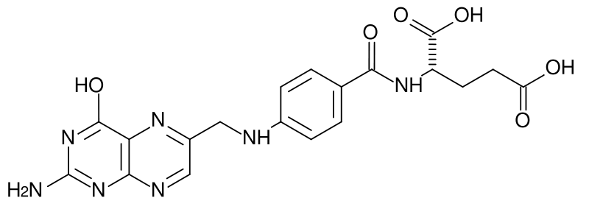
Introduction
Folate or folic acid is a B vitamin.
It is also referred to as vitamin M, vitamin B₉, vitamin Bc, pteroyl-L-glutamic acid, and pteroyl-L-glutamate.

Slide 3
Basic Description
Many people are familiar with the name of this B complex vitamin, and it has long been recognized as a key nutrient in human health. Low intakes of folate can have devastating effects, ranging from birth defects to blood diseases and possibly even cancers. Much more recent in our understanding of this critical B vitamin is its many different forms in food, and its influence far beyond birth defects, blood diseases, and cancers.

Slide 4
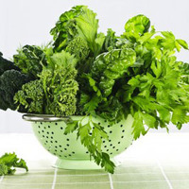
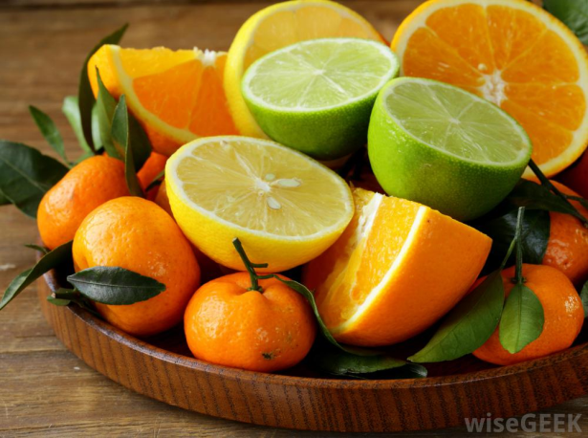
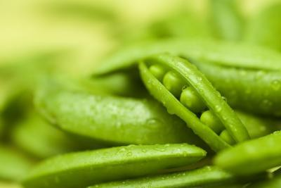
Role in Health Support
The past decade of folate research has taught us much more about the nature of this vitamin and its critical role in support of our health. However, in general, folate has been a complicated vitamin for researchers to understand, and research on folate has produced some confusion when scientific findings need to get translated into practical steps that we can take in the grocery store and in the kitchen.

Slide 5
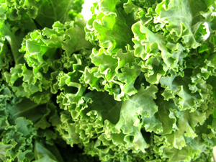
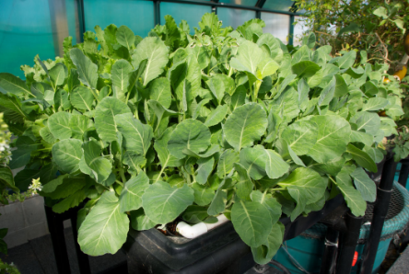
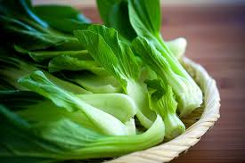
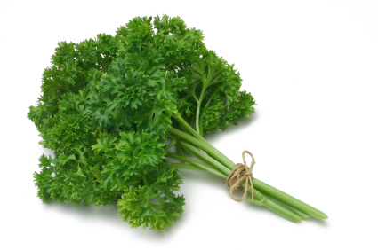
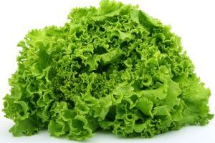
Summary of Food Source
Green leafy vegetables are among the best sources of folate. Spinach, turnip greens, bok choy, parsley, and romaine lettuce are all excellent sources of folate. Other vegetables can be strong sources as well, and asparagus, cauliflower, broccoli and beets join the excellent group.

Slide 6
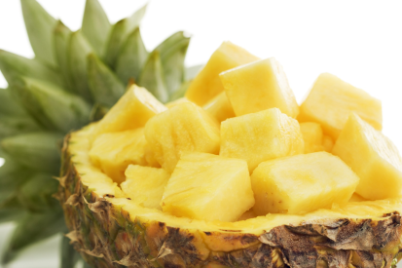
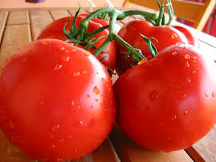
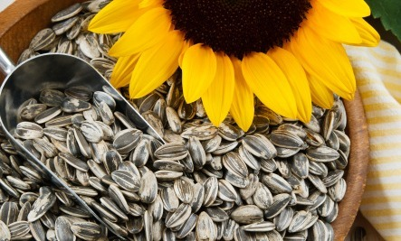
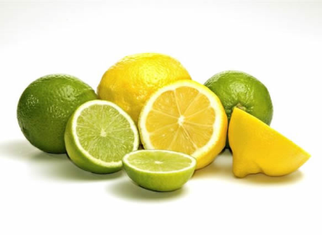
Nutrient Rating Chart
Food | Serving Size | Calories | World’s healthiest food rating
Pineapple | 1 cup | 82.5 | Good
Tomatoes | 1 cup | 32.4 | Very Good
Sunflower Seeds | .25 Cup | 204.4 | Good
Lemons & Limes | .25 Cup | 13.4 | Good

Slide 7
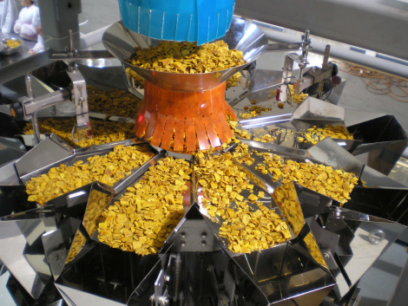
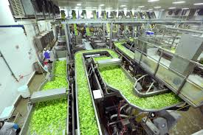
Impact of Cooking, Storage & Processing
Like most water-soluble vitamins, folate can frequently be removed from foods during processing. You should expect there to be a substantial loss of folate in the manufacture of canned foods. The exact amount of folate lost depends on the food in question and the processing method used, but here are some practical examples. One cup of cooked garbanzo beans (prepared from dried beans) can provide you with over 275 micrograms of folate, while the same amount of canned garbanzo beans (by weight) is likely to provide you with about 75 micrograms.

Slide 8
Interesting Fact
14+ years: 400 mcg
There are 1,000 micrograms in 1 milligram

Slide 9
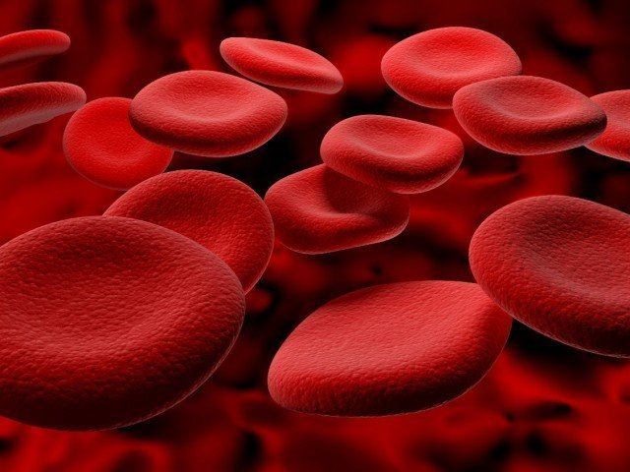
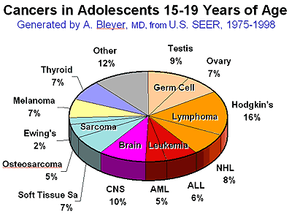
Interesting Fact
Low intakes of folate can have devastating effects, ranging from birth defects to blood diseases and possibly even cancers.

Slide 10
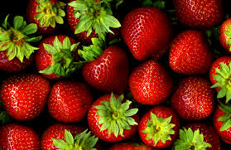
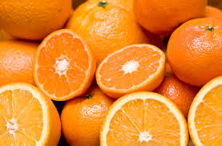
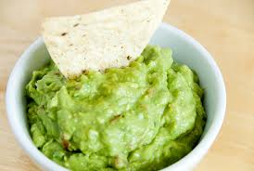
Closing
Although folate might not be in your favorite foods, it is a very important vitamin that your body needs. You may not think that you will be affected by it, but its best to not take the chance so eat your green veggies… ALSO it is in strawberries, oranges, and even avocados, so you just have to eat some guac!

