Slide 1


Welcome to the
2026 Summer Annual Meeting!

Slide 2
Agenda
  Call to Order
  Minutes Review and Approval
  Reports
    Treasurer
    Programmatic Vice-Presidents
    HOSA
    CTAC
    PAC
    Awards
    Diversity Action
    MBP Board
    Membership Committee
    Simulation
4. ODCTE Advisor Update
5. Announcements
6. Outgoing Officer Recognition
7. Presentation of 2026-2027
OkHSE Executive Council
8. Adjournment

Slide 3

Spring 2026 Business Meeting Minutes

Slide 4
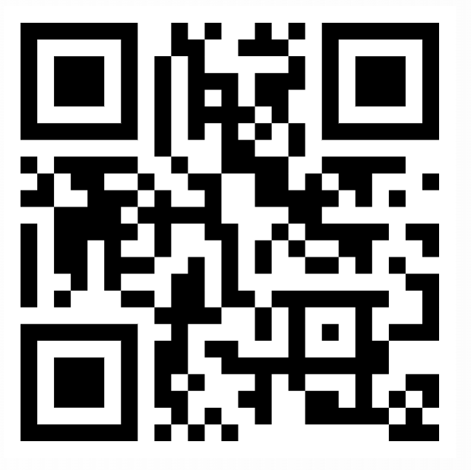
2026 Q2 Treasurer’s Report

Slide 5


ODCTE Update
Lara Morris

Slide 6
ODCTE Update—2026-2027
Apprenticeships—expansion (40 plus 16)
Comprehensive High School New Programs
Rural Health Transformation Grant (High School LPN programs)
Emily: Instructional Framework—(need syllabi, course descriptions, etc.)
Gilda: Creating “core” curriculum for comprehensive high school programs/Tech Center core; will be placing on ctyou.org into courses that can be duplicated for your use in the classroom
Susie is leaving us ☹ Her wife has taken a position in Arizona and they will be moving before the holidays.

Slide 7
ODCTE Update—2026-2027
Amy: All membership and participation at over 20% than ever before; created HOSA Partnerships/Sponsorship Guide—Please help us get new sponsors and partners! New partnerships this year include CVS, OU Health and OU Health Science Centers
State Question 844
Governor’s Council Health Science Committee will sponsor 5 regional Program, College and Career Fairs: Enid, McAlester/Durant, Lawton, OKC, Tulsa
Virtual Health Career Expo (Oct. 23, 2026, 9-1; See next slide to register)
If you are not receiving my emails—please let me know! Lara.morris@careertech.ok.gov

Slide 8
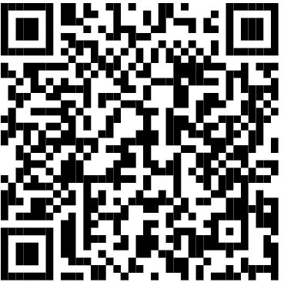

Partnership with Oklahoma Hospital Assn: Virtual Health Career Day
Middle, High School or Post-Secondary Adults
10 Careers at 8 Partner Hospitals; Featured in 5-10 min. video
Followed by live Q & A sessions.
Last year’s Recordings: Explore Healthcare: Oklahoma Virtual Career Expo – YouTube
Features Curriculum for Each Career as Pre-or Post-Session Work: Explore Healthcare Oklahoma Virtual Career Expo - Classroom Resources.pdf
Register Your Class HERE!

Slide 9



Slide 10


October 19-22, 2026, in Birmingham, Alabama! See you there!

Slide 11
Presentation of 2026-2027
OkHSE Executive Council
Officer: | Name:
President | Tyler Bell
President-Elect | Angela McDoulett
Past President | Heather Black
Secretary | Sarah Raney
Treasurer | Amber Pagel
Reporter | Jeremy Cooper
Vice Presidents: | Name:
Health Clusters/Academics | Chris Jones
Health Science Tech./HCC | Amie Underwood
Dental Lab Asst./Dental Asst. | Janet Coon
Emergency Medical Services | Brooke Meyer
Medical Assist/ Health Info. | Amanda Longan
Practical Nursing Coordinator | Dana Chandler
Practical Nursing Instructors | KaLisa King
Radiologic Technology | Quincy Knutson
Respiratory Therapy | Crystal Cosper
Pharmacy | McKenna Scott
Surgical Technology | Chanda Lewis
Rehabilitation Careers | April Johnson
Biomedical Science | Mia Sweetman
OkACTE Committee Reps: | Name:
CTAC Representative | Emilee Hedrick
PAC Board Rep #1 | Gilda Austin
PAC Board Rep #2 | Brandi Fisher
Awards Committee Chair | Casey Woods
Diversity Action Committee Rep | Melissa Peterson
MBP Board Rep | Sandra Patocka
Membership Committee Rep | Christin Jedlicka
Comprehensive Professional Committee Rep | Randi Wilson
ODCTE: | Name:
HSE Program Administrator | Lara Morris
HSE Program Specialist | Susie McEacherrn-Lauer
HSE Program Specialist | Gilda Austin
HSE Program Specialist | Emily Gedra
Coordinator/Specialist: | Name:
Sim Coordinator Specialist | Tessa Gerhart-Ball
HOSA State Advisor | Amy Warner

Slide 12
Announcements
Day 2: Health Science Divisional Conference
@ Hyatt Regency at 100 East Second Street
  Breakfast, lunch, and snack provided for:
  OkHSE Members who paid the HSE Registration fee
  Vendors will now be upstairs near the session rooms
  Bring your baskets for the Fundraiser Raffle
  Proceeds will fund scholarships for our HSE Educators!
  Don’t forget cash/card to buy tickets for the Raffle and 50/50 drawing. Tickets are 6 for $5. You can pay via Square; however,
  cash will be a smoother process
  Join us for the drawing for the 50/50 prize and the raffle items at 3 pm

Slide 13
Thank
You

