Slide 1
Bell Ringer
September 27, 2018
Write your answer on a sticky note and put it in the appropriate column on the board.

Slide 2
Bell Ringer
September 27, 2018
Write your answer on a sticky note and put it in the appropriate column on the board.

Slide 3
My Info:
Johni Edsel
Instructional Coordinator at Tulsa Tech
24 years in Education
21 years in the classroom
Johni.edsel@tulsatech.edu

Slide 4
Goals for Today:
Define Bell Ringers and the purposes of using them
Describe the different types of Bell Ringers
How to grade Bell Ringers
Access to over 5 years of Bell Ringers already made for you!

Slide 5
What is a bell ringer?
An academic activity students do to begin their day or period
A tool teachers use within their classroom to help focus their students’ minds.

Slide 6
Purposes
Provides transition from hallway to classroom
Provides time for teacher to tend to necessary tasks while creating positive learning time for students
Provides time to assess prior learning
Provides a “hook” to the objective of the day
Provides a “get ready to learn” attitude for students
Intro to Bell Ringers video

Slide 7
Different kinds of Bell Ringers
Journaling
Critical Thinking Activity
Video introducing a new concept
Soft skills review
Quiz or Review of a homework assignment
Project Work
Quote of the Day/Motivational

Slide 8
Procedure
As soon as the bell rings, students are expected to be seated, with paper (or bell ringer notebook) and pen ready.
Set timer to 5 minutes (or however long you think it will take)
When the timer rings, pencils down or students comeback from work station and get seated
Start discussion or sharing of answers.
Notes:
Say: In some rooms the bell may not be heard, so I make sure my watch or clock is set according to the bell and I would ring my bell to announce bell ringer is ready to be done.
A friend uses a 30 second song to announce time for bellringer.

Slide 9
Bell Ringer ideas (Journaling)
Notes:
*There are more than 300 video sharing websites http://www.reelseo.com/list-video-sharing-websites/
Teachertube, wingclips

Slide 10
Bell Ringer ideas (Critical Thinking)
Notes:
*There are more than 300 video sharing websites http://www.reelseo.com/list-video-sharing-websites/
Teachertube, wingclips

Slide 11
Bell Ringer ideas (Critical Thinking)
97. The lowest digit is dropped.
Notes:
*There are more than 300 video sharing websites http://www.reelseo.com/list-video-sharing-websites/
Teachertube, wingclips

Slide 12
Bell Ringer ideas (introducing new concept)
What does OSHA stand for?
Why is safety important in the workplace?
Objective:
At the end of the period, a student should be able to explain the role that safety plays in the construction crafts and know what OSHA stands for.

Slide 13
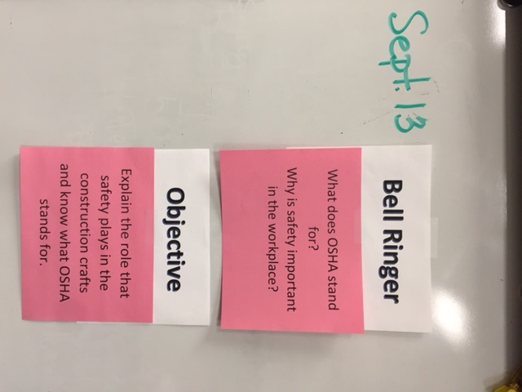
Example:
Safety Fails Video

Slide 14
Bell Ringer ideas (Soft Skills Review)
The Entitlement Creed (3:33) https://youtu.be/8cPuH8jg5nQ
Activity: Discuss what you expect from your future employer and what you think they will expect from you.
Notes:
Have a participant answer and give a prize

Slide 15
Bell Ringer ideas (Quiz or Review from Homework)
There are many apps that can be used for quick review and gives you immediate feedback.
Find a Kahoots game that is already made by going to www.kahoot.com
Notes:
Have a participant answer and give a prize

Slide 16
Bell Ringer ideas (Quote of the Day/Motivational)
The Pursuit of Happyness
https://youtu.be/DvtxOzO6OAE
What is your dream?
Notes:
Have a participant answer and give a prize

Slide 17
How to use bell ringers effectively
KISS. Keep it short and simple.
Be consistent. Post your daily bell ringer in the same place in the classroom.
Decide on a simple grading system.

Slide 18
How to use bell ringers effectively
Be prepared by keeping back-ups of other bell ringers.
Consider having a theme:
Motivational Mondays
Professional Tip Tuesdays
Workshop Wednesdays
Think about it Thursdays
Free Fridays

Slide 19
Important Note
“Teachers who review bell work and make the connection to the content have more success with the students. The more time on task, the more students learn. Bell ringers also add dignity to the classroom and eliminates most of the drama that occurs at the beginning of each period.”
Karen Seddon
tuesdaywithkaren.blogspot.
com

Slide 20
How to grade Bell Ringers
Make sure anything you take a grade on aligns with a course objective
Daily (participation)
Weekly (20 points each day)
End of grading period (spot check for one quiz grade)
Multiple choice quiz based on bell ringers
Notes:
I have done weekly grading for 100 points under participation

Slide 21
What can I use TOMORROW in my classroom??
*Professional Tip Tuesday videos with activities
(2 years already made)
*1 year of Bell Ringers for Electricity (Math Focused)
*2 years of Bell Ringers (variety of topics)
*1 year of Bell Ringers from Russell Area Technology Center
(Architectural Design, Healthcare Principles, CAD and CNC, WorkKeys, Welding, Machine Tool Technology, SkillsUSA,)
Notes:
I have done weekly grading for 100 points under participation

Slide 22
Want more Information?
Contact Information:
Johni Edsel
Instructional Coordinator for Tulsa Tech
johni.edsel@tulsatech.edu
Office phone: 918-828-5078

