Slide 1
Oklahoma CareerTech System
Notes:
Use this slide to open the meeting. Thank the legislator for taking the time to meet. Explain that one of the goals of the superintendents group is to meet will ALL of the legislators (returning and new) prior to the start of the Legislative session. Note that although most Oklahomans are familiar with some aspect of the Oklahoma CareerTech System, not very many are familiar with the scope of our programs and services.

Slide 2
CAREERTECH SYSTEM
Oklahoma’s Career and Technology Education System is focused on developing a world-class workforce. This comprehensive system delivers educational experiences through 393 K-12 school districts, 29 technology center districts, 16 Skills Centers sites and 31 adult basic education providers and to 6,948 businesses through business and industry services.
CareerTech’s goal is to improve Oklahoma’s economy by providing individuals with the training and skills necessary to be successful in the workplace and by providing companies with the workforce needed to compete globally.
Oklahoma CareerTech System graduates add more than $3.5 billion annually to the state's economy.*
Oklahoma CareerTech annual enrollments totaled 558,007 in FY18.
Nearly half (83,728) of Oklahoma ninth- through 12th-grade students were enrolled in CareerTech classes in FY18.
Business and Industry enrollments totaled 303,602 in FY18.
Oklahoma CareerTech Skills Centers offered specialized occupational training to 1,882 adult and juvenile offenders in FY18.
Student placement was 94 percent in FY16.
Notes:
Use this slide to emphasize that the Oklahoma CareerTech system impacts, directly or indirectly, every Oklahoman. Through our programs in:
393 K-12 schools
29 Technology Center Districts
16 Skills Centers (prisons), and
31 Adult Basic Education providers
The Oklahoma CareerTech System serves over 558,000 enrollments each year.
Nearly ½ of all 9th through 12th grade students are enrolled in a CareerTech class each year and those are the programs that people are most familiar with. That number, however, represents only about 25% of the enrollments we serve.
Accountability is important. CareerTech has always conducted follow-up studies of our full-time program students. Our success is impressive. 94% of the students surveyed indicate they are positively placed in employment, continuing education or a military career 6 months after program completion.

Slide 3
CareerTech Delivery Arms
Notes:
Visually, this graphic depicts the delivery arms of the Oklahoma CareerTech System. Through the Oklahoma Department of CareerTech and the State Board of Career and Technical Education, programs and services are offered in comprehensive schools, technology centers, skills centers, adult basic education sites and in businesses and industries throughout Oklahoma.

Slide 4
CareerTech System Enrollments (FY17)
Notes:
As mentioned before, the programs most commonly thought of when CareerTech is mentioned are those high school programs located in the comprehensive schools and at the Technology Centers. As you can tell by this chart, those numbers of students are impressive—almost 140,000 at the K-12 schools and another 21,000 at the Technology Centers.
But what that means is that only about ¼ of all students served by the Oklahoma CareerTech system are high school students. The remaining ¾ are adults who are looking for ways to increase their earning power through continuing education or skill upgrades. These may be individuals who are looking to start their first careers or they may be those who found that what they thought to be their preferred future no longer applied.

Slide 5
CareerTech Delivery Arms Governance
Arm | State Board of CareerTech | Locally Elected Tech Center | Local Elected K-12 School Board
State Agency | X
Skills Centers | X
K-12 (Comprehensive Schools) |  | X | X
Technology Centers |  | X
Business and Industry |  | X
Adult Basic Education |  | X | X
Notes:
Governance of CareerTech programs vary based upon the type.
The State Agency is governed by the State Board of Career and Technology Education. This entity is comprised of the State Superintendent of Public Instruction serving as the chair and includes eight other individuals that are gubernatorial appointments—2 of whom also serve on the State Board of Education. The State Board of CareerTech hires the state director—Dr. Marcie Mack--and sets policy for the agency. The State Board also oversees the operations of the Skills Center programs.
CareerTech programs located in the comprehensive schools (K-12) are largely under the auspices of the local school district board of education. In order to receive supplemental program funding, each CTE program at the comprehensive school must be an “approved” program and, as such, meet or exceed minimum program quality standards. Day-to-day decisions in regard to those programs fall under the local board’s responsibilities.
Each Technology Center has a locally elected Board of Education. They are the policy board for the Technology Center and are responsible for hiring the local superintendent and ensuring that the programs and services offered by the Technology Center meet the local needs of the communities they serve. The primary role of the Technology Center is workforce development—ensuring that employers have a skilled and educated pool of workers.
Training for business and industry is a shared responsibility of the local technology center, the state agency, and other workforce partners.
Adult basic education programs are governed by the LEA who applied for and receives the program funding.

Slide 6
CareerTech Delivery Arms Funding Sources
Notes:
Funding for the each CareerTech System delivery arms varies as well.
The State Agency is primarily funded through State Appropriations made by the Oklahoma Legislature. Each year, the budget request made by the State Board of Career and Technical Education reflects the needs of the system in terms of Agency operations, Skills Center Programs, and program support at the local comprehensive schools and the technology centers. More information on that will be shown on the next slide.
Skills Centers are funded through a partnership between the Oklahoma Department of CareerTech and the Oklahoma Department of Corrections as a part of their state appropriations.
CareerTech programs at the comprehensive schools receive state, local and federal funding support—but primarily local and state dollars through the K-12 school district. Because CareerTech programs are inherently more expensive to offer than traditional academic programs (cost of equipment and supplies), the State Department of CareerTech does provide supplemental funding (state dollars). The amount varies based upon program type and cost.
Technology Center’s receive the majority of their funding from local ad valorem taxes. Each of the 29 districts was formed as a result of 3 separate elections of the people living in the district it serves. The first vote was to approve the formation of the district. The second vote was to elect a Board of Education. The third vote was to approve some level of “millage” (assessment on property tax values) to fund the Center’s operations. This millage was separate and apart from any millage that might go to the public schools in the area. From the beginning of the Technology Center concept in Oklahoma, funding for Technology Centers and K-12 schools have always been separate—this has always encouraged cooperation among them. As you will see in a few minutes, Technology Centers do receive some state and federal funds and the level of each varies.
Most of the Business and Industry training done through the CareerTech System originates as the local Technology Center. There are some “specialized” funds provided by the state to supplement the cost if the industry qualifies as “new or expanding” and meet certain employment benchmarks. The bulk of the cost for business and industry training comes from tuition paid by the company and/or local tech center sources.
In Oklahoma, the responsibility for Adult Basic Education was fairly recently transferred from the State Department of Education to the Department of CareerTech. This move has been beneficial from the standpoint of adults having greater access to services through the technology center districts. Funding comes primarily through Federal literacy grants but some state funds are used.

Slide 7
Agency Funding For CareerTech
Revenue (FY17)
State $ 114,112,183
Federal $ 26,769,771
Revolving $ 4,701,988
State-Lottery $ 2,930,688
Fund Balance (required) $ 2,048,936
Total $ 150,563,566
Notes:
As a State Agency, the Oklahoma Department of CareerTech serves as the coordinating body for all CareerTech programs in Oklahoma. Their various sources of funding totaled a little over $150,000,000 in FY17. The majority of this was through legislative appropriations-- $114,112,183.
The agency also serves as the LEA of several Federal Programs such as Perkins 5, Adult Basic Education, and a couple of other smaller projects which accounts for another $26,769,771.
Through a couple of it’s operations, the agency has the ability to generate revenue. In the past this has been primarily through curriculum sales, printing, and testing/assessment. In FY17, the income from these enterprises were almost $5,000,000
CareerTech also receives lottery funds…again, the agency acts as the pass-through and almost 100% of funds are used for local program support and teacher scholarships.
The “fund balance” shown does not represent extra cash. The State Agency has some contractual obligations that involve more than 1 fiscal year. The fund balance shown represent those contractual obligations that are in place involving future fiscal years.

Slide 8
Agency Funding For CareerTech
Expenditures (FY17)
Tech Center Operations $ 67,454,435 ($ 9,965,821)
Comp. School CTE Programs $ 26,769,771
State Agency $ 21,879,381
Tech Center (Health Benefit Allowance)* $ 23,595,254 ($ 9,965,821)
Skills Centers $ 4,948,377
Colleges/Universities** $ 4,280,670
Other $ 805,857
Total $ 150,563,566
*Mandated by law
**Federal Perkins Grant
Almost $10 had to be taken from Tech Center Operations to pay the unfunded mandate.
Notes:
This chart shows how the Agency’s revenue is spent.
Only about $22 million is spent at the agency level…the majority is used for program support. $67 million goes to support Technology Center Operations, $27 million is allocated to comprehensive school-based programs and $5 million goes to Skills Centers.
Another $4.2 million is allocated to various colleges and universities to support joint programming between CareerTech and Higher Education whether that be in the form of Perkins consortia, data sharing, etc.
One point that I would like to emphasize here has to do with the (Health Benefit Allowance). This benefit was provided by the legislature some years back for all CareerTech employees with the commitment that sufficient funds would be appropriated each year to cover the full cost. The reality has been, however, that full funding hasn’t been provided in many years. Because the Agency is required by law to provide it, the only choice they had was to take money out of operational funds to cover it. In Dr. Mack’s budget request this year, full funding of the health benefit allowance will be the major request. By

Slide 9
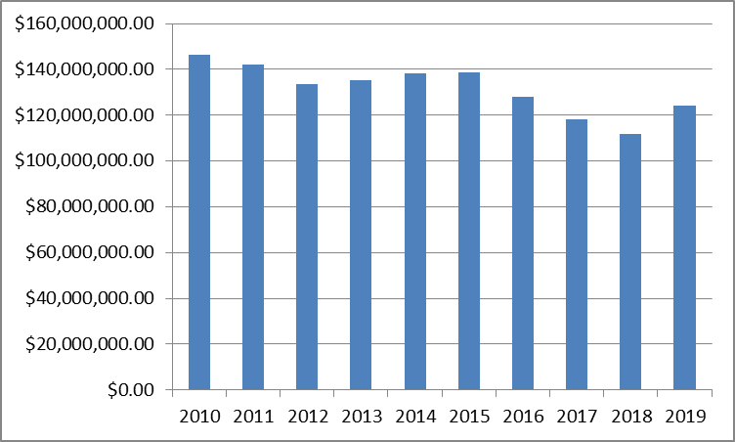
CareerTech State Appropriations
General Appropriations
FY17 $114,112,183
FY18 $111,769,218
FY19 $124,337,661*
* Increase of $12,568,443 to fund mandated teacher/support staff raises.
Notes:
This chart shows the decline in legislative appropriations between 2010 and 2019. It should be noted that the difference between FY18 and FY19 is the required teacher and support staff raises. No funding was appropriated to lessen the gap for Health Benefit Allowance or additional program operations.

Slide 10
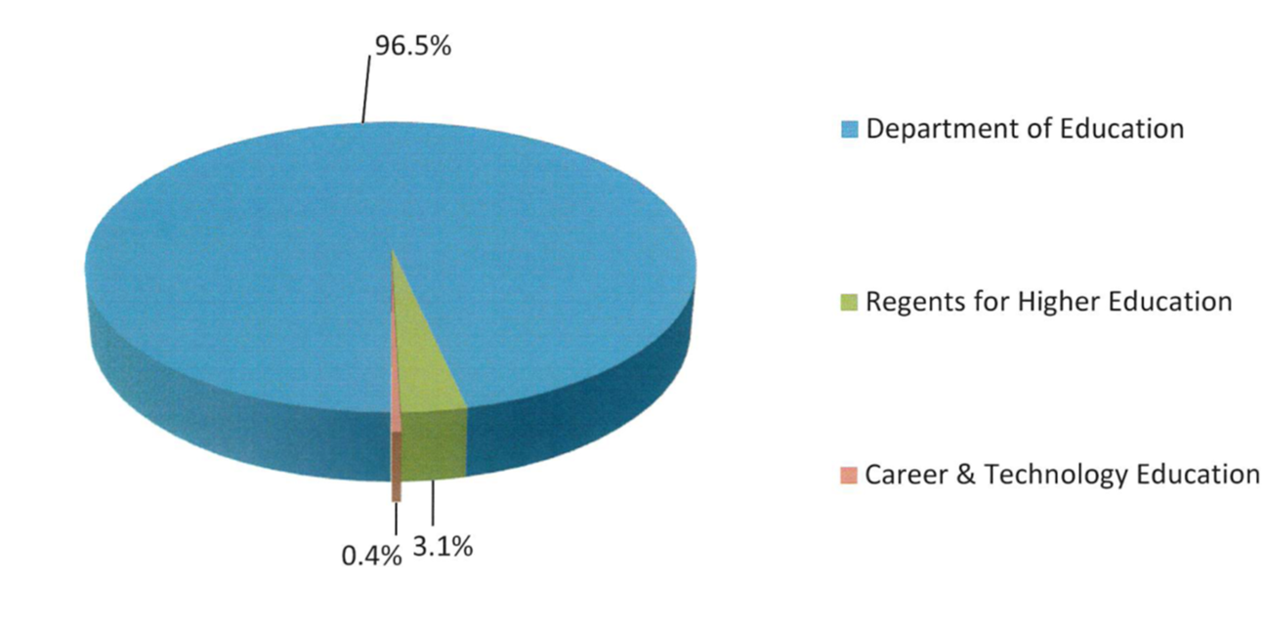
FY18 CareerTech Appropriations Compared to Other Education Entities
Notes:
CareerTech receives only .4% of the educational dollars appropriated by the Legislature.

Slide 11
Tech Center Funding
Funding for Tech Centers is a combination of Local, State, and Federal sources
State Average:
Sources
Local= Ad Valorem, Tuition, Rents
State= Program Support, Business and Industry, Lottery Grants, Special Program Funding (ABE, Truck Driver Training, etc.)
Federal= Carl Perkins, TANF, ABE. etc.
Notes:
Beginning with this slide, we will talk a little about the funding for each of the CareerTech Delivery arms.
Technology Centers receive local, state, and federal funding but the proportion of each varies according to district size, programs offered, and the millage levy approved for each district.
The maximum millage that a Technology Center may receive is 15 mils– 10 for the general fund and 5 for the building fund. While many are collecting the full millage, there are some that are not. That is a local decision. In general there is not an “equalization” formula for technology centers. State funding is based upon program counts rather than average daily membership of students.
On average, 81.7% of a technology center’s budget comes from local sources, 14.5% from state allocations, and 3.8% from federal funds.

Slide 12
Tech Center Funding
In general, larger Tech Center Districts receive, as a percentage of their total budget, less state funding. For example:
Tulsa Technology Center receives 5.3% of their budget from state funds
Southwest Technology Center receives 46.1% of their budget from state funds
Notes:
This slide will be customized according to the presentation…
In general, the larger the technology center district, the greater share of the funding comes from local sources. This technology center receives _____ % from local sources and ______ % from state funding.

Slide 13
FUNDING SOURCES BY TECH CENTER
Notes:
This chart is difficult to read but shows the differences in local v state percentages for each of the 29 districts.

Slide 14
Moore Norman Technology Center General Funding (FY17)
Local (90.0%)
Ad Valorem $ 7,747,205
Tuition/Fees $ 850,035
Earnings on Investments $ 67,619
Rents, Disposals $ 507,198
Other Local $ 659,442
State (8.8%)
Regular Operations $ 2,674,890
Business and Industry $ 18,590
Other State Lottery $ 88,637
Federal (1.2%)
Carl Perkins/ABE $ 236,750
*Represents only General Fund. 100% of Building Fund comes from local sources.

Slide 15
Tech Center Cash Flow
Example: Meridian Technology Center
Ad Valorem taxes are billed in November and paid December through April. Technology Centers must manage cash flow and carry forward balances to ensure that sufficient fund balances exist between March and December.
Need Content
Notes:
As you are discussing technology center funding, a topic that sometimes comes up is the “carry-over” balances that technology centers have from year to year. There is a good reason why technology centers have to carry forward larger amounts than some other entities.
When do you pay your property taxes? (the answer will be December). If the majority of a Technology Center’s annual budget comes from property taxes that aren’t paid until December, how can the technology center operate from July through December???—only by carrying over a sufficient amount. For Technology Centers, carryover is a cash flow tool.

Slide 16
Building Fund Expenditures
Program equipment
No State Funds are used for capital improvement or new construction
Capital expenditures for Technology Centers.
Capital expenditures are primarily paid for through local sources: Building Funds and/or Bond Issues.
In FY17, only 3 Tech Centers had proceeds from sinking funds. Most Tech Centers accumulate required funds for building projects BEFORE the project is done.
More Tech Centers are now utilizing revenue lease financing in order to construct facilities, thus leveraging future known revenue, to avoid inflationary costs associated with the “save and build” method.
Notes:
For the building fund, however, there is not a limit on how much a technology center can carry over from year to year. Because no state dollars are appropriated to technology centers for capital improvements, most maintain at least a minimal amount in their building fund in the case of an emergency need such as major mechanical systems failures and plan for predictive maintenance needs (roof replacements, etc.).
Technology Centers also use their building funds for building projects and, for many, it takes several years to accumulate enough funds to complete the projects. At Meridian, for example, we have two major building projects that need to be completed– an $8 million expansion for our STEM programs and a $10 project that includes site prep and our first building on the Guthrie campus.
Although we have the legal authority to go to the people and ask for a bond issue to be approved, it has been our philosophy that asking for additional funding from taxpayers would be in direct competition with our sending schools’ needs. To that end, we have always “saved” (or accumulated) enough in our building fund to be able to pay for the projects as we go. For the years between our projects, our building fund balance may appear to be high—but it is because we are not adding additional tax burdens to our patrons.

Slide 17
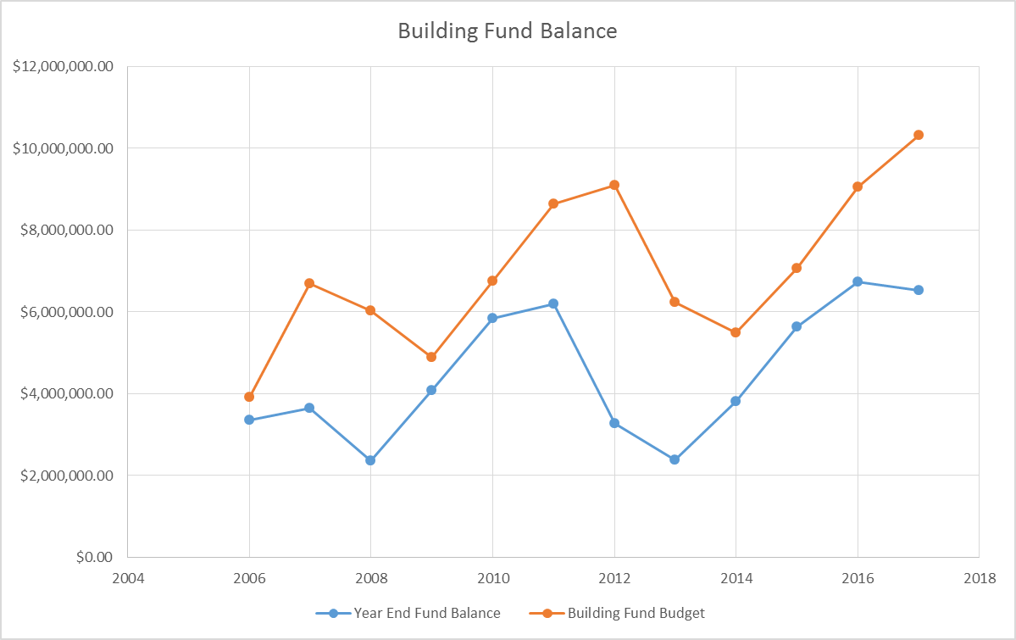
Building Fund Balances
Facility needs for Technology Centers are primarily paid from local building funds. Because most schools “save and build” the building fund balances fluctuate greatly from year to year. The following is Meridian Technology Center’s building fund balances between 2006 and 2017.
2008-Paid for Health Programs expansion
2012/2013- Paid for new construction trades facility
2017-Paid for demolition of previous construction trades facility/facility maintenance building remodel
2019-Saving for Pre-Engineering/Biomedical Sciences Facility ($8.7 million)
2024-Saving for Initial Guthrie Campus Building ($10 million estimated)
Notes:
This slide shows that “save and build” cycle.

Slide 18
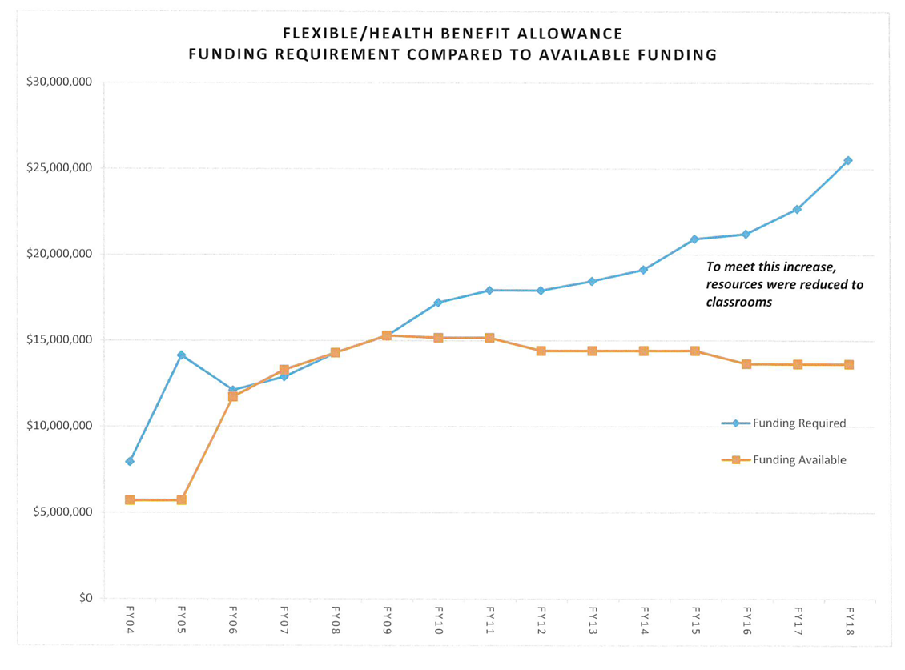
$23,595,254
$11.8 m gap between what is mandated and what is funded
$13,629,433
The state agency is required by law to fund the FBA. Any deficit in direct funding for FBA must be paid from agency appropriations—thus reducing classroom support.
Notes:
This graph shows the cost of the legislatively mandated “Health Benefit Allowance” compared to the funding provided. In FY 17 the Gap was $9,965,821. For FY18 the gap rose to $11,800. Again, the primary budget request from the agency in regard to Technology Centers is to FULLY FUND the required health benefit allowance. This will allow us to utilize all of the Technology Center Operations budget for programs and services.

Slide 19
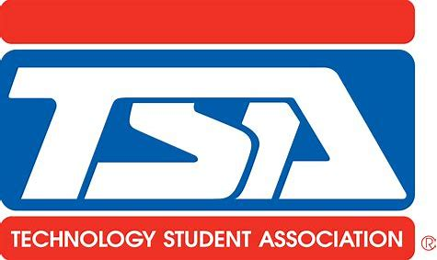
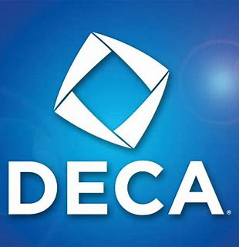
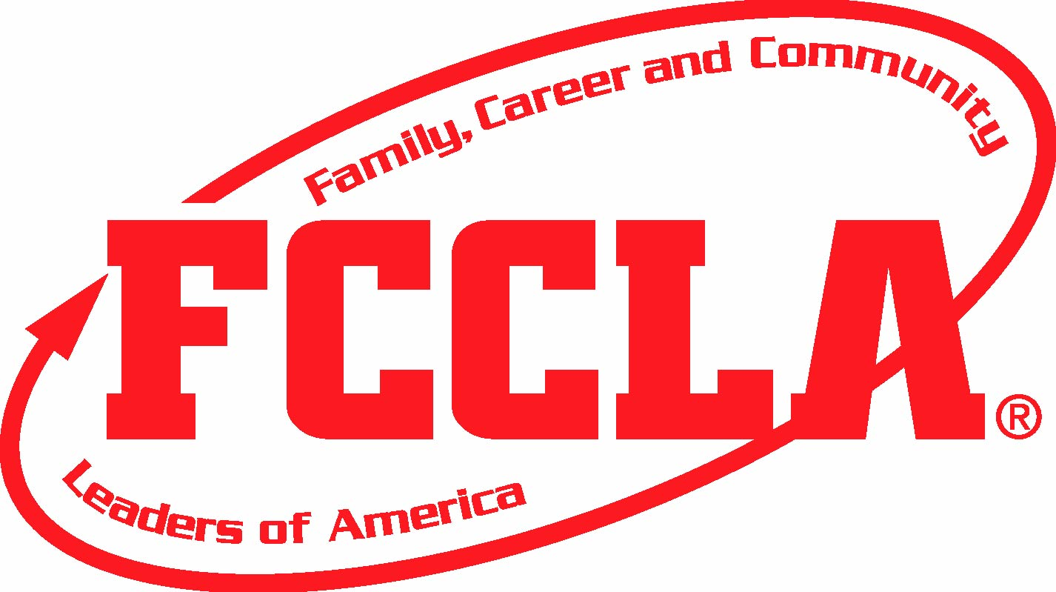
CareerTech Student Organizations (CTSO)
88,000 students strong
Notes:
We wanted to include this slide because as you see students at the Capitol with these various emblems on their clothing we want you to know that they are ALL CareerTech students.
We have over 88,000 students who are enrolled in CareerTech programs who are also members of CareerTech Student Organizations. These organizations are co-curricular and allow students to participate in leadership development, skills competitions, and community service activities.

Slide 20
Technology Centers
363,439 Enrollments
Each Tech Center District was formed as a result of a vote of the people within the district they serve.
Affords all students access to a wider array of high quality CareerTech programs
Tech Center funding is separate and apart from funding that goes to K-12 schools (not competing for tax dollars)
High school-age students living within the Tech Center’s district (including home-school and private school students) attend tuition free and transportation is provided.
Adult students living with in the Tech Center’s district pay tuition.
Many high school and adult students earn college credit through their Tech Center programs.
Programs offered at each Tech Center vary based upon local demographics and employer needs.
Tech Centers offer customized training for businesses and entrepreneurs located within their districts.
Notes:
For the next few slides, we will be discussing the enrollment demographics of each of our delivery branches. These are all FY18 numbers.
(just pick out some of the points on the slide you want to talk about). I like to talk about “Home School” being one of our fastest growing sending schools…that regardless of where a student goes to school if they are high school age they can come to the tech center tuition free.
This is also a good slide to talk about transportation—is provided to high school students free of charge.
Adult student tuition is extremely affordable and the programs we offer at the technology centers are often offered as “postsecondary” programs in other states.
Often the topic of college credit comes up on this slide… it is a good place to emphasize that we have a great relationship with most of our higher ed partners in Oklahoma and that college credit for courses taken at the technology center is typically available.

Slide 21
K-12 CareerTech Programs
139,598 Enrollments
CareerTech programs at comprehensive schools (K-12) are primarily funded through the comprehensive schools funding stream. The Oklahoma Department of CareerTech provides, from it’s state allocation, program support funds. These are intended to assist the comprehensive school districts with the additional costs associated with CareerTech programs (equipment/facilities/instructional support).
The level of support to each type of CTE program (Ag/FFA, Family Consumer Sciences, Business/Marketing, etc) varies based upon program costs. For example, a funded agriculture education program currently receives $19,055/year.
There are a number of CTE programs currently being offered at comprehensive schools that are “approved” but not funded.
Teacher salaries for comprehensive school CTE programs are paid by the local school district and any state contributions (FBA, pay increases, etc.) are included in the State Department of Education’s appropriations.
Notes:
Programs offered through our k-12 partners account for about 140,000 enrollments each year. While these are primarily funded through the local school’s budget, the Oklahoma Department of CareerTech does provide some program support funding.
The teachers are paid by the local school district and the teacher pay raise they received was included in the monies allocated to the State Department of Education.
If the subject of teacher pay at the technology center compared to teacher pay at comprehensive schools comes up, it is a good time to emphasize our longer contracts and the fact that our teachers have to have specialized knowledge/skills that we very often have to pay market rate for.

Slide 22
Skills Center Programs
1, 182 Enrollments
15 Locations
Skills Center Programs are administered through the Oklahoma Department of CareerTech.
Funding comes from a combination of state allocations and contracts with the correctional facility.
Instructor-related costs are included in the State Department of CareerTech’s appropriations.
Notes:
The primary emphasis of this slide is to say that the number of programs in skills centers has declined and there is a need to increase it back. Part of Dr. Mack’s budget request will be to restore funding for programs at Skills Centers so that more sites can be served.

Slide 23
Adult Basic Education Programs
Adult Basic Educations Programs are administered through the Oklahoma Department of CareerTech.
Funding comes from a combination of state and federal allocations.
The Oklahoma Department of CareerTech solicits RFPs from potential providers and awards contracts based upon regional locations.
Many programs are based at local Technology Centers and funds toward facilities and other program costs are “in-kind” contributions from the local Tech Center’s budget.
17,989 students served:
31 ABE Providers
9,694- high school equivalency
4,389 correctional center
1,375 English literacy/civics
Notes:
This slide is pretty descriptive…It is mainly an awareness that CareerTech has taken over the coordination of this important function in education. Many of the adults who enroll in the ABE programs also need CareerTech programs in order to meet their career goals.

Slide 24
Business and Industry Programs
7,824 Companies Served
Business and Industry Programs are offered jointly by the Oklahoma Department of CareerTech and the Local Technology Centers.
Funding comes from a combination of local and state sources.
State sources are primarily for statewide or targeted programs such as the Training for Industry Programs (TIP) which is dedicated monies for qualifying new or expanding industries.
Each local Technology Center works with the business and industry communities in their district and staffing varies based upon need.
Notes:
I think the emphasis on this slide is not so much the number of companies served, but that we partner with business and industry to meet their workforce needs. Through customized programming we are able to help ensure their companies have the talent needed to ensure productivity and success.
We build Oklahoma’s economy.

Slide 25
Highlights
We serve over half a million students each year including high school students, adults, business industry clients and inmates.
Having a stand alone State Agency & Board allows us the flexibility to meet the changing needs of Oklahoma’s workforce
Delivery Arms: Skill Centers, Adult Education, Technology Centers, Comprehensive Schools (K-12), Business and Industry
Funding for CareerTech in Oklahoma is a partnership between state and local communities
How you can help: Support the Agency’s budget request which includes increased programming at our comprehensive schools and skills centers as well as full funding of the state mandated flex benefit allowance.
Notes:
Summary slide…emphasize the “How you can help”

Slide 26
How a TIF works in a low- or no-growth area:
Assessed Value
Scenario: Area in 2010 valued at 100,000. The area is NOT likely to experience economic growth unless some action, such as creating a TIF, occurs.
A win for all entities involved.
A TIF is created and a public investment is made in the area.
As a result of the TIF, growth occurs
Growth Increment is captured and used to repay
the investment
Base Assessed Value (amount that continues to go to existing tax receiving entities for the duration of the TIF)
Notes:
Eligibility—is the area unproductive, undeveloped, underdeveloped-- “BUT FOR” the creation of the TIF would development occur?
Use of Funds—what is the defined project? Will it increase value? Is it worth the investment of public funds?
Impact—Is there any negative impact to existing tax-receiving entities? What is the potential benefit?

Slide 27
How a TIF works in an already growing area:
Growth approved by voters for other entities are diverted to the TIF.
Scenario: Area in 2010 valued at 100,000 that is experiencing average annual growth of over 10%. Is a TIF needed?
How are other entities affected if a TIF is created?
Any growth revenue, whether as a result of the TIF or otherwise occurring will be redirected away from existing entities (schools and county) to fund the TIF.
A Base Assessed Value will be set, “freezing” the amount of funds going to existing receiving entities at the base value at the time the TIF was created and for the duration of the TIF.

Slide 28
Thank you!
We understand the important role you play and we appreciate your time and service.
Notes:
Thank them for their time and ask for any questions they might have!

