Slide 1
CareerTech Financial Update
TechCent$
October 24, 2018

Slide 2
State Funding Process
July 1 - Sept 30: Develop agency budget request
October 1: Submit budget request to OMES, Senate, House
Oct 1 - May 31: Legislative season
Date of appropriation until June Board meeting: Develop agency's annual budget

Slide 3
July 1 - Sept 30: Develop agency budget request
Notes:
Develop agency budget request for next fiscal year. FY20

Slide 4
Notes:
1) Strategic Plan.
Goals through 2024.

Slide 6
Notes:
Business Plan
Every year
Take goals and lay out how we plan to accomplish our goals.
Resources needed for upcoming fiscal year to help accomplish goals
dollar amount we are required by law to provide to technology centers for the flex (health) benefit allowance?
Answer: $25,428,916. --

Slide 7
Notes:
Strategic Plan and Business Plan are presented to State Board
Board provides input
May re-work both documents
Take to board for approval at Aug or Sept Board meeting

Slide 8
October 1: Submit budget request to OMES, Senate, House
Notes:
After board approves budget request,
Standardized OMES format is used to prepare budget request submission.
Must be submitted by Oct 1 to OMES, Senate & House
About 90 pages of information,, including:
Detail for each goal
FTE assigned
All funding sources
Clients served
KPM
2 PY actual #s
CY projected #s
6 yrs of targets for the KPM
Breakdown of support services (HR, Admin, Finance, etc)
Operating request & supplemental request
justification
coding breakdown for all years

Slide 9
Oct 1 - May 31: Legislative season
Notes:
Right now is interim study time.
How does a bill become a law:
Legislator introduces a bill in the House or Senate
Bill is sent to a House or Senate committee for study and recommendations
Bill returns back to the House or Senate for a vote or a vote for further study
A bill passed at this point is then sent to the other chamber and is now referred to as “Engrossed”
An engrossed bill can be amended by the other chamber & then may go to conference committee which is composed of members of both chambers (House & Senate)
Conference committee may make amendments to the bill
A bill that passes both chambers is called “Enrolled”
Enrolled bills go to the Governor for signature
Governor signs the bill and it becomes a law. Sine Die is 5pm 5/31. Special session

Slide 10
Senate Bill 1600
SECTION 19. There is hereby appropriated to the State Board of Career and Technology Education from any monies not otherwise appropriated from the General Revenue Fund of the State Treasury for the fiscal year ending June 30, 2019, the sum of One Hundred Twenty Million Three Hundred Eighty-eight Thousand Three Hundred Seventy-one Dollars ($120,388,371.00) or so much thereof as may be necessary to perform the duties imposed upon the State Board of Career and Technology Education by law.
SECTION 20. There is hereby appropriated to the State Board of Career and Technology Education from any monies not otherwise appropriated from the Oklahoma Education Lottery Trust Fund of the State Treasury for the fiscal year ending June 30, 2019, the sum of Three Million Seven Hundred Six Thousand Six Hundred One Dollars($3,706,601.00)pursuant to paragraph 2 of subsection C of Section 713 of Title 3A of the Oklahoma Statutes for allocation by the State Board of Career and Technology Education for the education and general operating budgets of the institutions and for other programs, construction, renovations or repairs administered by the State Board of Career and Technology Education.
SECTION 21. There is hereby appropriated to the State Board of Career and Technology Education from any monies not otherwise appropriated from the Oklahoma Education Lottery Trust Fund of the State Treasury for the fiscal year ending June 30, 2017, the sum of Two Hundred Forty-two Thousand Six Hundred Eighty-nine Dollars($242,689.00) pursuant to paragraph 2 of subsection C of Section 713 of Title 3A of the Oklahoma Statutes for allocation by the State Board of Career and Technology Education for the education and general operating budgets of the institutions and for other programs, construction, renovations or repairs administered by the State Board of Career and Technology Education.

Slide 11
Senate Bill No. 1604
SECTION 1. Of the funds appropriated to the State Board of Career and Technology Education in Enrolled Senate Bill No. 1600 of the 2nd Session of the 56th Oklahoma Legislature, Ten Million One Hundred Eighteen Thousand Nine Hundred Seven Dollars ($10,118,907.00) shall be for the purpose of providing an increase in compensation for certified personnel, as defined in Section 26-
103 of Title 70 of the Oklahoma Statutes.
SECTION 2. Of the funds appropriated to the State Board of Career and Technology Education in Enrolled Senate Bill No. 1600 of the 2nd Session of the 56th Oklahoma Legislature, Two Million Sixty Thousand Dollars ($2,060,000.00) shall be for the purpose of providing an increase in compensation for support employees, as defined in Section 26-103 of Title 70 of the Oklahoma Statutes.

Slide 12
Date of appropriation until June Board meeting: Develop agency's annual budget
Notes:
Received our state general appropriation and lottery appropriation
Develop agency’s operating budget

Slide 13
Notes:
Executive Summary for the State Board meeting – 3rd Thursday in June.
Budget book
After board approves, OMES budget development process begins.
Take everything reflected in the budget book and put in into OMES required spreadsheet format
OMES review, approves, and then we are able to spend the new FY budget. Usually a couple weeks after July 1.

Slide 14
State Funding Process
July 1 - Sept 30: Develop agency budget request
October 1: Submit budget request to OMES, Senate, House
Oct 1 - May 31: Legislative season
Date of appropriation until June Board meeting: Develop agency's annual budget

Slide 15
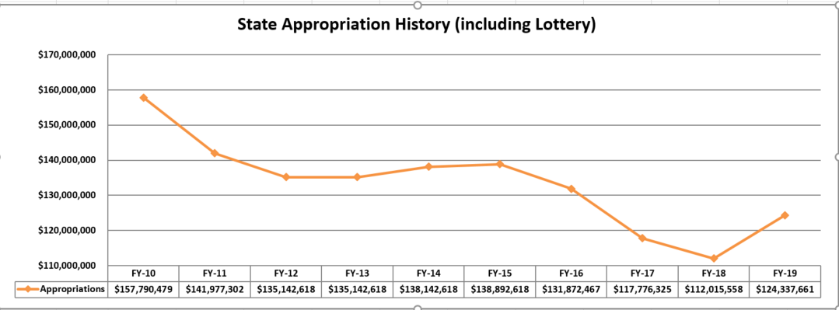
Notes:
FY10 = $157M for General appropriation and lottery appropriation
FY19 = $124M for General appropriation and lottery appropriation
$33M decrease
27% decrease
After adding $10M for certified personnel salary increase and $2M for support employee salary increases.

Slide 16
Federal Funds
Carl Perkins federal grant - $15,094,180
85% Sub-recipient awards
10% Leadership
5% Administration
Adult Basic Education federal grant – approx. $6.6M
82.5% Sub-recipient awards
12.5% Leadership
5% Administration
Oklahoma Bid Assistance Network (OBAN) federal grant – approx. $620,000
Sub-recipient awards
Cost sharing grant
TANF grants
TANF / Welfare to Work - $2.9M
Sub-recipient awards
$100,000 for administration
TANF / Adult Literacy - $698,000
Contracts with sites
Notes:
Primary recipient of 2 federal grants from USDOE:
Carl Perkins
ABE
Primary recipient of federal grant from US Dept of Defense
OBAN (12 TC’s)
Sub-recipient of TANF grant from Oklahoma DHS (15 TC’s)

Slide 17
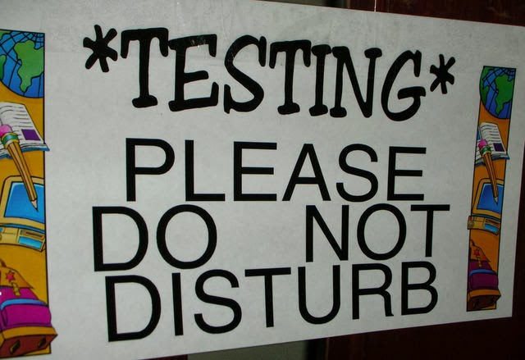
Revolving Funds
Contracts
Oklahoma Department of Corrections – Skills Centers training programs - $1.3M
Office of Juvenile Affairs – Skills Centers training program
Other
PrintShop
Curriculum Sales
Assessments
Career Readiness Project (KeyTrain licenses & WorkKeys assessments)

Slide 19
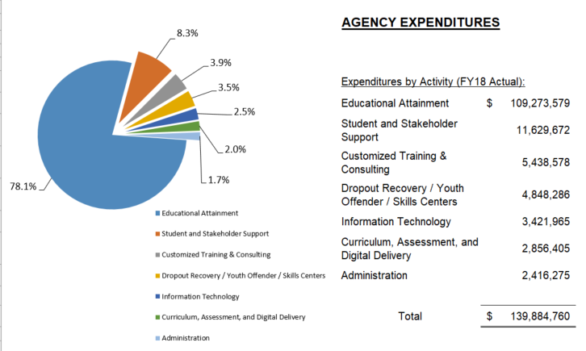
Notes:
how much of the agency’s budget (all funds) is passed through either thru operational payments or subawards to technology centers?
$84,338,899 (60% of agency’s total expenditures)

Slide 20
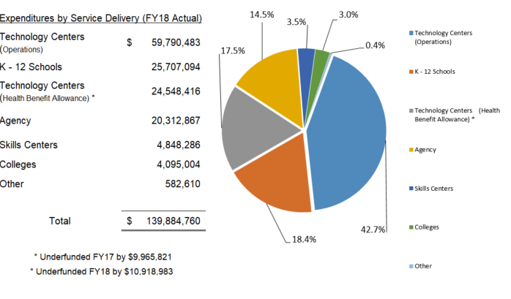
Notes:
How much the agency’s total pass thru to schools was for FY18?
TC, K-12 schools, colleges, etc.
$114,723,607
82% of all funding.
Budget 85% but actual was 82%

Slide 21
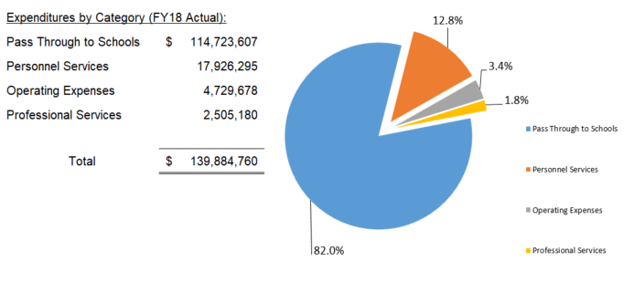

Slide 22
CareerTech Financial Update
Questions

