Slide 1
Keep Students Engaged The Next Step……..
Every day is important;
start and end the day the same way!

Slide 2
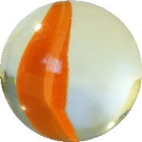
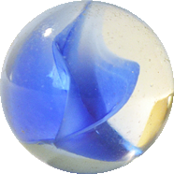
Keep Students Engaged or how NOT to lose your marbles!
Class Climate
Start the Year
(restart the year)
Build….
Teacher!
Evaluate
Every day is important; start and end the day the same way!

Slide 3
Process and Procedure…..it works! But let’s add Expectations to the classroom!!
Make connections in the classroom!!

Slide 4
Presentation or as I like to call it, the Build…….
Rubrics
Collaborative
Teams
Accountability
(not just tests)
Up to Date?!

Slide 5
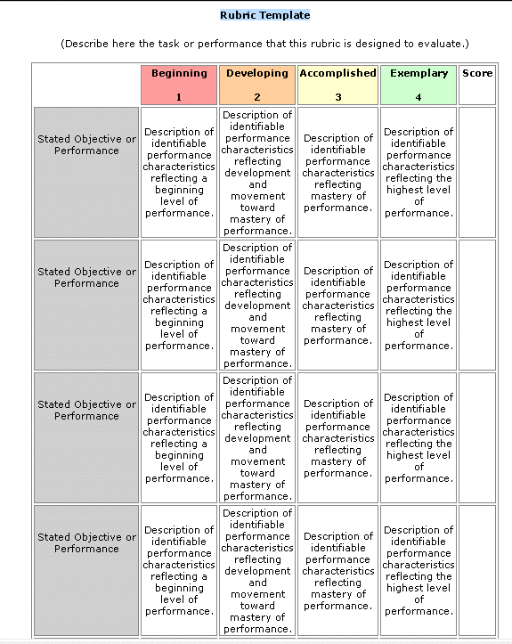
Rubrics
Let Students know the expectations
Take out the “guesswork”
Consistency in evaluation
Actually reduced time in grading!!
First development takes time
Once completed, only adapt or update.
Allows a great pathway for self evaluation D:\Student Engagement resources\Career Orientation Final Portfolio Review.doc

Slide 6
Collaborative and Teams
Can ease the comfort level of students
Practices a necessary Career Concept
Can be monitored and graded!
Students gain confidence
Ways to make teams
What happens if it doesn’t work?
Builds Trust

Slide 7
Accountability
We need tests but don’t get stuck in the “test rut”!
D:\Student Engagement resources\suggestions_for_writing_various_test_items_packet_.pdf
D:\edutopia-finley-53-ways-to-check-understanding-2016.pdf

Slide 8
Changing a Lesson….
D:\3_1_1 Safe Environmental Temperatures - Healthy Choices DJ.pptx
D:\Activity 2 - Tax Season in the US.pdf

Slide 9
So let’s change this…….
Instead of “Matching” why not print one sheet, cut and give out the parts?
Instead of short answer, put in small groups and they come up with a 90 second presentation to answer the question.
Paddles for “agree or disagree”!
Map out the answers on a graphic organizer; can you grade that?
Electronic and apps, you have options!

Slide 10
Difficult concepts to teach…
Had the “opportunity” to teach the following concepts in Family & Consumer Sciences
Fighting
Stealing
Respect
Don’t Tell Lies
Sharing
Grouping

Slide 11
Check for understanding……
We can no longer use the “any questions” method
Butcher paper, white boards, electronics
Start with Sentence Stems…
I think…… The reason I think this is because……
What did you mean when you said……..
When you said….it reminded me of……..

Slide 12
So I’m Checking for Understanding…..
I’m a little confused about what you said. Can you explain it in a different way?
When you said……it reminded me of……
What do you think about what I said?
Do you agree or do you have a different point of view?
?????

Slide 13
Comments…..

Slide 14
DJ Bowker,
Business Industry Career Development Coordinator
sdwatts-bowker@okcps.org
@DJBowker1
405-587-0071
College Career Readiness, CTE Department
Oklahoma City Public Schools

