Slide 1
Advisory Committee Members And Community Partnerships
How to Get them and Keep Them!!

Slide 2
Agenda
Know your program strengths
Collect Data and statistics on your program and comparable programs
Make the “Ask”
Document and reflect!
Questions………………

Slide 3
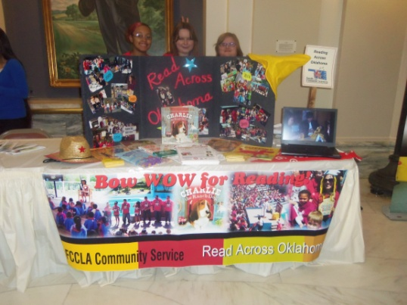
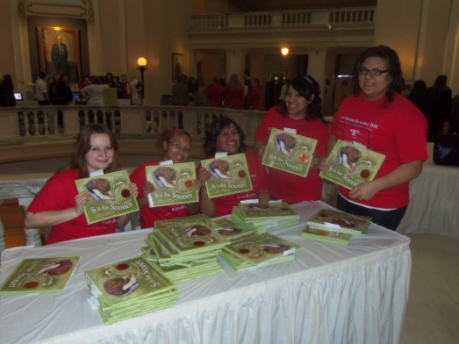
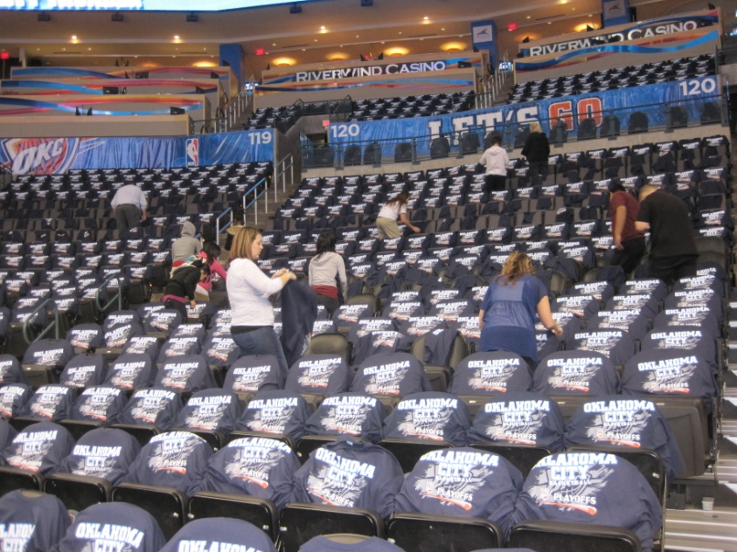
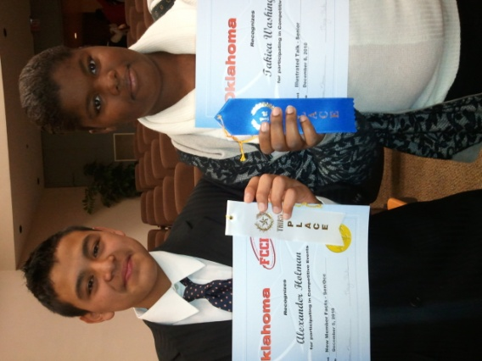
Program Strengths

Slide 4
After events or experiences we take time to reflect!
These reflections can be useful in identifying successes as well as needs of your program.

Slide 5
Collect Data
Most of education is data driven today;
There are many agencies that support purchases; they have the same requirements for data.
University programs of study will also offer support.
School has information;
Absences
Failure
Graduation rate
Pregnancy
Drop-out status

Slide 6
Supporting documentation
There are many agencies that offer reports such as this that will give you the documentation and “buzz” words to use. Be current in what you use for outcomes and applications of technology and teaching materials.

Slide 7
Now how do we find the partners!!
Google search
Local Agency search
Community Foundation
Corporate Foundations
Ex. Junior Achievement
People and places you go!

Slide 8
We sometimes forget to simply ask for assistance! Many companies have funds that need to be spent within the community and have partnerships for education and no access to schools. There are Community Liaison positions within many companies Talking Points for Career Explorations.docx
ASK!!!

Slide 9
Volunteer
OETA is a huge partner of the educational programs in OKCPS.
Ex. Read Across Oklahoma, Lee Christmas Party, Charity work
OETA Day at the Capitol; we are the characters for the event
Library system summer reading program and zoo volunteers.

Slide 10
Community Partners
Mentor “with benefits”
“Adopt” a need that you may have
Quid pro Quo, or you do something they will do something.
Take care of an expense that you have so that your funds can be used in other ways.

Slide 11
Advisory Committees
Plan meetings in Advance for School year; Give them the dates as soon as possible.
A set schedule gives importance and urgency to your meetings
Make then meaningful; ask for assistance and advice, have a purpose
Responsibilities of an Advisory Committee.docx
Combine if possible with other programs or schools;
This shows the larger picture to industry

Slide 12
Private Foundations (if available in your area )
This is the newest outlet for funding and advisory members that I have acquired. After attending several charity functions, I received calls about needs in the classroom. I was adopted by several fraternal/social organizations that have provided many resources and services for the classroom.
The documentation/request can be very different for these organizations
They offer grants, personnel for events, multiple resources for industry
Scholarships for students

Slide 13
Have Quotes ready!
Most companies, if they are aware that you are applying for a grant, will give you a quote with a time limit of 60-90 days. I have found that many companies will extend these if the process takes longer than the allotted time. Rarely the cost has increased and a couple of times the timing worked out for a SALE!!

Slide 14
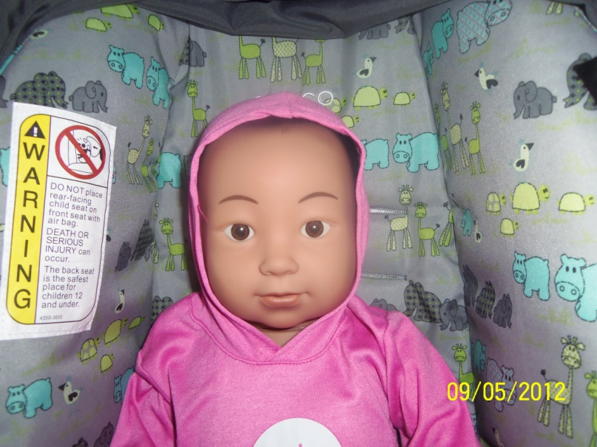
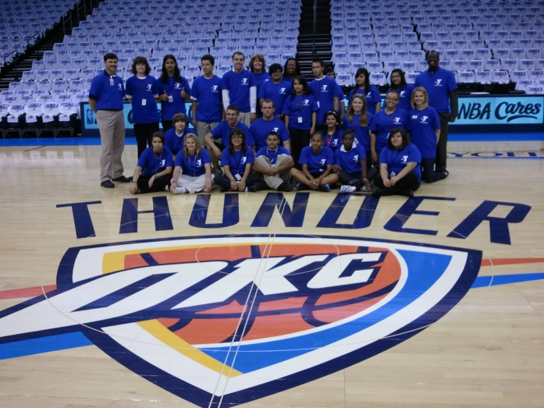
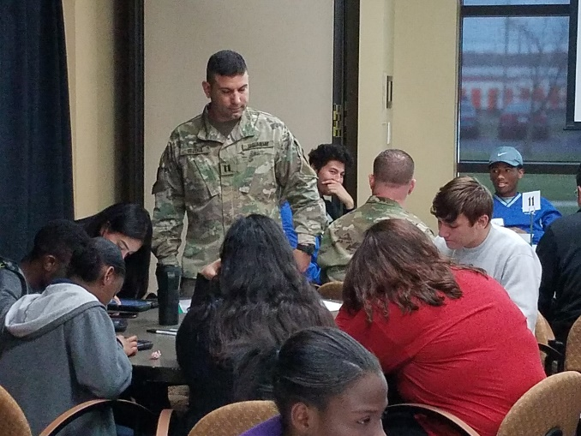
Document, Document, Document!!
Thank You!!!

Slide 15
Publicity
Some companies and foundations want/need recognition for how their available funds/personnel are used.
Call the newspaper
Brand your event or equipment
Invite a representative to the event or the first use of the equipment
Write letters and thank them for the event, lesson, grant or donation.

Slide 16
Statistics and data
There are some grants/Partnerships that require continuing “service” and will require you to keep information and successes.
Document the number of students that experience the event or use the equipment.
With the more personal/foundation grants and partnerships, use the personal touch.

Slide 17
Questions, clarification comments……………..

Slide 18
DJ Bowker,
Business Industry Career Development Coordinator
sdwatts-bowker@okcps.org
@DJBowker1
405-587-0071
College Career Readiness, CTE Department
Oklahoma City Public Schools

