Slide 1
Student Motivation
Kari Gibson- Tulsa Technology Center

Slide 2
Today’s Topics
Atmosphere for learning
Learn to be a guide
Change it up
Classroom ideas

Slide 3
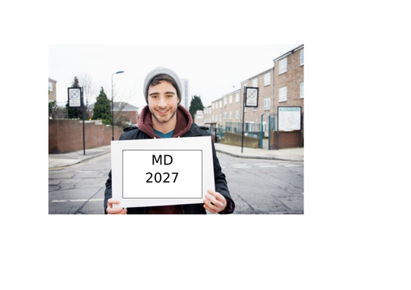
Atmosphere for Positive Learning
You can control your attitude and the atmosphere you create for your students.
Classroom engagement
  Expectations – raise the bar to a high level and students will come to that level you expect
  Set clear goals – be prepared for class, have all materials, and list objectives on board
  Do short bursts of information – remember people can handle about 20 minutes of information. (TV programs vs commercials, think about length of program as apposed to commercial breaks)
  Time management – schedule enough time for students to obtain the information

Slide 4
Learn to Be a Guide
Tell me about your teachers when you were young….we are now more like stand up comedians.
You now have to be more like a learning manager. Class management rules need to be in place for healthy learning.
Expectations – set the bar high, give them goals instead of so many rules.
  If you are early, your students will be early. If you do not want your students to use a cell phone in class then you shouldn’t either.
  Always be a leader, don’t be a do as I say and not as I do instructor. Lead by example. Adults look up to you and mimic your actions. They want to please you as your instructor so make them mimic great behavior.
  Student learning types vary, so get to know your students. You must be flexible in order for your students to be successful.

Slide 5
Change it Up
Keep lessons fresh. Types of presentations.
  Lectures – Remember keep it short. 20 minutes then check for understanding.
  Guest Speakers – Students hear you everyday, they learn to tune out your voice, bring in someone from industry.
  Student Presentations – Opportunity to see how they process information
  Discussion – Create questions, put them in a hat then let them draw and discuss, you facilitate
  Questioning – While lecturing always be asking questions. Also, never just hand out information, try as long as possible to answer your students question with a question. Of course it will be a leading one to help them find the information on their own.
  Role Playing – Students pull a med and complete the process for doctor’s office, pharmacy call, patient drop off, pharmacy technician, then customer pick up.

Slide 7
Classroom Ideas
Musical chairs – I do this with medical terminology and Top 200 Medications. Play regular musical chairs, but once the music stops the person who is left standing gets a question. If they get the question right they send someone back to their desk so they can continue to play. If they get it wrong they go to their desk. ( I give extra points for winners)
Kahoot – Fun way for students to use their cell phones, you can create the questions, and see quickly if the students are comprehending subject material. (I give extra points for teams)

Slide 8
Classroom Ideas
Bell Ringers – Start the day off with LEARNING!Don’t always give them something course related. For instance, I teach pharmacy, but maybe one day I ask the students how many tech centers there are in Oklahoma. Also, which one is the oldest? (Live activity with teachers)
Beach Ball Toss – I put questions on a beach ball and toss it around the room and what their right hand or left hand (you can decide) lands on then they must answer the question. (Live activity with teachers)
Think, pair, share – Ask a question or problem to the class. Then give the students time to do a little research. Then have them pair up with classmates and share their answers. I like to do this with groups and then have them report out, instead of lecturing they are discovering the lesson themselves and then teaching others.

Slide 9
Classroom Ideas
Whack a Board- You need a pool noodle, but in half. Then you design questions that are picture based answers. The student face away from the board while you read the question. Then when you are done, they turn quickly and “whack the board” pick the correct picture that answers the question.
Jigsaw – Use this with long chapters. Break up the classroom into sufficient amount of groups. Assign them a certain portion of the chapter to read. Then have them create some sort of presentation to give to the class.
Word Wall/Easy as ABC – Pre-assessment tool to gage what students already know about a topic.
Graffiti Wall- I have a board that students can color on once they have finished work for the day. It will become a drawing at the beginning of the year.
Doodle Notes – Creative and colorful way of learning information.
Would You Rather- Ice breaker activity for chapters. This is fun to do with diseases.
Heads Up – App on phone (with our without) one student cannot see the answer and then other student tries to get them to tell the answer. https://www.youtube.com/watch?v=f_e9_ScxLVQ

Slide 10
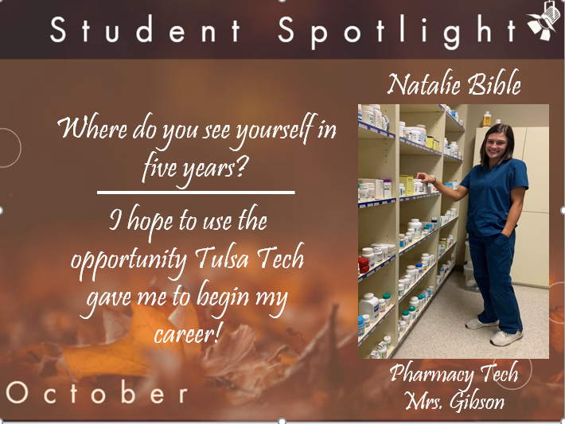
Student Spotlight
MOXIE

Slide 11
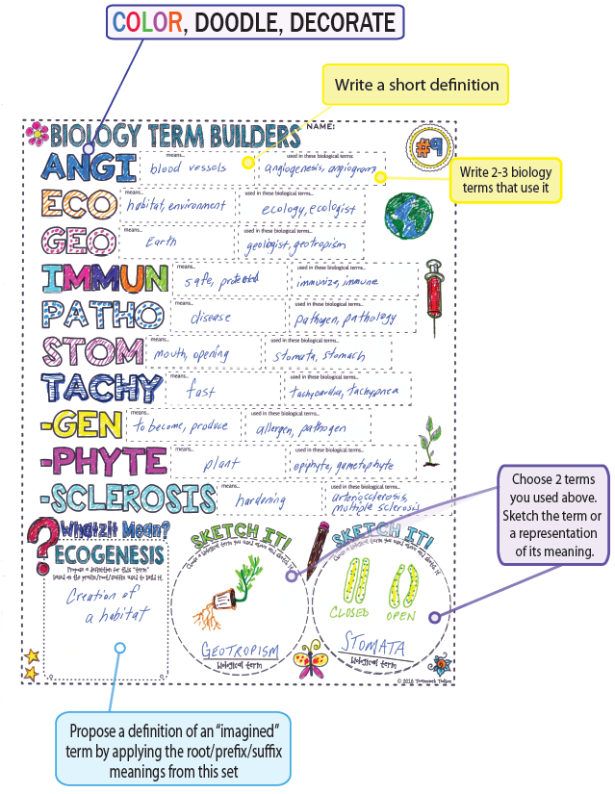
Doodle Note
Example

Slide 12
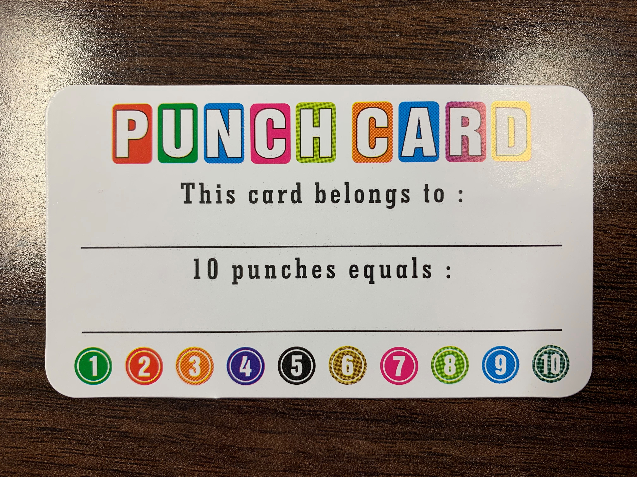
Punch card:
Students turn in assignments on time, they get a punch (I use a star punch). When they turn in 10 assignments on time, they get extra points on an exam and are entered into a drawing for a prize.

Slide 13
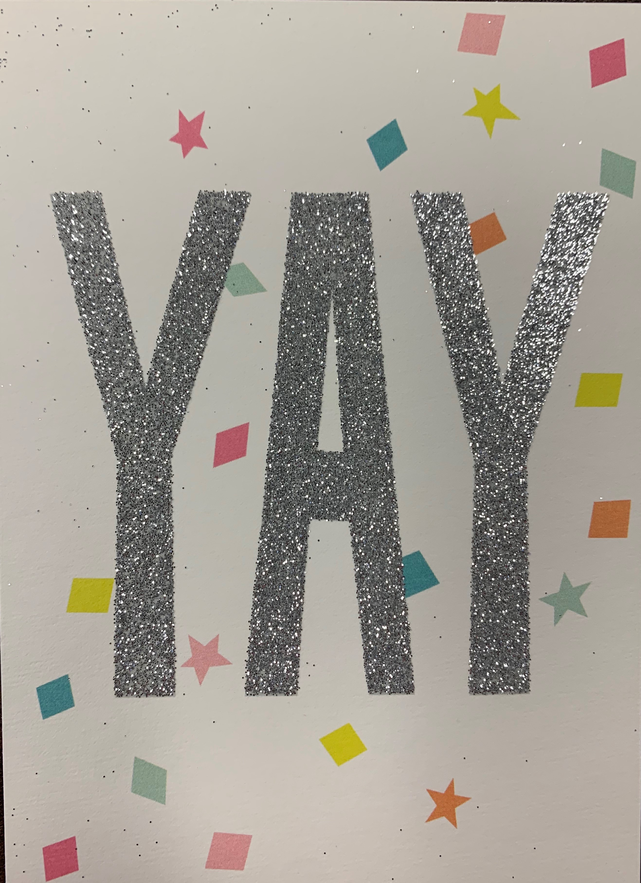
Cards for Praise
I like to use these to really encourage a student, especially if they are struggling student it really helps get them back in the game! A little encouragement with a hand written note goes a long ways! You could also use bright color sticky notes.

Slide 14
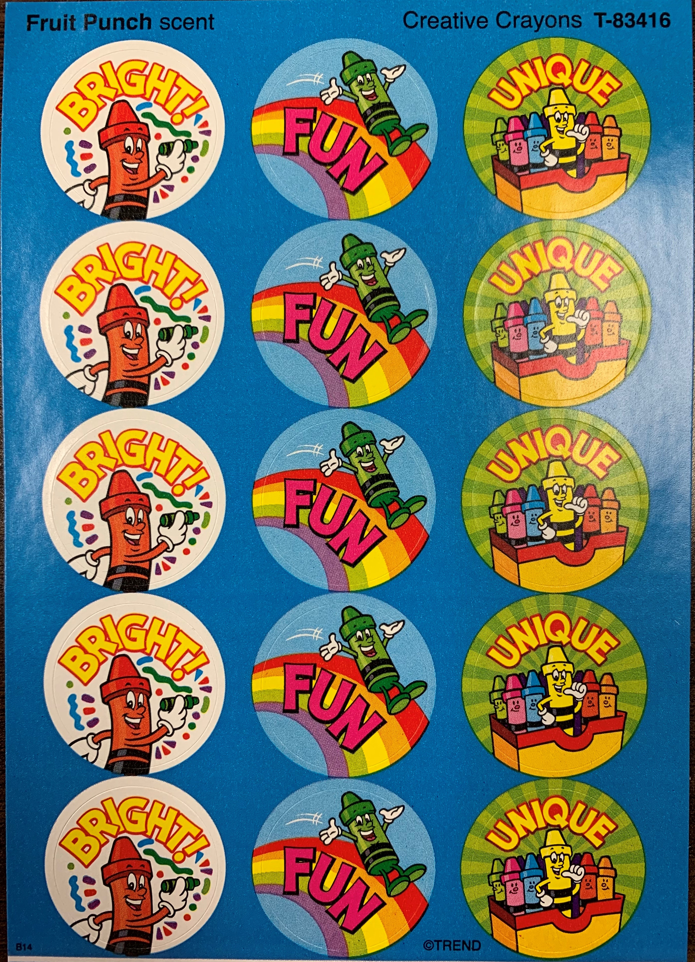
Scratch and Sniff Stickers
I ordered these from Amazon. No matter the age, they love it
when they get their work back with a sticker.

Slide 15
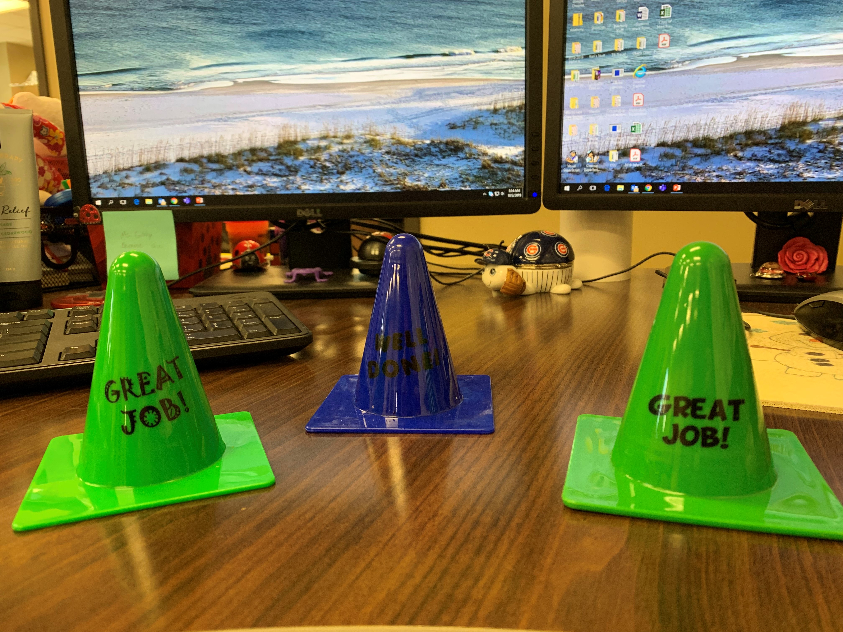
Great Job Cones

Slide 16
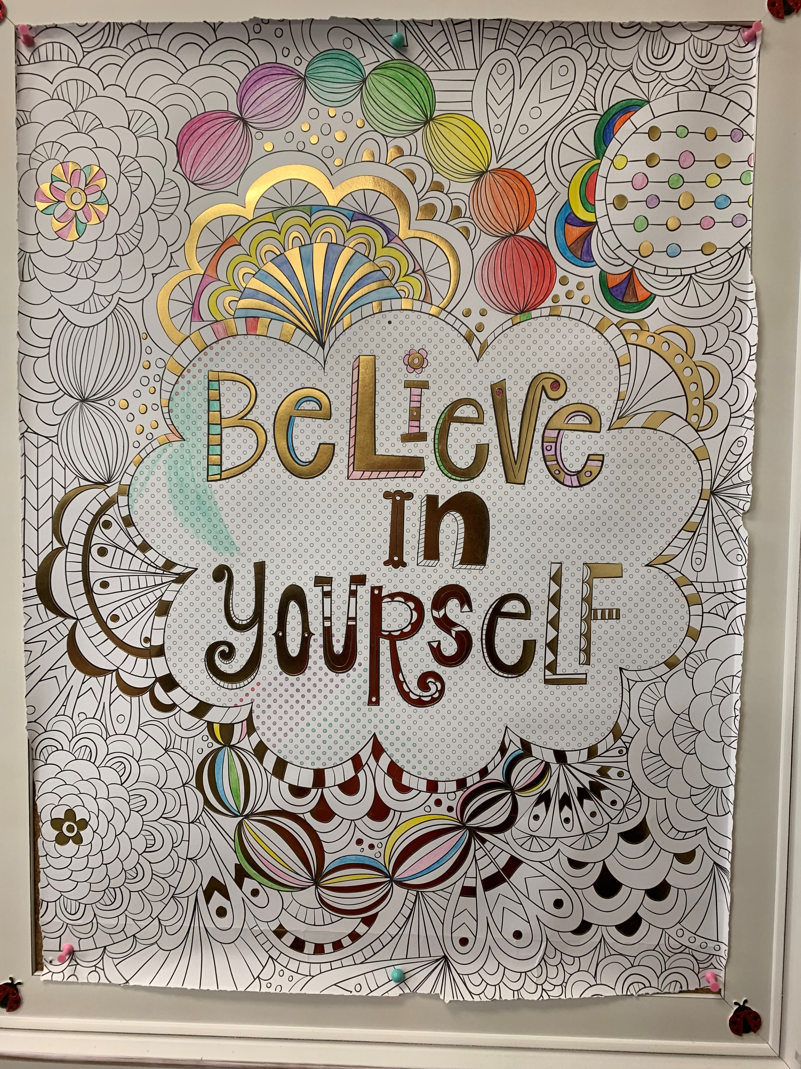
Believe in yourself
When students finish work, they can work on our class
poster. The poster will be up for grabs from a drawing at
the end of the school year. This is a great de-stresser for
your students. They also enjoy telling me about their day,
and asking questions about assignments.

Slide 17
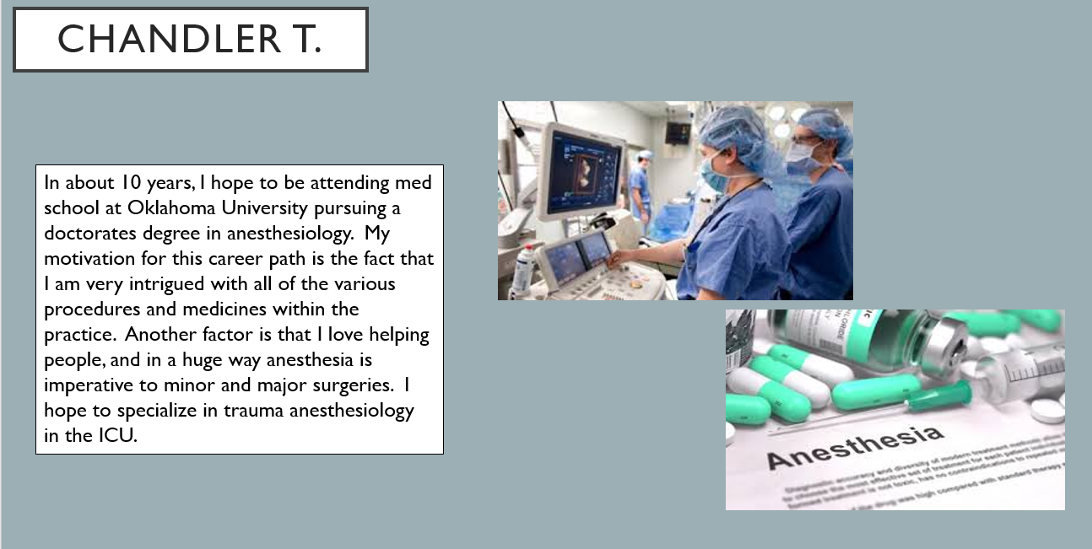
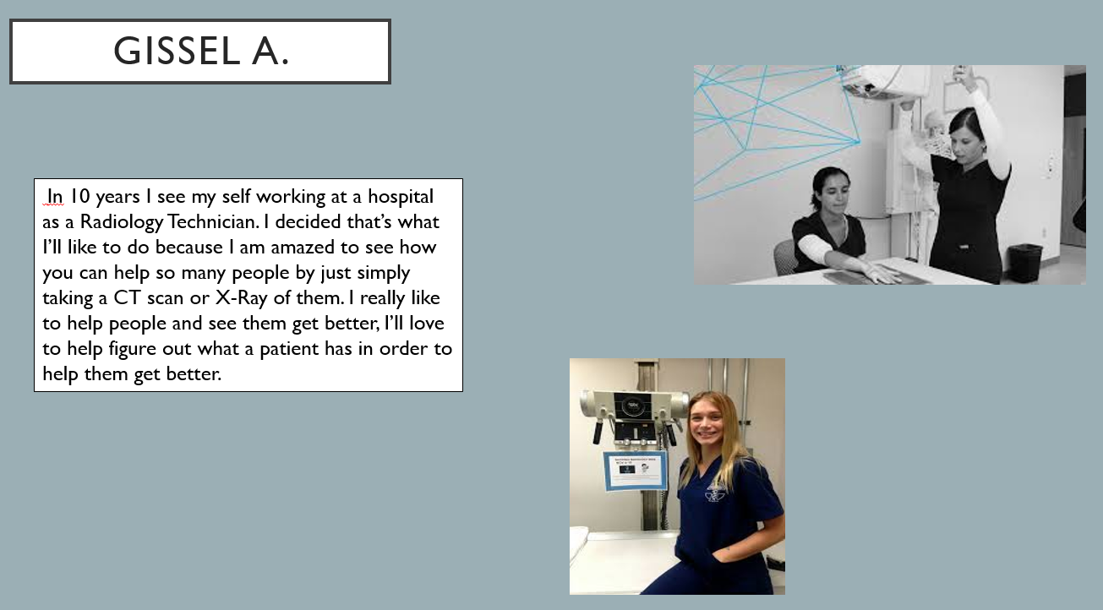
Where do I see myself…..

Slide 18
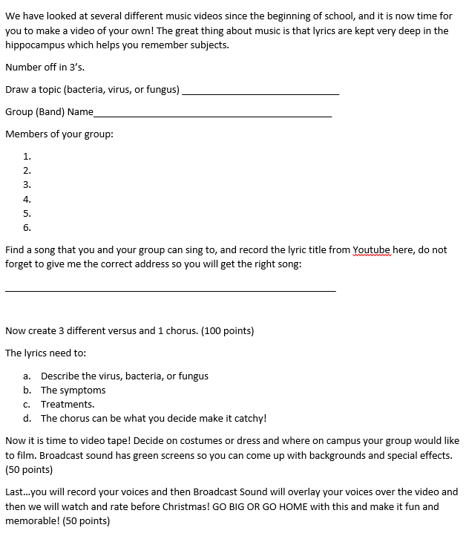
Cross curriculum

Slide 19
Questions
Thank you for coming to my session on motivation!
Kari.Gibson@tulstech.edu

