Slide 1
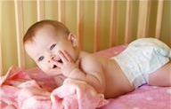
Unit 2-Exploring Parenting
By Mrs. Kristen Harris

Slide 2
Objectives
State responsibilities of parents to their children.
Distinguish among the types of parenthood.
Name parental adjustments after the birth of a baby.
Identify financial responsibilities parents face when raising children.
Determine the financial costs of raising a child.
Explain possible rewards and demands of parenting.
Discuss in writing basic characteristics.

Slide 3
Objectives
Describe medical techniques available to help couples overcome fertility.
Distinguish among methods of contraception.
State special challenges faced by teenage parents.
List parenting skills needed for guiding healthy child development.
Develop a personal and family-life goal plan.
Explore personal attitudes toward and readiness for parenting.

Slide 4
Objectives
Describe how characteristics are passed down from ancestors.
Determine possible gene combinations.

Slide 5
Terms
Infertility-the condition of temporarily or permanently being unable to conceive
Contraception-a device or agent designed to prevent pregnancy
Discipline-assisting children to learn and follow basic self-conduct rules
Chromosome-structure which carries hereditary characteristics

Slide 6
Terms
Dominant Gene-the strongest gene in a pair of genes; noticeable effects result in the offspring
Gene-basic unit of heredity
Heredity-the sum of traits that are passed from parents to their children
Recessive Gene-the gene, in a pair of genes, whose effects are not apparent unless paired with another gene of the same type

Slide 7

Legal and Moral Responsibilities and Obligations
If parents fail to provide for their child’s basic needs, they can, by law, be punished
Obligations to provide basic needs may be complete by the time the child reaches adulthood
Obligations may last a lifetime for those children with special needs

Slide 8
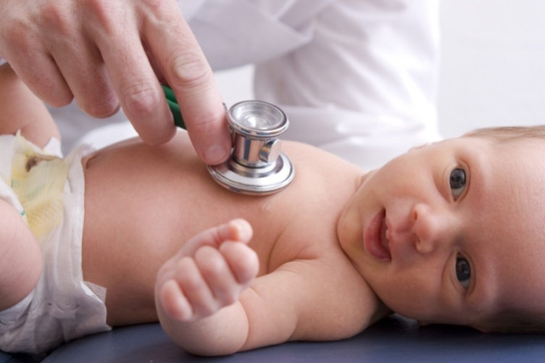
Responsibilities of Parents
Ensure children’s rights
Prepare children for adulthood
Promote intellectual development
Promote emotional development
Provide health care

Slide 9

Responsibilities of Parents
Provide opportunities for social development
Provide for feelings of security
Provide educational opportunities
Provide physical care
Provide financial support
Teach family heritage and culture

Slide 10

Types of Parents
Adoptive parent-one who assumes legal responsibilities for a child and raises the child as his or her own
Biological or natural parent-children who are related by blood to the parents; the biological offspring of a man and woman

Slide 11

Types of Parents
Foster parent
  One who provides a temporary living arrangement for children when their own parents are unable to care for them
  Reimbursed by the government or private institution for the children's expenses
  Volunteer their time, effort, and love
  Examples-residential home, group home, etc.

Slide 12

Types of Parents
Grandparent-a parent of one’s father or mother who may assist parents or help raise grandchildren in times of need or crisis
  Grandparents may serve a parenting role with or without the full responsibility of
  grandchildren.

Slide 13

Types of Parents
Guardian-one who has the legal responsibility to care for another person.
Single Parent-divorced, widowed, or unmarried person with children
Stepparent-the spouse of a child’s remarried parent

Slide 14
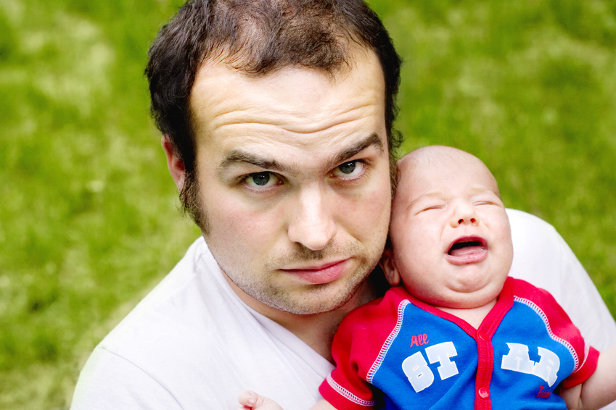
Adjusting to Parenthood
The addition of a baby to the family facilitates many changes in the family and household.
Parents may experience some or all of the following adjustments:

Slide 15

Adjusting to Parenthood
Less private and quiet time
Financial demands
Sleeping and eating habits around the schedule of the baby
Job schedules
Learn how to relate to each other as parents

Slide 16

Adjusting to Parenthood
Less time for friends
Management of household tasks
Siblings learning to share parents and adjusting to their new roles as brothers and/or sisters

Slide 17

Financial Responsibilities
According to the U.S. Department of Agriculture, the cost of raising a child from birth to age 17 ranges from $124.800 to $249,180 (2001)
How could these costs change as a child grows?

Slide 18

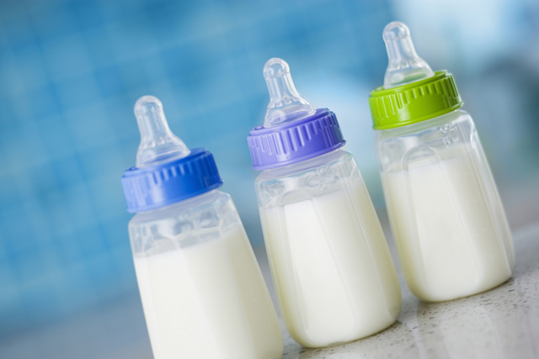

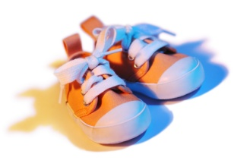
Financial Responsibilities
Equipment specific to children’s needs
    Car seats, crib, high chair, etc.
Clothing
Educational expenses
Food

Slide 19

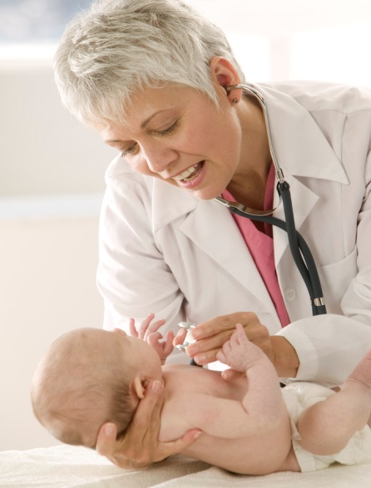
Financial Responsibilities
Ongoing medical care
    Insurance, immunizations, etc.
Prenatal and hospital care and delivery charges
Shelter

Slide 20

Rewards of Parenthood
May add to an already strong and loving relationship
Share the special bond between parents and children
Grow and learn through your children
Experience new depths of emotion

Slide 21

Rewards of Parenthood
Fulfills a desire to love, nurture, and guide another person
Constant ever changing adventure
Enjoyment of watching another human being develop
Stimulates feelings of
tenderness, accomplishment,
and pride

Slide 22
Demands of Parenthood
Can affect career development if one parent chooses to stay home
Can be emotionally, physically, and financially absorbing
Limits freedom and privacy

Slide 23
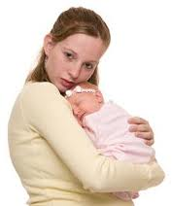
Demands of Parenthood
Limits the time available to focus on other relationships
Requires knowledge of child development
Long term commitment

Slide 24
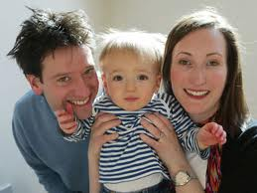
Characteristics of Parent Readiness
Emotional
  Stresses and demands of parenthood require emotional maturity
  Both parents need to honestly want a baby
  Be prepared for the
  commitment of
  parenthood

Slide 25

Characteristics of Parent Readiness
Financial
  Having a child is an expensive commitment to make
  Direct cost-doctors, hospitals, and infant care items
                Indirect cost-income lost of potential income

Slide 26

Characteristics of Parent Readiness
Intellectual
  Child development knowledge helps prepare parents to have realistic expectations of their child during various stages of development
  Aware of the
  responsibilities
  and commitments

Slide 27
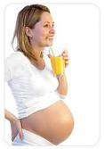
Characteristics of Parent Readiness
Physical
  I deal age for women to get pregnant 20 and 35 years of age
  Most likely to ensure a successful pregnancy
  Health of baby greatly
  depends on the health
  of the parents

Slide 28

Characteristics of Parent Readiness
Social
  Children change the lifestyle of couples
  Parent needs become second to babies needs
  Peer and social activities
  can be limited

Slide 29
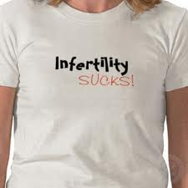
Overcoming Infertility
Couples should seek help from a physician if they are unable to conceive.
The following are treatments for infertility, some may have health risks involved:

Slide 30

Overcoming Infertility
Artificial Insemination
  Sperm is medically injected into the uterus or fallopian tubes
Counseling or reduction of stress

Slide 31
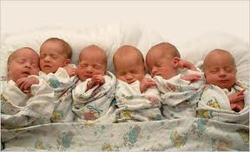
Overcoming Infertility
Fertility Drugs
  Powerful synthetic compounds used to trigger activity of the ovaries to release eggs
  Increases the chances of fertility
  Drawbacks
    Not an accurate way to determine dosage
    Too little can be unhelpful
    Too much can cause
    multiple births

Slide 32
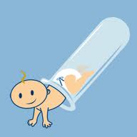
Overcoming Infertility
In vitro fertilization
  Egg and sperm are joined in a lab
  Fertilized egg is then implanted into the uterus
  Sometimes called “test-tube” babies

Slide 33
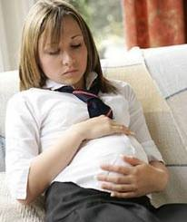
Challenges of Teenage Parents
              Increased health risks for mother and child
  Death rate for babies of teen moms are double the rate of babies born to older women
Increased risk of having a low birth weight and/or premature babies
  Premature delivery increases risks of long-term physical problems and defects

Slide 34

Challenges of Teenage Parents
Lack of income; dependence on financial assistance
Loss of friends, dates, and social activities
Loss of educational opportunities
Prenatal care often delayed
Social criticism

Slide 35

Skills Needed for Guiding a Healthy Child
Communication
  Hugs, facial expressions, words of encouragement, etc.
Intellectual and physical endurance
Knowledge of and realistic expectations for the various stages of child dev.
Listening skills

Slide 36
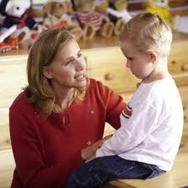
Skills Needed for Guiding a Healthy Child
Discipline techniques
  Examples:
    Set small number of rules
    Rules are reasonable and fair
    What can be done instead of what can not
    Reward good behavior with praise
  Difference between punishment and discipline

Slide 37


Skills Needed for Guiding a Healthy Child
Nurturance
Responsibility
Teaching

Slide 38
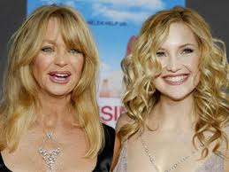
Heredity
Because of family heritage, people have unique characteristics that make them “who they are”.
Some are physical traits like bone structure, hair texture, height, musical ability, etc.

Slide 39
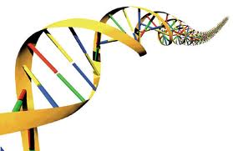
Heredity
Genes carry characteristics that are passed down from parents to offspring
At conception, a new, one-celled organism is formed.
The new cell will pass down characteristics to each generation through genes.

Slide 40
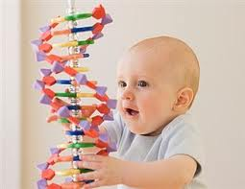
Heredity
A string of hundreds of genes make a chromosome
The man and the woman pass on half of the chromosome the offspring will have
A normal, healthy body cell has 46 chromosomes, or 23 pair
Woman’s egg contains 23 and
a male’s sperm has 23

Slide 41
The End ☺

