Slide 1
REVIEW
FETAL DEVELOPMENT

Slide 2
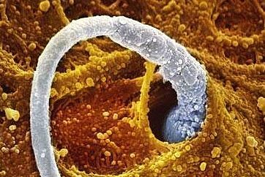
Month 1

Slide 3
Month 4
Which month can a baby begin to suck its thumb?

Slide 4
Month 1
Which month does a baby’s heart beat begin?

Slide 5
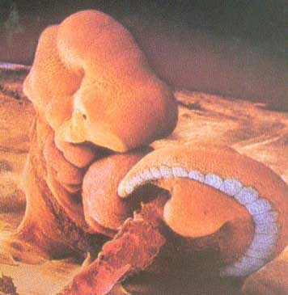
Month 2

Slide 6
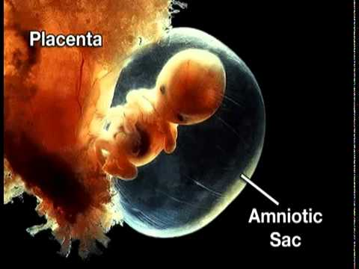
Month 3
Fingers and toes are almost complete

Slide 7
20 weeks
Approximately which week do you find out the gender of the baby

Slide 8
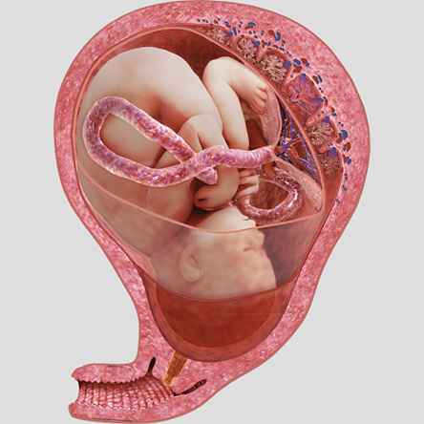
Month 8
Which month does a baby move head down?

Slide 9
FETAL
Which stage of fetal development is the longest stage?

Slide 10
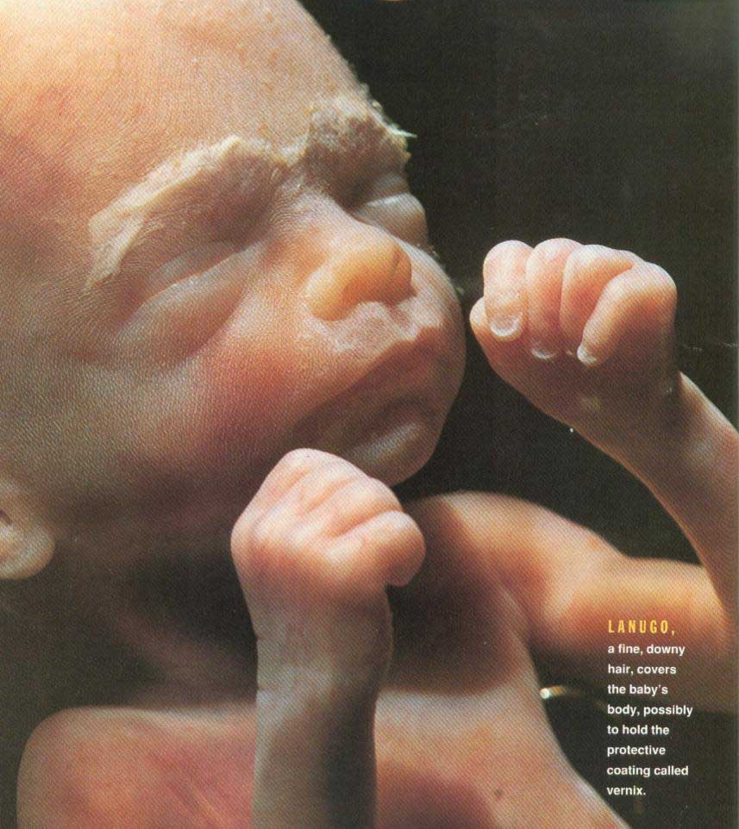
Month 6
Which month are the eyebrows and eyelids visible?

Slide 11
Month 8
Which month does your baby begin gaining half a pound per week?

Slide 12
Embryonic
Which stage of development occurs during the second month?

Slide 13
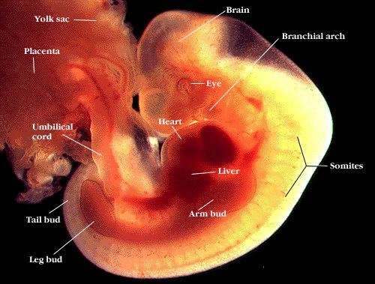
Month 1
By the end of this month, the embryo is about 1/10 inch long

Slide 14
Month 5
Which month does a baby begin growing hair on the head?

Slide 15
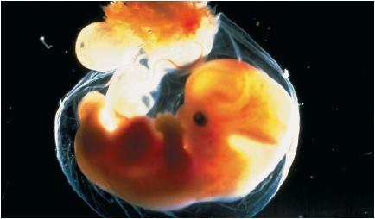
Month 2
Which month do bones begin to form?

Slide 16
GERMINAL
Which stage of fetal development is considered rapid cell division?

Slide 17
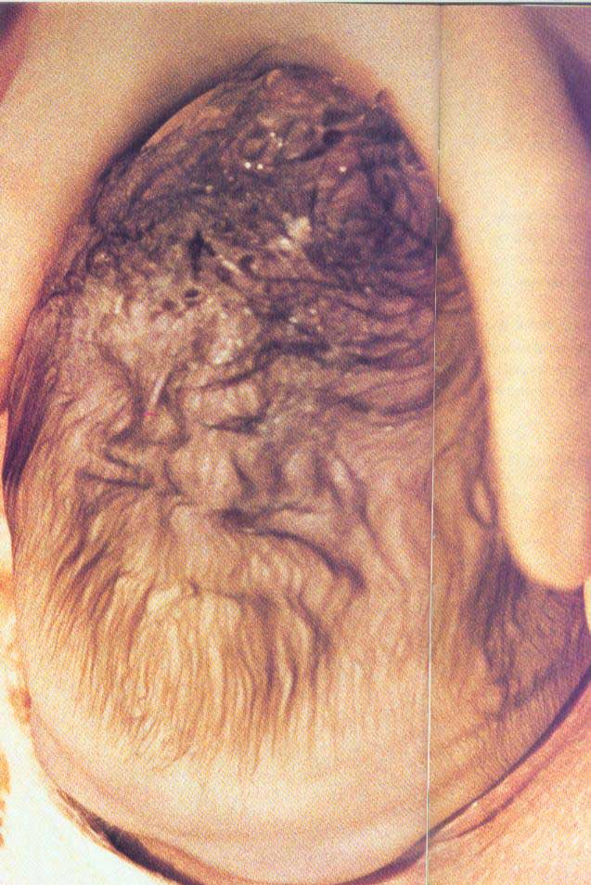
Month 9
Which month?

Slide 18
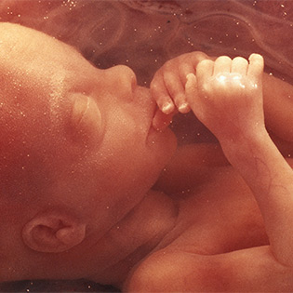
Month 8
Which month do the fingernails extend beyond the fingertips?

Slide 19
8th week
The embryonic stage ends at the end of which week?

Slide 20
Month 9
Which month do the lungs mature and are able to function completely on their own?

Slide 21
Month 7
Which month can it hear and respond to the mother’s voice?

Slide 22
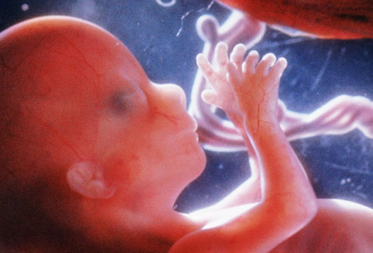
Month 3
Which month?

Slide 23
Month 6
Which month can the fetus hear you if you talk or sing?

Slide 24
40 weeks
Approximately how many weeks is a woman pregnant for?

Slide 25
Month 4
Which month may you feel the baby’s first kick?

Slide 26
Month 3
Which month does a baby start looking like a human?

Slide 27
matching
Reproductive System/Conception

Slide 28
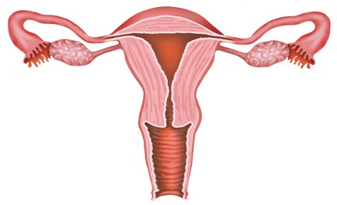

Slide 29
matching
Fetus in the Womb

Slide 30
