Slide 1
Fetal Development Month by Month

Slide 2
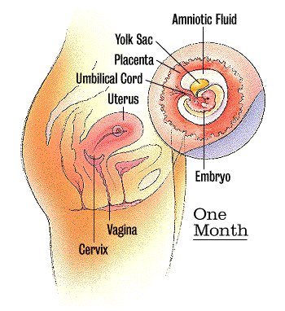
First Month
By the end of the first month, the embryo is about 1/10 of an inch long. The heart, which is no larger than a poppy seed, has begun beating.

Slide 3
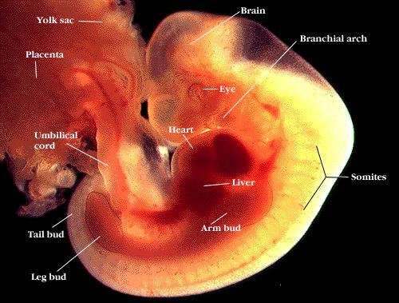
First Month

Slide 4
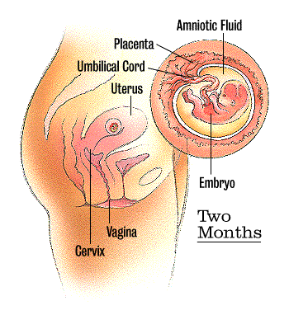
Two Months
The embryo is about 1/4 inch long and has distinct, slightly webbed fingers. Veins are clearly visible. The heart has divided into right and left chambers. Face, eyes, ears, and limbs take shape. Bones begin to form.

Slide 5
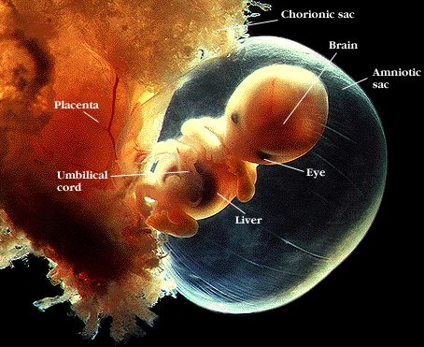
Two Months

Slide 6
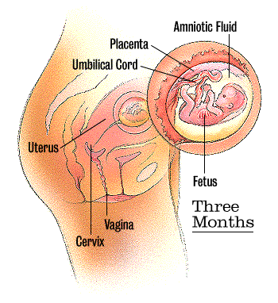
Three Months
By now the fetus is 1-2 inches long and is fully formed. He has begun swallowing and kicking. All organs and muscles have formed and are beginning to function. Nostrils, mouth, lips, and eyelids form. Fingers and toes almost complete.

Slide 7
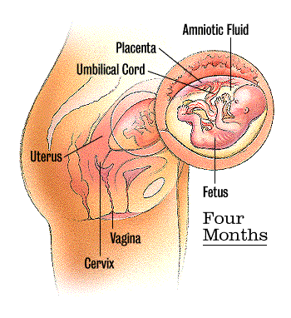
Four Months
By now the fetus is about 3 inches long and weighs 1 ounce. Can suck its thumb, swallow, hiccup, and move around. Facial features become clearer. His heartbeat can be heard clearly. This is when you may feel your baby's first kick.

Slide 8
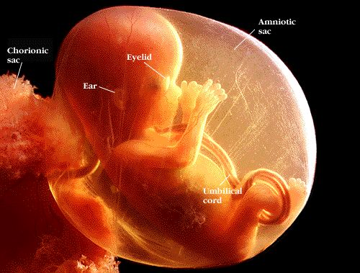
4 months

Slide 9
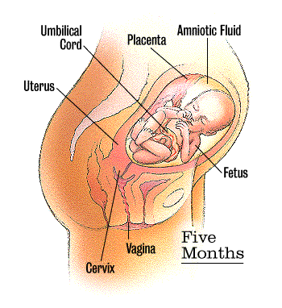
Five Months
Fetus is about 6 ½-7 inches and weighs about 4-5 ounces. Hair, eyelashes, and eyebrows appear. Your baby will become more active during this month.

Slide 10
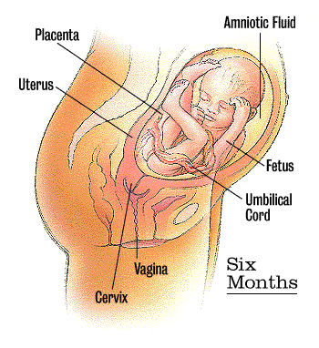
Six Months
Eyebrows and eyelids are visible. Your baby's lungs are filled with amniotic fluid, and he has started breathing motions. If you talk or sing, he can hear you.

Slide 11
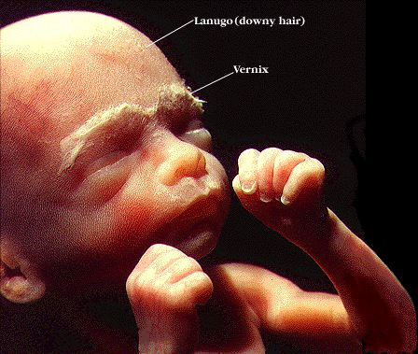
6 Months

Slide 12
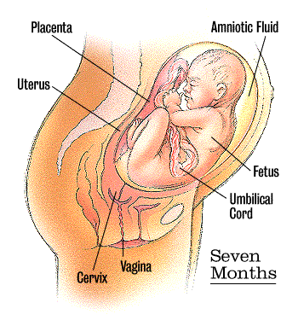
Seven Months
By the end of the seventh month, your baby weighs about 1 1/2 - 2pounds and is about 12 inches long. His body is well-formed. Fingernails cover his fingertips

Slide 13
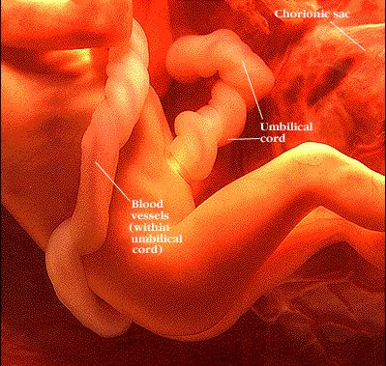
7 Months

Slide 14
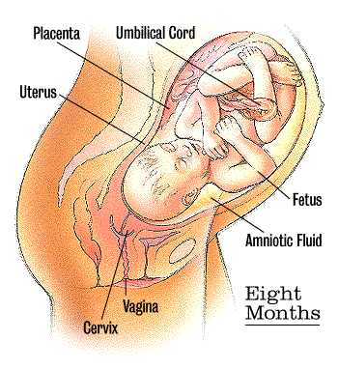
Eight Months
Your baby is gaining about half a pound per week, and layers of fat are piling on. He has probably turned head-down in preparation for birth. He weighs between 3 and 5 pounds.

Slide 15
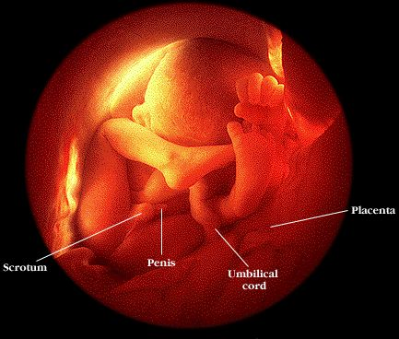
8 months

Slide 16
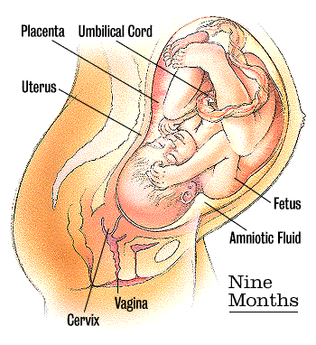
Nine Months
Your baby is a hefty 5 to 7 pounds and measures between 18 and 22 inches. As he becomes more crowded, you may feel him move around less. Descends into pelvis and prepares for birth.

