Slide 1
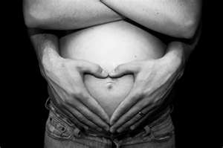
Unit 3-Describing Pregnancy, Prenatal Care, and Childbirth
By Mrs. Kristen Harris

Slide 2
Objectives
Select from a list of early possible signs of pregnancy.
List normal body changes and discomforts during pregnancy.
Identify danger signals that might indicate a complication during pregnancy.
Describe the stages of prenatal development.
Answer questions about healthy prenatal development.

Slide 3
Objectives
Distinguish among available prenatal tests.
Plan a balanced diet for a pregnant woman.
Investigate factors influencing healthy prenatal development.
Name sings of approaching labor.
Name in order the stages of labor and delivery.
List the methods of childbirth.
Analyze situations involving pregnancy, prenatal care, and childbirth.

Slide 4
Terms
Embryo-unborn child from the end of the second week after conception until the end of the second month of pregnancy
Fetus-unborn child from the end of the second month after conception to birth
Ovum-a female cell or egg
Prenatal-period of time between fertilization of the egg and birth
Zygote-one-celled organism formed by the union of a sperm and an ovum

Slide 5
Terms
Teratogens-substances that are potentially harmful to the fetus
Alpha-fetoprotein-a protein produced by a growing fetus; present in amniotic fluid and in the mother’s blood
Neural tube defect-a fetal birth defect that is the result of improper development of the brain or spinal cord
Placenta-mass of small blood vessels embedded in the uterine wall through which the fetus obtains nourishment

Slide 6
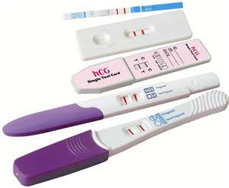
Signs of Pregnancy
None of the following signs are positive indications of pregnancy.
Reliable pregnancy test and exam by a physician can provide an accurate diagnosis.
Some, all, or none of these symptoms may be experienced by a woman throughout pregnancy

Slide 7
Signs of Pregnancy
Missed menstrual period
Food aversions
Food cravings
Full or tender breasts
Nausea, or morning sickness
Experienced to some degree by 2/3 of pregnant women
Usually ends after the third month

Slide 8
Signs of Pregnancy
Fatigue and feelings of tired or sleepiness even after getting plenty of rest
Frequent urination

Slide 9
Body Changes and Discomforts
Normal discomforts should be reported to the doctor during regular prenatal visits
Back aches
Bleeding gums
Pregnant women should see the dentist at least once during their pregnancy
Constipation
Frequent urination
Gas (flatulence)

Slide 10
Body Changes and Discomforts
Heartburn
Hemorrhoids
Increased vaginal secretions
Leg Cramps
Nausea or morning sickness
Nosebleeds
Shortness of breath
Skin changes
Swollen feet and ankles
Tender breasts
Uncomfortable bladder leakage
Varicose veins
Weight gain of 25-35 lbs.

Slide 11
Danger Signals
Danger signals indicate that some treatment or intervention may be needed to prevent complications
Symptoms do not necessarily mean there is a medical problem, but they do often precede the possibility of a complication
If experiencing any of these symptoms, the doctor should be called immediately

Slide 12
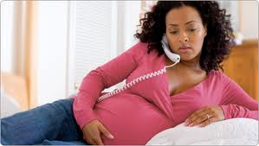
Danger Signals
Abdominal pain
Chill/fever
Dimness or blurred vision
Excessive or rapid weight gain
Exposure/contraction of contagious disease
Fainting
Headaches
Lack of fetal movement after the 28th week
Painful, burning, or bloody urination
Persistent vomiting

Slide 13
Danger Signals
Regular, rhythmic contractions
Sudden escape of fluids from the vagina
Swelling of the face and/or fingers
Unusual vaginal discharge
Vaginal bleeding

Slide 14
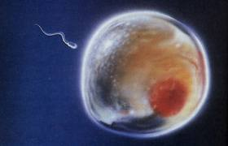
Stages of Prenatal Development
Period of the ovum
Conception through second week of life
Cell is formed by the united sperm and ripe ovum (egg)
Zygote contains the potential for everything the baby will become even though it is smaller than the point of a pencil
During this period
zygote reaches the uterus
Attaches to the uterine lining
Begins to grow

Slide 16
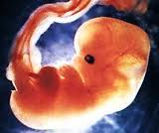
Stages of Prenatal Development
Period of the embryo
Second stage of prenatal development
End of second week to end of second month
Six weeks of rapid growth to a length of about one inch
Central nervous system develops
Lungs develop
Heart begins to beat
Surrounded by amniotic fluid that cushions and protects

Slide 17
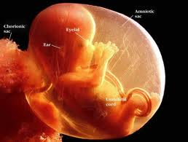

Slide 18
Stages of Prenatal Development
Period of the Fetus
Third and last stage of development
Extends from end of second month to birth
3rd Month
Arms, hands, fingers, feet, and toes are fully developed
4th month
Eyebrows and lashes
May suck thumb

Slide 19
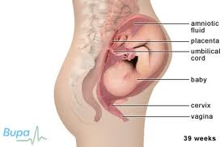

Slide 20
Stages of Prenatal Development
5th month
Can feel movement
End of 6th month
Baby weighs as much as 2 lbs.
Skin is covered with heavy perfective coating called vernix
7th and 8th month
Baby is getting longer and fatter
Continues to grow and exercise
Once the baby has reached the 8th month, the babies survival chances are good

Slide 21
Stages of Prenatal Development
End of 9th month
Approximately 40 weeks after conception
Full-term baby weighs about 7 ½ lbs and be about 20 inches long
Baby will drop into the pelvis
Head will engage in the birth position
Ready to be born

Slide 22
Healthy Prenatal Development
Health of mother is directly linked to the health of the baby!
Obtain proper and regular medical care
Start when pregnancy is suspected
Continue throughout pregnancy
Preconception counseling can improve the health and safety of the mother and baby

Slide 23
Healthy Prenatal Development
Diet
Should be Balanced
Consume an additional 300 calories per day from health food
Protein
Complex Carbs
Vitamins
minerals

Slide 24
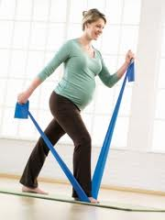
Healthy Prenatal Development
Exercise
Should be pregnancy appropriate
Moderate exercise
Pregnancy is not a time to start an intensive exercise program
Avoid risky sports such as skiing, horseback riding, etc.
Always consult a doctor

Slide 25
Healthy Prenatal Development
Avoid exposure to disease or infections
Abstain from drinking alcohol
If the mother drinks, the baby drinks!
Can lead to serious birth defects
No “safe” limit
Women trying to conceive or suspect they are pregnant should NOT drink
Quit Smoking and avoid cigarette smoke
Increased risk of miscarriage, premature birth, stillbirth, low birth weight, SIDS, and mental problems

Slide 26
Healthy Prenatal Development
Stop unnecessary drugs
Prescription and non prescription drugs should be avoided, unless prescribed by a doctor who knows the patient is pregnant
Reduce stress
Avoid teratogens
Postpone elective x-rays
Refrain from raising the body temperature above 102 degrees
Ex. Hot tubs, saunas, and steam rooms

Slide 27
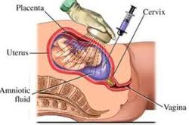
Parental Tests
Amniocentesis
16th week of pregnancy or after
Sample of amniotic fluid taken with a needle
Tests for birth defects or health problems
Can identify Down’s syndrome, reveal sex, determine fetal age and health status
Commonly done in women over 35

Slide 28
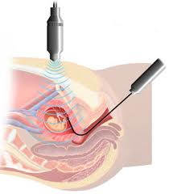
Parental Tests
Chorionic Villi Sampling
Done between the 9th and 11th month
Determines health status
Slightly riskier than amniocentesis
Catheter is inserted into the uterus though the vagina
Samples are taken of the tissue encasing the fetus

Slide 29
Parental Tests
Maternal-Serum Alpha-Fetoprotein Screening (MSAFP)
Blood sample is taken between 16th and 18 week
May indicate neural tube defects (such as spina bifida), an absence of all or part of the brain, or to suggest a risk of Down’s Syndrome or other chromosomal defects
Requires further testing for confirmation

Slide 30
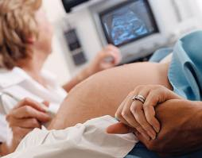
Parental Tests
Ultrasound
Sound waves are used to make a video image of the developing fetus
Can reveal problems
Abnormally small or large head
Body malformations
Can be used to:
Guide the needle during Amnio
Catheter for CVS
Diagnose twins
Estimate fetal age

Slide 31
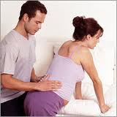
Signs of Labor
One of all of the following signs may occur as signals of approaching labor
Amniotic sac or “water” breaks
Followed by a flow of liquid from the vagina
Contractions
Repeating cramps in the uterus and/or back
Gradually become stronger
Comes in shorter intervals

Slide 32
Signs of Labor
“Show” appears
Small discharge of blood-tinged mucus from the vagina

Slide 33
Stages of Labor
Dilation Stage
Uterine muscles begin to contract causing pressure necessary for dilation of the cervix
Three phases: early, active, and transitional
Averages about 12 hours for first time deliveries

Slide 34
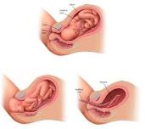
Signs of Labor
Expulsion Stage
Mother is actually pushing the baby out of her body
Can last from 20 min to an hour

Slide 35
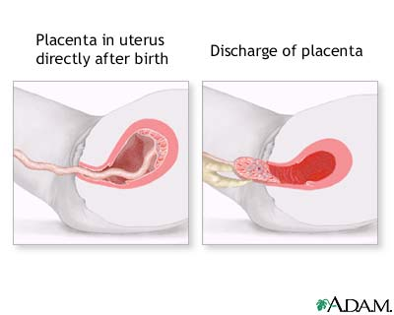
Stages of Labor
Afterbirth stage
Placenta is delivered

Slide 36
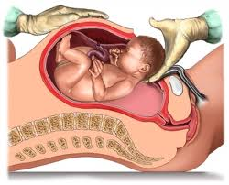
Methods of Childbirth
Cesarean Section or C-Section
Baby is delivered through a surgical incision in mothers abdomen and uterus
Used when:
The baby needs to be delivered as soon as possible
Doctor determines that a vaginal birth could be dangerous to the mother or baby

Slide 37
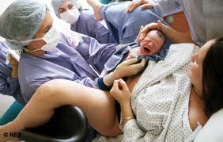
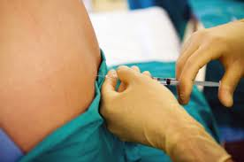
Methods of Childbirth
Natural Child Birth
Very little or no medication is given to the mother
Child Birth with anesthetics
Local or general
Can reduce the discomfort of delivery
May slow the birth process, cause
a sleepy baby, and/or slow the
fetal heart rate

Slide 38
And Now….What you have all been waiting for!!!

Slide 39
The Video

