Slide 1
Fetal Alcohol Effects

Slide 2
Do you think…
Is it OK for a pregnant woman to drink alcohol?

Slide 3
Do you think…
What if it is only 1 drink, or occasionally?

Slide 4
Teratogen
An agent that causes malformation in an embryo

Slide 5
How does alcohol affect the developing brain?
Alcohol is a teratogen.
The area that is affected the most by alcohol is the nervous system. Damage can occur in various regions of the brain.
The areas that might be affected by alcohol exposure depend on which areas are developing at the time the alcohol is consumed.
Since the brain and the central nervous system are developing throughout the entire pregnancy, the baby's brain is always vulnerable to damage from alcohol exposure.

Slide 7
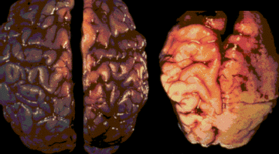
Brain of a non-affected baby
Brain of a FAS affected baby

Slide 8
Alcohol Exposure During Stages of Pregnancy
1. During the first trimester, alcohol interferes with the migration and organization of brain cells.
2. Heavy drinking during the second trimester, particularly from the 10th to 20th week after conception, seems to cause more clinical features of FAS than at other times during pregnancy.
3. During the third trimester, the hippocampus is greatly affected, which leads to problems with encoding visual and auditory information (reading and math).
From the College of Cognitive and Linguistic Sciences at Brown University, Providence, RI.

Slide 10
The most noteworthy damage occurs in the prefrontal cortex, which controls what are called the “executive functions”.
inhibition
problem solving
sexual urges
planning
time perception
internal ordering
working memory
self-monitoring
verbal self-regulation
empathy
regulation of emotion
motivation
judgment

Slide 11
Effects of alcohol exposure on behaviors related to executive functions:
socially inappropriate behavior, as if inebriated
inability to figure out solutions spontaneously
inability to control sexual impulses, esp. in social situations
inability to apply consequences from past actions
difficulty with abstract concepts or time and money
like files out of order, difficulty processing information
storing and/or retrieving information
needs frequent cues, requires policing by others
needs to talk to self out loud, needs feedback
diminished sense of remorse, inability to understand others
moody roller-coaster emotions, exaggerated
need external motivators to complete menial tasks
inability to weigh pros and cons when making decisions

Slide 12
Fetal Alcohol Spectrum Disorder (FASD)
is an umbrella term that describes a continuum of conditions that result from prenatal alcohol exposure. FASD is not a diagnosis. The specific diagnoses within the spectrum include:
Fetal Alcohol Syndrome (FAS)
Partial Fetal Alcohol Syndrome (pFAS)
Alcohol Related Neurodevelopmental Disorder (ARND)
Alcohol Related Birth Defects (ARBD)

Slide 13
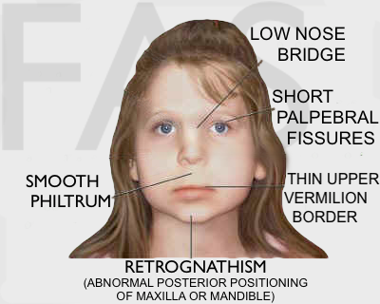
Fetal Alcohol Syndrome
4 key features:
1. Classic facial features
2. Growth deficiency
3. Central nervous system damage – Clinically significant structural, neurological, or functional impairment. Usually determined through psychological, speech-language, and occupational therapy assessments
4. Prenatal alcohol exposure – Confirmed prenatal alcohol exposure

Slide 14
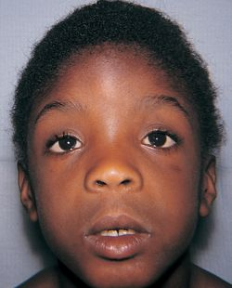
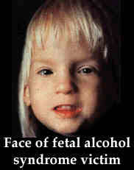
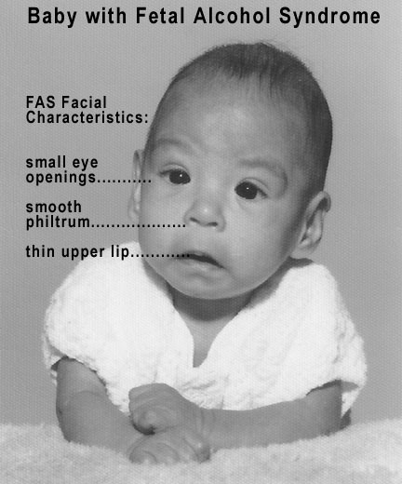
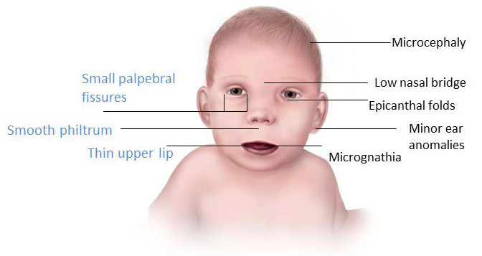

Slide 15
Partial Fetal Alcohol Syndrome (pFAS)
These individuals have the same functional disabilities but "look" less like FAS.

Slide 16
"Alcohol causes more neurological damage to the developing baby than any other substance."
Institute of Medicine report to Congress

Slide 17
What if they only drink a little?
Children do not need to have full FAS to have significant difficulties due to prenatal exposure to alcohol.
According to research, even light drinking (average one-quarter ounce of absolute alcohol daily) can have adverse effects on the child's verbal language and comprehension skills.
Studies show that children of mothers who drank but who do not have a diagnosis of FAS have many of the same neurological abnormalities as children who have been diagnosed with full FAS.

Slide 18
No amount of alcohol during pregnancy has been proven safe.

Slide 19
Birth Mother Story
Why do some people continue to drink while pregnant?

Slide 20
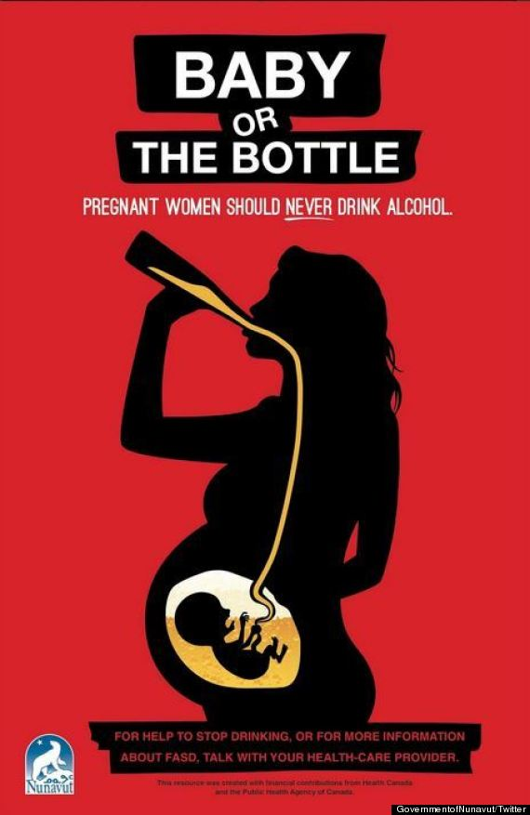

Slide 21
Project

Slide 22
Egg
The egg shell represents the mother’s body.
It has been removed by soaking the egg in vinegar for 24 hours.
This allows us to see the membrane, which represents the placenta and amniotic sac.
Remember, the placenta is where nutrients and wastes are exchanged between the mother and the fetus.
The white and yolk are representative of the amniotic fluid and the unborn baby.

Slide 23
Add eggs into 3 different glasses. Along with eggs, add:
Glass 3
Water & dye
Glass 1
“Control”
Water
Glass 2
Alcohol
Leave eggs in glasses for 2-4 days, and then “open” to evaluate results.

Slide 24
What do you think will happen?

Slide 25
101 reasons to abstain from alcohol during pregnancy
***********
***********
two eyes
one nose
two ears
ten toes
************
************
ten fingers
one sweet mouth
two arms for hugging
two strong legs to run
two feet to walk on in the sun
one spine straight and strong
two hands to hold all day long
****************************************
*****************************************
20 baby teeth for a beautiful smile
32 permanent teeth after a while
one heart to beat steady & strong
two lungs to sing a nursery song
one good liver, healthy as a horse,
two first words “Mama & Dada” said
over and over and over, of course.
*********************************************
*********************************************
2 frontal lobes for impulse control
1 corpus callosum to process it all
2 healthy parents to care for this child
1 precious little spirit so tender & mild
1 first step towards independence,
as we nurture, protect, guide and love
this wee precious gift sent from above.
************************************************
************************************************
Drinking in pregnancy may cause birth defects, brain damage
© 2004 Teresa Kellerman & Cathy St. Peter, www.fasstar.com
************************************************

Slide 26
Results

Slide 27
Results
Glass 1
Water
Control
Glass 2
Alcohol
Remember, the effects of any harmful substance are exaggerated because the fetus is so small.
Glass 3
Water & dye
Shows how substance penetrate the placenta and amniotic fluid to reach the fetus.

Slide 28
Evaluate
How do the results compare to your hypothesis?

Slide 29
Extended Lesson
The alcohol-soaked egg can be placed into a glass filled with water to demonstrate that even if the conditions change (for example, the mother stops drinking), the effects of the alcohol on the egg cannot be reversed.

