Slide 1
Unit 1-Describing Family and Its Future
Parenting and Child
Development
Mrs. Kristen Harris

Slide 2
Objectives
Identify functions of families.
Match types of family structures to their description.
Discuss characteristics of families past and present.
Profile families past and present.

Slide 3
Objectives
List the effects dual-career families have on family members.
Distinguish among stages of the family life cycle.
Develop a family life cycle chart.
Identify at-risk families.
Discuss the impact of changes
  affecting families.

Slide 4

Terms
Family-unit of intimate, transacting, and interdependent persons who share responsibilities for decisions and resources, and have commitment to one another over time.
Family Structure-the way a family is organized with boundaries, power, influence, and support.
At-risk-individuals who face the possibility of limited participation in the social, political, and economic mainstream of society.

Slide 5
Major Function of the Family
To raise children and accept the challenges and rewards of parenthood.
To provide physical care of individuals
To receive security and emotional support which includes love, acceptance, understanding, and encouragement from each other
To help children learn about societal and family values such as honesty,
sharing, and fair play.

Slide 6

Family Structures
Blended Family-when the
parent in a single-parent family marries; family will include stepparents and possibly stepsiblings.
Cooperative Family-nonrelated people who join together to raise children as their own
Extended Families-all generations and relatives who are direct descendants of a person

Slide 7

Family Structure
Non-child Family-couples without children or couples whose children have grown up and left.
Nuclear Family-a couple who marries and establishes a home of their own.
Single-parent Family-when one parent lives with his or her children

Slide 8
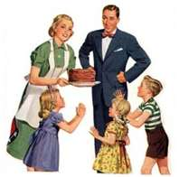

Families Past and Present
Many men and women no longer feel they must respond to the division of labor and action on the basis of gender.
Males and females are sharing household chores and child care responsibilities.

Slide 9
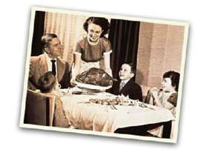
Families Past and Present
Employment of both men and women inside and outside the home is a major factor affecting the current trend toward multiple role responsibilities.
The average number of children in families has decreased.

Slide 10

Effects of Dual-Career Families
Children and parents learn the importance of each family member contributing to the family household upkeep
Children may become more independent
Couples allow for individual development of professional identities

Slide 11

Effects of Dual-Career Families
Family financial pressures may be relieved and the standard of living improved
Children relate to the positive image their parents set and identify with their parents when thinking about career possibilities

Slide 12
Effects of Dual-Career Families
Couples have the chance to expand their lives and face new challenges
A partner who vies his or her career as more important than the other partners career or the demands of the family can cause stressful situation for the family.

Slide 13
Effects of Dual-Career Families
Child care arrangements have to be made for preschool and school age children
Child care, transportation, and working wardrobe expenses sometimes cost the family almost as much ad on working parent makes

Slide 14

Effects of Dual-Career Families
Children may return home from school to an empty house until their parents come home
Family conflicts can arise when individuals are unable to give 100 percent of their time, energy, and thought into both their career and their family life.

Slide 15
Effects of Dual-Career Families
Parents who carry the major load of the household tasks and maintain a work scheduled are likely to experience the stress and strains of an overloaded schedule

Slide 16
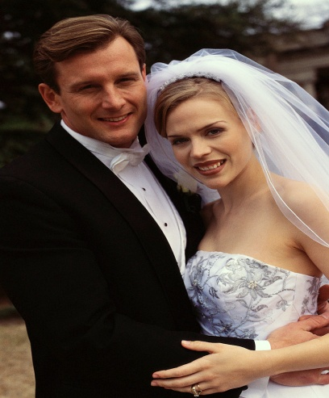

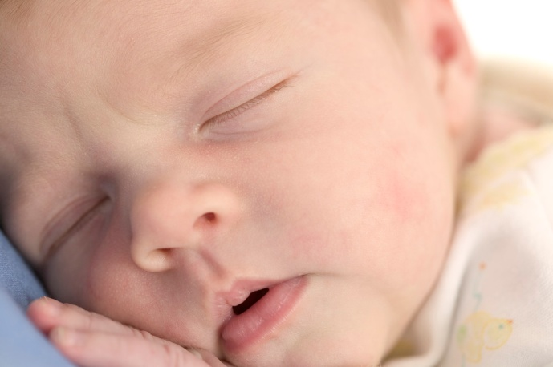
Stages of the Family Life Cycle
Growth Stages
  Stage 1 Newly married couple; no children
  Stage 2 Childbearing years; infants and toddlers
  Stage 3 Preschool years; between ages 3-6
  Stage 4 School age; between 6-13
  Stage 5 Adolescent years; between 13-18

Slide 17


Stages of the Family Life Cycle
Contracting Stages
  Stage 6 Launching years; the time when the oldest child leaves home until the last child leaves
  Stage 7 Middle-age; the time when children leave home until the couple retires
  Stage 8 Retirement; the time form retirement until death of both spouses

Slide 18
At-Risk Families
Children from single-parent families
Children attending schools with a high concentration of students who live in poverty
Children with limited English proficiency
Children who live in neglectful and/or non-nurturing families

Slide 19
At-Risk Families
Children with various physical and/or mental disabilities
Children who live in families where substance abuse occurs
Families headed by teenage parents
Individuals who drop out and/or fail in school
Those who live in poverty or low income households

Slide 20
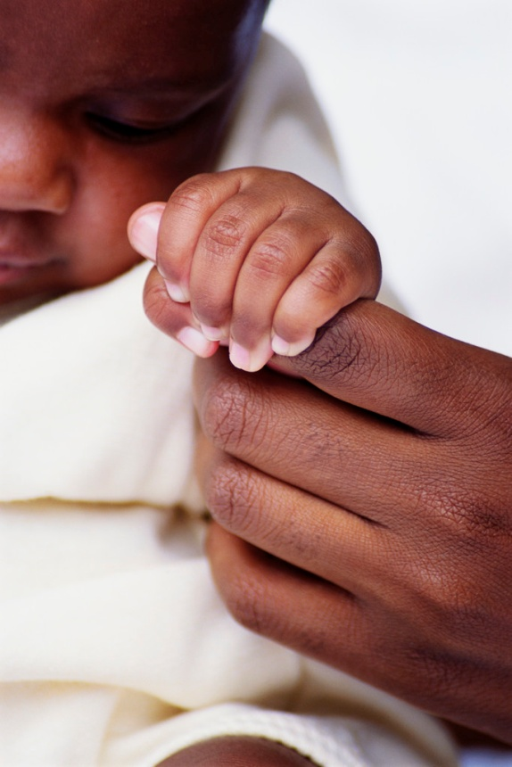
Impact of Changes Affecting Families
Accident/injury/illness
  Affects all family members
  Increases financial pressures
Birth of a Family Member
  Additional responsibilities
  Focus of family changes
Crime
  Victim of violence, domestic violence, or incarceration

Slide 21
Impact of Changes Affecting Families
Death of a Family Member
  Responsibilities must be shared
Disaster
  Floors, tornados, or earthquakes
  Can destroy belongings and shelter
  Can claim the lives of family members
Divorce
  Affects spouses and children
  Custody or visitation arrangements can cause stress

Slide 22
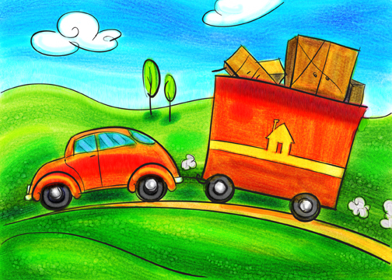
Impact of Changes Affecting Families
Relocation
  May be because of economic necessity
  Many families relocate
  Relocation uproots family members from familiar surroundings and friends
Remarriage
  Affects all family members
  Creates a blended family
  Must learn to interact with new family

