Slide 1
My Timeline Project
15 things that made me who I am today!

Slide 2
What is the Timeline Project
The timeline project allows you to look at your life from birth until today. Think about things that have happened and have made you who you are today.
For example: Getting your driver’s license =
Independence
Added Responsibility
For example: Change of family structure (due to death or divorce)=
New role within the family
More or less responsibility

Slide 3
Examples:
The following timelines were completed by Mrs. Comer’s Parenting and Child Development Class and Central High School – Sallisaw, OK in the fall semester of 2014.
We hope you enjoy looking at them as much as the we enjoyed making them.

Slide 4
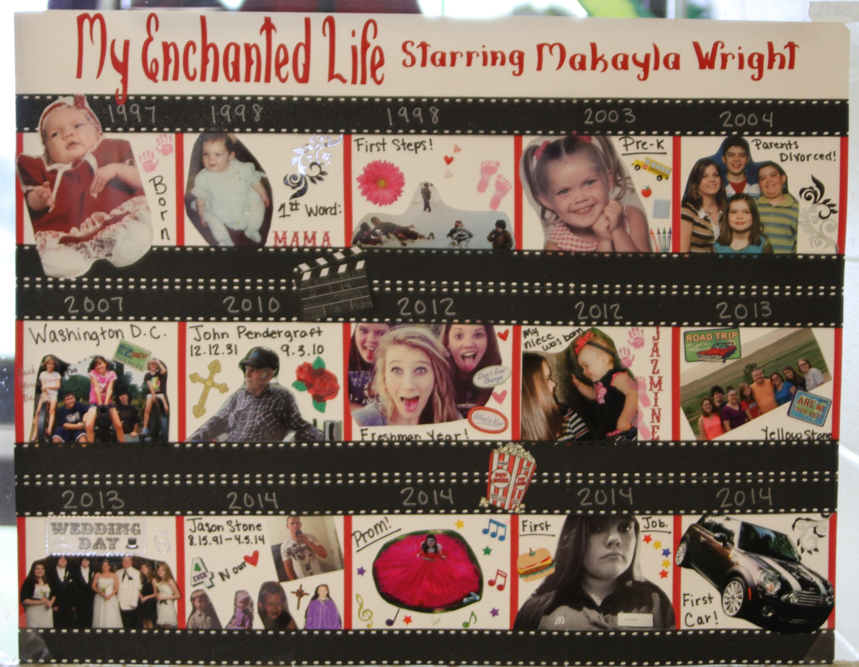
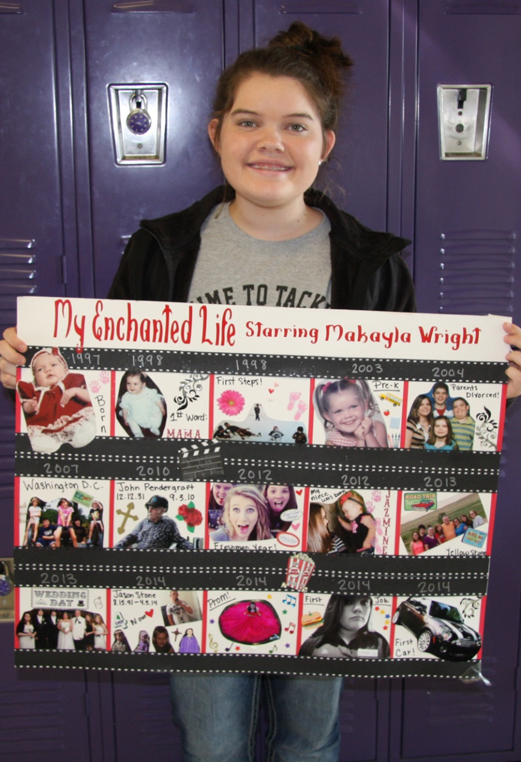
Makayla Wright, Junior

Slide 5
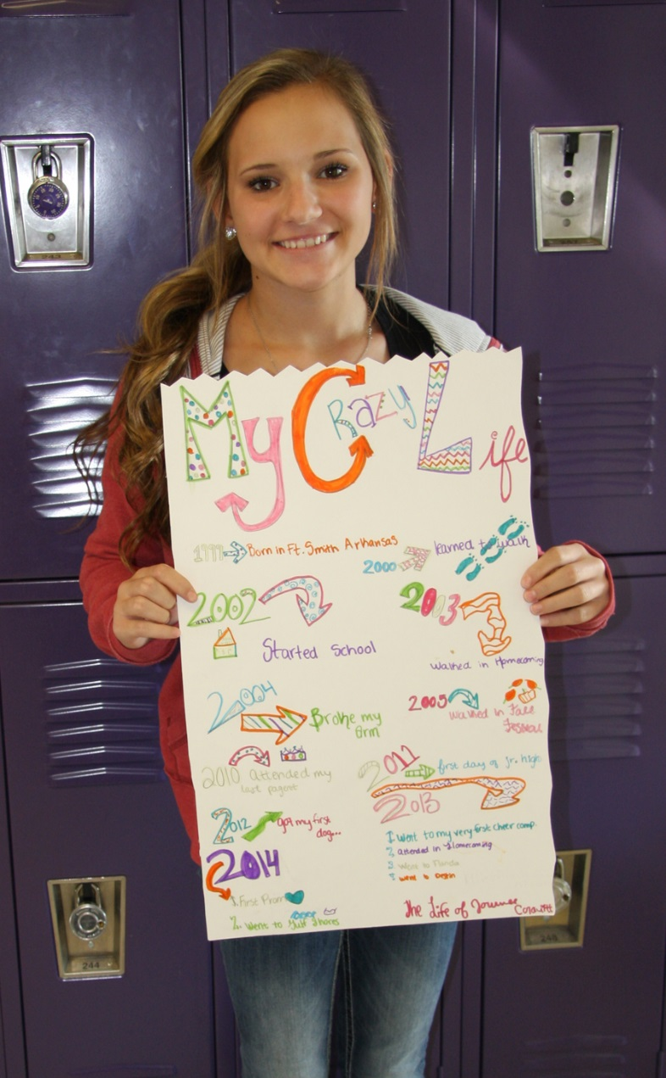
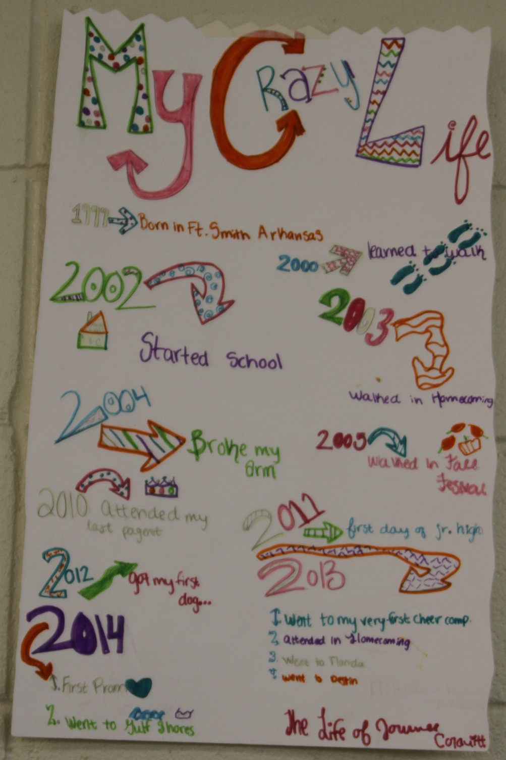
Journee Colquitt, Sophomore

Slide 6
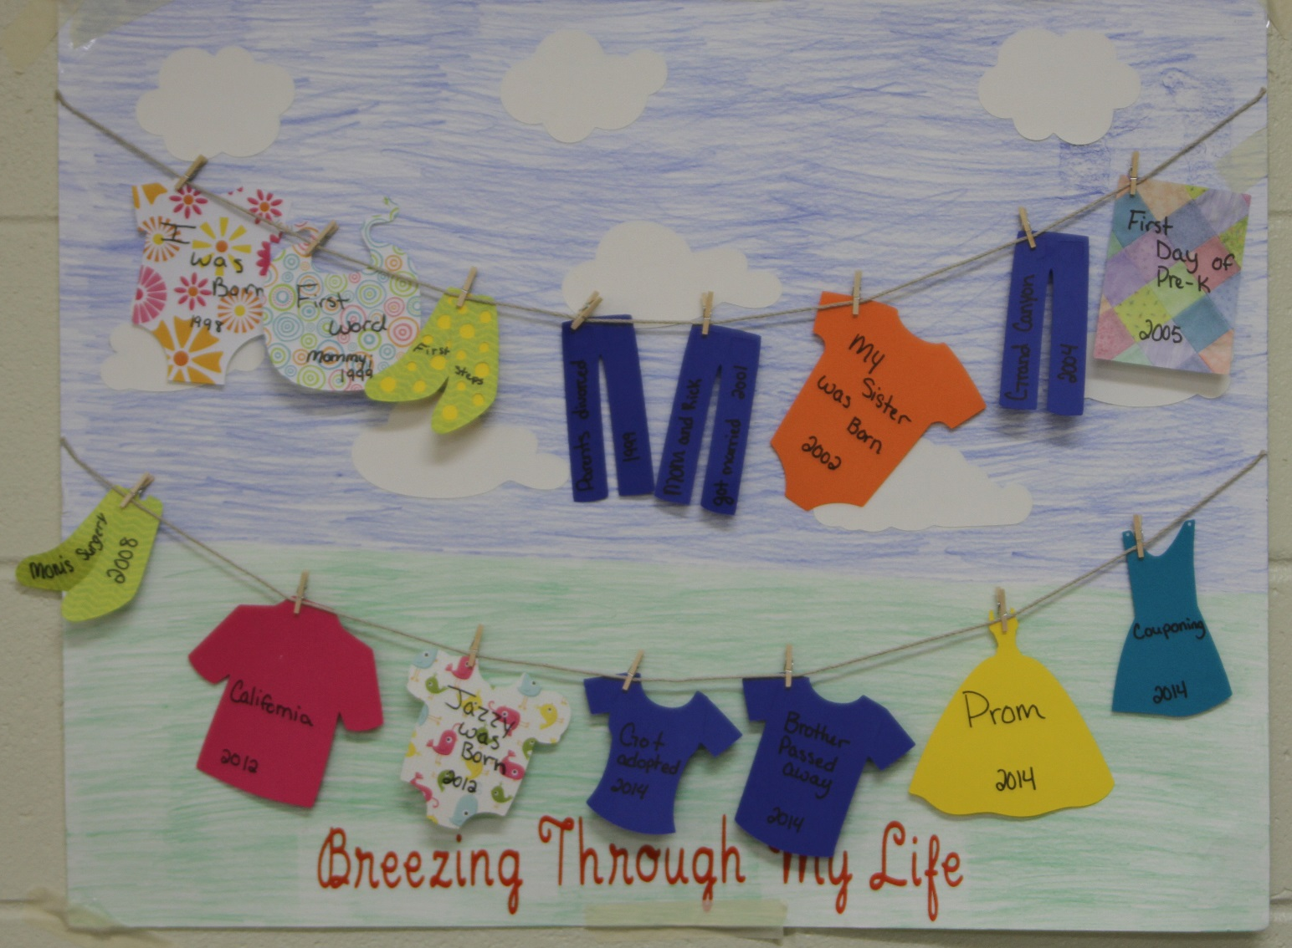
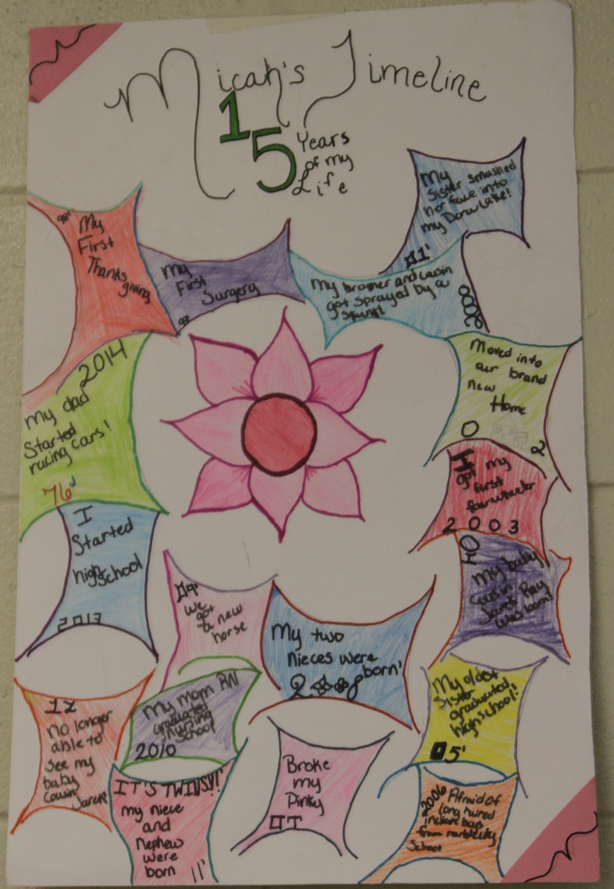
Danielle Stone, Sophomore

Slide 7
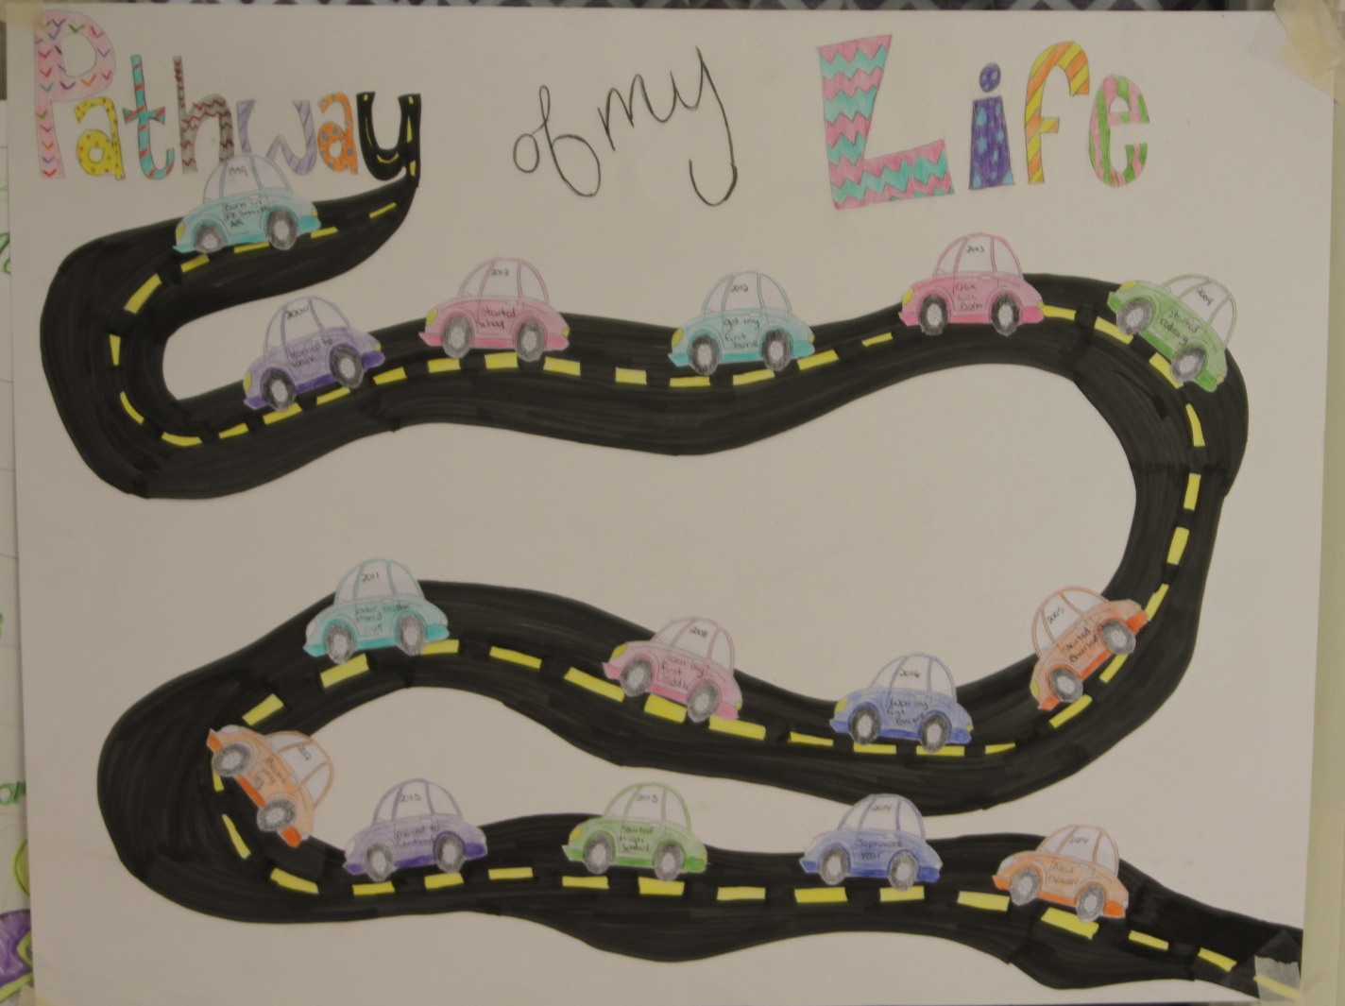
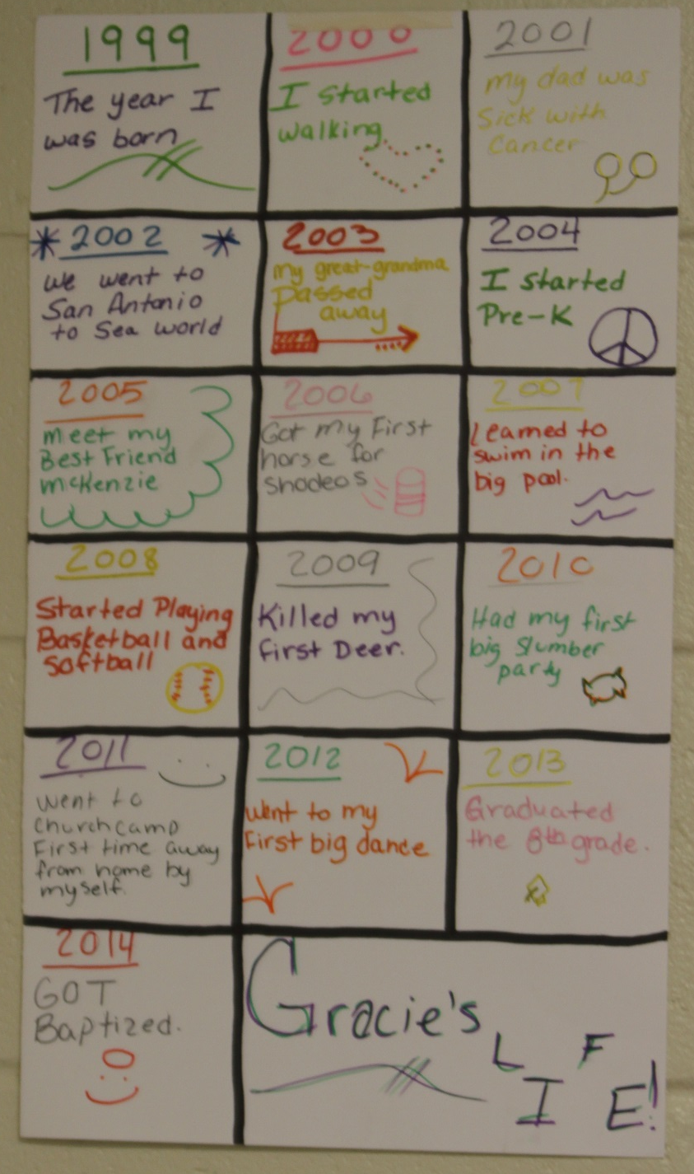

Slide 8
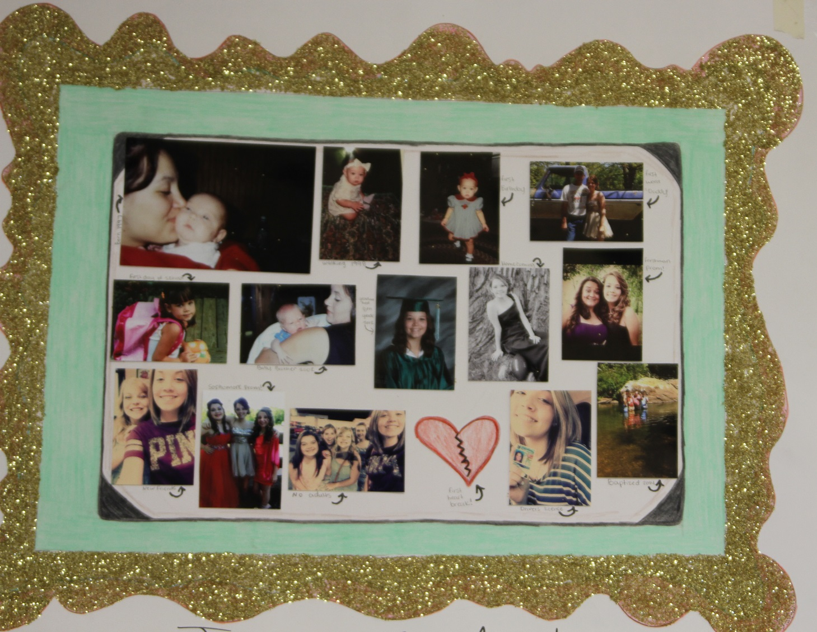
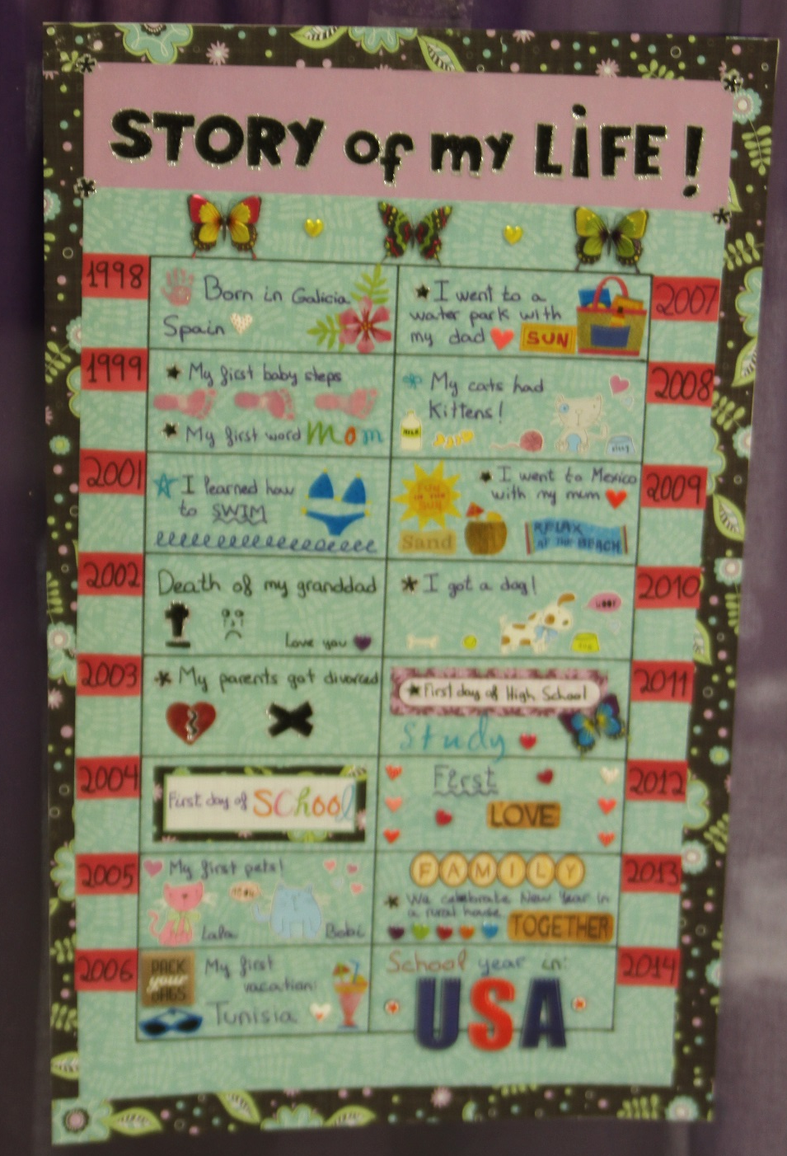

Slide 9
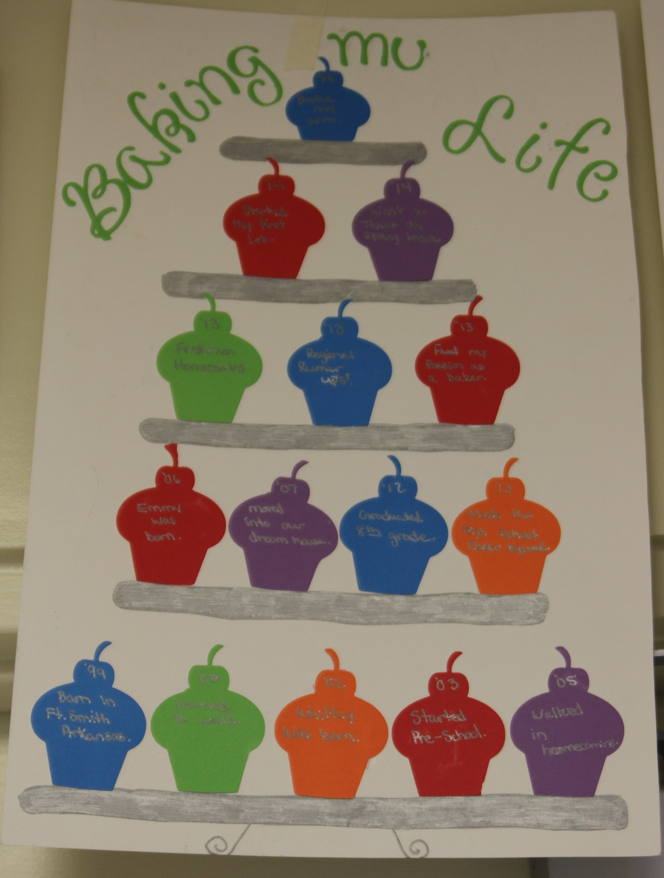
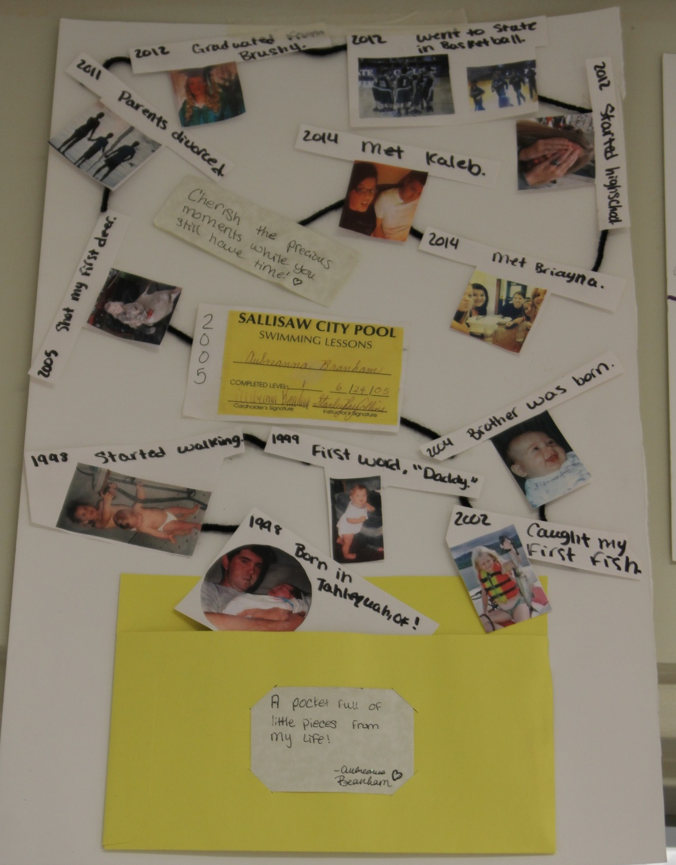

Slide 10
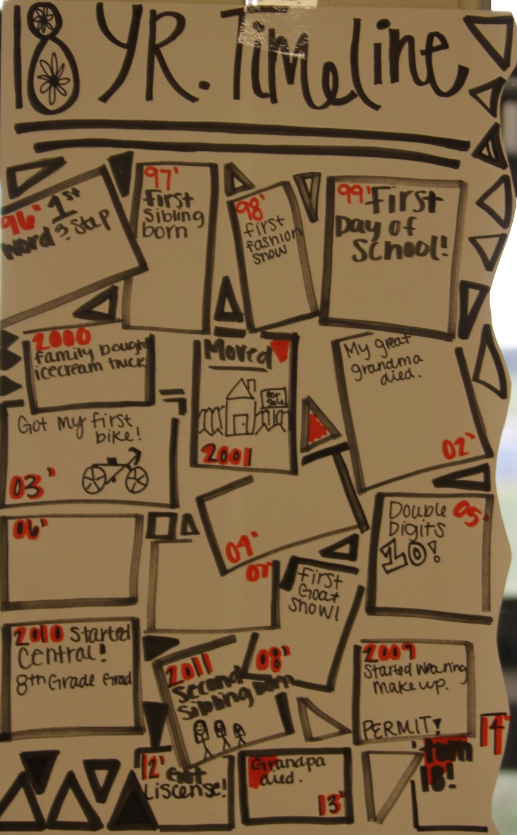

Slide 11
Thanks for watching!!!

