Slide 1
Construction
Popsicle Stick House

Slide 2
Foundation
Foundation- The underlying base of the house.
Foundation with crawl space
Slab Foundation-concrete
Basement

Slide 3
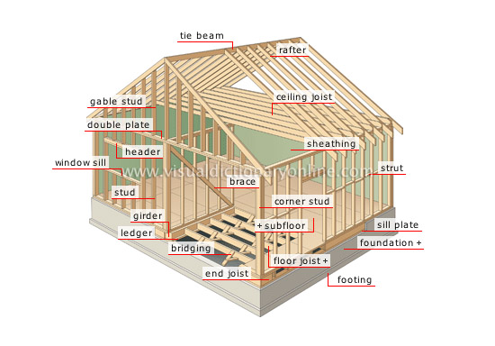

Slide 4
Floor Frame
Sill Plate- Supports the outside walls of the house
Floor Joists- lightweight horizontal support members
Girders- a large horizontal member in the floor that takes the load off joists.
Bridging- Structure composed of two members forming an X and placed between the joists to reinforce them and keep them from deforming.
Subfloor- a covering of plywood sheets nailed directly to the floor joists.

Slide 5
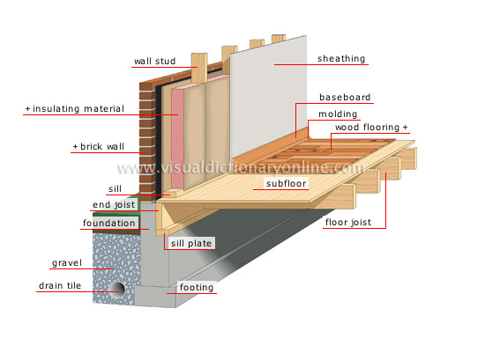

Slide 7
Wall Frame
Studs- wall frame built on top of the floor frame. It is made from 2x4 or 2x6 vertical framing members
Plates- single on the bottom and double on the top that supports the ceiling joists and roof members
Headers- small built up beams that carry the load of the structure over door and window openings

Slide 8
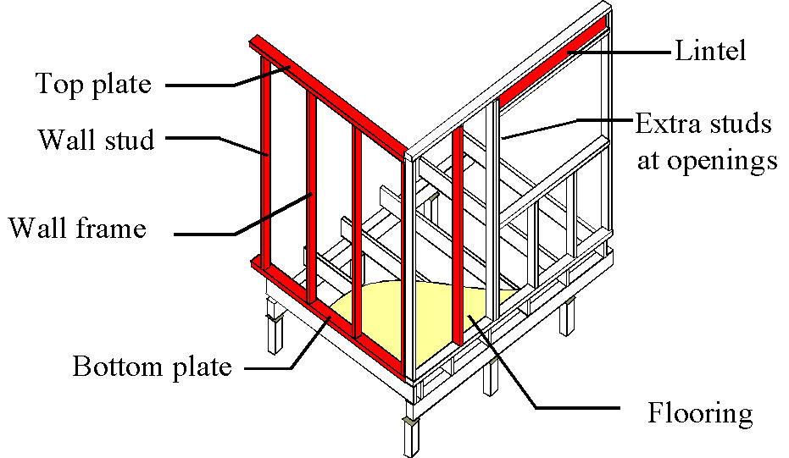

Slide 9
Ceiling Roof Frames
Rafters with an overhang- a series of beams that support the weight of the roof
Ridge/Tie beam- the horizontal line at which the two slopes of the roof meet. The highest point of the roof frame.
Ceiling Joists- a horizontal support beam which creates stability for the roof
Roof Trusses- a group of members forming a rigid triangular framework for the roof.

Slide 11
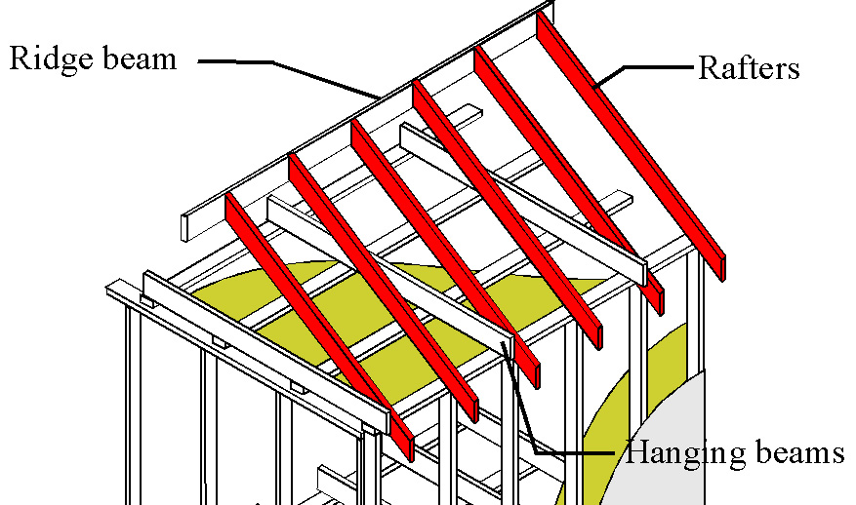

Slide 12
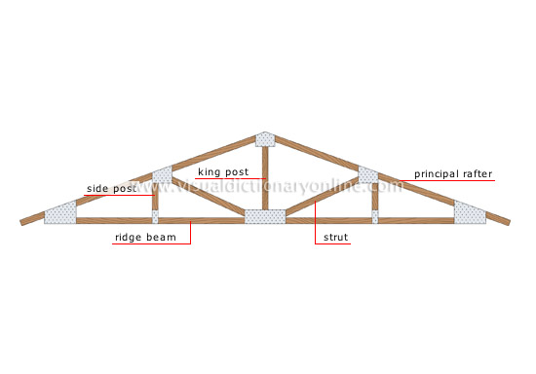

Slide 13
The End

