Slide 1
Popsicle House

Slide 2
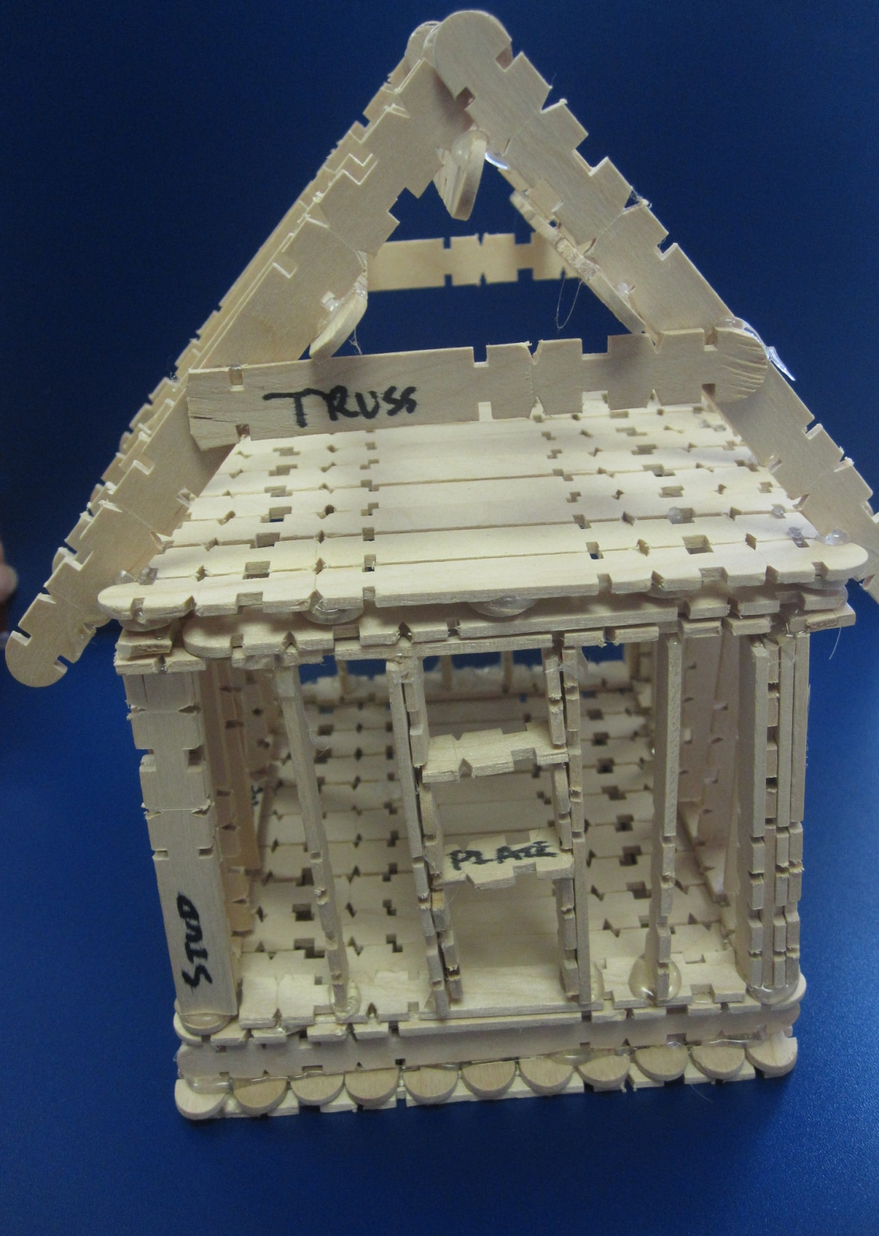

Slide 3
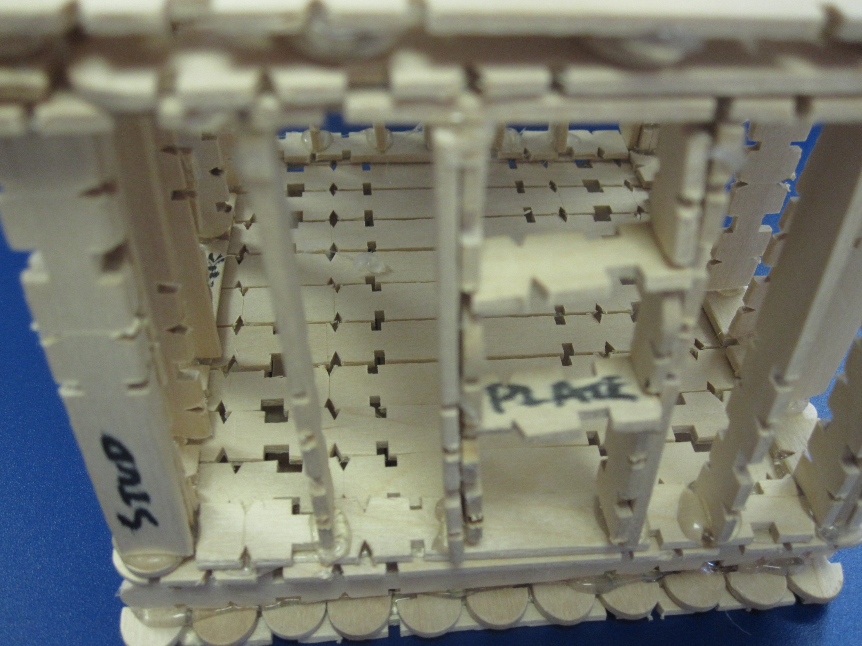

Slide 4
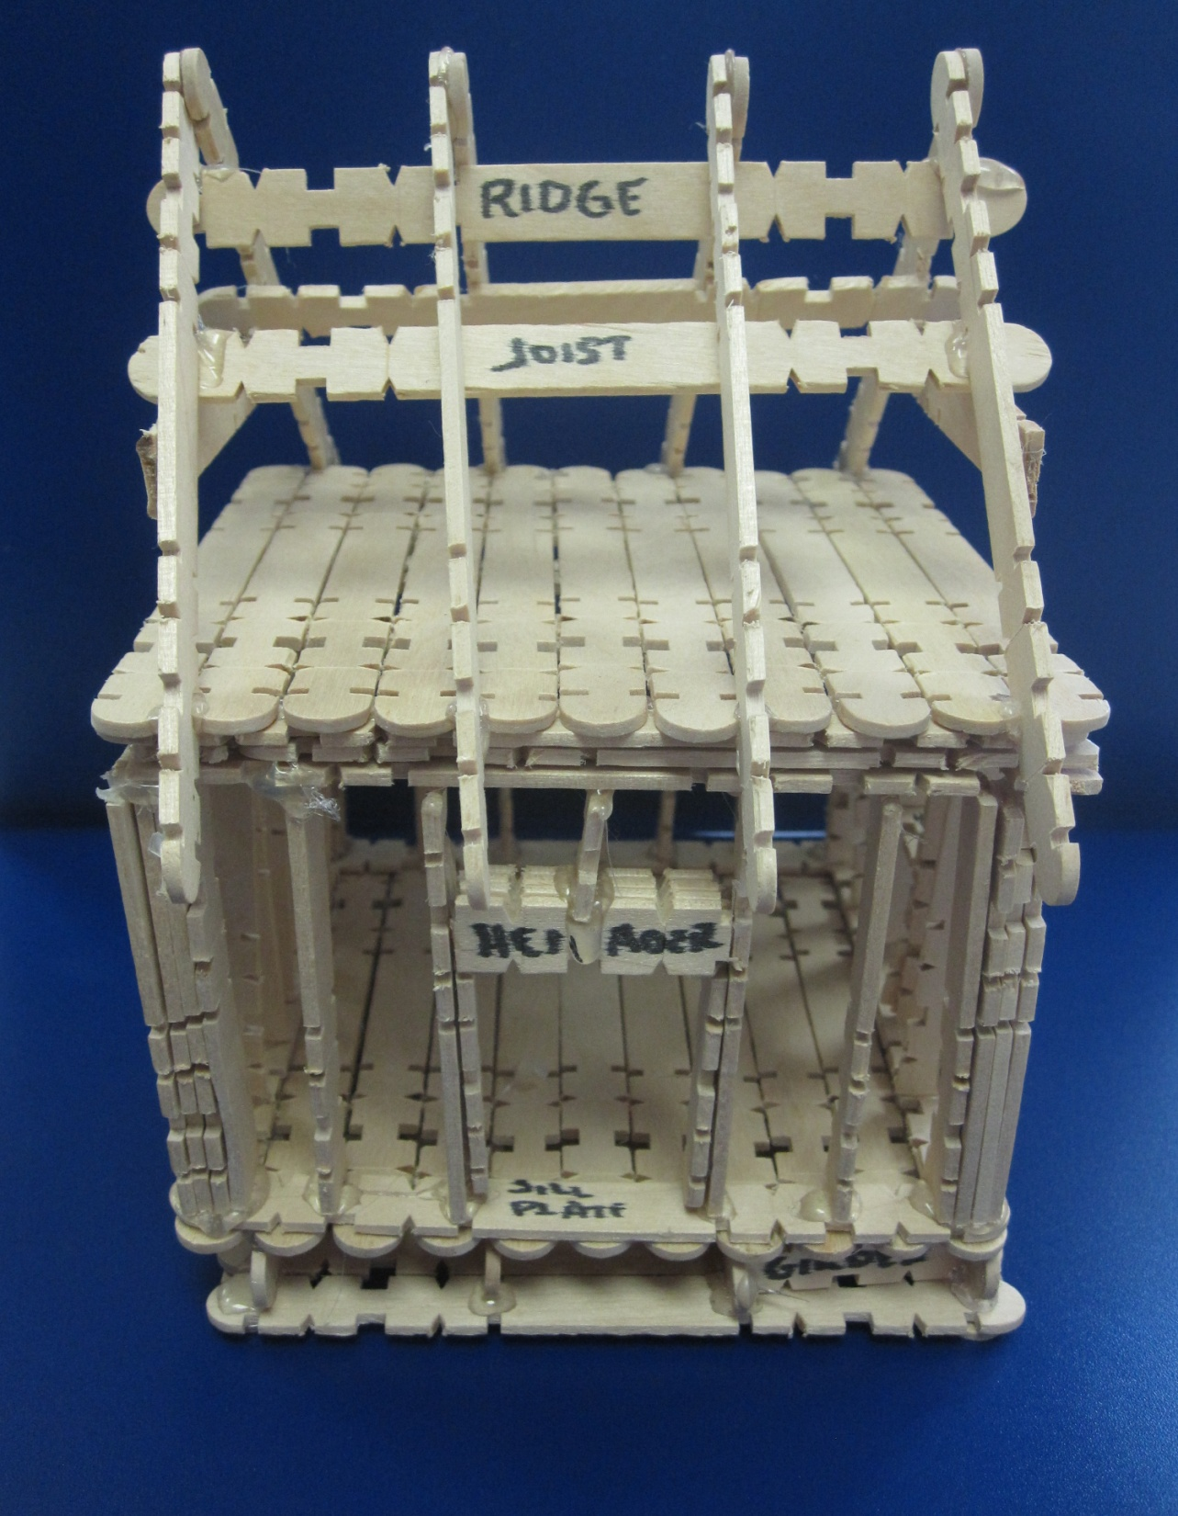

Slide 5
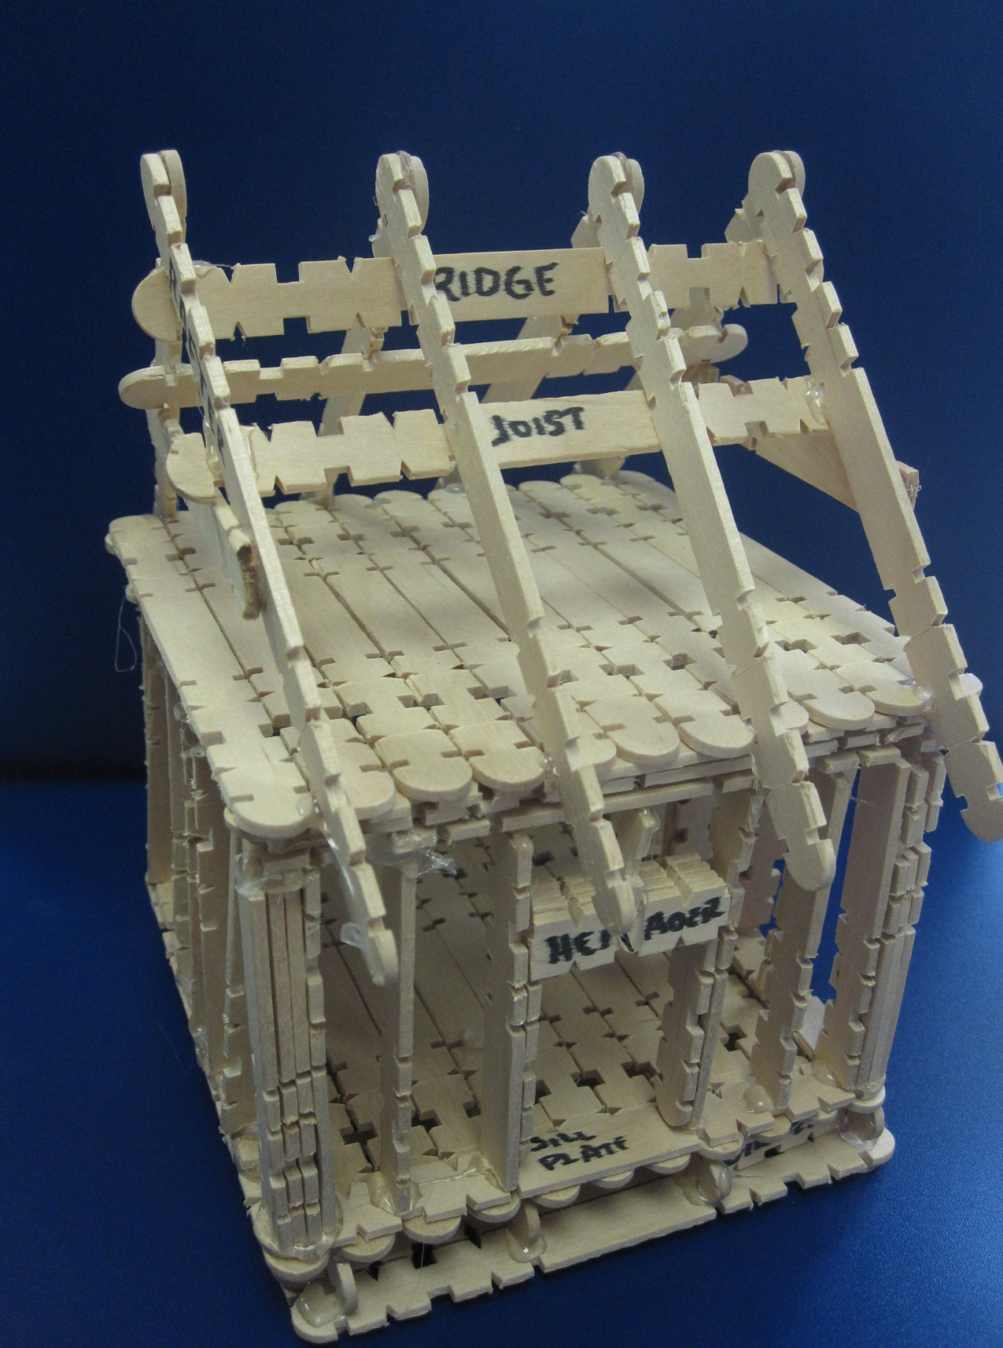

Slide 6
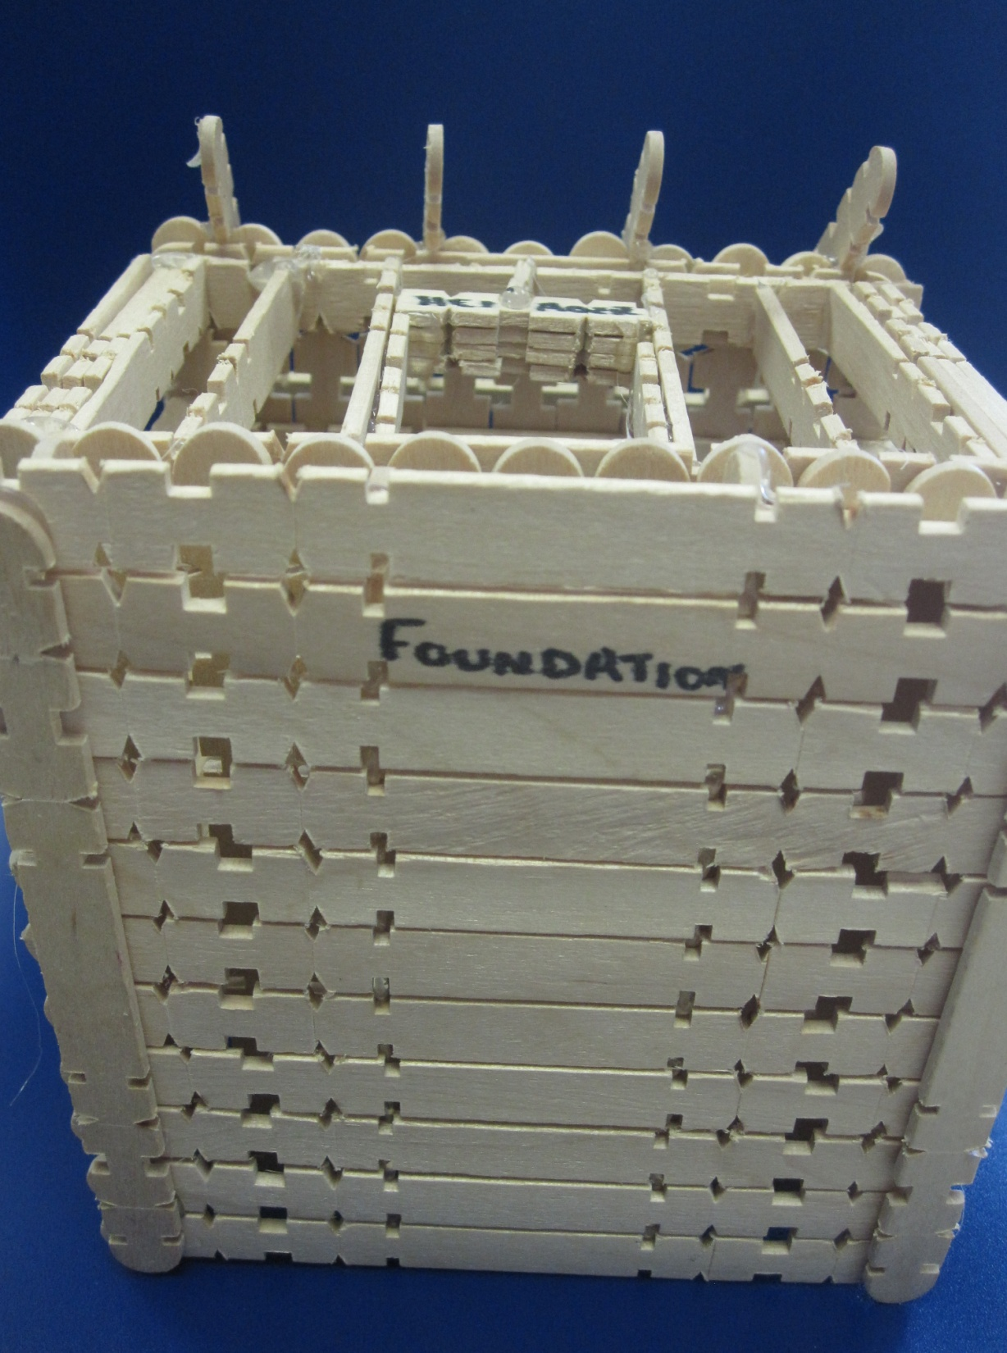
Label the foundation from the bottom.

Slide 7
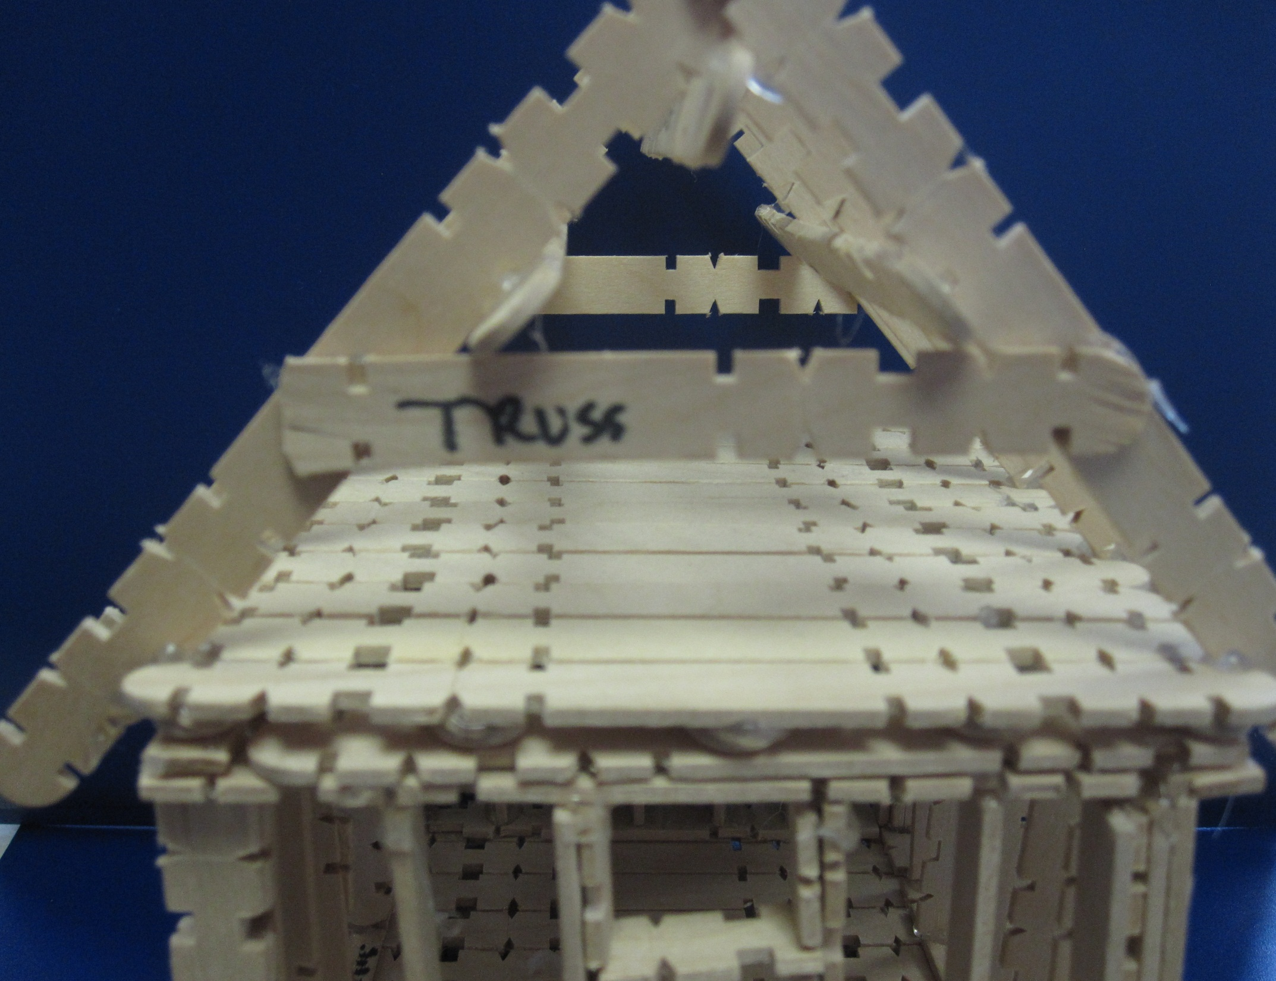

Slide 8
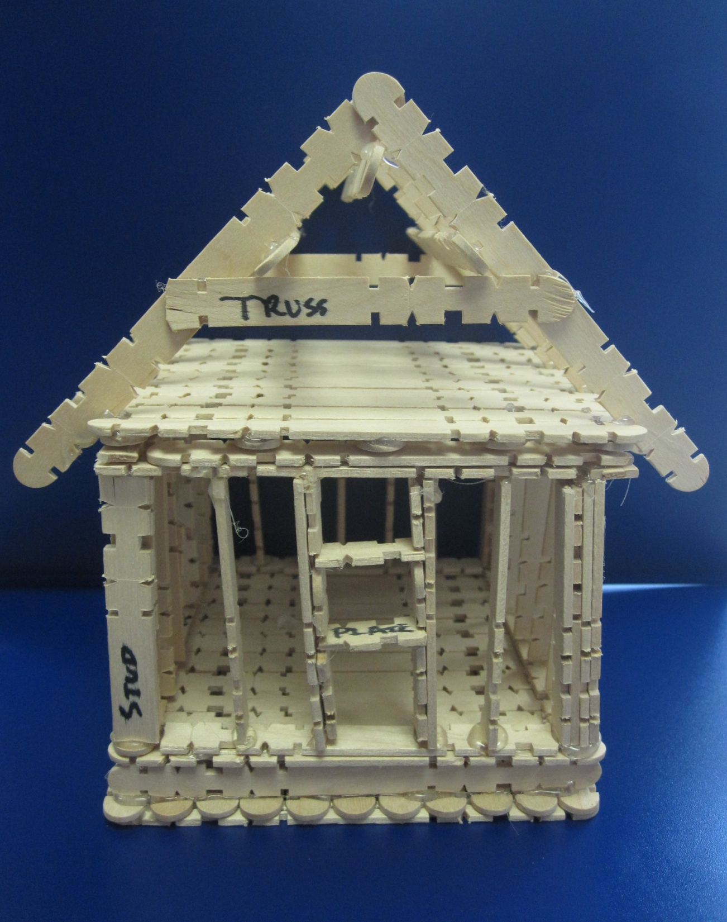
On one of the ends a window is framed and plate is marked. The truss is labeled on one of the ends as well.

Slide 9
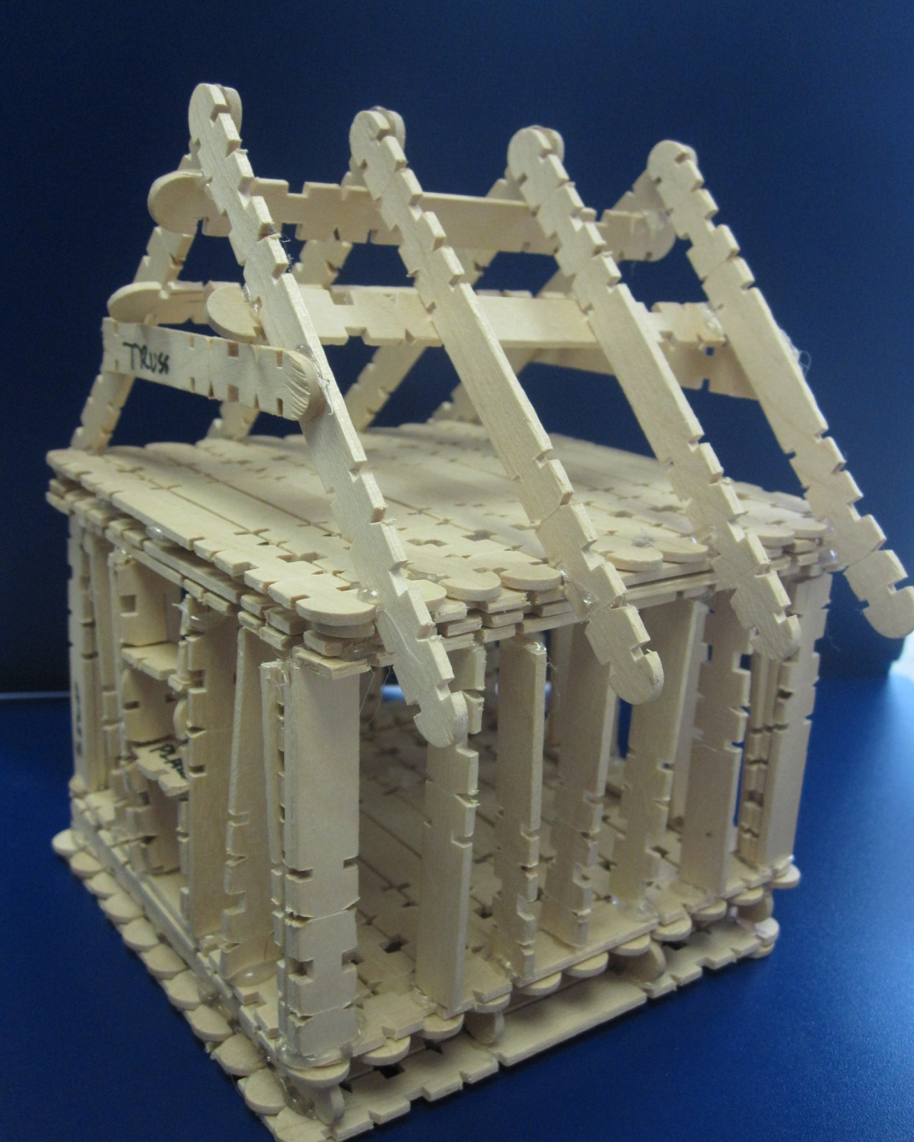
Notice the corners of the walls have three studs for extra support.

Slide 10
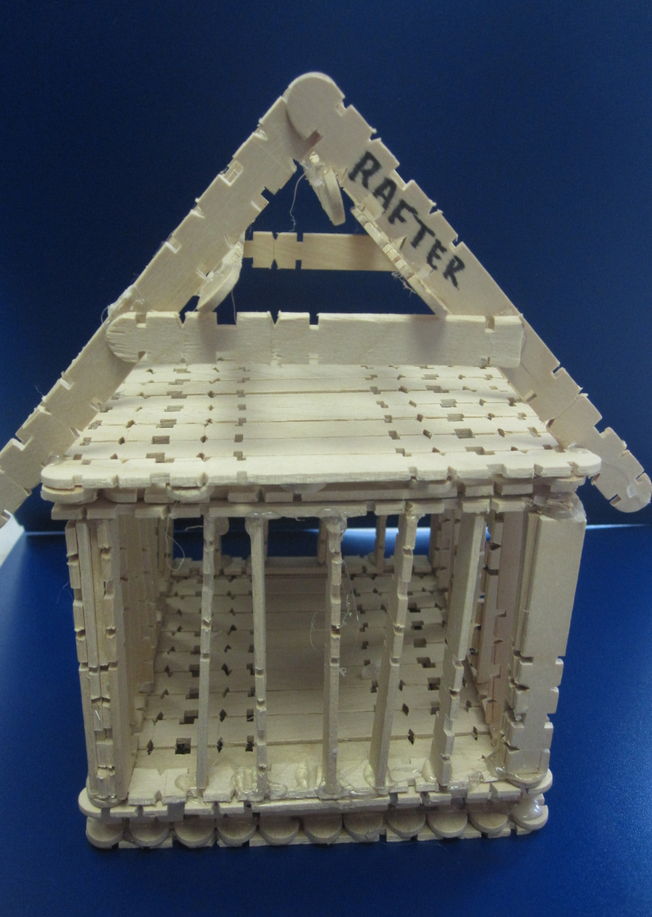
Back view of house.

Slide 11
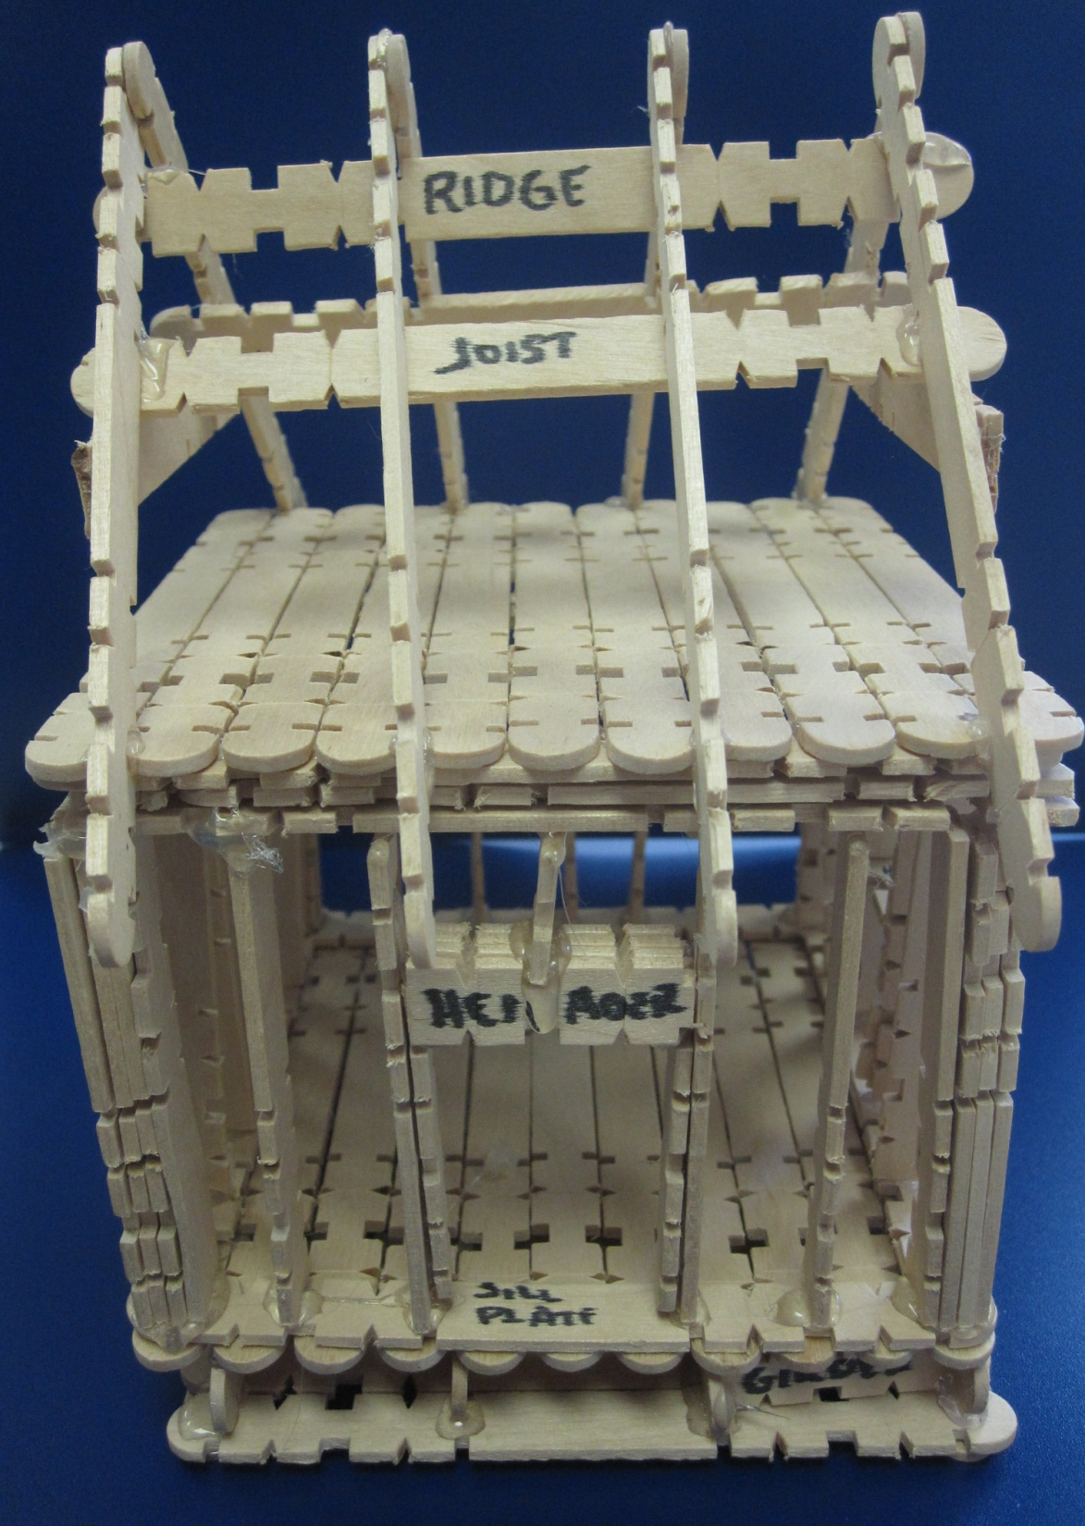
This is a header for the door frame and sill plate on the bottom. The subfloor should have been labeled and is not.
Notice the girder at the very bottom of the foundation.

