Slide 1
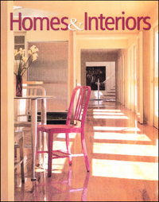
Choosing A Place To Live

Slide 2
The Decision-Making Process
Step 1: State the Situation
Step 2: Identify Your Resources
Step 3: List the Options
Step 4: Weigh the Options
Step 5: Choose the Best Option
Step 6: Carry Out Your Decision
Step 7: Evaluate the Decision

Slide 3
Influences on Housing Decisions
Needs
Wants & Priorities
Resources
Human Resources: personal qualities that people possess including creativity, imagination, knowledge, skills, talent, time, energy and experience.
Material Resources: tangible assets, such as money, property, supplies, and tools.

Slide 4
Choosing A Location
Housing Trends in the United States
Housing tends to be more expensive on the East and West Coasts than in the interior of the country.
Housing costs tend to be higher in areas with the most desirable climates and lower in areas with severe winters.
Housing within and near major cities tends to be more expensive.

Slide 5
Housing Trends cont.
Within major cities, housing costs are generally higher in downtown areas.
Single-family homes in suburbs often cost more than those in cities.
Housing costs in rural areas tend to be the lowest of all.

Slide 6
Types of Locations
Urban-
living in the city, convenience of living close to work, shopping and cultural opportunities
Suburban-
residential area adjacent to a city, offers the best of both city and country living. Offers more space than city living but within driving distance of the amenities of the city.
Rural-
living in the country, offers a slower –paced life, wide open spaces, less industry in area.

Slide 7
Factors to Consider in Choosing A Location
Convenience
Close to public transportation
Close to place of employment
Close to basic services such as retail stores etc.
Close to schools or recreational facilities
Condition of the Neighborhood
The value of the home increases or decreases with the value of other homes in the area.

Slide 8
Factors to Consider in Choosing A Location (cont.)
Neighbors
If have children are there other children in the neighborhood?
Friendly neighbors?
Drawbacks
Check amount of noise and air pollution
Noise on streets
Safety concerns such as child abusers, drug activity etc. in the neighborhood

Slide 9
Assessing Community Services
Services vary from community to community. Check out availability and quality of the services before choosing a place to live.
Utilities & Public Services
Electricity, gas, water, telephone, internet access
Public Safety
Number of staff and distance from the home can affect response time
Location of nearest hospital and ambulance

Slide 10
Assessing Community Services (cont.)
Tax Policies
What is the tax rate?

Slide 11
Housing Alternatives
Multifamily Units-offer lower housing costs than single-family housing
Apartments:
High-rise apartment: one of many separate living units in a multistory building.
Low-rise apartments: an apartment in a building with few floors.
Garden apartment: unit in a low-rise building that includes landscaped grounds
Efficiency apartment: unit with one main room, a small kitchen area, and a bathroom. It is also known as a studio apartment.

Slide 12
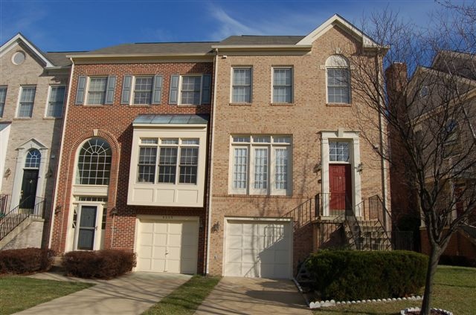
Housing Alternatives (cont.)
Town Houses
Consists of several houses attached together at the side walls.
Each unit has it’s own separate entrance from the street and some private backyard or patio.
Require less maintenance than single-family homes since they have only 2 or 3 exterior sides and tend to have smaller yards.
Older town houses are sometimes called row houses.

Slide 13
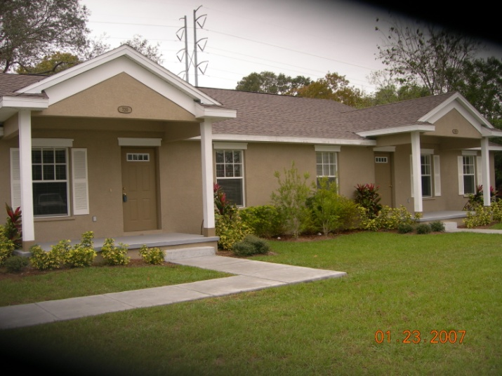
Housing Alternatives (cont.)
Duplexes:
one building that contains two separate living units.
The units may be attached side by side or one unit on the first floor and the second unit on the second floor.
Each unit has its own outside entrance.

Slide 14
Housing Alternatives (cont.)
Other Multifamily Units:
Triplex: 3 housing units that are attached at the side walls
Fourplex: 4 housing units that are attached at the side walls
Single Family Housing:
A detached, or separated dwelling designed to be used by one household.
Most attractive advantage is privacy
Owners are responsible for their own outdoor maintenance and upkeep of the home.

Slide 15
The End

