Slide 1
Types of Roofs
Housing and Interior Design
“Identify Roof Shapes”

Slide 2
Roof Terms
Roof
The upper exterior
surface of the
home.

Slide 3
Roof Terms
b. Fascia
A flat horizontal band around a roof's perimeter.

Slide 4
Roof Terms
c. Boxed eave
An overhang enclosed with a soffit that runs horizontally from the eave edge to the side of the building.

Slide 5
Roof Terms
d. Cornice
The decorative section just below the roofline. The cornice may be simple or ornate depending on building style.

Slide 6
Roof Terms
e. Rake
the pitched edge of a gable roof. Rakes may be close, or extend from the building to allow for an overhang.

Slide 7
Roof Details
Hip
A change in roof direction, where two planes meet at an angle to make a vertical ridge or fold (the opposite of a valley).

Slide 8
Roof Details
Valley
A change in roof direction, where two planes meet at the bottom of their pitch to make a valley with two steep slopes running up and away from it (the opposite of a hip).

Slide 9
Roof Shapes
Roofs are broken into two basic shape families:
Gabeled
and
Hip

Slide 10
Roof Shapes - Gabled
Gabled
Gabled refers to the family of houses classified by the straight slope falling from ridge to eave, creating a peak or triangle on the side or front facade.

Slide 11
Roof Shapes - Gabled
Side-Gabled This style of home locates the front door on the non-gabled façade.

Slide 12
Roof Shapes - Gabled
Front-Gabled Houses have the peak or gable facing the front.

Slide 13
Roof Shapes - Gabled
Cross-Gabled Cross-gabled houses have additional sections or wings crossing perpendicular to the main section, meeting in a valley, each with its own peaked or gabled façade.

Slide 14
Roof Shapes
Hipped
This family of houses avoids having a peak or triangle at the roof junction by breaking the roof plane along the slope line, allowing the roof to bend or wrap around the house. Hipped houses have an even roof to wall junction all the way around the house and eaves on all sides.

Slide 15
Roof Shapes - Hip
Simple
A hipped roof where all four roof faces rise to a ridge across the top, often with broader faces across the front slope and narrower side sections.

Slide 16
Roof Shapes - Hip
Pyramidal
A hipped roof where all four sides come to a point at the roof peak.

Slide 17
Additional Roof Shapes
Gambrel A gabled roof that peaks at the ridgeline then falls away in a broad, low slope, breaks horizontally and changes to a steeper pitch. A gambrel roof has a broad upper story and side façade, and is often associated with barns.

Slide 18
Additional Roof Shapes
Saltbox
A gabled roof with asymmetrical roof faces. This asymmetry produces one facade that is two stories high dropping to a single story or story and one half on the opposite side of the building.

Slide 19
Additional Roof Shapes
Mansard
A hipped roof with two distinct roof pitches, low-sloped from the flat top or ridgeline then breaking to a steep pitch above the wall junction.

Slide 20
Additional Roof Shapes
Shed
A gabled roof with a single roof face falling away from the main building. Shed roofs are often used for porches, additions, and raised-roof sections.

Slide 21
Additional Roof Shapes
Flat
Actually its own roof type, flat roofs have no slope and may terminate with or without eaves.

Slide 22
Additional Roof Features
Dormers
Rise up out of the roof and are often separate from the roof-to-wall junction. Like houses, dormers are classified by their roof shape (shed, hipped, gabled, flat, etc).
Roof dormers
Wall dormers

Slide 23
Additional Roof Features - Pitch
Pitch The degree of slope, steepness, of the roof from ridge to eave or valley.
Low slope A roof angle or pitch that is less than 30 degrees. Normal slope A roof whose angle or pitch is from 30 to 45 degrees. Steep slope A roof whose angle is more than 45 degrees.

Slide 24
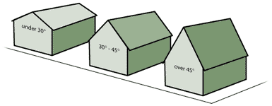
Additional Roof Features - Pitch
Low Normal Steep

Slide 25
Home Styles Since 1700
Chapter 15
Pages 340-364

Slide 26
Understanding Period Housing Styles
Architectural history traditionally is divided into various periods.
Each period is influenced by the historical events of its time and is characterized by distinctive housing styles.
Several design movements can exist at the same time in different areas of the country.

Slide 27
Understanding Period Housing Styles
Many homes, especially recent styles, break the traditional rules, creating new, individual designs

Slide 28
The 18th Century
Three main architectural styles associated with this century are:
Immigrant Style
Georgian Style
Federal Style

Slide 29
Immigrant Style
The English used timber sawed into boards
The Dutch used stone and brick
The Germans used wood and quarry stone
The Swedes used squared logs
The Spanish used cut stone and adobe brick

Slide 30
Georgian Style
Named for the kings of England who ruled during that time
Main characteristics:
-formal, balanced design
-gable roof
-large windows symmetrically placed
-doorway details, door is focal point of house
-distinctive cornice (decorative strip at the area where the roof and walls meet)

Slide 31
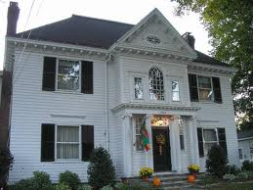
Georgian Style (cont.)
-central chimney or a chimney at each end of the house
-contrasting materials. Red brick is often used with white wood trim.

Slide 32
The Federal Period
After the American Revolution, Americans turned away from the English Georgian style.
Two distinct styles developed:
Adam Style
Early Classical Revival Style

Slide 33
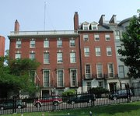
Adam Style Features
A rectangular design with one or more stories
Gable roofs
Symmetrically placed windows with fanlights (a semicircular, round or oval window with fan-shaped panes)
Decorative interiors, plaster & wood carvings, decorative mantels

Slide 34
Early Classical Revival Style
Developed by Thomas Jefferson
Used for many government buildings including many in Washington DC
Similar to Adam style:
-rectangular shape
-Symmetrical windows
-fanlight windows

Slide 35
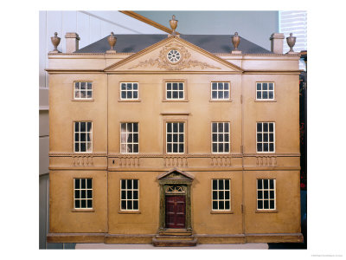
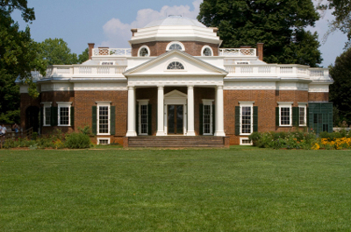
Early Classical Revival Style
Different from Adam style because of the portico, a tall and open porch supported by columns over the front entrance. The portico is topped by a triangular pediment.
Early Classical Revival Style Home
Adam Style Home

Slide 36
19th Century Factors Affecting Housing
Immigrants pouring into the USA which provided cheap labor
Factories mass producing products needed to build and furnish homes which caused the prices of building homes to drop
Factory owners built row houses which they rented to their employees
Tenements- apartment complexes with minimum standards of sanitation, safety, and comfort were built

Slide 37
The Romantic Revival Period

Slide 38
Greek Revival Style- 1825 to 1860
Two-story rectangular house with symmetrically placed windows
Gable roof emphasized by wide trim at the cornice
Pilasters on the corners of frame houses or across the whole front

Slide 39
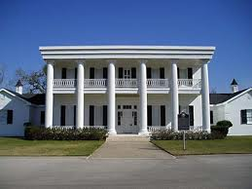
Greek Revival Style- 1825 to 1860
An elaborate entrance
Columns supporting a small or large porch. Greek columns are most common.

Slide 40
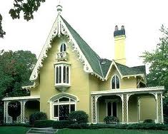
Gothic Revival Style-1840-1880
Built of wood because stone was very expensive and there was a shortage of stonemasons.
High-peaked Gothic gables decorated with gingerbread, lacy-looking, cut-out wood trim.

Slide 41
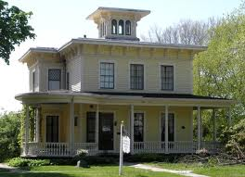
Italianate Style-1840-1885
Features of Italian villas or estates
Square and 2 stories high
Feature wide, overhanging hip roofs with decorative brackets at the cornices

Slide 42
The Victorian Period
1837-1901
Styles are very elaborate
Mansard Style
Queen Anne Style

Slide 43
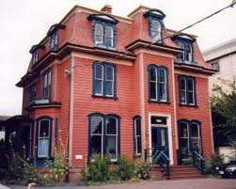
Mansard Style- 1860 to 1880
Mansard Roof has two slopes on all sides, with the lower slope being steep and the upper slope almost flat
Decorated cornices and French windows that open lengthwise at the middle

Slide 44
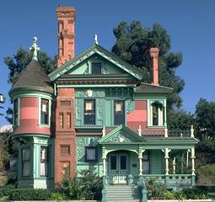
Queen Anne Style-1870 to 1880
Most decorative and ornamental of the Victorian Styles
Irregular steep roof with ornamental gables
Overlapping decorative wood shingles for siding
Wraparound porches with railings and columns

Slide 45
End of Victorian Period
Architects and designers started to build as simply as possible.
The designs stripped away the overwhelming amount of ornamentation and details found in the earlier Victorian period.
This formed a link to the Modern style.

Slide 46
Early 20th Century
Period Revival Styles
Colonial Revival Style
Tudor Style
Chateauesque Style
Mission Style
Modern Styles
Prairie Style
Craftsman Style
International Style

Slide 47
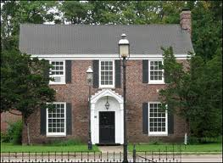
Colonial Revival Style 1880 to 1955
Brought back styles such as the Georgian, saltbox, and Cape Cod
Door is prominent, usually with a decorative pediment supported by pilasters
Windows symmetrical balanced pairs with double hung sashes

Slide 48
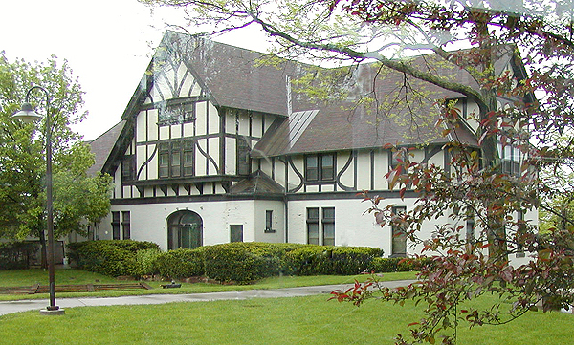
Tudor Style 1890-1940
Half-timbered look is the most dominant characteristic

Slide 49
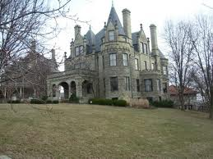
Chateauesque Style
Modeled after French palaces
Feature towers, turrets, ornamental metal cresting, elaborate moldings, relief carvings and arched windows and doorways

Slide 50
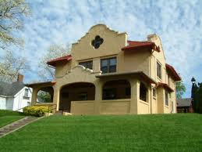
Mission Style 1890-1920
Born in California and spread eastward
Fashioned after the old mission churches in southern California
Tile roofs
Exterior walls made of stucco

Slide 51
Modern Styles
Prairie Style
Craftsman Style
International Style

Slide 52
Prairie Style
Frank Lloyd Wright began designing homes in the Prairie Style at the beginning of the 20th century. Most were built about 1920.
Emphasis on horizontal lines
Low-pitched roofs with overhanging eaves
Wide porches

Slide 53
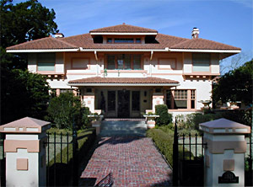
Prairie Style (cont.)
Rows of leaded-glass windows
Interior rooms flow into one another giving a feeling of spaciousness.
Rooms open and designed to connect to the outdoors

Slide 54
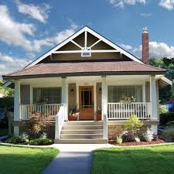
Craftsman Styles
Originated in southern California
Shares many characteristics with the Prairie Style
Low-pitched gable roof (some have hip roofs)
Decorative beams or braces under the eaves
Full or partial width porches with the roof supported by columns or pedestals

Slide 55
International Style
After the end of WWI, European architects began to experiment with new materials and new building methods.
The immigration of Walter Gropius and Ludwig Mies van der Rohe to the US helped introduce the International Style to the United States.
The result was the International Style, also called Modernism or Functionalism.

Slide 56
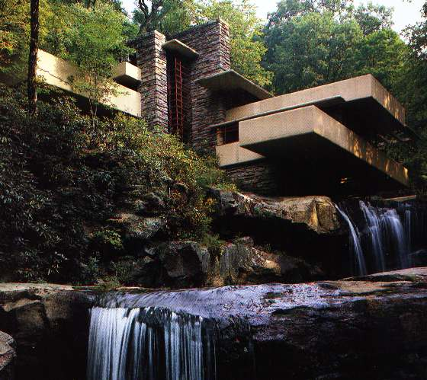
International Style
Emphasizes function or usefulness
Elements that are purely decorative or ornamental are avoided
Combines simple geometric shapes to create asymmetrical design that resembles a piece of sculpture
j
Fallingwater designed by Frank Lloyd Wright in 1935

Slide 57
Mid 20th Century to Today
1950 to Today
Postwar Modern Styles
-Ranch Style
-Contemporary Style
-Split-Level Style
-Shed Style
Unique Designs
-A-Frame
-Geodesic Dome

Slide 58
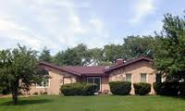
Ranch Style
Long, low, one-story house
Spread out floor plan
Private outdoor living areas are generally in the rear
Gives access to all rooms on the ground level

Slide 59
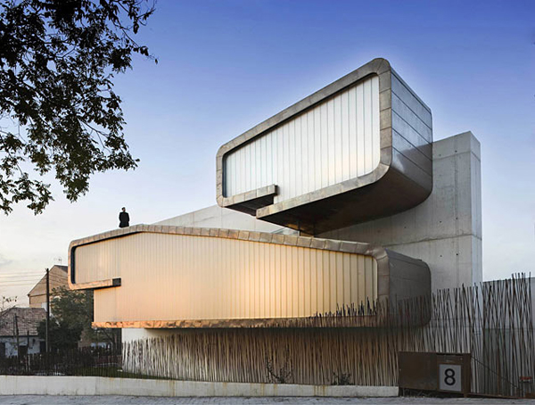
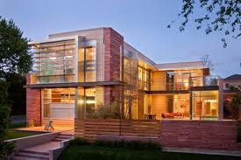
Contemporary Style
Popular in the 1950s, 1960s, and early 1970s
Wide eave overhangs
Flat or low-pitched roofs
Unusual placement & shapes of windows

Slide 60
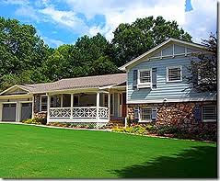
Split-Level Style
Became popular during the 1950s
Has at least two levels of living space, connected by short flights of stairs
Originally designed to take advantage of sloping lots

Slide 61
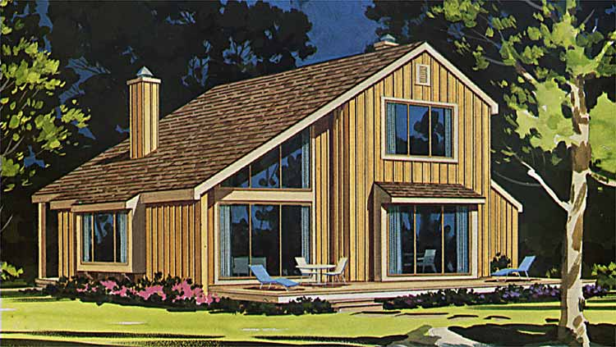
Shed Style
Appeared in the 1960s
Roofline is made up of a combination of steeply pitched shed roofs
Little or no traditional ornamentation
Entrance is not obvious

Slide 62
Unique Designs
Break all the existing rules of accepted housing design
Use modern technology and materials to design new forms and shapes of housing
A-Frame
Geodesic Dome

Slide 63
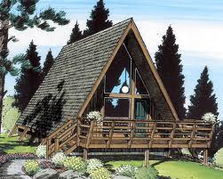
A-Frame
Design which the gabled roof continues to ground level on two sides
Biggest disadvantage is the odd interior space created by its design

Slide 64
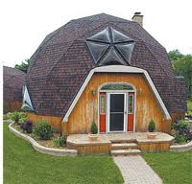
Geodesic Dome
Invented in 1947 by R. Buckminster Fuller
Triangular frames are joined to form a self-supporting roof and walls.
The dome is self-supporting so interior walls are not needed
Provides low-cost, energy-saving housing

Slide 65
The End

