Slide 1
Recognizing Furniture Styles

Slide 2
Changing Styles
Some furniture styles are identified by the historic era in which they were first made.
Such “period pieces” are often named for the king or queen who was in power when the furniture was built

Slide 3
Why Designs Change
Changing expectations for furniture
Materials available
Methods of manufacturing
Changes in lifestyles
Tastes

Slide 4
Changes in Taste
The styles people prefer today are different from the styles people liked during other periods of time.
Tastes change from era to era
These changes are influenced by several factors, including lifestyle, fashion and needs.

Slide 5
Materials and Manufacturing
New manufacturing techniques and materials influence furniture design
Lifestyle Changes
Furniture designs have often reflected the time during which the pieces were made and the lifestyles of the people who used the furniture.
During the 18th century in France & England much furniture was formal and elegant. In the New World early colonists built furniture by hand so it was plainer and more informal.

Slide 6
Understanding Furniture Styles
Overlapping Style Periods
There is no definite beginning or end to any period. Styles develop gradually.
In the 19th century, styles became popular in America later than they did in Europe.
Furniture that incorporates designs from two periods is referred to as transitional.
The dates given in this chapter refer to the period when the styles were most popular in America.

Slide 7
Understanding Furniture Styles (cont.)
Styles go through stages
Most periods begin with simple, basic designs.
As time goes by, designers tend to add more decorative features to the style.
When people grow tired of these designs, a new cycle of designs begins.
Styles may be formal or informal
Formal styles are more ornate and elegant.

Slide 8
Understanding Furniture Styles (cont.)
Informal Styles were made for the common people of the same era.
They were usually made with simple hand tools.
The pieces were plainer, smaller versions of formal styles.

Slide 9
Designs That Last
Well designed furniture tends to survive over the years.
There is a large demand for reproductions, or accurate copies of originals.
Antiques: in the United States a piece of furniture must be 100 years old to be classified as an antique.
Generally, if an antique has been refinished or changed significantly, it is less valuable.

Slide 10
Designs That Last
Adaptations: furniture made today in the style of old designs. For example, furniture in the Victorian style may have many features characteristic of the Victorian era without exactly copying any one piece.

Slide 11
Colonial Period, 1600-1780
Jacobean Style
William & Mary Style, 1700-1725
Queen Anne Style, 1720-1755
Chippendale Style, 1755-1780
The colonists adapted foreign styles to make furniture that was practical for everyday use.
Furniture made in America during colonial times was often simpler than European furniture of the same style and period.

Slide 12
17th Century
Furniture styles were introduced to the colonies in several ways.
Trained furniture makers who immigrated from Europe.
Some designs were copied from European designs.
Furniture of 17th century was often referred to as Jacobean style after James I.

Slide 13
Jacobean Furniture
Heavy and rectangular
Geometric or floral carvings
Rounded forms such as legs and spindles were made by a method called turning-adding shape by using a lathe. The lathe spins wood against a cutting tool, held by the furniture maker, which cuts away various parts of the wood to different depths.

Slide 14
17th century
Stools and benches were more common than chairs during this period.
Chairs had straight backs and hard plank seats.
Furniture was often painted black, red, or yellow.
No closets in homes at this time so chests were very important for storage and as seating.

Slide 15
17th Century
Tables were less common than chests. They were designed to save space.
Draw-top table had leaves that could be pushed beneath the tabletop when the table wasn’t in use.
Chair table was a chair that had a large back that protected the occupant from drafts when upright and that could be tipped forward to form a table.

Slide 16
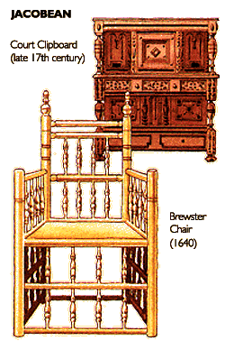
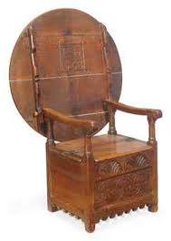
Jacobean
Chair Table

Slide 17
William & Mary Style 1700-1725
Delicate furniture style
Curved back replaced the straight back chair
Seats were often woven from rushes
Marked by lightness not found in Jacobean furniture
Featured fine carvings and trims
Velvets & silks were used to upholster chairs
After the chair, the table was the most common type of furniture
The gateleg table-a table with legs on each side that swing out to support drop leaves that pulled up from the sides was popular
The highboy, a chest of drawers mounted on legs, was developed in this period.

Slide 18
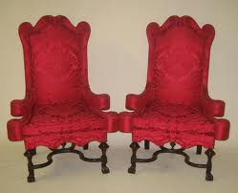
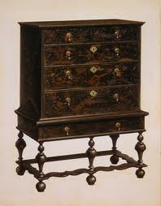
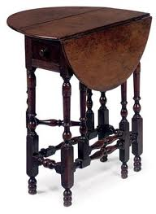
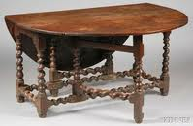
William & Mary Style
Highboy
Gateleg Tables

Slide 19
Queen Anne Style, 1720-1755
Graceful, curved lines
Slender and flowing, featuring curved rather than straight lines.
The cabriole leg, a leg that curves out at the middle and then tapers inward just above an ornamental foot, is characteristic of the Queen Anne style
Innovations in sofa and chair design:
Upholstered furniture became widely available
The furniture was more comfortable

Slide 20
Queen Anne Style, 1720-1755
Wing Chair, an armchair with a high back and high sides (or “wings”) became popular
The “wings” were designed to give protection from drafts in the winter
Windsor chair- a chair with turned legs and a spindle back inserted into a saddle-shaped plank seat, is still popular from this period.

Slide 21
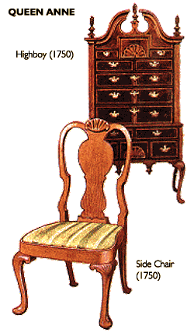
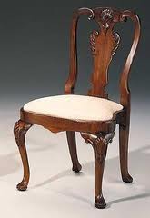
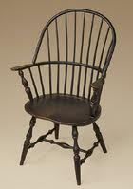
Queen Anne
Windsor Chair

Slide 22
Chippendale Style, 1755-1780
Two developments changed the course of furniture design:
The increasing popularity of mahogany wood
Thomas Chippendale’s book of furniture design, published in 1754, the first such book ever published.

Slide 23
Chippendale Style 1755-1780
S-shaped chair and table legs ending in claw-and-ball feet were common features in his early work
Camelback sofa, distinctive for its curved back and sides
Decoration often included shells, leaves, and flowers carved into wood.
Compared to Queen Anne furniture, Chippendale furniture appears heavier and more solid.

Slide 24
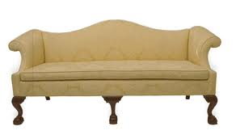
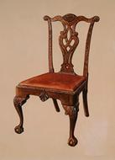
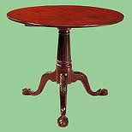
Chippendale

Slide 25
Postcolonial Period, 1780-1840
After the Revolutionary War there were changes in furniture styles.
Designs were influenced by the delicate balanced lines of classical styles of ancient Greece and Rome
Often referred to as Neoclassicism
Two styles predominated in America during this time:
Federal
Empire

Slide 26
Federal Style, 1780-1820
The earlier of the two classical styles
Designs were small and rectangular
Furniture was light, delicate and symmetrical
Robert Adam was the first to design this style, his furniture was more decorative
Two English designers simplified Adam’s designs.
George Hepplewhite
Thomas Sheraton

Slide 27
George Hepplewhite (Federal Style)
Chairs had tapered legs and decorative backs in the shape of a shield, an oval, or a heart.
Thomas Sheraton (Federal Style)
Chairs legs were slender and tapered, sometimes decorated with reeding. Reeding is decorative carving of vertical lines that resemble thin reeds. The chairs had rectangular or square backs

Slide 28
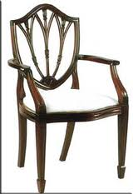
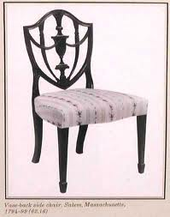
Heppelwhite- Federal Style

Slide 29
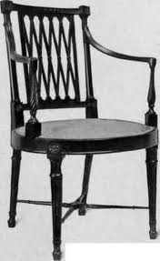
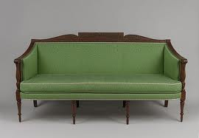
Sheraton- Federal Style
Reed Leg

Slide 30
Empire Style, 1820-1840
Named after the rule of the French emperor Napoleon I.
The style was created by Napoleon’s official court architects and interior designers.
Elaborate and dramatic
Duncan Phyfe, the most famous Empire designer in America.

Slide 31
Duncan Phyfe
Used classical designs as leaves, swans, eagles, and dolphins, urn-shaped pedestals and lion’s-paw feet
Pedestal tables with curved legs and brass feet
Chairs with a back shaped like a lyre-a musical instrument resembling a small harp.
Incorporated the factory method into his workshop
Furniture makers began to standardize their designs and to keep some finished furniture on hand.
Furniture making moved from being a craft to an industry. In some cases mass production caused the quality of furniture to decline.

Slide 32
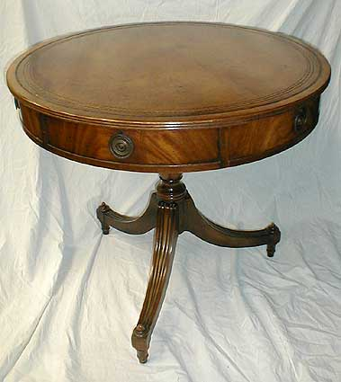
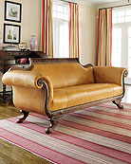
Duncan Phyfe

Slide 33
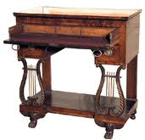
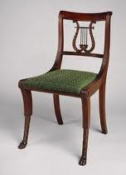
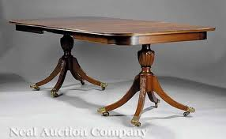
Duncan Phyfe

Slide 34
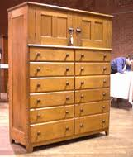
Shaker Furniture
Plain and simple style of furniture that existed along with the Federal and Empire furniture.
Created by the Shakers, a religious group
Emphasized utility not ornamentation
Not very popular in the 1800s but today is very popular

Slide 35
Victorian Period, 1840-1900
Advances in technology encouraged more elaborate details and fancy upholstered fabrics.
Curving lines, inlaid floral patterns, and rich upholstery
Tables, desks and chairs were very ornate and heavy-looking
Black Walnut was used in tables and cabinets later in the period
Marble, iron, and brass were also used

Slide 36
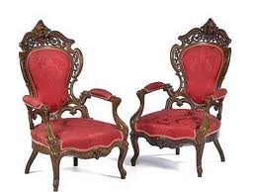
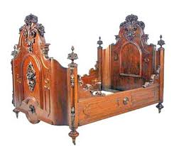
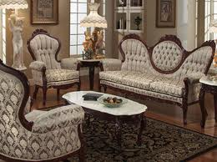
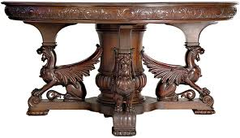
Victorian Style

Slide 37
Modern Period, 1901-Present
International Style
Contemporary Designs
Abstract, doesn’t always resemble recognizable forms
Uses very little decoration

Slide 38
International Style
Architect Walter Gropius founded the Bauhaus (BOW-hows) school of design in 1919.
Followers believed that furniture should not include details that didn’t contribute to its function
Early designers abandoned the use of wood and other natural materials.
They used chrome-plated steel tubing and other manufactured materials
Modern Scandinavian designers returned to the use of wood.

Slide 39
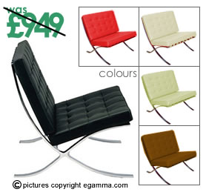
Bauhaus Style
TExt

Slide 40
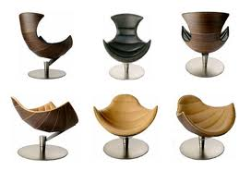
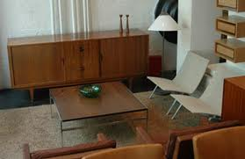
Scandinavian Style

Slide 41
Contemporary Designs
Aren’t confined to one nation or continent
Usually utilize architectural materials such as marble, wood, glass, stone and plastics
Furniture shapes are designed for the human body
Freedom of design, along with an emphasis on convenience, has made modular furniture popular. Modular furniture consists of standardized pieces that can fit together in a variety of ways. Sofas may convert into individual seats or beds.

Slide 42
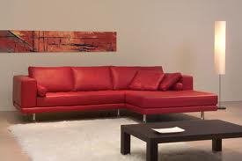
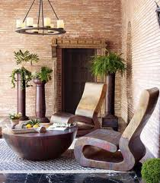
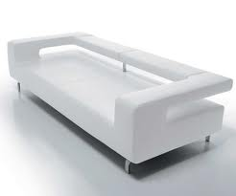
Contemporary

Slide 43
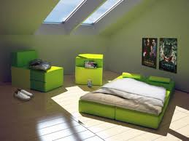
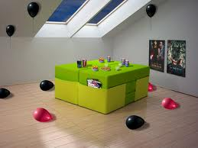
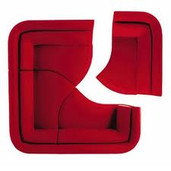
Modular Furniture

Slide 44
Contemporary Designs
Furniture may now be influenced by the work of engineers and chemists
Contemporary furniture is usually created with new materials such as plastic, glass, and metal, the use of traditional materials as wood and fabric is not ruled out.
Some people distress wood, a process which makes new wood look like old wood. The wood surface is scraped and then rubbed with a piece of smooth metal.

Slide 45
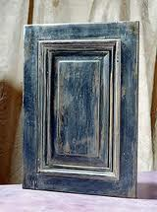
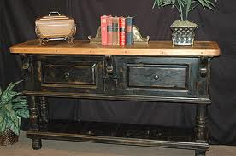
Distressed Wood

Slide 46
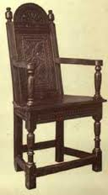
Working with Furniture Styles
Knowing the characteristics of pieces from a period will help you identify other furniture items that would complement the room.
A dark, heavy Jacobean style cabinet would not work well with a contemporary table with lighter wood and with little ornamentation.
Would you like them in the same room?

Slide 47
The End

