Slide 1
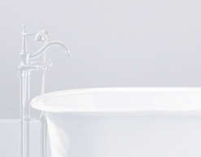
li
Kitchens, Laundry Areas & Baths

Slide 2
li
Planning Kitchens
Which meals will usually be prepared in the kitchen? Will they be elaborate or simple meals?
For how many people will food usually be prepared?
Will there be more than one cook at a time?
Should the kitchen accommodate people with physical limitations?
How many appliances are to be stored in the kitchen?

Slide 3
li
Planning Kitchens
How many appliances are to be stored in the kitchen?
Will the kitchen be used for eating as well as food preparation?
What other activities will be carried out in this space-such as doing laundry, accessing the internet, or doing homework?
How much food-centered entertaining does the household do?

Slide 4
li
Designing an Efficient Layout
What makes one kitchen easier to work in than another?
Not size but efficiency
No matter how small or large a kitchen, an efficient layout will make it more convenient and pleasant to use.
The first step is to plan the work centers.

Slide 5
li
Work Centers
An area of a kitchen especially equipped for a particular chore.
A well-planned kitchen includes three basic work centers:
Food Storage Center
Cooking Center
Cleanup Center
(some kitchens also have mixing and planning centers)

Slide 6
li
Food Storage Center
The refrigerator is the focus of fresh food storage.
Some people find it convenient to store spices, sauces, mixes, and such staples as rice near the range.
Canned food can be stored in cabinets or a pantry.

Slide 7
li
Cooking Center
The focus of the cooking center is the range or a separate cooktop and oven.
If a microwave oven is used for meal preparation, it should also be located in this area.
Other appliances in the cooking center are small cooking appliances, pots, pans, and utensils used for cooking: pot holders and serving bowls.

Slide 8
li
Cleanup Center
Includes the sink and the dishwasher.
Some people prefer to store dishes, glassware, and silverware near the cleanup center.
The cleanup center also needs storage space for dishwashing detergents, scouring powder, dishcloths, and towels.

Slide 9
li
Mixing Center
Where much food preparation takes place.
Best located between the refrigerator and the sink or between the sink and the range.
Mixing bowls, knives, cutting boards, and utensils used for stirring and measuring should be within easy reach.
Electric mixer and blender might be located nearby.
Foods used most often in cooking and baking such as flour, sugar and spices, should also be within easy reach.

Slide 10
li
Planning Center
A convenient place to plan meals and store cookbooks.
Some also use a planning center for coordinating family messages and schedules, and paying bills.
Planning centers range from a small table and chair to an office area that includes a computer.

Slide 11
li
Other Centers
Many kitchens have a serving and eating center.
People who bake frequently may add a baking center with a marble surface for kneading dough and making pastry, and extra-wide storage spaces for appliances and bakeware.
Socializing or casual seating area is very popular in today’s kitchens.
Other areas include laundry, sewing and maintaining indoor plants.

Slide 12
li
The Work Triangle
The triangle formed by drawing imaginary lines to connect the sink, range or cooktop, and refrigerator.
It should be the basis for kitchen design.
The triangle should not be so small that the kitchen is cramped or so large that the work centers are too far apart.
Ideally, the total length of the sides of the triangle should be between 12 ft. and 22 ft.
Functions best when the 3 sides are nearly equal with the sink located between the refrigerator and the range.
Traffic passing through the kitchen should not cross the work triangle.

Slide 13
li
Common Kitchen Layouts
One-Wall
Corridor
L-Shaped
U-Shaped
These basic layouts can be varied by adding an island (a freestanding storage and countertop unit) or a peninsula (countertop that extends out into the room with one end attached to a wall or cabinet).

Slide 14
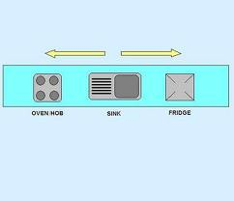
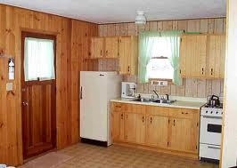
li
One-Wall Kitchen
The range, sink, refrigerator, and cabinets are arranged along the wall
Advantage: saves space, a practical choice in apartments or other small homes
Disadvantages: Very limited space and counter space
If stretched out to allow more storage and counter space, work centers may be too far apart.

Slide 15
li
Corridor Kitchen
Appliances and cabinets are arranged along two walls, with an aisle between them. Both ends of the kitchen may be open, or one end may be a wall.
Advantage: Usually has a compact, efficient work triangle
Disadvantages: Work triangle may be too cramped to allow more than one person to work in the kitchen at a time.
If both ends are open, people walking through the kitchen can interrupt meal preparation.

Slide 16
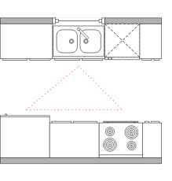
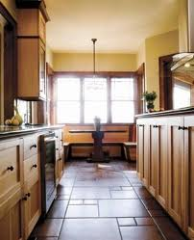
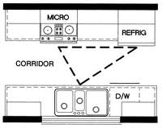
li
Corridor Kitchen

Slide 17
li
L-Shaped Kitchen
Appliances and cabinets are arranged along two adjoining walls. This arrangement permits an open area that may be used for dining
Advantages: The work triangle is not interrupted by traffic
More than one person can work conveniently in the kitchen
More continuous counter and cabinet space is possible than with one-wall and corridor layouts
Disadvantage: Corner storage might not be fully accessible.

Slide 18
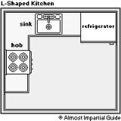
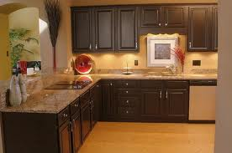
li
L-Shaped Kitchen

Slide 19
li
U-Shaped Kitchen
Appliances and cabinets are arranged along three adjoining walls. Some U-shaped kitchens also have an island in the middle of the U.
Advantages: Usually has more continuous counter and cabinet space than any of the other layouts.
A major appliance may be placed along each wall so that the sides of the work triangle are equal
Disadvantage: Corner storage may not be fully accessible.

Slide 20
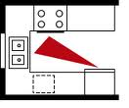
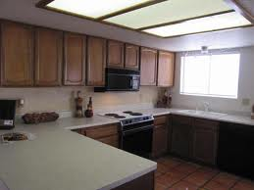
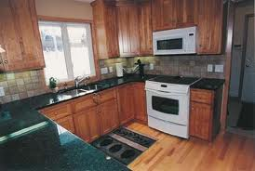
li
U-Shaped Kitchen

Slide 21
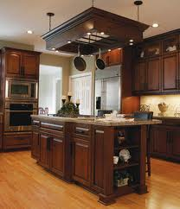
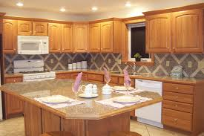
li
Adding an Island
Any of the basic designs may be altered by adding an island.
Advantage: Offers many options for making a kitchen more functional
Disadvantage: can be a traffic obstacle if not well planned.

Slide 22
li
Using a Peninsula
A countertop that extends out into the room.
Advantages: Can serve as an open divider between the kitchen and a dining area or family room
Can be used to add a 4th countertop to a U-shaped kitchen
Disadvantage: some people may not like the openness of the peninsula

Slide 23
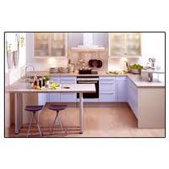
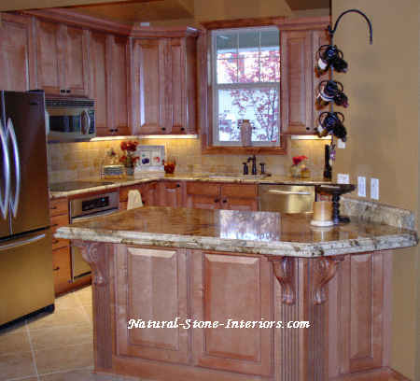
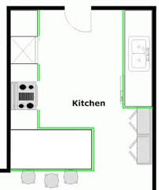
Peninsula Kitchen

Slide 24
li
Making a Kitchen Floor Plan
Draw a floor plan to scale
Use templates to determine the best locations for cabinets and appliances
Be sure to double-check the floor plan before work begins and appliances are ordered
Once the plumbing, equipment, and cabinets have been installed moving them is usually complicated and expensive

Slide 25
li
Choosing Cabinets and Fixtures
Cabinets-base cabinets are usually 24 inches deep, wall cabinets are usually 12 inches deep.
Light-toned cabinets give a feeling of spaciousness. Dark-toned cabinets create a feeling of warmth and coziness.
The most durable cabinets have solid hardwood doors, drawer fronts, and frames.

Slide 26
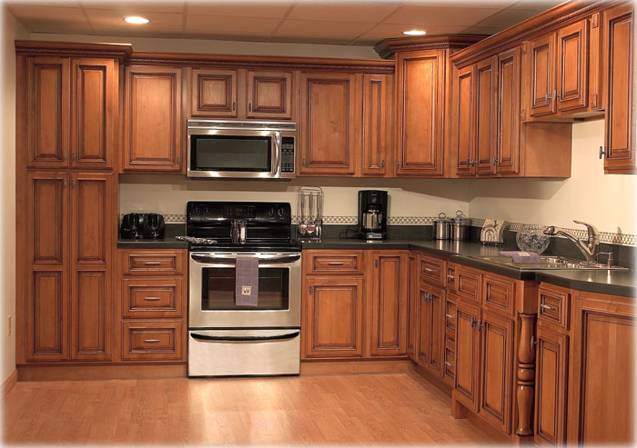
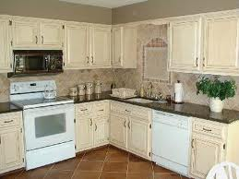
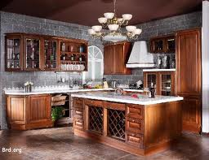
li
Cabinets

Slide 27
li
Countertops
Should be attractive and durable. The ideal countertop material would withstand chopping, grinding, cutting, hot dishes, and stains.
Unfortunately there’s no one material with all these features.

Slide 28
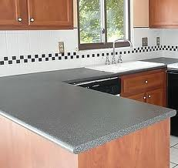
li
Plastic Laminate
Advantages:
Economical
Easy to maintain
Disadvantages
Scratches easily
Scorches easily
Difficult to repair

Slide 29
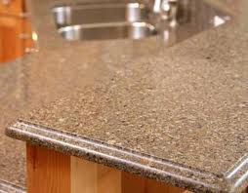
li
Solid Surface Countertops
Advantages:
-Can be worked into different shapes and integrate sinks
-Easy to clean
-Range of colors and stone-like finishes
-Durable
-Resists germs and mildew
Disadvantages:
-Can scorch
-Expensive

Slide 30
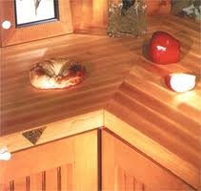
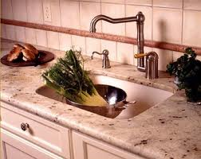
li
Wood, Butcher Block Countertops
Advantage: Good for chopping and slicing
Disadvantages: Spots easily
Scorches
Germs can breed
Marble Countertops
Advantage: Good for making pastry or candy
Disadvantages:
Stains easily
Expensive

Slide 31
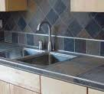
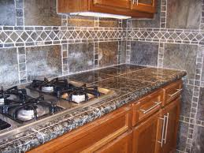
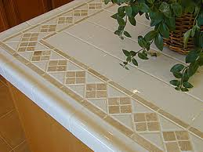
li
Ceramic Tile
Advantages: Durable
Easy to maintain
Resists scratching
Resists scorching
Disadvantages:Grout must be sealed
Surface can be uneven
Objects dropped on it often shatter

Slide 32
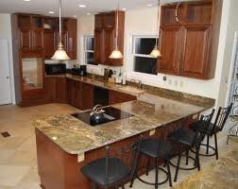
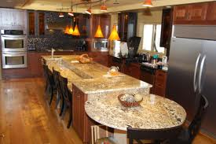
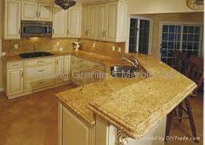
li
Granite
Advantages: Durable
Resists Stains

Slide 33
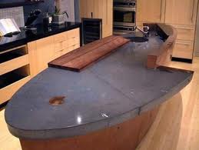
li
Concrete Countertops
Advantages: Resists scratching
-Resists scorching
-Can be worked into different shapes and integrate sinks
Disadvantages: Stains easily
-Prone to crumbling and cracking

Slide 34
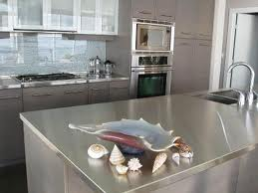
li
Stainless Steel Countertops
Advantages: Resists stains
Resists scorching
Easy to clean
Can include an integrated sink
Disadvantages: Shows scratches
Shows fingerprints
Can dent
Expensive

Slide 35
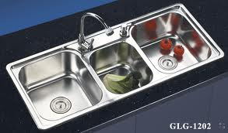
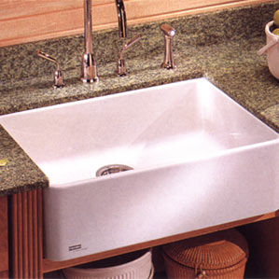
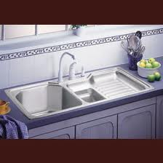
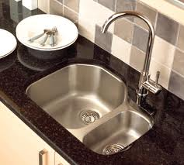
li
Kitchen Sinks
Sinks and faucets are available in styles, materials, and colors to suit every kitchen design. Sinks may be round, square, oval, or have double, single or triple bowls.

Slide 36
li
Other Kitchen Design Considerations:
Electrical Circuits and Outlets
-Electric ranges, cooktops and ovens require a separate 240-volt circuit.
Ample outlets
Spacing between outlets should be approximately 5 to 6 ft. and never more than 10 ft.
Any outlet near a water source should be equipped with a ground-fault circuit interrupter (GFCI).

Slide 37
li
Lighting
Various areas in the kitchen have different lighting needs
Ventilation
Steam, odors, and condensation in a kitchen makes it necessary to have adequate ventilation in a kitchen.
Recirculating range hood does not exhaust air to the outdoors, but filters it and returns it to the room
Downdraft system uses a vent in or near the cooktop itself

Slide 38
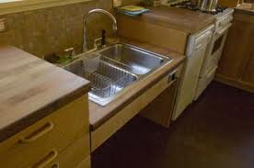
li
Universal Design & Kitchens
Features:
Extra-wide doorways and traffic areas
Room for a wheelchair to turn around 180 degrees
Enough clear floor space at cabinets, etc for wheelchair access

Slide 39
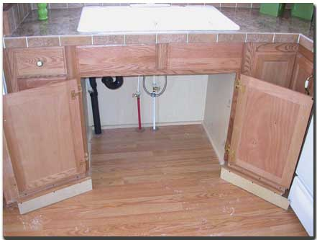
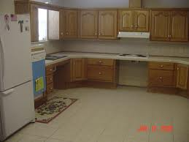
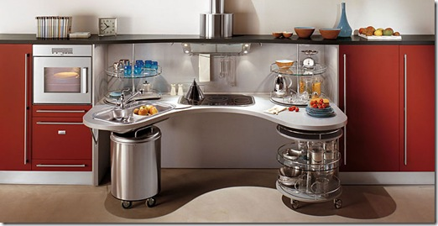
li
Universal Design

Slide 40
li
Universal Design
Counters with rounded edges
Color-contrasting borders at the edges of counters
Lower and higher counters for people of varying heights
A counter on a crank-operated unit that can be raised or lowered to a convenient work height
Counter areas without base cabinets
Extra toe space under cabinets for wheelchairs

Slide 41
li
Universal Design Countertops & Cabinets
Large, easy-to-grip, D-shaped cabinet pulls
Lighting to illuminate cabinet interiors
Turntable storage aids
Pull-out shelves in base cabinets
Pull-down shelves in wall cabinets
Safe storage for household chemicals and sharp objects out of children’s reach.

Slide 42
li
Universal Design (cont.)
Fixtures
Sink in a motorized unit that can be raised or lowered at the touch of a button
Single lever faucets with scald protection
Pull-out step under the sink for children to use
Appliances:
Side-by-side refrigerator
Cooktop, wall oven & microwave lowered to a height convenient for all users
Range or cooktop with controls positioned on the side or front
Dishwasher installed next to a chair-accessible space

Slide 43
li
Factors When Choosing Major Appliances
First step is research the product
What features in the appliance are most important to you? (size, style etc.)
Performance-check performance ratings
Energy Use
Safety- for electrical appliances check for the Underwriters Laboratoires (UL)
For gas appliances look for the seal of the American Gas Association
Warranty and Repairs
Appearance-colors that blend well with walls and cabinets

Slide 44
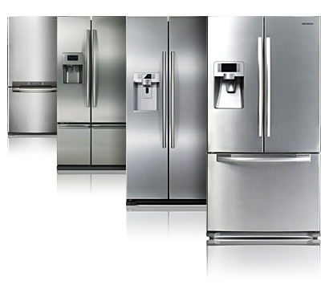
li
Refrigerators and Freezers
The recommended size depends on the number of people in the household.
For two people 16 cu. Ft is
recommended. Add 1.5 cu. Ft. for each additional people.
There are many special features available.

Slide 45
li
Ranges, Cooktops & Ovens
Ranges combine surface cooking units and one or more ovens in one appliance.
An alternative to the range is to use two separate, built-in components.
A built-in cooktop is installed in a countertop.
A built-in oven is typically installed in a wall.
One advantage of separate units is that both the cooktop and the oven can be installed at any convenient height.

Slide 46
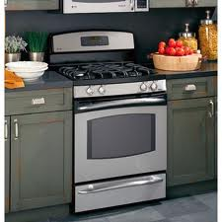
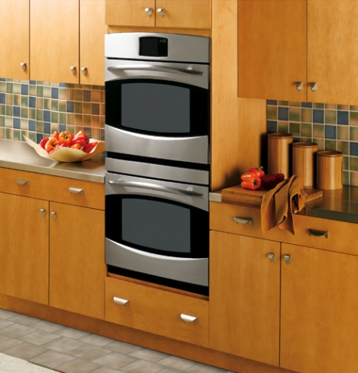
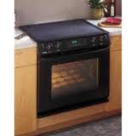
li
Gas or Electric
Gas- for surface cooking, many people prefer gas burners because the temperature can be adjusted instantly and precisely.
A gas appliance costs less than half as much to operate as an electric one.
Electric- often preferred for oven cooking because it keeps the temperature more even and is a safer heat source for children and older adults.

Slide 47
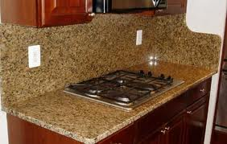
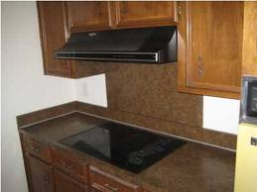
li
Types of Surface Cooking Units
Gas Burners or electric coils
Sealed gas burners are easier to clean than standard burners but are less energy efficient
Smooth cooktops are made of glass ceramic
Halogen and induction elements are more energy efficient than conventional electric coils.

Slide 48
li
Types of Ovens
Conventional-uses gas or electricity to heat the air in the oven compartment. Some gas ranges also have a separate broiler compartment.
Convection- similar to a conventional electric oven but uses fans to circulate heated air over the food. Heat is more evenly distributed and food cooks more quickly.
Microwave-the higher the wattage, the faster the food will cook, not as effective at browning food

Slide 49
li
Types of Ovens
Halogen-powerful halogen lights cook in about one-fourth the time of a conventional oven. Generally higher priced than conventional ovens.
Rapid Cook- uses a combination of convection or conventional heat and microwave energy to cook food much faster than a conventional oven. More expensive than conventional or convection ovens.
Combination- ovens are available that can be used for more than one type of cooking, such as conventional/convection or halogen/microwave.

Slide 50
li
Dishwashers
Available in both built-in and portable models with a variety of cycles.
Portable dishwashers are ideal for renters and people who move frequently.
Dishwashers conserve energy. They use less hot water than washing dishes by hand.

Slide 51
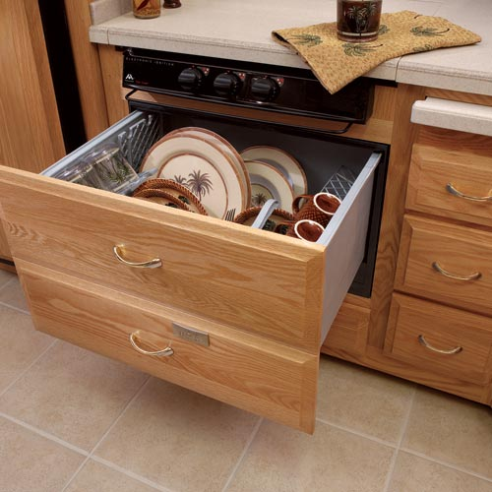
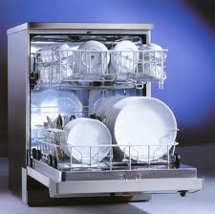
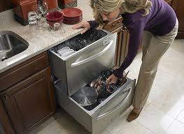
li
Dishwashers
Newer models use as little as 4 gal of water.
Drawer-type dishwashers are installed like drawers in a cabinet. The drawers can be washed independently for small loads or together for large loads

Slide 52
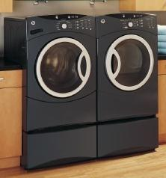
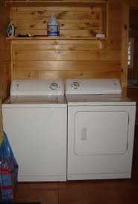
li
Washing Machines
Have energy saving features such as separate controls for wash and rinse temperatures.
Another energy saving feature are machines that automatically detect the size of the load and adjust the amount of water needed.

Slide 53
li
Space-Saving Laundry Appliances
Washer-dryer combinations-in these the same machine washes and dries the clothes
Stacked washer and dryer
Portable washer and dryer- filled and drained at the sink.

Slide 54
li
Washing Machine Innovations
Water Saving- Front-loading machines use up to 40 percent less water than top-loading models.
Silver Nanotechnology- involves the electrolysis of silver solids into silver ions. These ions fill the wash and rinse water, penetrating fibers at the molecular level. Silver ions remove dirt and kill bacteria using cold water. As a result, only a small amount of electrical energy is needed.

Slide 55
li
Washing Machine Innovations
Agitator-Free Design- causes less stress to clothing, while handling bigger loads
“Smart” machines- have the ability to automatically adjust the water level to the size of the load.
Ultrasonic Cleaning- cleans without water. Uses ultrasonic sound waves to sterilize equipment in medical and research labs. Not used for cleaning clothes yet but might be in the future.

Slide 56
li
Planning Laundry Areas
A laundry center can be located in almost any part of the home that provides these basic requirements:
Hot and cold water supply and drains.
A 240-volt electrical outlet for an electric dryer or a gas line for a gas dryer.
Proper ventilation for the dryer’s exhaust system
Often located on the main floor near a side, back, or garage entrance.
Sometimes located in the kitchen area

Slide 57
li
Planning Laundry Areas
In or near a bathroom or sleeping area, one drawback to a sleeping area location is that laundry equipment is noisy.
Basement laundry room keeps soiled clothing and linen as well as the noise of the washer and dryer away from living areas. Basement area is less convenient.

Slide 58
li
Planning for Efficiency
Include as many of the following features as possible:
A washable floor covering
Proper lighting that does not create shadows
Storage space for detergent and other laundry supplies
Baskets, bins, or carts for sorting and carrying laundry
A sink near the washing machine for hand laundering or presoaking stains
A clothesline or rod for line drying

Slide 59
li
Planning for Efficiency
Horizontal racks for drying items flat.
A rod or hooks for hanging items as they are removed from the dryer.
A countertop or other flat surface for folding laundry.
Space to set up an ironing board near an electrical outlet.

Slide 60
li
Universal Design & Laundry Areas
Some compact washers are only 32 in. high with the controls mounted on the front.
A dryer door that swings to the side, rather than down, provides easier access for wheelchair users.
Placing the dryer on a platform reduces the need to bend or stoop while loading and unloading.
Easy to read controls
Braille control panels
Lower work table
Single-lever controls for faucets

Slide 61
li
Planning Bathrooms
Planning the size and location
Full bath- has a minimum of a sink, toilet, and a bathtub.
Three-quarter bath- refers to a bathroom with a sink, a toilet, and shower, but no tub.
Half-bath- contains only a sink and a toilet
Master-bath- a full bath that is part of the master bedroom area.

Slide 62
li
Planning the Location of a Bathroom
Locate a bathroom close to existing drainage pipes reduces costs.
Might also be positioned to provide a sound barrier between quieter and noisier parts of the home.
When making a bathroom plan design and measure the layout carefully. Once features have been installed, they’re expensive and difficult to move.

Slide 63
li
Selecting Fixtures & Cabinets
Bathtubs- may be rectangular, square, round, or oval. Usually enclosed by walls on three sides. There are also free-standing, built into a platform, or sunken into the floor.
Showers-
Tub Shower
Walk-in Stall shower
Toilets- building codes in some states require new toilets to be ultra low flush which use no more than 1.6 gallons per flush compared to older toilets which use 5 gallons per flush

Slide 64
li
Bathroom Sinks
Wall-hung- has open space beneath which helps make a small bathroom seem roomier.
Pedestal sink- supported by a freestanding base.
Inset sink- set into a countertop
Above-counter basin- looks like a decorative wash bowl set on the counter.

Slide 65
li
Other Considerations for Bathrooms
Electrical Outlets- be sure there are enough outlets in the room. Any outlet near a water source should be equipped with a GFCI.
Lighting- should be wall or ceiling mounted and operated with wall switches for safety.
Ventilation- without proper ventilation, wallpaper will start to peel and mildew will grow.
Floor and Wall Coverings- choose a floor covering that will not be slippery when wet and can be cleaned easily.

Slide 66
li
Universal Design & Bathrooms
Wide doorway and extra floor space
Grab bars placed near toilets and tubs
Elevated toilet seat added to a standard toilet
Shower with a seat
Shower doors that retract & pivot
No-sill, doorless shower stall and rolling shower chair.
Hand-held shower head
Single-lever shower controls
Barrier-free sink
Tiltable mirror at the sink
Faucet with a retractable spray handle
Low counter for access by seated users

Slide 67
li
Easy Updates
Can be less expensive by using one or more of these approaches
Hire a professional to repaint appliances or put a new porcelain coating on fixtures
Paint the walls or new wallpaper
Paint or refinish the cabinets
Replacing hardware (cabinet knobs, handles, towel bars, & faucets)
Change the color scheme
Choose a coordinated set of accessories that harmonize with the room’s style.

Slide 68
li
The End

