Slide 1
Completing & Presenting a Design

Slide 2
Design Process
6. Plan Use of Space
7. Choose a Style & Color Scheme
8. Select Backgrounds, Furniture, Lighting & Accessories
9. Present the Design
10. Implement the Design

Slide 3
6. Plan Use of Space
Arranging Space
Review the purposes the room serves
Consider the features of the room
Furniture needs to be arranged so it doesn’t block doors, windows, heating and cooling vents, or electrical outlets
Outline the path people would use to walk through the room. As you try out various furniture arrangements, consider their impact on the room’s traffic patterns.

Slide 4
Arranging Space (cont.)
The height of furniture should also be considered.
When furniture is drawn to scale on a floor plan it may appear that you have a great deal of clearance space. However, a floor plan represents only 2 dimensions of an object-length and width.
The 3rd dimension, height, can reduce the apparent openness of a space.

Slide 5
Arranging Space (cont.)
As you plan your furniture arrangement, keep these factors in mind:
Don’t overcrowd a room. Leave some open space for a feeling of airiness.
Attempt to balance the room. Using the same size & quantity of furnishings on opposite walls can help create a feeling of balance.

Slide 6
Furniture Arrangement (cont.)
Create a focal point by highlighting an interesting feature
Consider the views from one part of the home to another, as well as to the outdoors.
Use your imagination. Sometimes an unusual arrangement will solve a problem or create an interesting effect.

Slide 7
Plan Use of Space, Room by Room
Living Rooms & Family Rooms:
In homes that have both, a living room is often more formal.
Arrange the seating so that people can converse without having to raise their voices.
Provide a convenient surface for reading materials or refreshments near the seating (end table, coffee table etc.)
The living or family room might include electronic entertaining equipment.

Slide 8
Dining Areas
The dining table usually takes up so much space that you may be limited in the ways you can arrange other furniture, such as a china cabinet.
Be sure to allow space for chairs and movement around the table.

Slide 9
Bedrooms
Bed placement usually depends on the other furnishings that must fit in the room. Try to leave space on both sides of the bed.
Most people want a nightstand next to their bed.
Might want a sitting area or work area in the bedroom.
A child’s bedroom is often a multipurpose room (play, sleep, study etc.)

Slide 10
Hobby Areas
A guest bedroom may double as a den, a sewing room, computer room, exercise room, or workshop for crafts and hobbies

Slide 11
Drawing Plans
In the past, design work always involved drawing by hand.
Today designers use CAD (computer aided design) software to create design plans.
Interior elevations show one wall as seen from the center of the room. It gives a side view of the room.

Slide 12
Drawing Plans
With an elevation, you can see the relative heights of furniture, walls, windows, doorways, and other architectural features.
A floor plan shows the arrangement of the room as if seen from above.

Slide 13
Computer-Aided Design (CAD)
Designers can prepare drawings and make changes to them faster than can be done by hand.
Designers can duplicate standard appliances and pieces of furniture, conventional plumbing and electrical fixtures, and windows, doors, and closets with ease.
CAD programs create views that seem as realistic as a photograph. Color schemes can also be changed with the click of the mouse button.

Slide 14
Step 7: Choose a Style & Color Scheme
Style:
Style probably has the greatest impact on the room’s overall effect.
It might reflect a specific period of time, a region, or a designer.
It might also evoke a feeling such as formal, informal, stark or cozy.
The home itself might have a distinctive style. Don’t feel limited to that style, but don’t stray too far from the look, either.

Slide 15
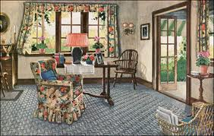
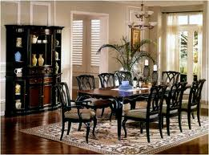
Colonial Style
Rooms are generally small
Have low ceilings, and a large fireplace as the focal point.
Quilts are often used as accessories.

Slide 16
Queen Anne Style
Relatively formal
Rooms are large with high ceilings and classical architectural details.
Walls are covered with wood paneling or wallpaper.
Simple window treatments use luxurious fabrics.
Uses mahogany and walnut woods, along with silk fabrics and silver accessories.

Slide 17
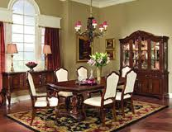
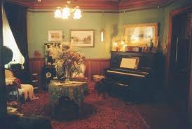
Queen Anne Style Rooms

Slide 18
Victorian Style Room
Flamboyant and elaborate
Generally have carved wooden panels
Stenciled architectural designs
Elaborate window treatments
Fringes, tassels, and dark, rich colors are used on furniture and accessories.

Slide 19
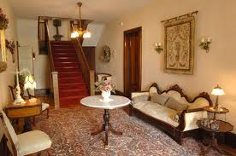
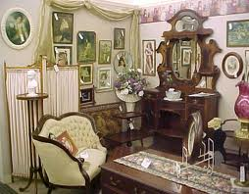
Victorian Style Rooms

Slide 20
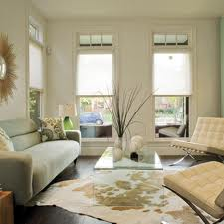
Modern Style Room
Simple and unify technology with art
Focus is on the horizontal line and monochromatic color schemes
Window treatments are minimal

Slide 21
Color Schemes
Decide what colors support the style you chose and how to distribute them throughout the room.
Do you want the room to feel warm or cool, calm or vibrant, spacious or cozy?
Consider a compatible color scheme for the entire home. Each room should have a color scheme that complements colors in other rooms, especially rooms next to each other.

Slide 22
Step 8: Select Backgrounds, Furniture, Lighting & Accessories
Backgrounds:
Decide which materials, colors, patterns, and textures to use. Most people enjoy this process the most.
The goal is to make sure the choices harmonize with the overall style of the room.
Furniture, Lighting & Accessories
One of the most challenging parts of the design process.
Completing the Budget
Now replace estimated costs with actual prices

Slide 23
Step 9: Present the Design
Designers use more than words to express their ideas.
Visual aids are useful in the design process
Floor Plans or elevations
Pictorial drawings
Renderings
Samples
Computer Presentations
Models or other visual aids

Slide 24
Types of Drawings
Perspectives
A pictorial drawing: shows the viewer several surfaces in the room simultaneously. More like a picture than a diagram
Usually a one-point perspective or two-point perspective.

Slide 25
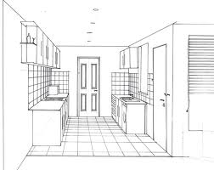
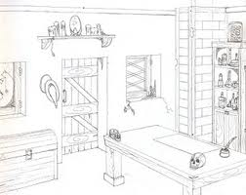
Perspectives (see pg. 481)
One-point perspective: shows what is seen when the viewer looks directly at the opposite wall
Two-point perspective: illustrates what you see when looking at the corner where the two walls meet.
Two-Point
One-Point

Slide 26
Renderings & Overlays
Renderings: a drawing in which the designer adds realistic details such as textures, shadows, shadings, and color. The designer may use pen and ink, watercolor or CAD software to make the rendering.
Overlays: sheet of transparent material placed over the basic drawing. Overlays can be used to show alternative color schemes, furniture arrangements and other design ideas.

Slide 27
Types of Visual Presentations
Sample Boards
Computer Presentations
Models

Slide 28
Sample Boards
Piece of illustration board with mounted samples of proposed wall coverings, floor coverings, fabrics, and window treatments.
Also includes the floor plan
Pictures of furniture
Pictures of accessories

Slide 29
Computer Presentations
Many designers prefer to present their designs right on the computer screen
A series of images can be prepared, each showing the design from a slightly different angle.
This technique creates the illusion of walking through a room

Slide 30
Models
A three-dimensional model
Gives an overall sense of a design because it lets you observe all the elements in the room from any angle.
In the past, a model had to be physically built
Now can use computer models

Slide 31
A Professional Presentation
The presentation can save time and money by making it easy to make changes and help ensure the client’s satisfaction.
Three parts to the presentation:
Introduction
Discussion of the design
Summary

Slide 32
The Presentation
Introduction: Identifies the main features of the design and emphasizes how the design satisfies the client’s needs.
Discussion of the Design: presents the designer’s detailed analysis of the design solutions. Focus on the current problems associated with the space and identify how the proposal will help solve the issues.

Slide 33
The Presentation
Summary: reviews the key features of the proposed design
After presenting the design, the designer will present the budget and outline a rough schedule for completing the work.
Before beginning to implement the design, the designer will draw up a written contract that outlines cost, the items to be purchased, fees, and the responsibilities of the designer and the client.

Slide 34
Step 10: Implement the Design
The final step in the design process is implementation it involves:
Developing a projected timeline
Ordering purchases
Scheduling installations
Communicating throughout all 10 steps of the design process will help to ensure the client’s satisfaction with the finished design.

Slide 35
The End

