Slide 1
Cultural Influences in Teaching and Learning
Steven R. Aragon, Ph.D.
Equity/Diversity Specialist
Professional Development

Slide 2
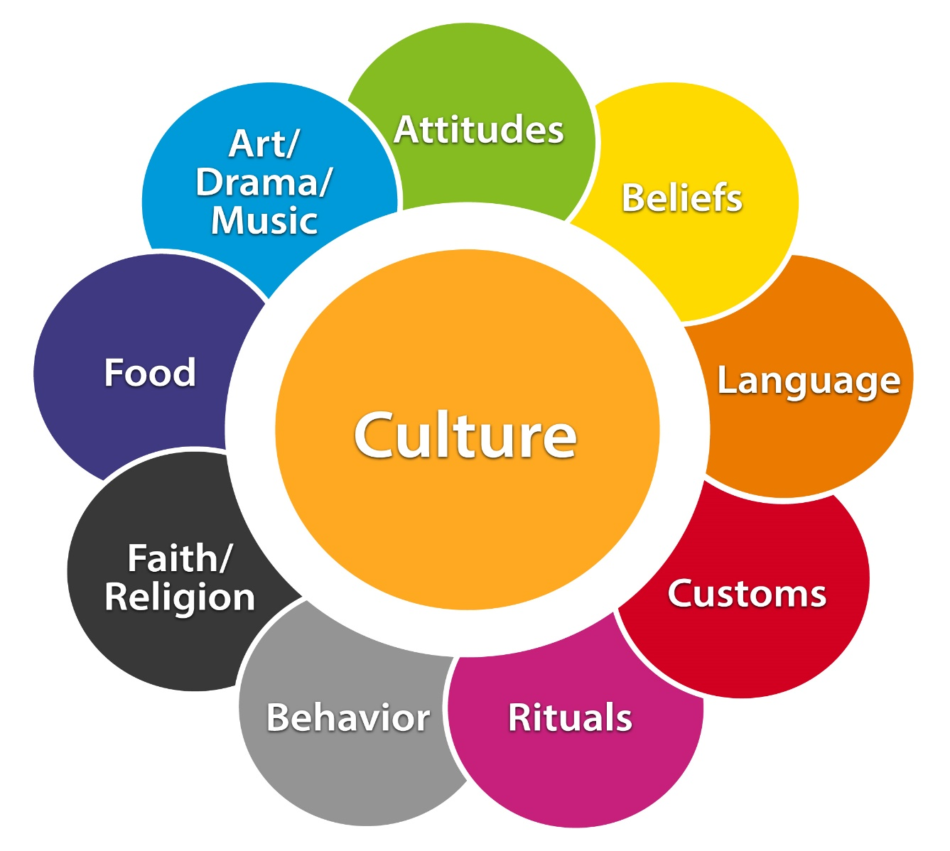
Culture Definition
“The sum total ways of living; including values, beliefs, esthetic standards, linguistic expressions, patterns of thinking, behavioral norms, and styles of communication which a group of people has developed to assure its survival in a particular physical and human environment.” (Pusch, 1979, p. 3)

Slide 3
Culture: Behavior “Software” that Programs Us All
All of us are programmed by cultural “software” that determines our behavior and attitudes.
Because we get our cultural teachings from a variety of sources, none of us has exactly the same program.

Slide 4
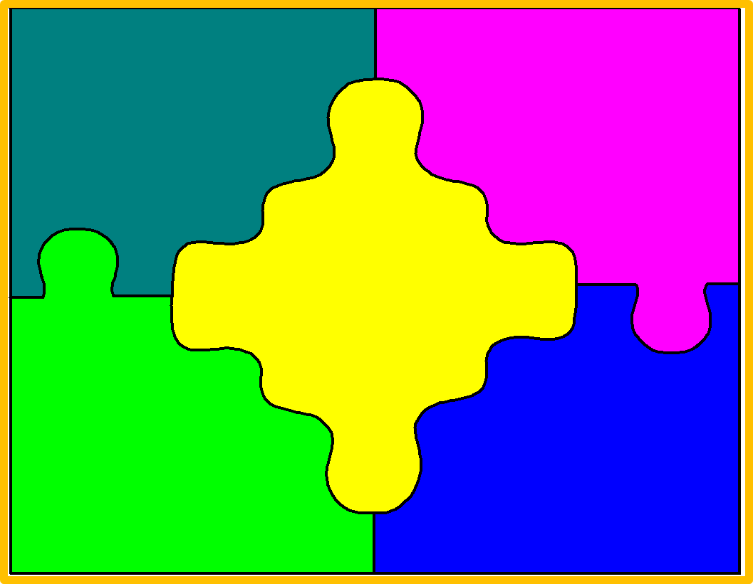
Culture at Work
Learned system of differences
Not genetically transmitted like the more physiological characteristics of race and ethnicity
Transmitted to its members through a complex matrix of socialization practices

Slide 5
Cultural Programming: Where Does it Come From?
Ethnicity & Race
Parents
Religion
Education/Teachers/Schools
Profession/Field of Work
Organizations (i.e. CTSOs)
Friends
Neighborhoods/Zip Codes
Communities
Media/Social Media
Other Family Members
Travel
???
???
Notes:
Ethnicity: refers to a category of people who identify with each other, which may or may not include a shared language, shared customs, share religious expression, or a shared nationality (especially outside that nation’s borders)
Race: often used to describe one of several very broad categories people are divided into that are biologically arbitrary yet considered to be generally based on ancestral origin and shared physical characteristics , such as bone structure and skin, hair, or eye color.

Slide 6
“Unconscious Bias”
Prejudices we ALL have but unaware of
Influenced by past experiences
“Mental shortcuts based on social norms and stereotypes” (Guynn, 2015)
Rooted in our brain
  Same region associated with fear and threat
  Temporal lobe stores general information about people and objectives and is the storage place for social stereotypes
  Frontal cortex is associated with forming impressions of others, empathy, and reasoning

Slide 7

Cultural Lens Activity

Slide 8
Unconscious Biases in CTE
CTE is “less than” academic/college track curriculums
Men are not nurturing and thus cannot be good nurses and teachers.
Women do not have the mechanical or mathematical aptitude for skilled trade work.
Nontraditional jobs are too dirty, noisy, demanding, and dangerous for women.
Careers requiring creativity, writing, and the arts are not for men.
Men and women who are in nontraditional studies and careers are gay.

Slide 9

Learning About Culture
Someone breaks one of the taken for granted rules
Someone shows us discrepancies between our attitudes and beliefs to theirs
Someone studies our culture and gives us their point of view on our culture
Blatant, obvious

Slide 10

Cultural Style & Classroom Learning
Perception differs between cultures resulting in different points of reference among different cultures
Different points of reference lead to different judgments
Different points of reference influence language, values, believes, and behaviors

Slide 11
Cultural Style & Classroom Learning
Cultural and cognitive conflict often occurs when a group is asked to perform in a manner and setting which is foreign to their style and/or does not capitalize on it
Educators are not always equipped to identify, interpret, and respond to the variant styles of multicultural and diverse student populations

Slide 12

So what can we do?

Slide 13
Culturally Responsive Teaching
Appreciate & Respect differences
Engage the motivation of all learners
Create a safe, inclusive, and respectful learning environment
Derive teaching practices from principles crossing disciplines and cultures
Relate content and instructional strategies to the cultural backgrounds of your students
Promote justice and equity in society

Slide 14
Motivational Framework for Culturally Responsive Teaching
Establish inclusion
  What do we need to do to make all students feel respected by and connected to one another?
Develop attitude
  How can we use relevance and choice to create a favorable attitude towards learning and the topic?

Slide 15
Motivational Framework for Culturally Responsive Teaching
Enhance meaning
  What are active ways to increase the complexity of what we are learning so that it matters to us and contribute to a pluralistic democracy?
Engendering competence
  How can we create an understanding we are becoming effective in learning we value?

Slide 16
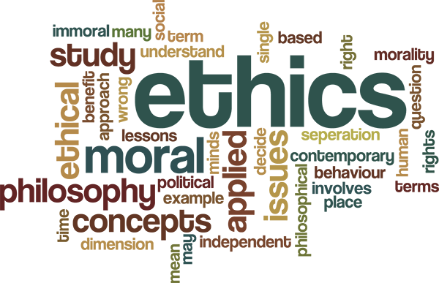
Ethnics & Integrity

Slide 17
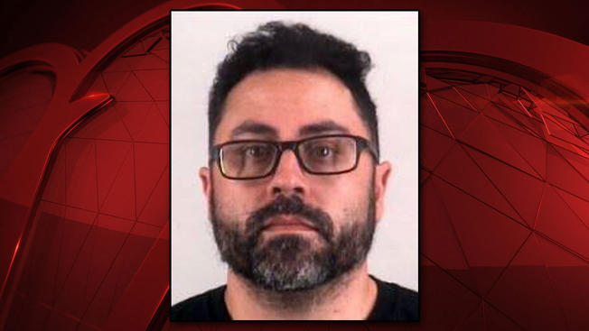


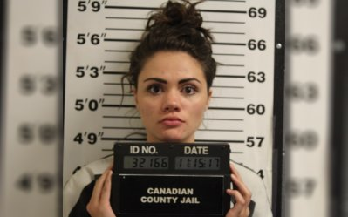

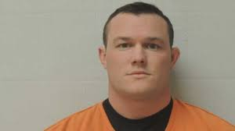
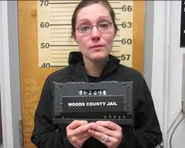


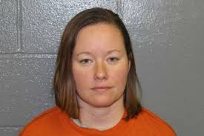
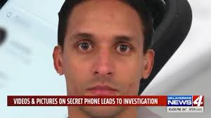
What do these individuals have in common?

Slide 18
Some of the NEVERS with Students
Sexting
Dating
Having sex with
Suggestions of a quid pro quo
Sexual comments
Calling/Skype/FaceTime
Meeting behind closed doors
Giving rides
Loaning money
Leaning over a student
Invading personal space
BEING A BYSTANDER
Texting
Emailing
Patting on back and/or shoulder
Hugging
Comments about body/clothes

Slide 19
Learning Process for Diversity Competency
Development
Phase 1
Development
Phase 2
Development
Phase 3
AWARENESS
UNDERSTANDING
ACTION
Consequences of Action Brings New Awareness

Slide 20
Thank You!
Contact Info:
Dr. Steven Aragon
steven.aragon@careertech.ok.gov
405.743.5180

