Slide 1
Follow Up Reports

Slide 2
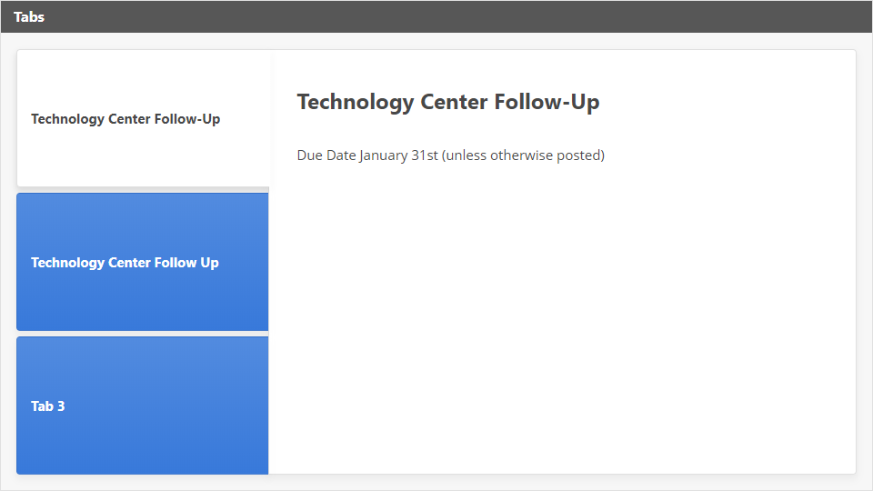
Interaction
Click the Interaction button to edit this object

