Slide 1
The online academic and career development system
available to all Oklahomans at no cost.

Slide 2
HB 2155 – The ICAP Bill
Individual Career and Academic Plans (ICAPS) include:
Career and college interest surveys.
Interest Assessment, Skills Confidence Assessment, & Work values Assessment.
Written post-secondary and workforce goals, and information of progress towards them.
My Ed Plan
Intentional sequence of courses that reflects progress toward the post-secondary goal.
My Ed Plan
Academic progress, including course taken, assessment scores and remediation, credit recovery, Advanced Placement (AP), International Baccalaureate (IB), and concurrent enrollment credits earned career certifications and endorsements.
My Ed Plan
My Assessments
My E-Portfolio
Experience in service learning and/or work environment activities.
C2B- Related Opportunities
My E-Portfolio

Slide 3
ICAP Requirements – From State Department of Education
Students will complete an online career assessment every year to explore their career interests, learn career skills and begin connecting their interests to careers.
Students will update their career and post-secondary goals every year as they learn about new opportunities.
Students will update their required state and federal assessments (English language arts, mathematics and science) and college and career readiness assessment (ACT or SAT) results as they become available.

Slide 4
ICAP Requirements – From State Department of Education
Students will annually update their academic courses and progress in those courses. Students will also list any career technology programs, AP or IB courses, concurrent enrollment courses or career endorsements that reflect progress toward their individual career pathways.
Students will complete and record at least one service learning or work-based learning activity (apprenticeship, mentorship, job shadow or internship) activity between ninth grade and graduation

Slide 5
Participate in WBL or get a Job
Notes:
Just like the problem solving cycle there is a career exploration cycle.

Slide 6
Notes:
Hand out Guides

Slide 8
Notes:
Type: Current, HS, After Graduation
Category: Academic, Career, Personal, Other

Slide 14
Notes:
If thy want training get request form after finished.

Slide 15
Curriculum Support
11 Modules
All resources included
Customizable

Slide 16
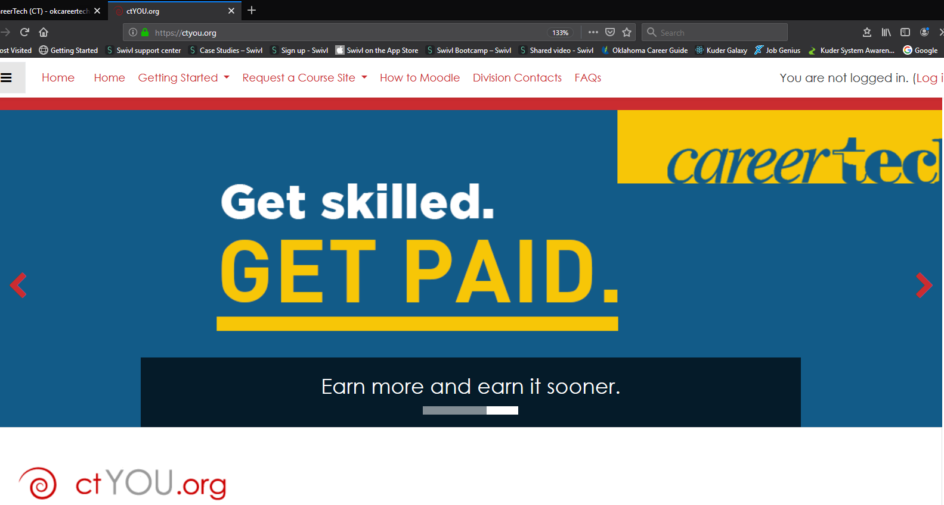
Notes:
Show how to get to ctyou.org

Slide 17
Notes:
WBL tool kits
Hand out time lines

Slide 19
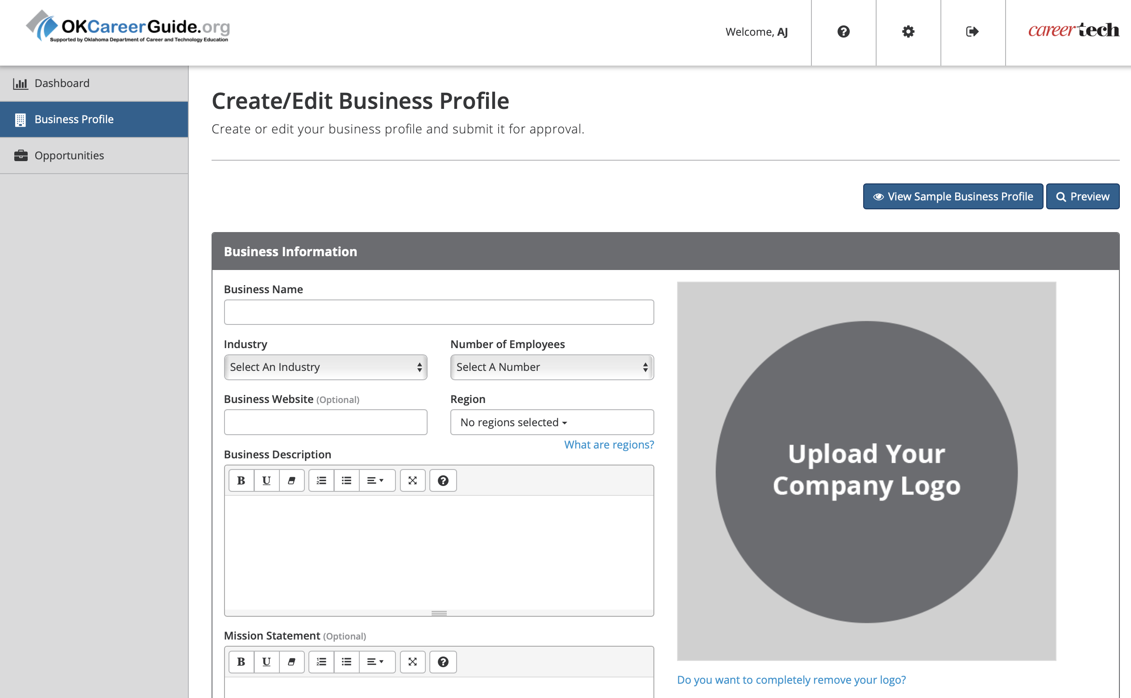
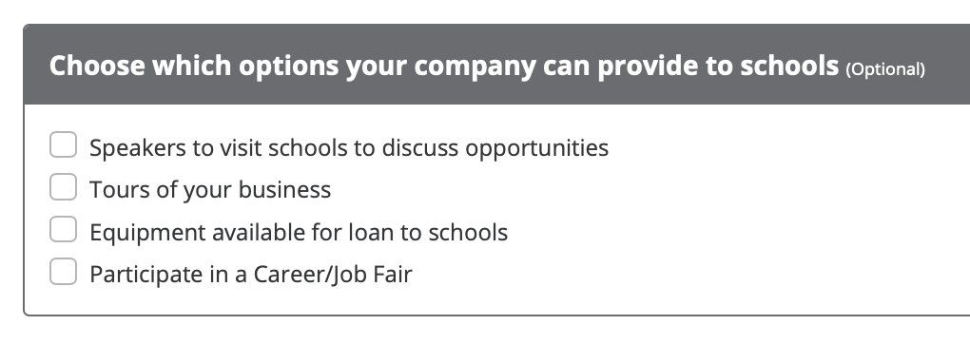
CONNECT 2 BUSINESS: New Account
Notes:
Hand out C2B Cards.

Slide 20
Choose Your Involvement
Create a custom profile in minutes that highlights your primary industry and generates awareness of your business to more than 300,000 OKCareerGuide.org users.
Opportunities include:
Full & part-time job openings
Internships
Job Shadowing
Apprenticeships
Connect and communicate with educators and workforce agencies to participate in job fairs, business tours, guest speaking, and more.
Help build a seamless talent pipeline from education to employment by posting unique opportunities that support learning and your business needs.

Slide 21
AJ Crowell
405.743.5105
AJ.Crowell@careertech.ok.gov
Nathan Brubaker
405.743.5113
Nathan.Brubaker@careertech.ok.gov
Questions?

