Slide 1
Why won’t my resume task complete?

Slide 2
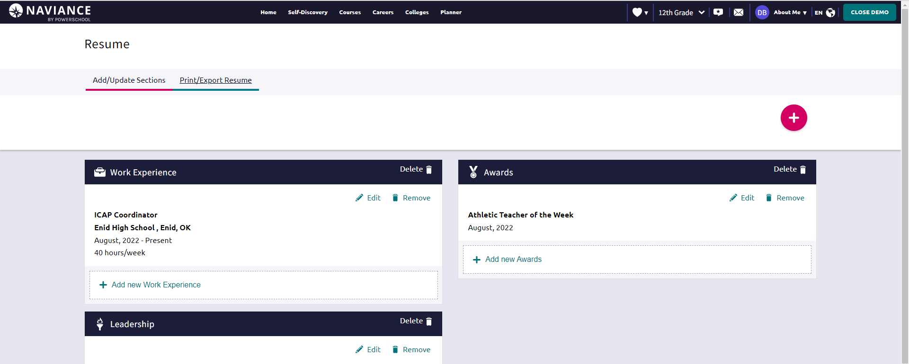
Once you’ve created the sections, you still need to Print/Export Resume to complete this task.

Slide 3
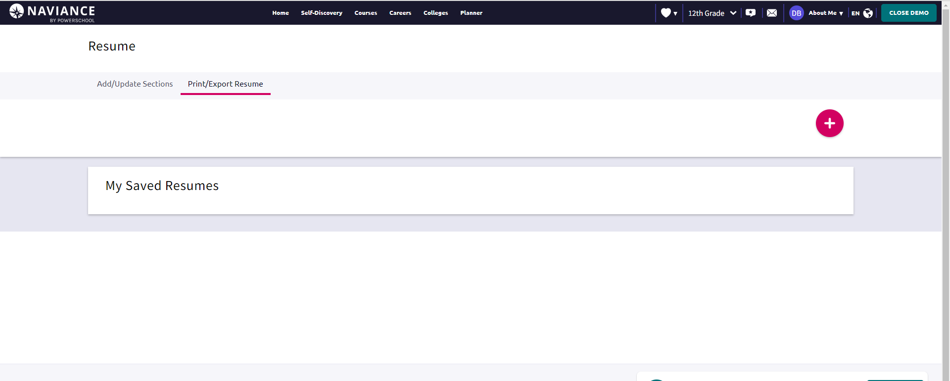
On the Print/Export page, click the plus sign.

Slide 4
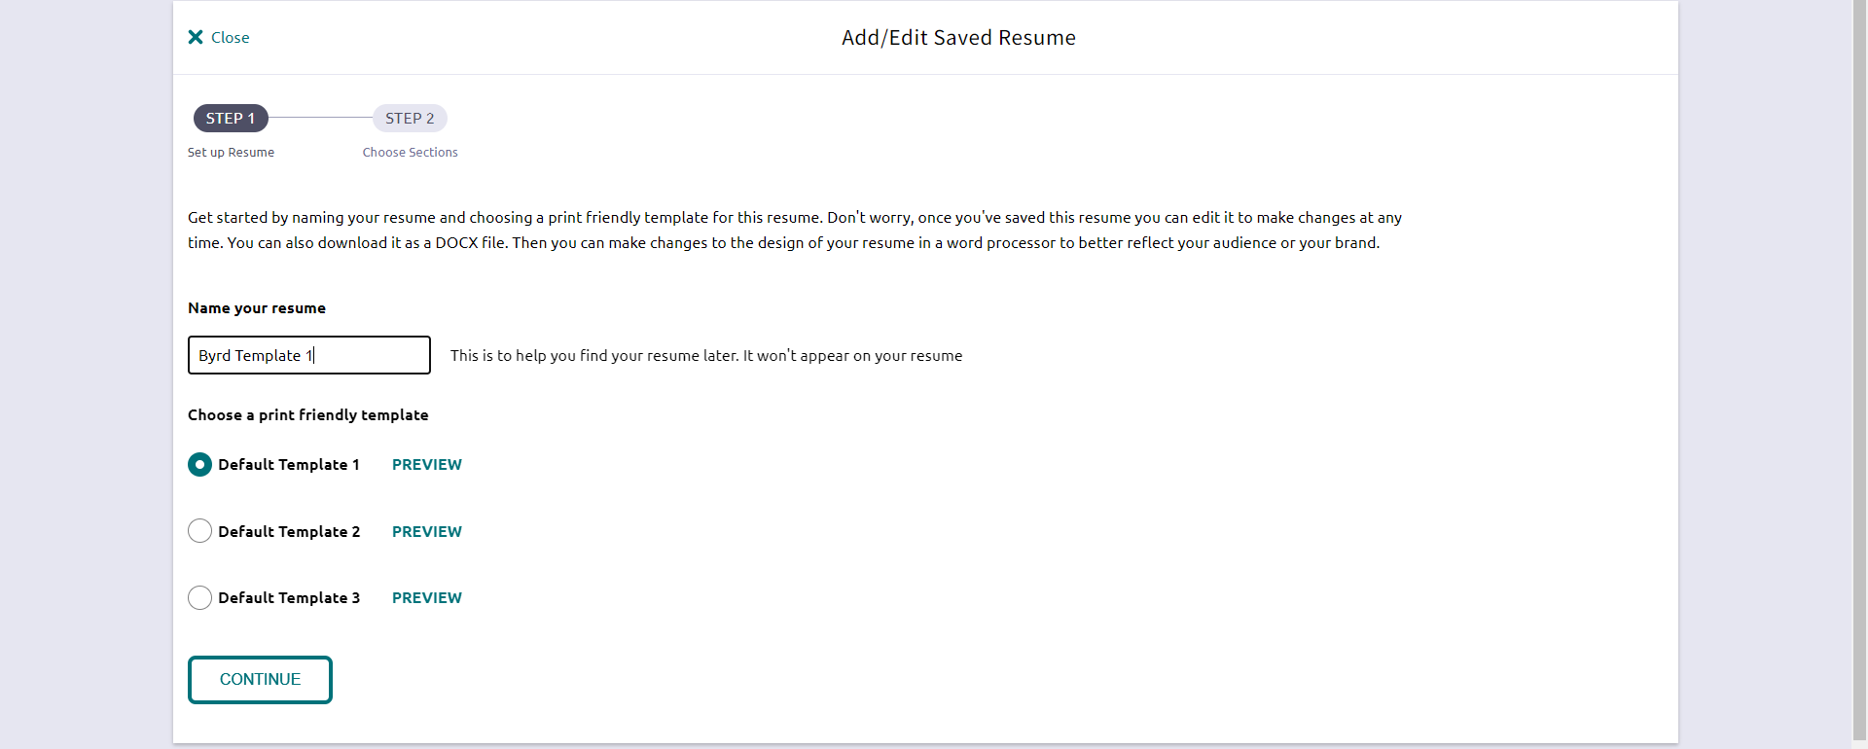
Name it, choose a template, and continue.

Slide 5
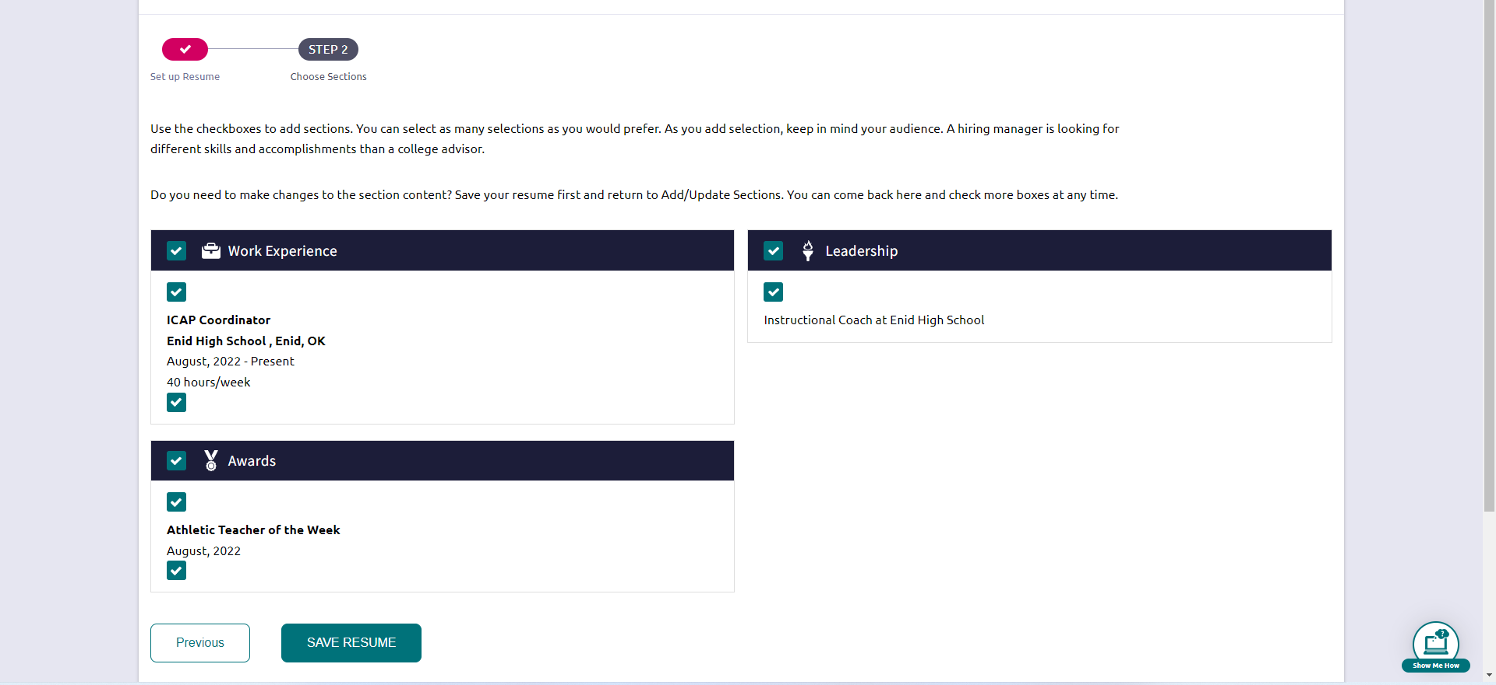
Choose the sections you want on your resume. Then, choose SAVE RESUME.

Slide 6
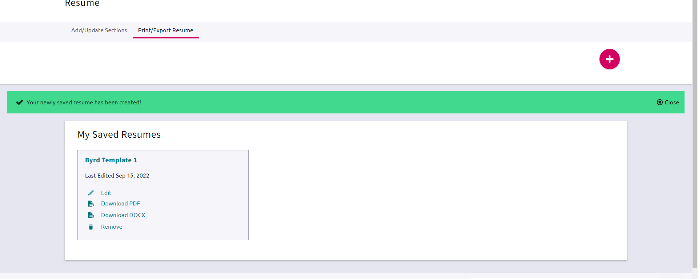
Success! Task complete.

