Slide 1
The Basics of Customer Service
An Essential Guide

Slide 2
What is Customer Service?
Customer Service Means: (Answers)
Doing ordinary things extraordinarily well.
Going beyond what is expected.
Adding value and integrity to every interaction
Being at your best with every customer.
Discovering new ways to delight those you
serve.
Surprising yourself with how much you can do.
Taking care of the customer like you would take care of your grandmother.

Slide 3
Customer Service Questions
Q: Are all these definitions true?
Q: Which definition do you like
best and why?
Q: Why isn’t their one common
definition?

Slide 4
3 Main Steps to Good Customer Service
One:
Listen to the Customer
Don’t assume
Ask discovery questions
Watch non-verbal cues

Slide 5
3 Main Steps to Good Customer Service, cont.
Appreciate the customer
Be Aware of Body Language
Make eye contact
Smile
Nod your head
Don’t ignore your customer

Slide 6
3 Main Steps to Good Customer Service, cont.
Two:
Identify and Anticipate Customer Needs
think ahead about what your customer may need
Make it available to them
Give them more than what is expected

Slide 7
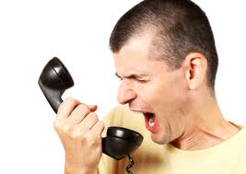
3 Main Steps to Good Customer Service, cont.
Three:
Admit to making mistakes
don’t judge
Admit your mistakes
Value complaints

Slide 8
How to Handle Complaints
Listen
Ask questions to clarify
Take notes
Address guests feelings
Suggest alternatives
Thank the guest
Begin work on a solution
Follow-up

Slide 9
Internal Customers
Don’t forget about your internal customers
don’t prejudge them
treat them as individuals
manage time and tasks effectively

Slide 10
Customer Service Basics: Service with a Smile
DVD available from LearningZonexpress – information available from our booth in the exhibit hall
Information at:
www.learningzonexpress.com

Slide 11
Learning Activities
Customer Service Lesson 1
Customer Service – Determining Needs and Wants
Five Pillars of Success
Now That’s Rapport
The Great Service Debate
Role Plays
Make It Personal

Slide 12
The W.H.A.T Factor
Welcome: immediately greet customers in a friendly and professional manner
Hear: ask customers how you can help, and listen carefully
Accomplish: own the issue and take action until customers' needs are satisfied
Thank: thank the customer and invite them to return
W.H.A.T. makes great customer service!

Slide 13
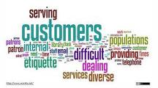
Contact Information
Mary Levinski, FACS Instructor
mary.levinski@isd47.org
Thank-you!

