Slide 1
School District Budget Act
An Alternative Budget System for Oklahoma Schools
TechCENT$
May 13, 2020
J. Bruce Campbell
Notes:
1

Slide 2
Alternative To What?
The School District Budget Act replaces the Estimate of Needs system, a system that has been in place since statehood.
Notes:
2

Slide 3
Why Would Anyone Change?
A budget prepared in the SDBA format may be easily read and understood by:
  School Business Officials
  School Board Members
  The Public
An Estimate of Needs may be easily read and understood by:
  The Auditor
Six tech centers use this format
Notes:
2

Slide 4
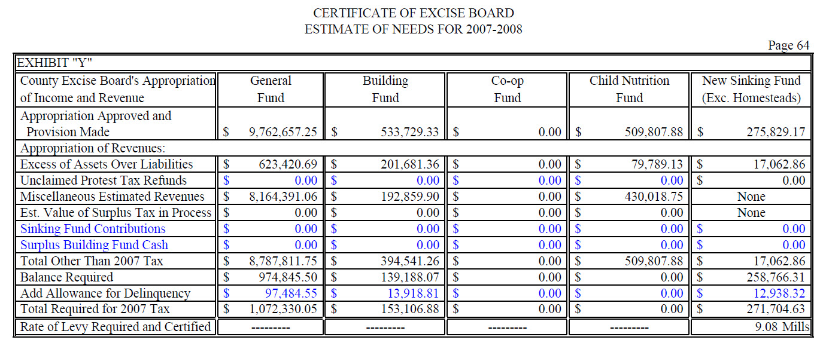
Estimate of Needs – Sched Y

Slide 5
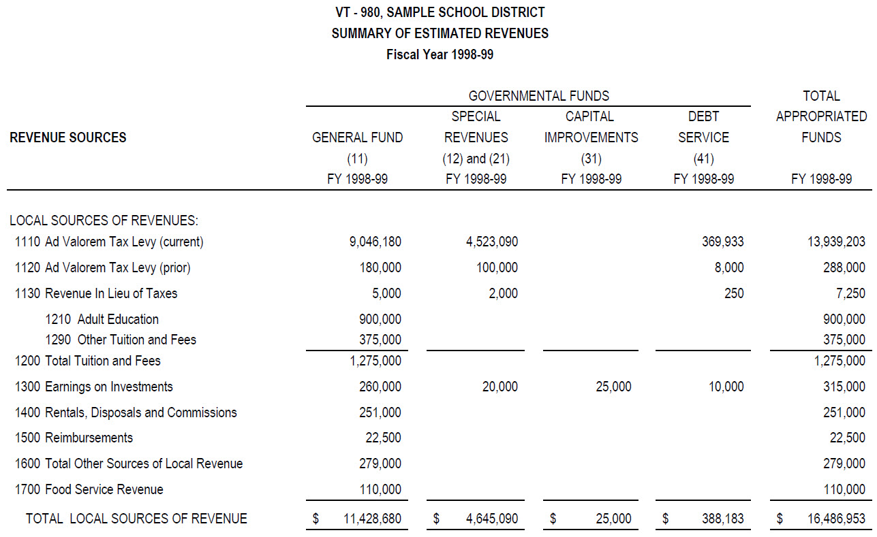
SDBA Budget

Slide 6
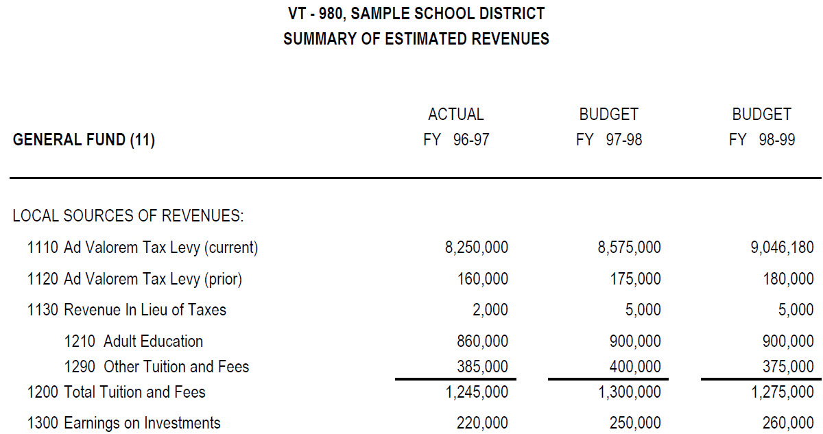
SDBA Revenue – Fund 11

Slide 7
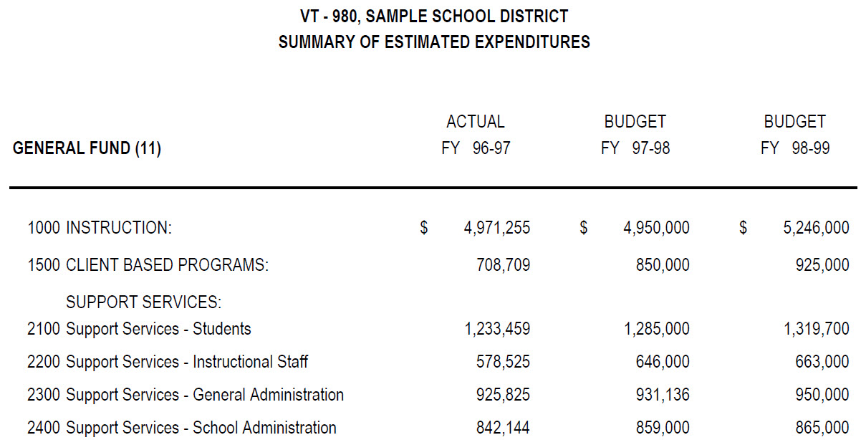
SDBA Expenditures – Fund 11

Slide 8
Alternative Budget System
Provisions of the act are optional
Board can elect to comply on an annual basis
Board can return to the old budget system at the beginning of any given fiscal year
Statutory authority is in Section 5-150 et seq. of Title 70
Notes:
2

Slide 9
Board Resolution
“The Board of Education, Sample School District VT-980, hereby resolves to implement budgeting procedures in compliance with the provisions of the School District Budget Act (Section 5-150 et seq. of Title 70) for FY2020-2021.”
Notes:
3

Slide 10
Timing of Board Action Items
Board Resolution (May or June)
Publish budget and notice of public hearing (5+ days before hearing)
Conduct public hearing (May 16 to June 30)
Approve “Original” budget (June)
The public hearing and approval may occur at the same meeting

Slide 11
Distribution of Original Budget
State Auditor
County Clerk
SDE or ODCTE
District Treasurer
District Encumbrance Clerk
Independent Auditor

Slide 12
Full Operating Budget at July 1
Eliminates piecemeal budgeting
Avoids duplicate appropriation of same money
No longer operating on Temporary Appropriation into September or October

Slide 13
Format: Original Budget
“A complete plan for the school district”
Disclose financial position and condition
  Include an interim Balance Sheet
Disclose revenues and expenditures
  Both past and anticipated
Budget message, explaining the budget and its important features
See Section 5-155

Slide 14
Format: Original Budget
Revenue presented at major Source level
Expenditures presented at major Function level
Three years of information
  FY2019: Prior year actual
  FY2020: Current amended budget
  FY2021: Proposed budget year

Slide 15
Optional Schedules
Interim Balance Sheet
Expenditures at major Object level
Graphs

Slide 16
Fund Groupings
General Fund
Special Revenue Funds
  Building Fund
  Child Nutrition Fund
Capital Improvement Funds (Bond Fund)
Debt Service Funds (Sinking Fund)
  Must be presented on Estimate of Needs

Slide 17
Amended Budget
Prepared after valuations are certified
  Add levy sheet
  Update FY2020 and FY2021 columns
  Typically August or September
Final Revenues & Expenditures for prior year
Final Fund Balance
Allocations from SDE or ODCTE

Slide 18
Amended Budget Requirements
Publication and Public Hearing not required
Submit to Board of Education
Submit to State Auditor and County Clerk
Distribution to:
  Treasurer
  Encumbrance Clerk
  Independent Auditor
  ODCTE or SDE

Slide 19
GASB Format
Governmental Accounting Standards Board
Presents the budget in a GASB format
Annual audits must currently be prepared in a GASB format
  Comparing budget to audit is “Apples to Apples”
Notes:
5

Slide 20
Advantages
Management Budget and Legal Budget are the same
Full operating budget available on July 1
Eliminates or Replaces:
  Temporary Appropriation
  Estimate of Needs
  Supplemental Appropriation
Notes:
6

Slide 21
Advantages (cont.)
Prepared by Business Manager and/or Auditor
Identification of erroneous or omitted Revenue & Expenditures
No longer requires Excise Board approval
  Eliminates up to 7 week wait
  Tax levies still approved by Excise Board
  15-day protest period applies

Slide 22
Disadvantages
Fewer “hidden” dollars
Timing is more critical – requires approval prior to July 1
Monitoring of revenue and expenditures requires extra care
Notes:
9

Slide 23
School District Budget Act
An Alternative Budget System for Oklahoma Schools
TechCENT$
May 13 2020
J. Bruce Campbell
Notes:
1

