Slide 1
Carl Perkins CTIMS Agreements & Invoicing TechCent$ - May 2020

Slide 2
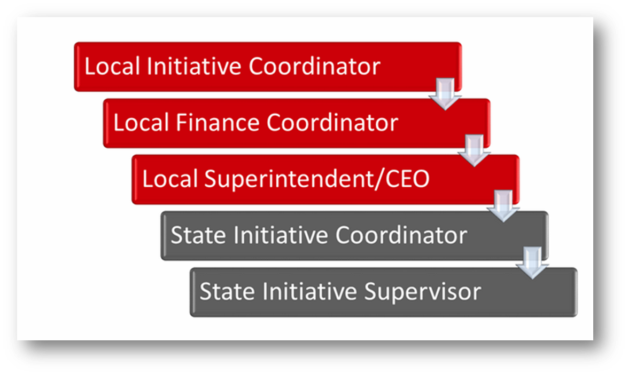
Worksheet Approval Process

Slide 3
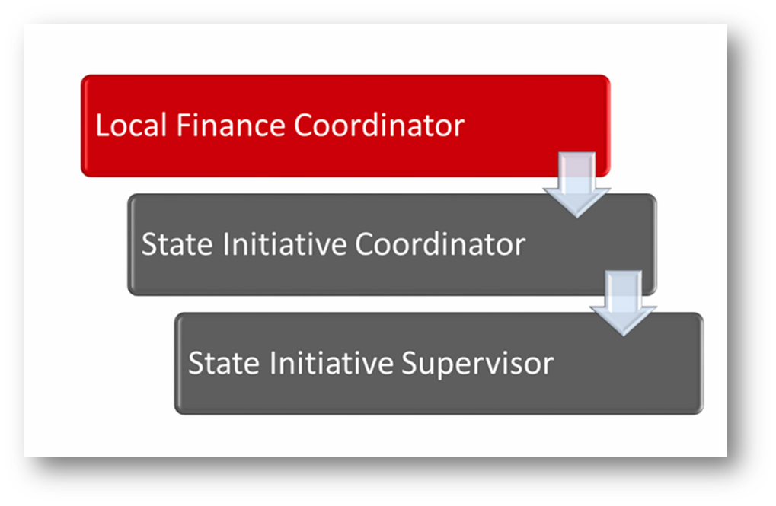
Agreement Approval Process

Slide 4
Creating and Submitting the Agreement
The Agreement
is the working copy of the Budget Line Items in the Worksheet.
contains the OCAS codes and details of planned expenditures
can only be changed once the Worksheet is fully approved by ODCTE staff.
Agreement

Slide 5
Creating and Submitting the Agreement
Steps 1 – 7 Starting the Agreement Process
Role: Local Finance Coordinator
Use Internet Explorer version 11 or higher
Sign on as FLA-Local Finance from the dropdown in the top right corner
Click the triangle icon next to Grants on the left side navigation area.
Click the triangle icon next to Grant Process.
Click the triangle icon next to FLA Process.
Select FLA Mange Grant Worksheet/Agreement Flow.
Complete the FLA Manage Grant Worksheets / Agreements / Invoice / Follow-up form. The tagged numbers on the screen shot correspond to the instruction steps below.

Slide 6
Creating and Submitting the Agreement
Note: The red asterisks* represents a required field.
Verify Fiscal Calendar Year to make sure correct year is showing*.
Verify Grant Fund Type is set to FLA*.
Select your correct Organization Type from the dropdown menu.
Select your Organization by typing in the first three characters of the name.
Verify the Organization District* if it does not automatically appear after typing the first three letters of your Organization name or if you need to select a different Organization District.
Select a Program Initiative*.
Approval Function Type will remain as All.
Filter on Status will remain as All.
Select the Search button to search for any outstanding Worksheets/Applications that need your approval.

Slide 7
Creating and Submitting the Agreement
Step 8: After clicking the Search button, click on the blue word “New” in the Agreement column.
Step 9: On the FLA Grant Agreement page, the Budget Line Items section should be open.
Step 10: Enter the OCAS coding in the order of Function-Object-Program code (e.g. 1000-100-330) Note: all Object Codes should be entered at the 100 level (100, 200, 300, etc.).
A dropdown list of OCAS codes will display as you begin typing (you may need to enter several numbers to fully prompt the list).Select the valid OCAS code for each budget item; next TAB to the Agreement Line Description column (helps ensure codes are saved). Click on the Save as Draft when completed.
Step 11: Scroll down to the Acknowledgements heading.
Click the certify box and enter an Acknowledgement note (required).
Click on Submit for Approval

Slide 8
State Level Approval
The FLA State Initiative Coordinator and the FLA State Initiative Supervisor continue the Agreement review and approval/rejection process by following Steps 1-11 above (the same steps as the FLA Local Finance Coordinator).
After the Agreement is approved by the
FLA State Initiative Supervisor, the
FLA Local Finance Coordinator can
begin submitting Invoices.

Slide 9
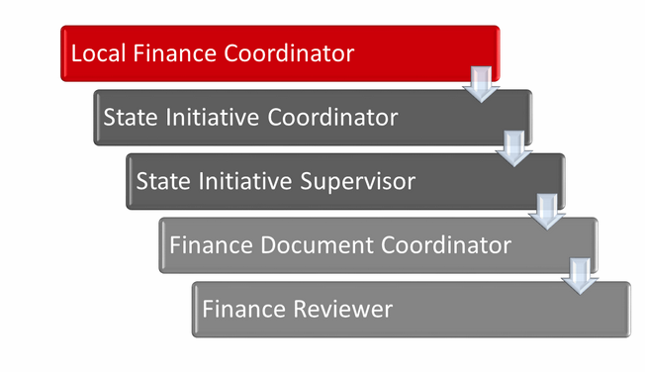
Invoice Approval Process

Slide 10
Invoicing for Reimbursement
Steps 1-6: Starting the Invoicing Process
Role: Local Finance Coordinator
Use Internet Explorer version 11 or higher
Sign in with the FLA Local Finance Coordinator role
Click the + (plus) sign next to Grants on the left navigation panel.
Click the + (plus) sign next to Grant Process.
Click the + (plus) sign next to FLA Process.
Select FLA Invoice Process.

Slide 11
Invoicing for Reimbursement
Step 7
Note: The red asterisks* represents a required field.
Verify Fiscal Calendar Year to make sure correct year is showing*.
Verify Grant Fund Type is set to FLA*.
Select your correct Organization Type from the dropdown menu.
Select your Organization by typing in the first three characters of the name.
Verify the Organization District* if it does not automatically appear after typing the first three letters of your Organization name or if you need to select a different Organization District.
Select a Program Initiative*.
Approval Function Type will remain as All.
Filter on Status will remain as All.
Select the Search button to search for any outstanding Worksheets/Applications that need your approval.

Slide 12
Invoicing for Reimbursement
Step 8: After clicking the Search button, click on the blue words New Invoice to start a new Invoice Process.
Note: To see the status of a Draft Invoice in the process, or one already submitted or paid, click the (small dark triangle) sign to the left of the blue words New Invoice. Additional information is included in the “Accessing a Draft Invoice or View Status of Submitted Invoice’” section of the CTIMS Guidebook.
Step 9: Verify that the information is correct, then select Save & Next.
Step 10(a): Under the Invoice Line Items tab, select the Agreement Line Desc (Description) you want to add to your Invoice.
The system defaults to the full budget line amount. If you want to claim the full amount shown in the Total column, click in the check box to the left of the description. Once the Invoice is complete, go to Step 13.
Step 10(b): If you do NOT want to claim the full amount of the line item, click on the (small dark triangle) to the left of the line description. Next, click on the Edit button which appears in the dropdown section.

Slide 13
Invoicing for Reimbursement
Step 11: You can now edit the Units, Unit Cost, Req Unit Type &/or Total to claim a portion of the Total line item amount. This ensures your requested reimbursement will match the invoice/receipt submitted as documentation.
Use the scroll bar at the bottom to go to the right side end of the row and enter the Date of Expense. After you enter the amount of the line you are invoicing, select the Update button on the left to add the line to the Invoice.
To add more lines, select the Add Invoice button.

Slide 14
Invoicing for Reimbursement
Step 12: If you start to edit a line and discover you don’t want to save your changes you can select the Cancel button on the right.
To correct a mistake after you have selected the Update button, use the Edit button, correct your errors, and select the Update button again.
To remove a saved item your invoice, Inactivate the line item: select Edit, then uncheck the box under the column Is Active, and select Update. That line becomes Inactive and will not show up in your invoice.
Another way to inactivate a Line is to put zeroes in the Units and Unit Cost boxes and select Update.

Slide 15
Invoicing for Reimbursement
Step 13: Verify that the Total Invoiced column is correct for the amount of reimbursement you are requesting. Verify that the Invoice OCAS codes and line item amounts match the OCAS report you will attach in Step 14.
Select the Save As Draft button from either the top or the bottom of the screen. Select the Invoice Summary button to create reader-friendly copy of your Invoice. Verify line items, totals, and OCAS coding.
Step 14: Scroll down and select the Attachments heading. Use the Browse button, then the Upload and Save button to attach the OCAS Summary and Detail Expenditure Report(s), along with any required receipts and vendor invoices.
The Expenditure report(s) should match the amount of the Invoice. Upload additional attachments individually.

Slide 16
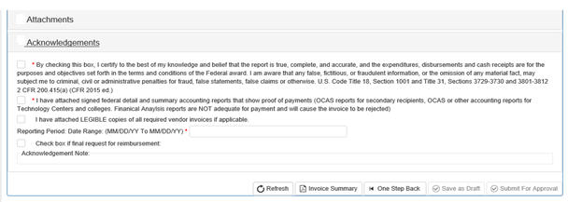
Invoicing for Reimbursement
Step 15: Scroll down and select the Acknowledgements heading. Check all three required boxes. Input the Reporting Period (Claim) Date Range (must match the date ranges in the OCAS reports).
If this is final reimbursement request, check the “Is final payment?” box. Enter a required Acknowledgement Note, then select the Submit for Approval button.

Slide 17
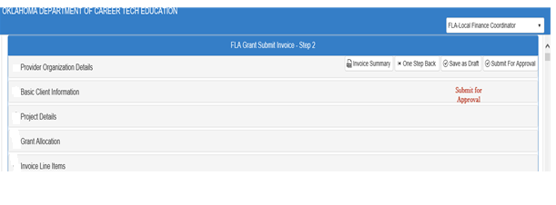
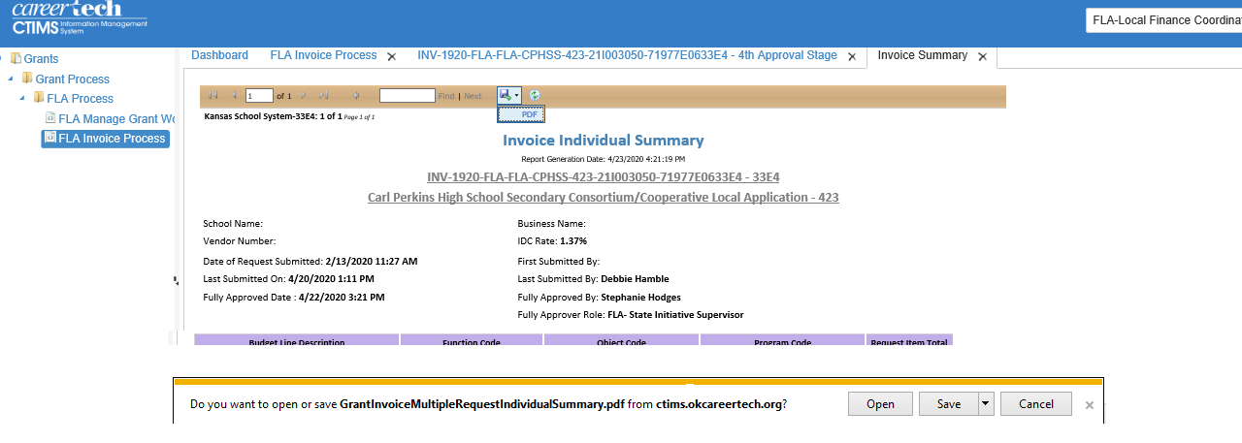
Invoicing for Reimbursement
Step 16: Click on the Invoice Summary button to create and print a PDF report of the Invoice you are
submitting. Select the PDF
button to Create a copy of
Your Invoice. (You may also
need to select the Open or
Print Button at the bottom
of the Screen. Save or print
the PDF as usual.
The Invoice is now
successfully submitted
and will go to the ODCTE
for review and
processing.

Slide 18
Change Request or Budget Adjustment?
Worksheets and Invoices get Change Requests
After a Worksheet or Invoice is submitted for approval, use the Change Request Process to make any changes.
Agreements get Budget Adjustments
After an Agreement is submitted for approval, use the Budget Adjustment Process to make any changes. CHECK YOUR AGREEMENT before starting Invoices.

Slide 19
Steps 1-3 – Change Request Process
Role: Local Finance Coordinator
Use Internet Explorer version 11 or higher
Sign in with the FLA Local Finance Coordinator role
Click the + (plus) sign next to Grants on the left navigation panel.
Click the + (plus) sign next to Grant Process.
Click the + (plus) sign next to FLA Process.
Select FLA Manage Grant Worksheets / Agreements / Invoice.
Complete the required sections of the FLA Grand Funds Worksheet and select the Search button.
Use the bottom scroll bar
to reach the Agreement
column on the right.

Slide 20
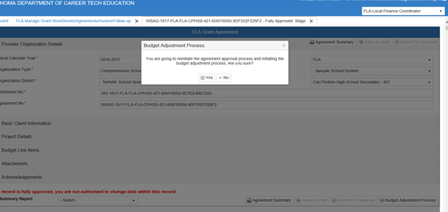
Step 4-6 – Budget Adjustment Process
Need to work on this more….
In the Budget Adjustment process, you are changing the AGREEMENT (budget)
Click on the Agreement Number (begins with WSAG-) under the Agreement column.
On the Agreement page, select the Budget Adjustment Process at the bottom right.
Click YES to make a Budget Adjustment.

Slide 21
Step 7 – Budget Adjustment Process
The Budget Adjustment Process can help with several types of changes to the budget.
(a) To add new items to your budget, click on Budget Line Items - Add Budget Line. Complete all the required fields for the new budget line (OCAS code, Agreement Line Description, Units, Unit Cost and Req. Unit Type).
(b) To make changes to an existing budget line item, click on the cell(s) to be changed (OCAS codes, Units, Unit Cost, Req. Unit Type) and enter the new information.
(c) Changes to the agreement line descriptions for a NEW item are not allowed.
Use the Add Budget Line for new items.
Permissible changes are additional descriptors or to clarify the description.

Slide 22
Steps 7(continued) – Budget Adjustment Process
Inactivating a Budget Line Item
(d) A budget line cannot be removed once the original Agreement has been approved. Instead, change the status of a budget line to Inactive in order to remove it from your budget calculations.
Use the scroll bar to scroll to the Status column on the right side.
Click on the word Active then click on the check-mark so it no longer shows.
Tab to the next column. The Status should now show as Inactive, and the line item and amount are no longer included in your budget.
It is highly recommended that you execute a Save As Draft after completing changes to the Budget Line Item section.

Slide 23
Steps 8-9 – Budget Adjustment Process
If additional documents (already saved on your computer) are needed, select Attachments. Use the Browse button and the Upload & Save file button to attach your documents to the Agreement.
If the Upload & Save was successful, a File Uploaded pop up box will appear.
Select OK then repeat these steps for each file you need to attach to the Agreement.
In the Acknowledgements section, a Budget Adjustment Justification Note is required. In this note field describe ALL THE CHANGES made to your budget Agreement and the reason(s) for doing so. You will also need to click in the two Validation/Certification Boxes with red asterisks (*).
Enter text (initials, short note, etc.) in the required Acknowledgement Note field.

Slide 24
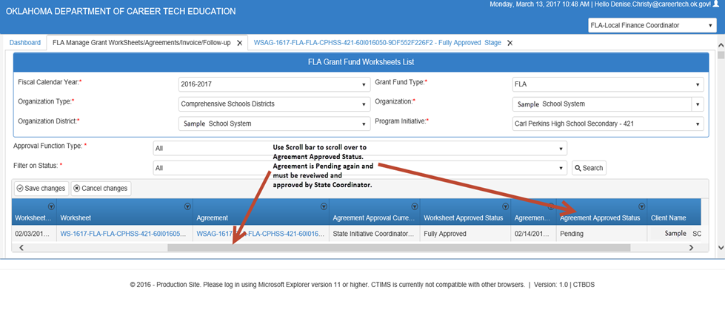
Step 10-11 – Budget Adjustment Process
Select the Submit for Approval button (located at the top or bottom of the page) to send the Budget Adjustment through to the approval process.
Check the status of the adjusted budget by going back into the FLA Manage Grant Worksheets / Agreements / Invoice menu. Use the scroll bar to move to the right,
then look at the status
under Agreement
Approval Status.

Slide 25
Budget Adjustment After an Invoice is Started
Budget Adjustments should be completed before you begin an invoice.
Once Invoicing begins, CTIMS treats the funds as “encumbered” and will prevent them from being changed.
If a Budget Adjustment is started, the Invoicing process will be locked down until the adjustment is approved.
BUT…if an Invoice is saved as draft, there are specific steps you can take.
1. Open the Invoice and start a Change Request.
2. Inactivate specific or all Invoice line items.
3. Open the Agreement and complete/submit a Budget Adjustment.
4. When the Agreement is approved, re-open the Invoice and activate the inactivated line items.
5. Resubmit the Invoice for approval.

Slide 26
Budget Adjustment After an Invoice is Started
If the Invoice is started but a Budget Adjustment is needed, it is best just to close out of the Invoice process and DO NOT save as draft.
Submit a Budget Adjustment, and when it is approved then return to the Invoicing process and submit for approval.

Slide 27
Perkins Administration Staff
Josh Miller – Southeast Coordinator
josh.miller@careertech.ok.gov 405-743-5401
Debbie Hamble – Northeast Coordinator
debbie.hamble@careertech.ok.gov 405-743-6881
Steve Robison – West Coordinator
steve.robison@careertech.ok.gov 405-743-5xxx
Stephanie Hodges – Financial Analyst / Invoicing
stephanie.hodges@careertech.ok.gov 405-743-5xxx
Jordan Duck – Administrative Assistant
jordan.duck@careertech.ok.gov 405-743-5xxx
Letha Bauter – Manager
letha.bauter@careertech.ok.gov 405-743-5xxx

