Slide 1
Education Partnerships and Customized Services TechCENT$
April 21, 2020
Oklahoma Department of Career & Technology Education
Gina Hubbard, Manager – Education Partnerships & Customized Services
Max McKnight, Manager – Economic Development & Business & Industry Services

Slide 2
Education Partnerships & Customized Services
Justin Lockwood, Deputy State Director
Gina Hubbard
Division Manager
Max McKnight, Manager – Economic Development & Business & Industry Services
Andrea Bradley, Administrative Assistant
Delbo Leach, RC/EDU
Cara Pattison, RC/EDU
Karen Talbott, RC/EDU
Whitney Blaylock, RC/EDU
Patrick Clanin, RC/BIS
Lori Broyles, RC/BIS
Lori Laufer,
RC/BIS

Slide 3
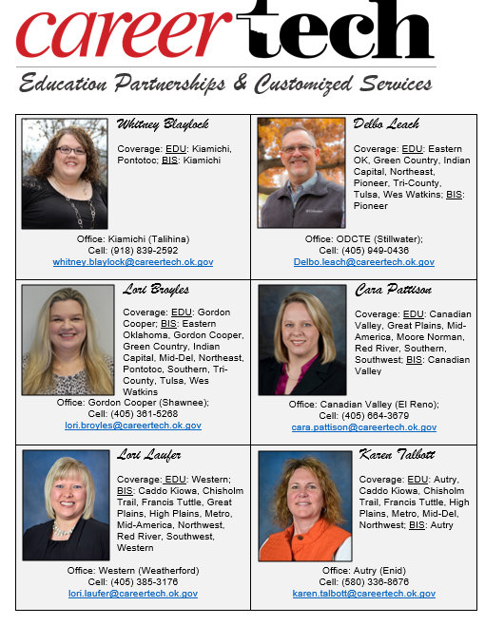

Slide 5
What do we do?
Agency liaisons for k-12 and Technology Center Administrators (Each regional coordinator averages 100 school visits/meetings annually)
Carl Perkins monitoring, support, and CTIMS technical assistance
Advisors: Instructional Leaders, OkACTE Administration (OCLA), Local Directors, and OkACTE Post Secondary Adult Career Education (PACE), Municipal Clerks & Treasurers, attend SDE Board Meetings, Career Tech Foundation liaison
Participate in various agency and state-level committees as needed/assigned
Monthly updates for BIS Staff and K-12 Administrators
Professional Development: BISCP, ACD, IC, BES, Local Directors, OEIP,
CTIMS, etc. (24 sessions in FY19)
Manage the Technology Center Lottery Grant process
Participate in at least one CTSO event/year

Slide 6
But wait…there’s more!
Serve on Technology Center Accreditation Teams
Agency liaisons for Business and Industry Services and OK Dept. of Commerce
Manage the Economic Development Initiatives budget of nearly $6 million
Review and revise BIS Guidelines annually
Manage performance-based funding formula
Facilitate BIS Advisory & Educational Attainment committees
CTIMS support for EDI Agreements
Verify statewide inventory for BIS
Maintain the BIS “Star Map”
Recognition of credentials earned through BIS Training
Other duties as assigned…☺

Slide 7
Economic Development Initiatives
Customized/Safety Training (formula $) $3,936,913.00
Volunteer Firefighter Training $ 399,999.00
Training for Industry Programs (TIP) $1,500,000.00
Training Industry Growth (TIG) $ 73,847.00
Safety Grants $ 30,300.00
Incubator $ 5,000.00
Total $5,946,059.00

Slide 8
Autry Technology Center
Oklahoma Department of Commerce
Western Technology Center
Gordon Cooper Technology Center
Canadian Valley Technology Center
Kiamichi Technology Center

Slide 9
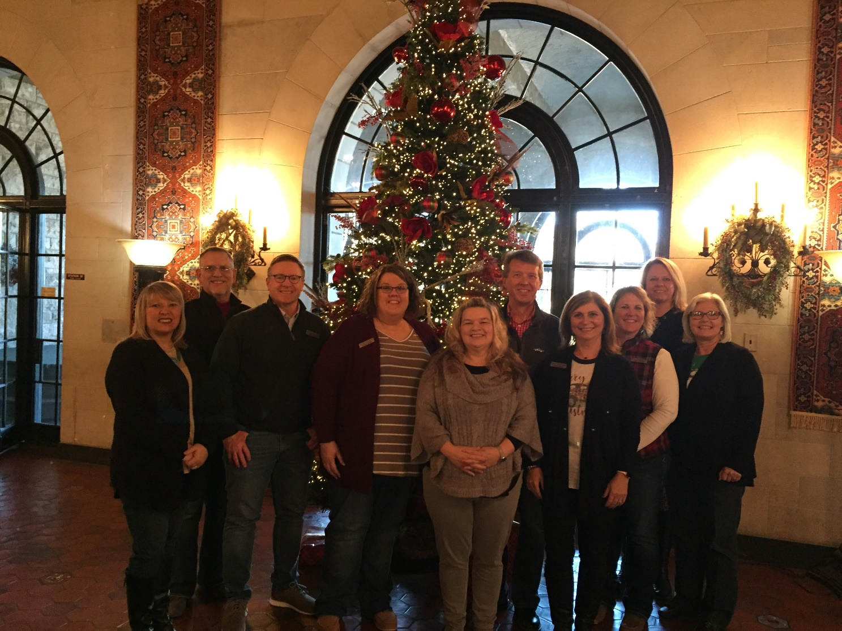
QUESTIONS?

