Slide 1
WELCOME
Central 4
Notes:
[8:55 AM-Rebecca Ingram]: The opening session will begin in 5 minutes. Please take your seats.
[9:00 AM -Hannah] Good Morning. Welcome to the North District 2 FCCLA District Conference. As district officers we are excited about todays events! Let get started by introducing ourselves. {play videos}

Slide 2
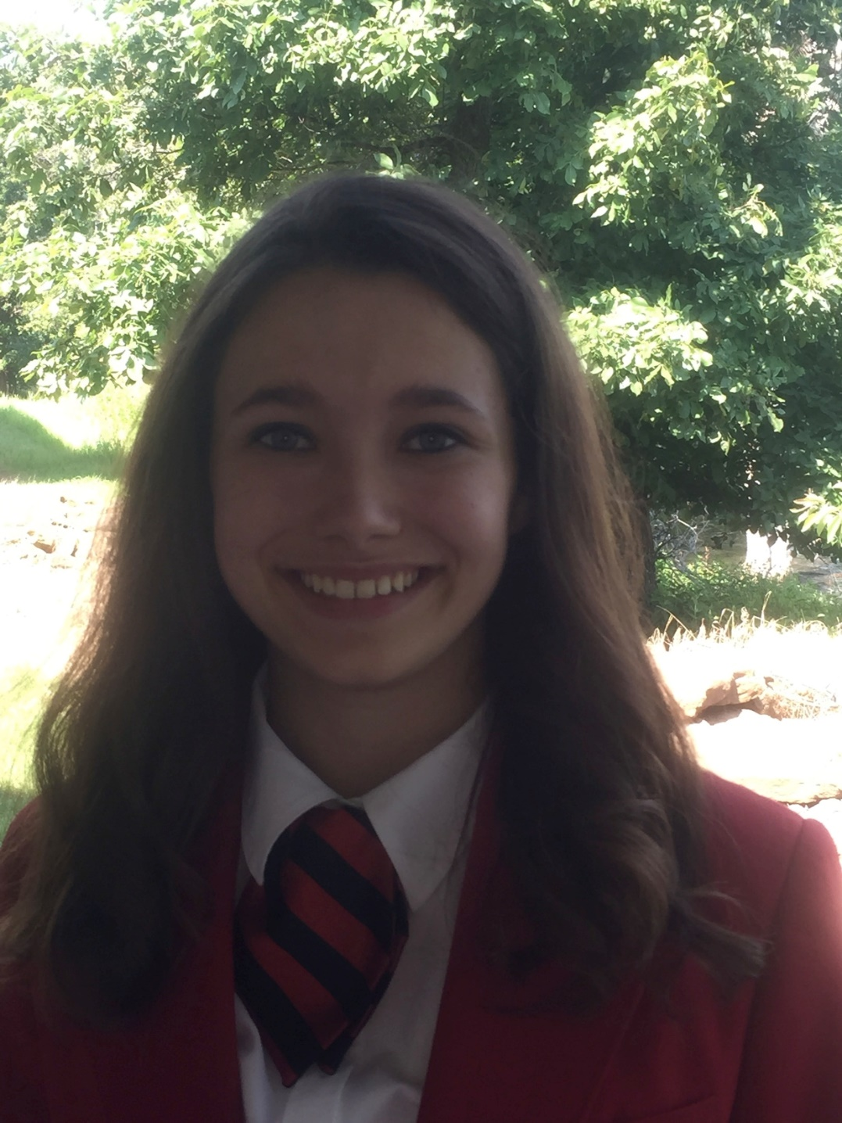
Peyton Jones
Vice President of STAR Events
Notes:
[GABI] Once again this is your district officers North two

Slide 3
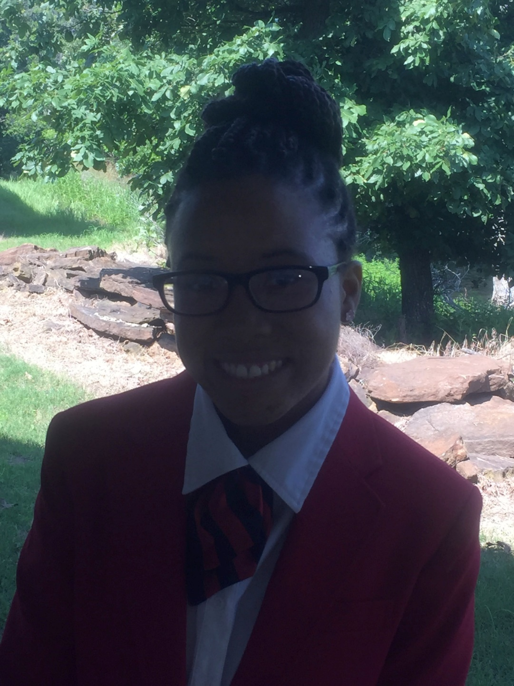
Destiny Henry
Vice President of Public Relations
Notes:
[GABI] Once again this is your district officers North two

Slide 4
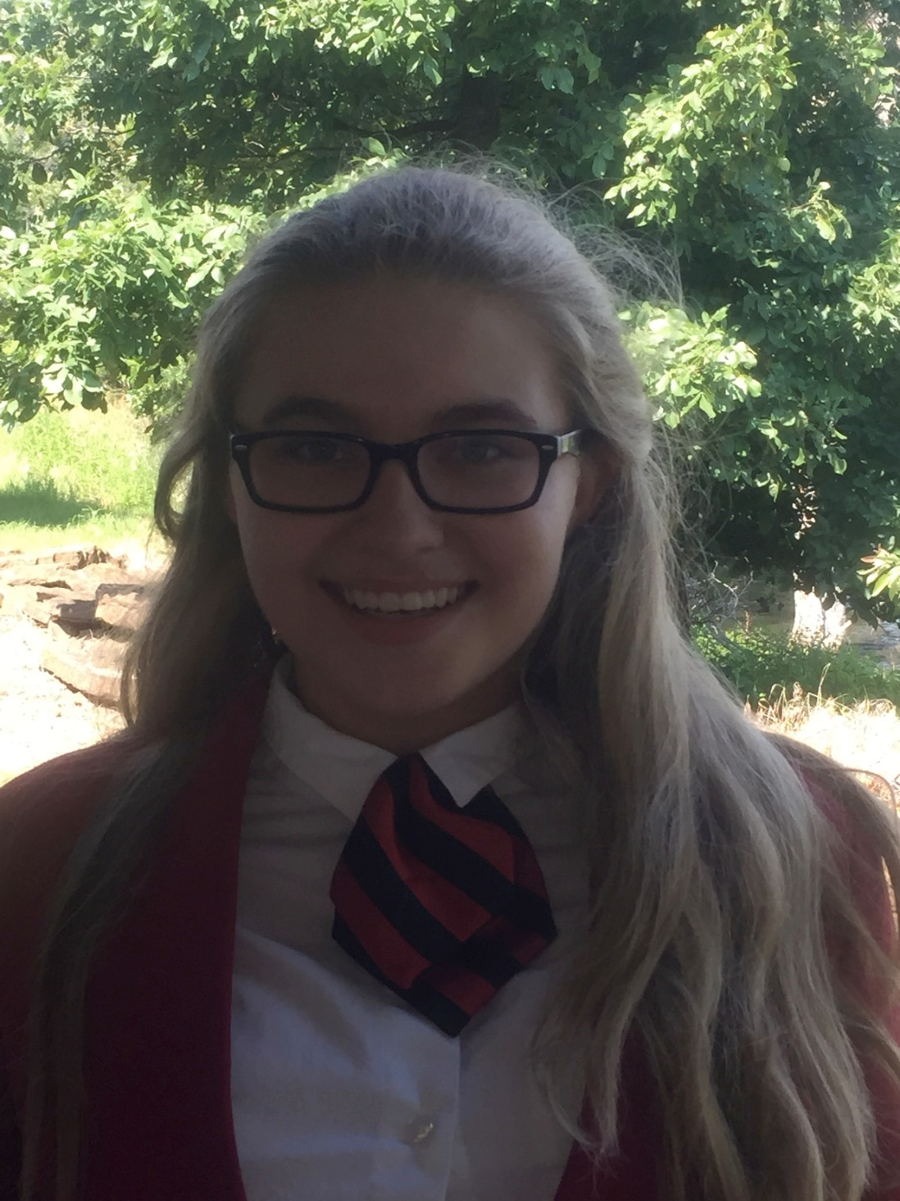
Katie Day
Vice President of Membership
Notes:
[GABI] Once again this is your district officers North two

Slide 5
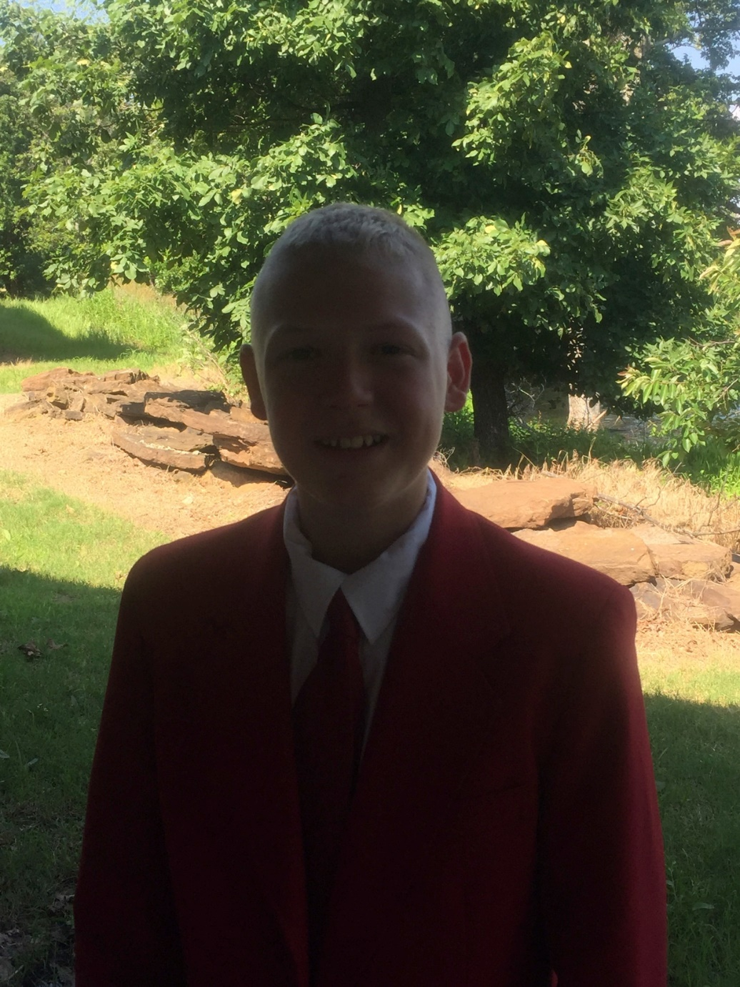
Timothy Vines
Vice President of Community Service
Notes:
[GABI] Once again this is your district officers North two

Slide 6
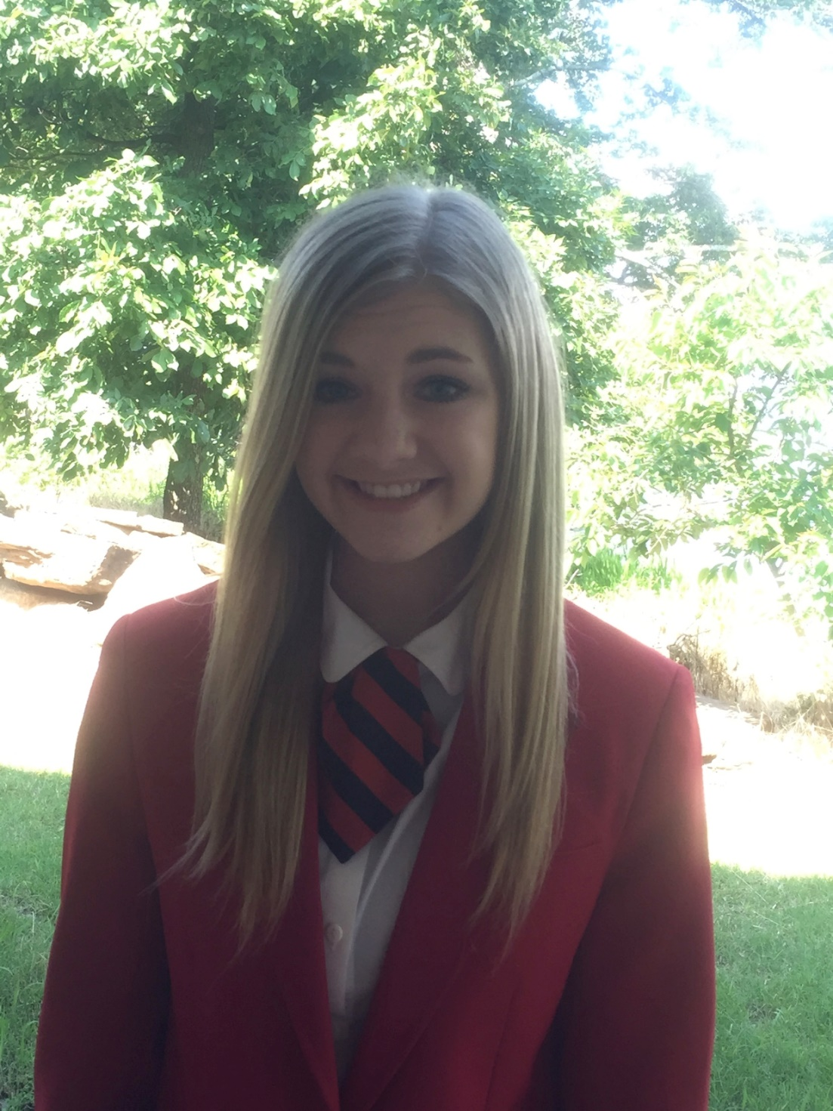
Abbey Claunch
President
Notes:
[GABI] Once again this is your district officers North two

Slide 7
Officer
Installation
Notes:
[GABI]
Gabriella – At this time we would like to focus our attention on leadership. Good leaders are special people; they view the situation, recognize the need, and encourage the necessary action. They understand the importance of teamwork and cooperation and the fulfillment of responsibilities.
Each year symbolizes one more step in the process of individual growth. The installation of newly elected officers is both a joyful and solemn occasion. We congratulate them and look forward to their new vision. Will each officer elect please come forward as I call your name.
(as you state the duties of their office hand them a rose)
President: Hannah Buller– The office of president is one of great responsibility. You will want to be firm, impartial, considerate, and a friend to all members. You shall preside over all meetings of North District 2 FCCLA.
First Vice-President of Community Service: Alexis Peeper- You shall assume responsibility in the absence of the president. You will also work with members to develop and plan projects and activities that will meet the needs of the chapter, school, and community.
Vice-President of Membership: Rebecca Ingram – You shall provide leadership in planning and implementing programs for membership promotion and development.
Vice-President of STAR Events: Branch Hibbitt – You shall provide leadership in planning and implementing the organization's public relations programs.
These officers have been elected to serve the North District 2 2015 - 2016 school year. As incoming officers, the highest honors of the organization are being bestowed on you. North District 2 has faith and confidence in your ability to lead the organization forward.
The pledge of your office signifies your willingness to do this. Please repeat after me……
“I will, to the best of my ability……………faithfully perform all the duties………….of the office to which I have been elected.”
As incoming officers, we ask you to remember that real leadership strength comes through cooperative efforts. We are confident the organization will continue to grow under the leadership these new officers will provide.
(Hands gavel to President elect Hannah) “By giving you this gavel, I place in your hands the responsibilities of President of North District 2 Family, Career, and Community Leaders of America. Congratulations!

Slide 8
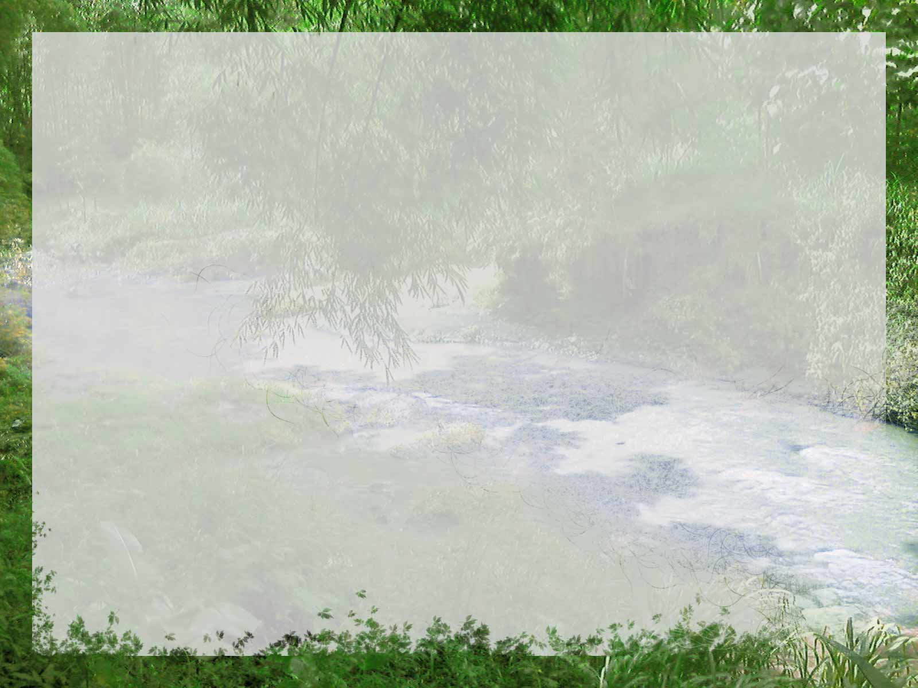
Opening Ceremony
[President:] We are members of Family, Career and Community Leaders of America. Our mission is to promote personal growth and leadership development through Family and Consumer Sciences Education.
[Officers:] Focusing on the multiple rolls of Family members, wage earner, community leader, members develop skills for life through character development, creative and critical thinking, interpersonal communications, practical knowledge, and career preparation.
[Everyone:] As we work toward the accomplishment of our goals, we learn cooperation, take responsibility, develop leadership, and give service.
Notes:
[HANNAH] Thank you Holly.
We will now begin with our FCCLA Opening Ceremony. Please stand.
<President gives a rap of the gavel>
[President:] We are members of Family, Career and Community Leaders of America. Our mission is to promote personal growth and leadership development through Family and Consumer Sciences Education.
[Officers:] Focusing on the multiple rolls of Family members, wage earner, community leader, members develop skills for life through character development, creative and critical thinking, interpersonal communications, practical knowledge, and career preparation.
[Everyone:] As we work toward the accomplishment of our goals, we learn cooperation, take responsibility, develop leadership, and give service.
[President:] This meeting of the FCCLA North 2 District is now in session <Give a rap with the gavel>You may be seated!
<Officers leave stage while members are sitting>

Slide 9
Notes:
[Alexis] Thank You Mr. Beierschmitt
It is my privilege to introduce Holly Barrow a senior from Kingfisher Chapter. She will be singing our national anthem, could everyone please stand?
SING

Slide 10
Roll Call
Notes:
Good morning, my name is Gabriella Cutruzzula and it is truly an honor to be serving as the National Vice President of Community Service. Today I am so excited to have the opportunity to bring you greetings from the National Executive Council. National Leadership conference was held July 5th through 11th in Washington DC where we assumed our titles, took official photos, and were formally installed.
This past week, we attended our September planning meeting at our National Headquarters in Reston, Virginia. We had a busy week of planning this year’s upcoming events, completing our program of work and were able to meet with the Department of Education and the Department of Agriculture.
National FCCLA “Go For The Red” is a new membership campaign that encourages members to recruit, retain, and recognize members for their achievements. With the new membership campaign comes a brand new membership kit, full of promotional posters, DVD's, and a new Lead2Feed course advertisement. With the Go For The Red campaign, members across the nation are encouraged to recruit their peers and fellow students. It's time to #GoForTheRed for the 2015-2016 School year!
We also have a new national outreach project called “Lead2Feed” which is a service learning program fir advisers to teach to their students about how they can create their own service project and target the needs in their own communities.
National FCCLA also just revamped our National Program “student body”. The new 4 units of student body are: the healthy, the fit you, the real you, and resilient you. National Cluster Meetings are just around the corner and will be held in Dallas and Indianapolis this November!!
On behalf of the Family, Career and Community Leaders of America’s 2015-2016 National Executive Council good luck and have a fabulous FCCLA filled year!

Slide 11
National
Officer
Update
Notes:
Good morning, my name is Gabriella Cutruzzula and it is truly an honor to be serving as the National Vice President of Community Service. Today I am so excited to have the opportunity to bring you greetings from the National Executive Council. National Leadership conference was held July 5th through 11th in Washington DC where we assumed our titles, took official photos, and were formally installed.
This past week, we attended our September planning meeting at our National Headquarters in Reston, Virginia. We had a busy week of planning this year’s upcoming events, completing our program of work and were able to meet with the Department of Education and the Department of Agriculture.
National FCCLA “Go For The Red” is a new membership campaign that encourages members to recruit, retain, and recognize members for their achievements. With the new membership campaign comes a brand new membership kit, full of promotional posters, DVD's, and a new Lead2Feed course advertisement. With the Go For The Red campaign, members across the nation are encouraged to recruit their peers and fellow students. It's time to #GoForTheRed for the 2015-2016 School year!
We also have a new national outreach project called “Lead2Feed” which is a service learning program fir advisers to teach to their students about how they can create their own service project and target the needs in their own communities.
National FCCLA also just revamped our National Program “student body”. The new 4 units of student body are: the healthy, the fit you, the real you, and resilient you. National Cluster Meetings are just around the corner and will be held in Dallas and Indianapolis this November!!
On behalf of the Family, Career and Community Leaders of America’s 2015-2016 National Executive Council good luck and have a fabulous FCCLA filled year!

Slide 12
Notes:
Good morning, my name is Gabriella Cutruzzula and it is truly an honor to be serving as the National Vice President of Community Service. Today I am so excited to have the opportunity to bring you greetings from the National Executive Council. National Leadership conference was held July 5th through 11th in Washington DC where we assumed our titles, took official photos, and were formally installed.
This past week, we attended our September planning meeting at our National Headquarters in Reston, Virginia. We had a busy week of planning this year’s upcoming events, completing our program of work and were able to meet with the Department of Education and the Department of Agriculture.
National FCCLA “Go For The Red” is a new membership campaign that encourages members to recruit, retain, and recognize members for their achievements. With the new membership campaign comes a brand new membership kit, full of promotional posters, DVD's, and a new Lead2Feed course advertisement. With the Go For The Red campaign, members across the nation are encouraged to recruit their peers and fellow students. It's time to #GoForTheRed for the 2015-2016 School year!
We also have a new national outreach project called “Lead2Feed” which is a service learning program fir advisers to teach to their students about how they can create their own service project and target the needs in their own communities.
National FCCLA also just revamped our National Program “student body”. The new 4 units of student body are: the healthy, the fit you, the real you, and resilient you. National Cluster Meetings are just around the corner and will be held in Dallas and Indianapolis this November!!
On behalf of the Family, Career and Community Leaders of America’s 2015-2016 National Executive Council good luck and have a fabulous FCCLA filled year!

Slide 13
Notes:
[HANNAH] Thank you Mrs. Grantz
Its time to do HOT SPOTS!! We are doing this different this year. Each adviser has selected one member from their chapter. Could those members from the following chapter please join us on the stage at this time.
Blackwell High School
Cimarron
Covington-Douglass
Crescent
Drummond
Enid
Frontier
Garber
When its your turn speak into the microphone and tell us your name, what grade your in, what school you are from , and name something interesting about yourself

Slide 14
Rookie Camp Video
www.okalumni.org
Notes:
Cimarron1: Good Morning, My name is Kallie Jones and I am from Cimarron FCCLA.
Drummond1: I am Malynn Broomfield
Drummond2: and I am Carson Rutledge. We are from the Drummond FCCLA.
Drummond2: This last June we attended Oklahoma FCCLA Rookie Camp which was held in June at Camp Tulakogee in Wagnorer, Oklahoma. Rookie camp exposes FCCLA members to the numerous opportunities found with membership in FCCLA.
Drummond1: 58 FCCLA members from across the state of Oklahoma attended Rookie Camp this year. Brittani Parker of Four16 Training Solutions facilitated the camp. This year’s focus was on team building. Members participated in indoor and outdoor, leadership and team building activities while learning what leadership means to the organization.
Cimarron1: The state executive council serves as camp counselors allowing members to interact and get to know them. We highly encourage every chapter to send @ least one member to Rookie Camp this coming summer. You may register now at www.okalumni.org. Thank you!

Slide 15
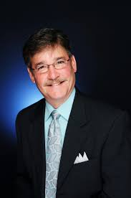
Patrick Grady
Keynote Speaker
Notes:
Thank you everyone and we will do the rest of the chapters Hot Spots in a little bit. Please join us on the stage or in the isles to DANCE!

Slide 16
Membership Awards
Notes:
Thank you everyone and we will do the rest of the chapters Hot Spots in a little bit. Please join us on the stage or in the isles to DANCE!

Slide 17
Closing Ceremony
“We are the Family, Career and Community Leaders of America. We face the future with warm courage and high hope.
For we have the clear consciousness of seeking old and precious values.
For we are the builders of homes,
Homes for America’s future,
Homes where living will be the expression of everything that is good and fair,
Homes where truth and love, and security and faith, will be realities, not dreams.
We are the Family, Career and Community Leaders of America. We face the future with warm courage and high hope.”
Notes:
[Hannah] Please stand and join in the Closing Ceremony.
“Family, Career and Community Leaders of America, we are challenged to accept the responsibility of making today’s decisions that affect our lives and the world in which we live. Let us repeat our Creed.”
[Everyone]
“We are the Family, Career and Community Leaders of America. We face the future with warm courage and high hope.
For we have the clear consciousness of seeking old and precious values.
For we are the builders of homes,
Homes for America’s future,
Homes where living will be the expression of everything that is good and fair,
Homes where truth and love, and security and faith, will be realities, not dreams.
We are the Family, Career and Community Leaders of America. We face the future with warm courage and high hope.”

Slide 18
Have a great year!
Notes:
[Hannah] Thank you all very much. Great things are ahead for each and every one of you. As we go our separate ways today, let’s remember our unique opportunity to Be…..Know…. and Do in our chapters, schools and communities. Safe travels to you all!

