Slide 1
1
1
2
2
3
3
4
4
Notes:
Family Feud Template
Introduction Slide – The Countdown!

Slide 2
FAMILY FEUD FAMILY FEUD FAMILY FEUD FAMILY FEUD FAMILY FEUD FAMILY FEUD FAMILY FEUD FAMILY FEUD FAMILY FEUD FAMILY FEUD FAMILY FEUD FAMILY FEUD FAMILY FEUD FAMILY FEUD FAMILY FEUD FAMILY FEUD FAMILY FE
FAMILY FEUD FAMILY FEUD FAMILY FEUD FAMILY FEUD FAMILY FEUD FAMILY FEUD FAMILY FEUD FAMILY FEUD FAMILY FEUD FAMILY FEUD FAMILY FEUD FAMILY FEUD FAMILY FEUD FAMILY FEUD FAMILY FEUD FAMILY FEUD FAMILY FE
Notes:
Family Feud Template
Introduction Slide – Family Feud!

Slide 3
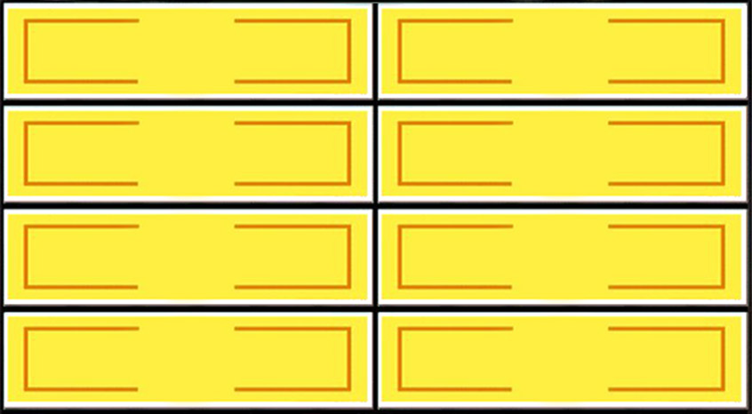
Something you would see at a bullfight
Round 1
X
X
X
X
X
X
X
X
X
The Bull
40
Blood
7
Bull Fighter
17
Roses
5
Cape
15
The Crowd
4
Sword
12
X
X
X
Win
Lose
Cheer
Boo
Silence
Notes:
Family Feud Template
7 Panel Slide

Slide 4
Name a kind of cheese
Round 2
X
X
X
X
X
X
X
X
X
Cheddar
24
Parmesan
11
Swiss
20
Pepper Jack
7
American
17
Mozzarella
5
Blue
14
Goat / Feta
2
X
X
X
Win
Lose
Cheer
Boo
Silence
Notes:
Family Feud Template
8 Panel Slide

Slide 5
Name something you fill with air.
Round 3
X
X
X
X
X
X
X
X
X
Balloons
36
Floaties
6
Tires
20
Sports Balls
5
Beach Ball
15
Lungs
5
Raft/Inner Tube
9
Air Mattress
4
X
X
X
Win
Lose
Cheer
Boo
Silence
Notes:
Family Feud Template
8 Panel Slide

Slide 6
Name something that moves very slowly.
Round 4
X
X
X
X
X
X
X
X
X
Elderly People
30
The DMV
7
Snails/Slugs
21
Worms
6
Turtles
16
Glaciers
6
Babies
10
Sloths
4
X
X
X
Win
Lose
Cheer
Boo
Silence
Notes:
Family Feud Template
8 Panel Slide

Slide 7
Name something people are afraid of.
Round 5
X
X
X
X
X
X
X
X
X
Spiders
26
Ghosts
10
Snakes
21
Being Alone
7
Heights
15
Rejection
5
The Dark
13
Roller Coasters
3
X
X
X
Win
Lose
Cheer
Boo
Silence
Notes:
Family Feud Template
8 Panel Slide

Slide 8
Name something that flies.
Round 6
X
X
X
X
X
X
X
X
X
Bird
29
Bee
10
Airplane/Helicopter
22
Butterfly
5
Kite
16
Drone
2
Bug
15
Time
1
X
X
X
Win
Lose
Cheer
Boo
Silence
Notes:
Family Feud Template
8 Panel Slide

Slide 9
Name something people put on salads.
Round 7
X
X
X
X
X
X
X
X
X
Dressing
40
Croutons
7
Eggs
18
Meat
6
Cheese
15
Oil/Vinegar
3
Vegetables
10
Salt/Pepper
1
X
X
X
Win
Lose
Cheer
Boo
Silence
Notes:
Family Feud Template
8 Panel Slide

Slide 10
Question
Round 1
X
X
X
X
X
X
X
X
X
Answer 1
0
X
X
X
Win
Lose
Cheer
Boo
Silence
Notes:
Family Feud Template
1 Panel Slide

Slide 11
Question
Round 2
X
X
X
X
X
X
X
X
X
Answer 1
0
Answer 2
0
X
X
X
Win
Lose
Cheer
Boo
Silence
Notes:
Family Feud Template
2 Panel Slide

Slide 12
Question
Round 3
X
X
X
X
X
X
X
X
X
Answer 1
0
Answer 2
0
Answer 3
0
X
X
X
Win
Lose
Cheer
Boo
Silence
Notes:
Family Feud Template
3 Panel Slide

Slide 13
Question
Round 4
X
X
X
X
X
X
X
X
X
Answer 1
0
Answer 2
0
Answer 3
0
Answer 4
0
X
X
X
Win
Lose
Cheer
Boo
Silence
Notes:
Family Feud Template
4 Panel Slide

Slide 14
Question
Round 5
X
X
X
X
X
X
X
X
X
Answer 1
0
Answer 5
0
Answer 2
0
Answer 3
0
Answer 4
0
X
X
X
Win
Lose
Cheer
Boo
Silence
Notes:
Family Feud Template
5 Panel Slide

Slide 15
Question
Round 6
X
X
X
X
X
X
X
X
X
Answer 1
0
Answer 5
0
Answer 2
0
Answer 6
0
Answer 3
0
Answer 4
0
X
X
X
Win
Lose
Cheer
Boo
Silence
Notes:
Family Feud Template
6 Panel Slide

Slide 16
Question
Round 7
X
X
X
X
X
X
X
X
X
Answer 1
0
Answer 5
0
Answer 2
0
Answer 6
0
Answer 3
0
Answer 7
0
Answer 4
0
X
X
X
Win
Lose
Cheer
Boo
Silence
Notes:
Family Feud Template
7 Panel Slide

Slide 17
Question
Round 8
X
X
X
X
X
X
X
X
X
Answer 1
0
Answer 5
0
Answer 2
0
Answer 6
0
Answer 3
0
Answer 7
0
Answer 4
0
Answer 8
0
X
X
X
Win
Lose
Cheer
Boo
Silence
Notes:
Family Feud Template
8 Panel Slide

