Slide 2
Classroom ORGANIZATION

Slide 3
Before throwing items out
Check with your administration on the local school’s surplus policy

Slide 5
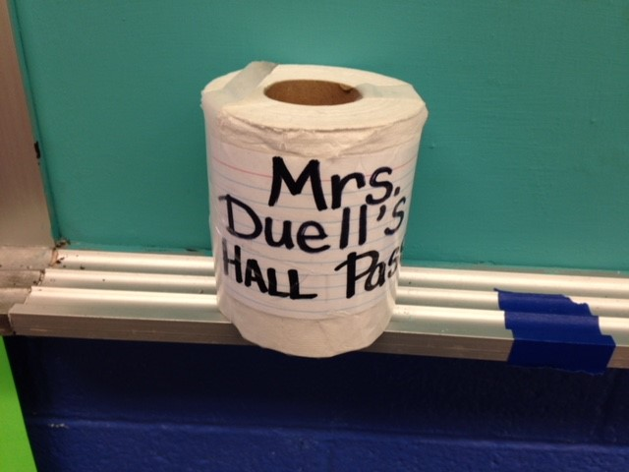
Just a little humor! Most teacher’s use hall passes and this was one that was actually used by a FCS teacher!

Slide 6
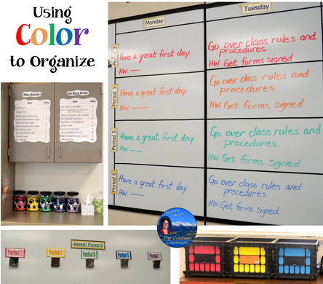

Slide 7
Have a place for everything; label everything

Slide 8
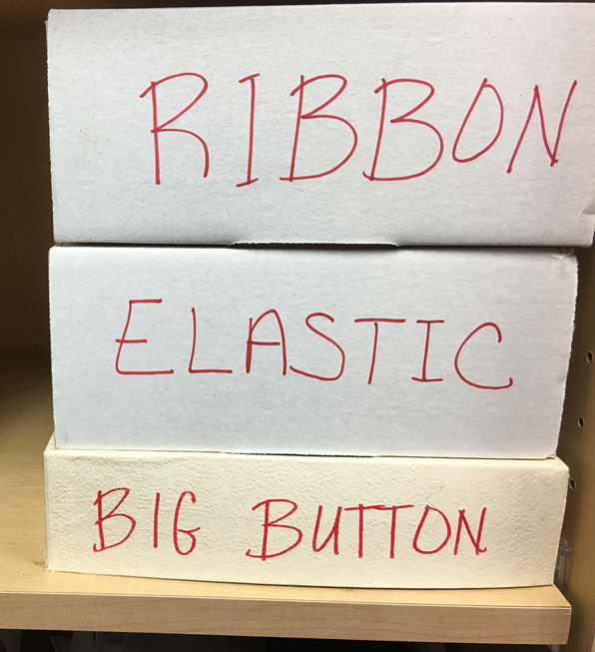
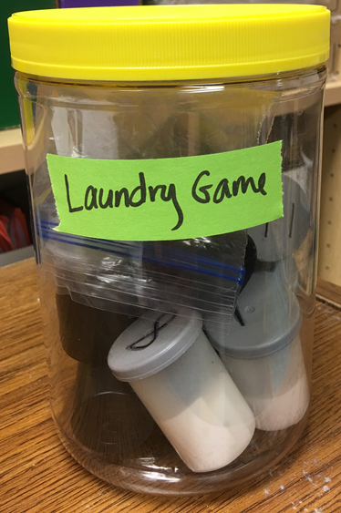
Teen Times, FCCLA Magazine; Connections, Oklahoma FCCLA Magazine; Choices – Scholastic Magazine

Slide 9
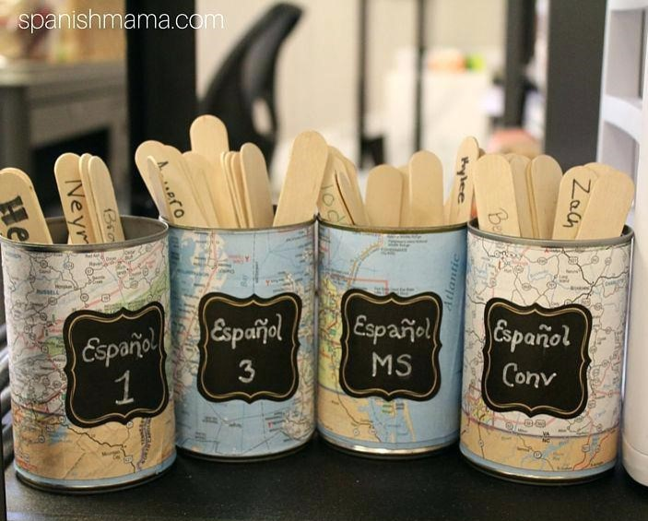
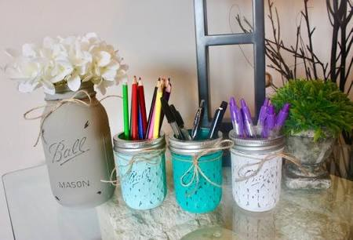

Slide 10
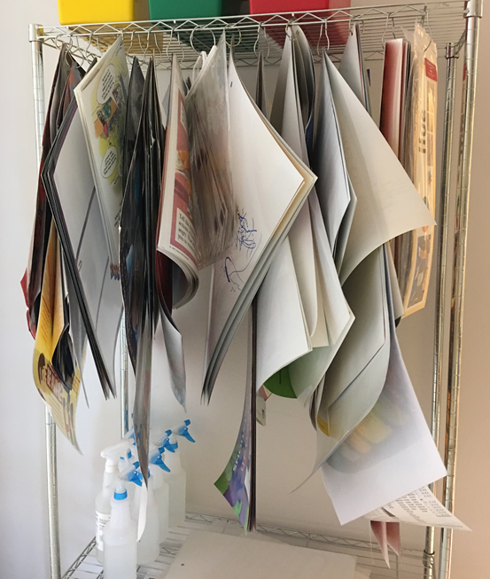
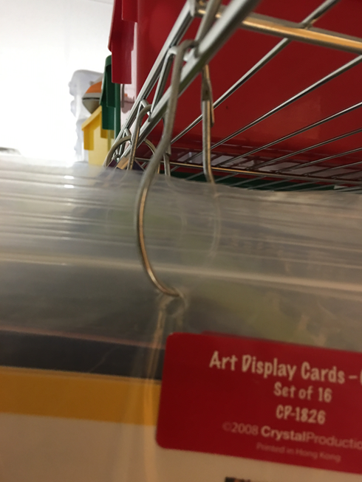
Poster Problems?

Slide 11
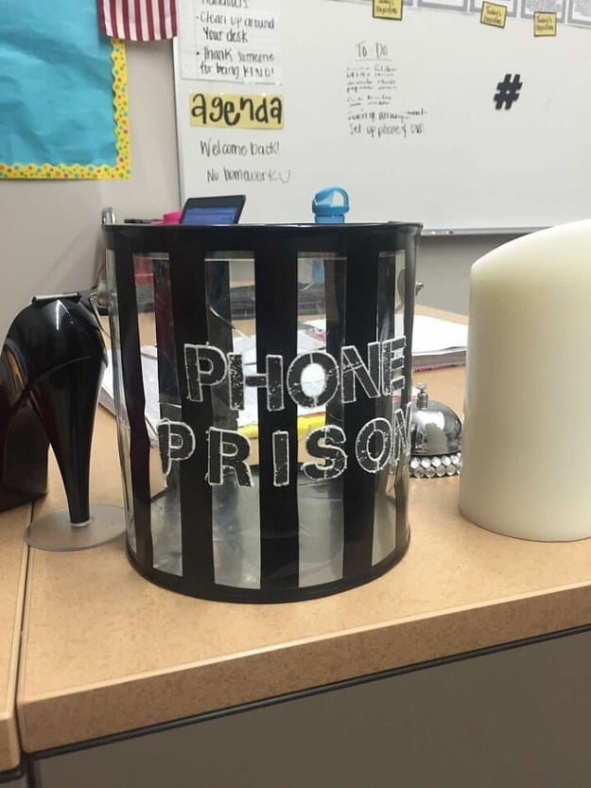
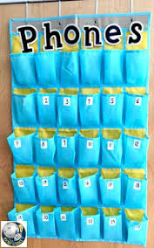
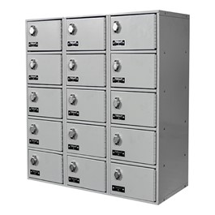
Phone Issues?

Slide 12
Help students stay organized

Slide 13
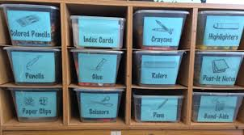
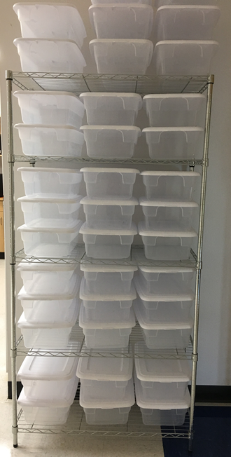

Slide 14
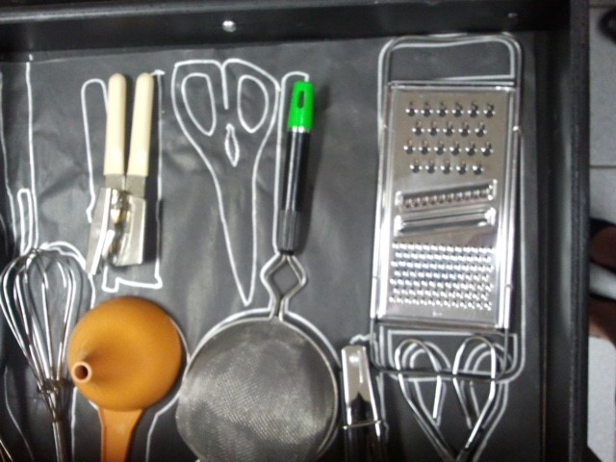
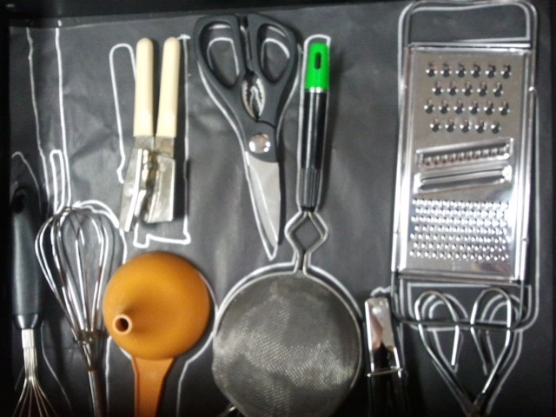
Drawer organization

Slide 15
Require students to replace items in the correct location
(this should be a part of classroom routines at the end of the hour – allow the final 2-3 minutes of class to be cleanup and restore room as they found it)
Hint: if you allow too much time for this procedure, you can end up with chaos for the last minutes. Don’t lose control of your class!

Slide 16
Classroom Theme Use a theme to brighten and enhance your classroom

Slide 17
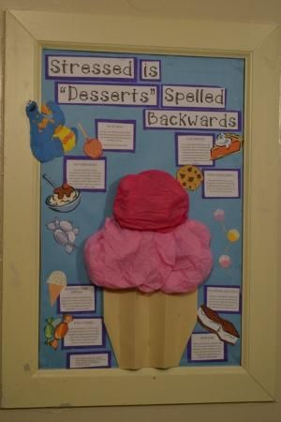
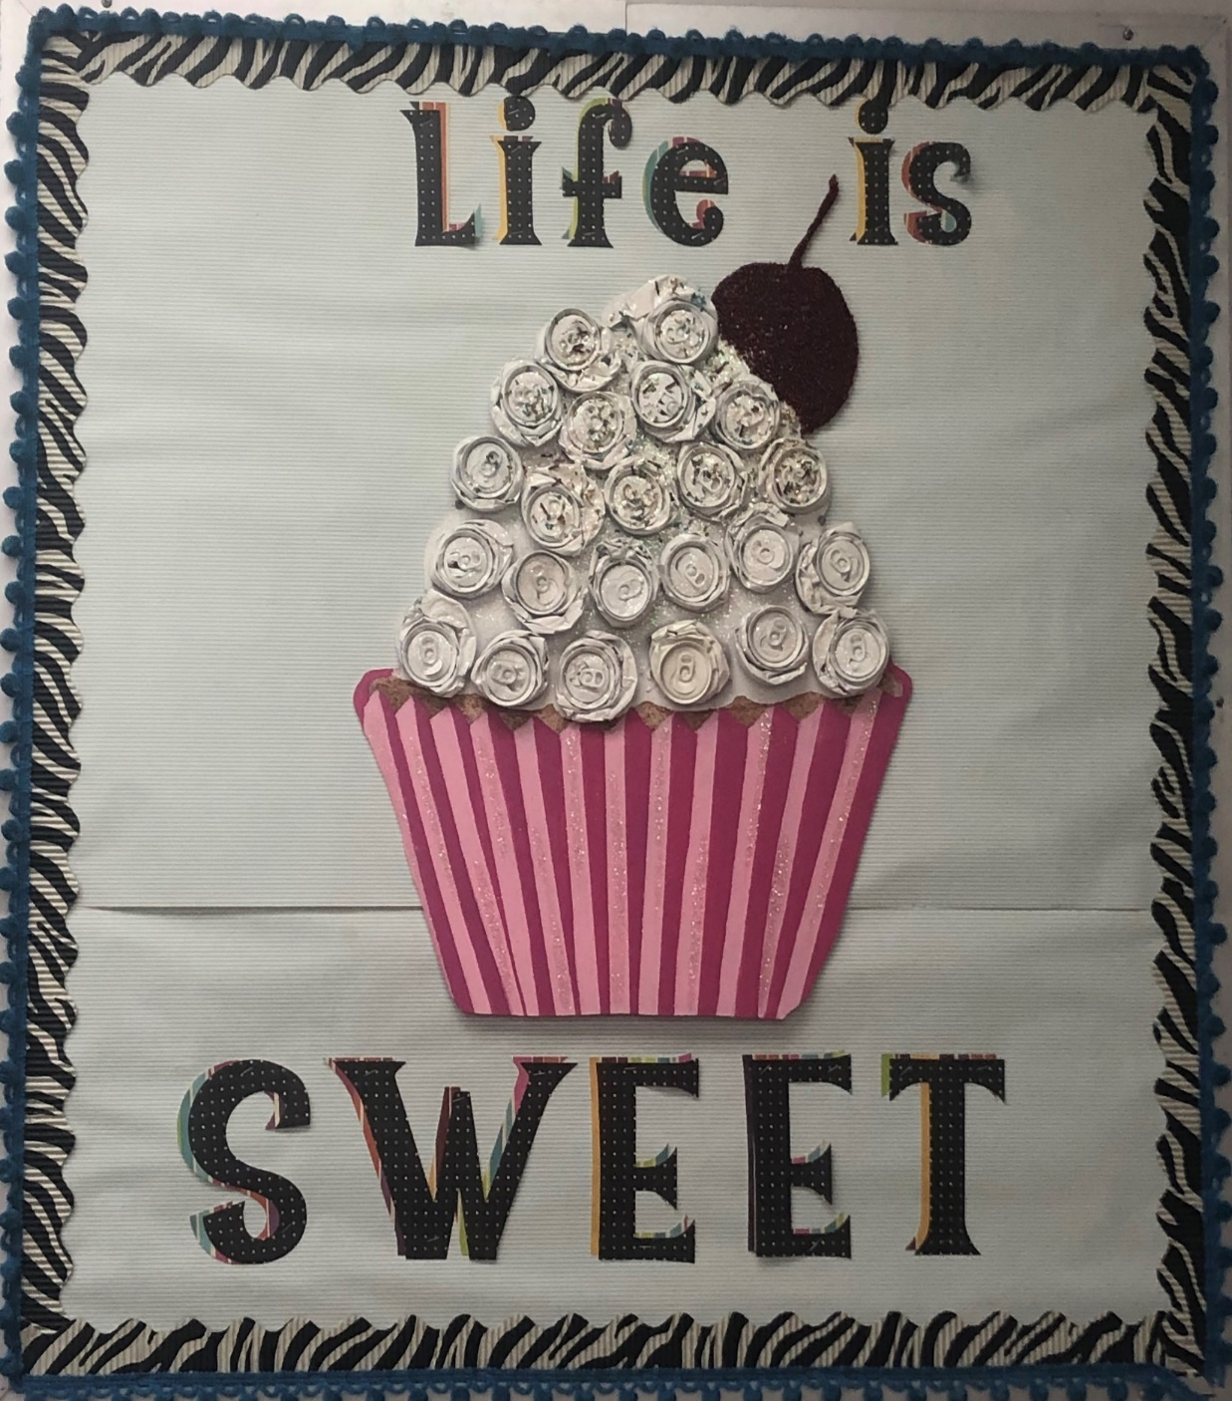

Slide 18
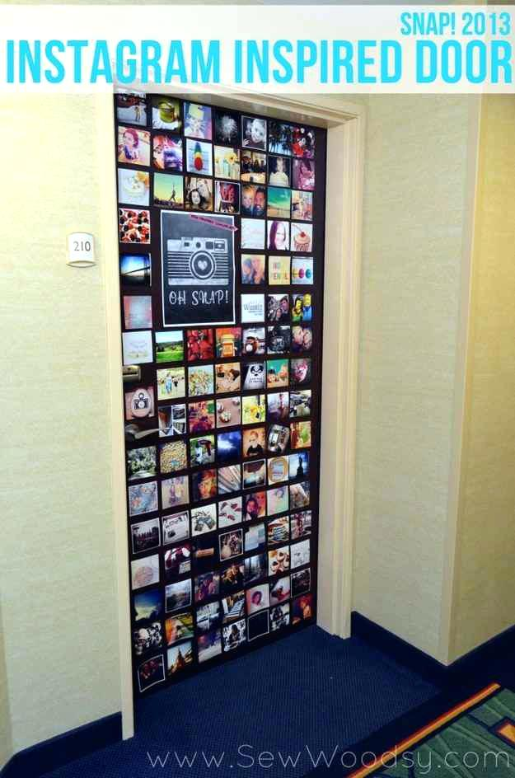

Slide 19
Posters & Wall Decor
Can be decorative and functional
Can give directions or guidelines
Can be relaxing or subject related

Slide 20
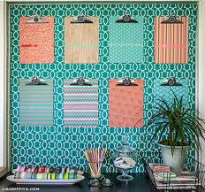

Slide 21
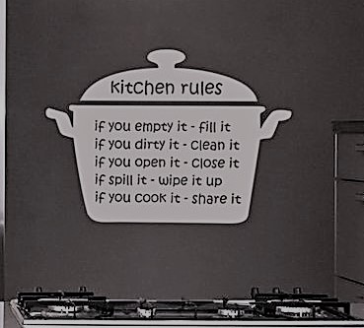

Slide 22
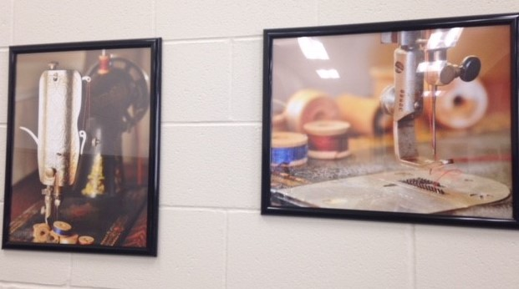

Slide 23
Several FCS teachers are starting to use alternative seating in their classrooms
Bean bag chairs
Dining room tables and chairs
Futons
Large floor pillows on soft floor rugs

Slide 24
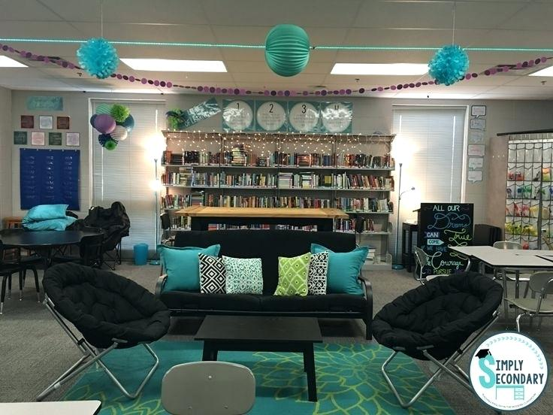

Slide 25
Other resources
Excellent magazine to use with for substitutes
Excellent book for ideas on activities, classroom management, discipline and much more

Slide 26
Print magazine Online resources Teaching Support Standards
https://classroommagazines.scholastic.com/all-magazines.html

Slide 28
https://elearningindustry.com/321-free-tools-for-teachers-free-educational-technology

Slide 29
Thank you for being a teacher!
You make a difference.
mary jane.grayson@careertech.ok.gov
405.743.5469

