Slide 1
North
Northeast
South
Southeast

Slide 2
Virtual Meeting Etiquette
Name- make sure your name and region are on the screen
Dress appropriately
Be aware of surroundings- background, other family members can be distracting
Mute microphone- prevents background noises from interfering with presentations
Be present- avoid doing other things during the meeting
Video should remain on- Look at camera when speaking
Listen- listen actively to what the speakers have to say
Take Notes- helps you to concentrate and process information
Be prepared- be on time when the meeting begins
Ask questions- Jot down questions/use chat feature to make sure they are answered at appropriate time

Slide 3
Icebreakers,
Games and
Team-Building Activities

Slide 4
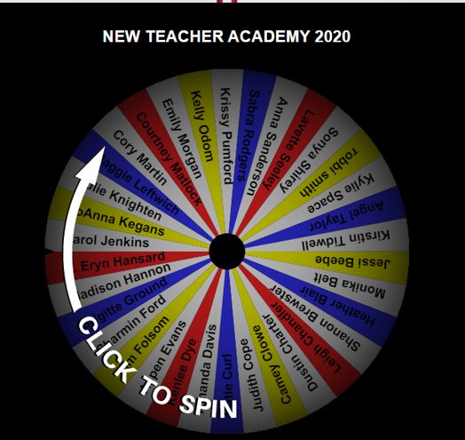
*Participant Introductions*
Share the following information
Name
School
Number of years teaching
An interesting fact about yourself

Slide 5
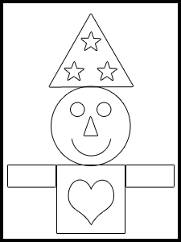
Draw My Picture
What you will need:
Paper
Pen/pencil
Ears
Listen to the directions and follow them the best you can
Let’s see if we all end up with the same picture.
Notes:
THE DRAW MY PICTURE GAME
Materials:
Pencils or crayons
White paper
Clipboards
Ears (Available on the heads of most children though not always used)
Directions:
Have each player partner up with another player. Give each person a piece of paper, a writing utensil, and a clipboard. Tell the players to sit back-to-back with their partners. Explain that one person (the Artist) will draw a picture using only simple shapes and lines. The other player (the Apprentice) cannot look while he is doing it. When the Artist is done, he must give the Apprentice verbal directions on how to draw his picture. The Artist may not look at the Apprentice’s work while he is drawing. When the Apprentice is finished, the two players compare their drawings. They can then switch roles and play again.
EXAMPLE
Here’s your chance to try The Draw My Picture Game. Grab a piece of paper and a pencil and follow the directions below.
First, your paper should be situated vertically on your desk.
Draw a medium-sized circle in the middle of your paper.
Draw a medium-sized square below the circle but have the top of it touch the bottom of the circle.
Draw a medium-sized heart in the square.
Draw two smaller rectangles, one on each side of the square. They should go the wide way not the tall way and they should touch the sides of the square. Also, the top of each rectangle should line up with the top of the square.
Draw a medium-sized triangle above the circle. The bottom of the triangle should touch the top of the circle.
Draw three small stars anywhere inside the triangle.
Draw a small triangle in the center of the medium-sized circle.
Draw an arc which curves up below the small triangle.
Draw two small circles above the small triangle, one slightly to the right and one slightly to the left.
Done.
Here it is.

Slide 6
*2 Truths and 1 Lie*
Icebreaker:
Email your answers to Holly.Hanan@careertech.org
Be sure your name is on the email.
Write down 2 true items about yourself and 1 item that is a lie.
You don’t have to tell me which is which.
Later in the week we will have an activity to see if others can guess who each of these describe.
Example:
Holly Hanan
My favorite ice cream is Cookies and Cream
I live on a horse ranch
My favorite vacation was to the Grand Canyon

Slide 7
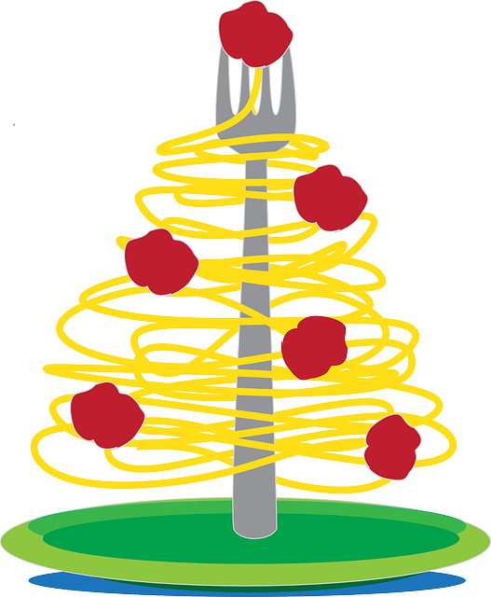
*Rose, Thorn, and Spaghetti*
This is a great idea for groups who are a little more familiar with one another. Each participant shares three highlights from their day:
Rose: the best thing that happened that day
Thorn: something the person wishes hadn’t happened or something unpleasant that happened
Spaghetti: something funny or unexpected that happened

