Slide 1

New Teacher Academy 2020

Slide 2
How do I know which curriculum to use?
What career plans are in place within your school?
FCS Program of study
What courses are to be taught?

Slide 3
Speak with administration
Talk with program specialist

Slide 4
Why plan???

Slide 5
P
P
P
P
P
rior
lanning
PPPPP
revents
oor
erformance

Slide 6
Standard 1 (of program standards)
Learning activities are properly coordinated, planned, organized and are being sequentially implemented as evidenced by
Course Syllabi
Integration of Core Academic Subjects
Year-Long Lesson Plans

Slide 7

Where do I begin with curriculum planning?

Slide 8
YEAR LONG PLANNING
Create a plan for the entire course
Year long
Semester
Use Pacing Guides to determine how long to teach a unit
Plan foods units, sewing units, etc. at the same time if teaching same subject areas for more than one class

Slide 9
For each curriculum, there are
suggested
Pacing Guides.
Covering all of the intended material is important, particularly for those courses that offer an end-of instruction (EOI) test.
Who remembers which courses have an EOI (end of instruction test)?

Slide 10
Assignment:
Using information for the curriculum: FACS Basics (or a course of your choice-use correct pacing guide)
Complete a School Year Instructional Plan of your choice
Map out which courses you will teach when and for how long

Slide 11
Suggestions for planning:
Use your school calendar and block out days that you are not in school with an X
Put in test dates (i.e. 2 days for 9 weeks; 4 for 9 weeks and semester)
Then select order of units to teach

Slide 12
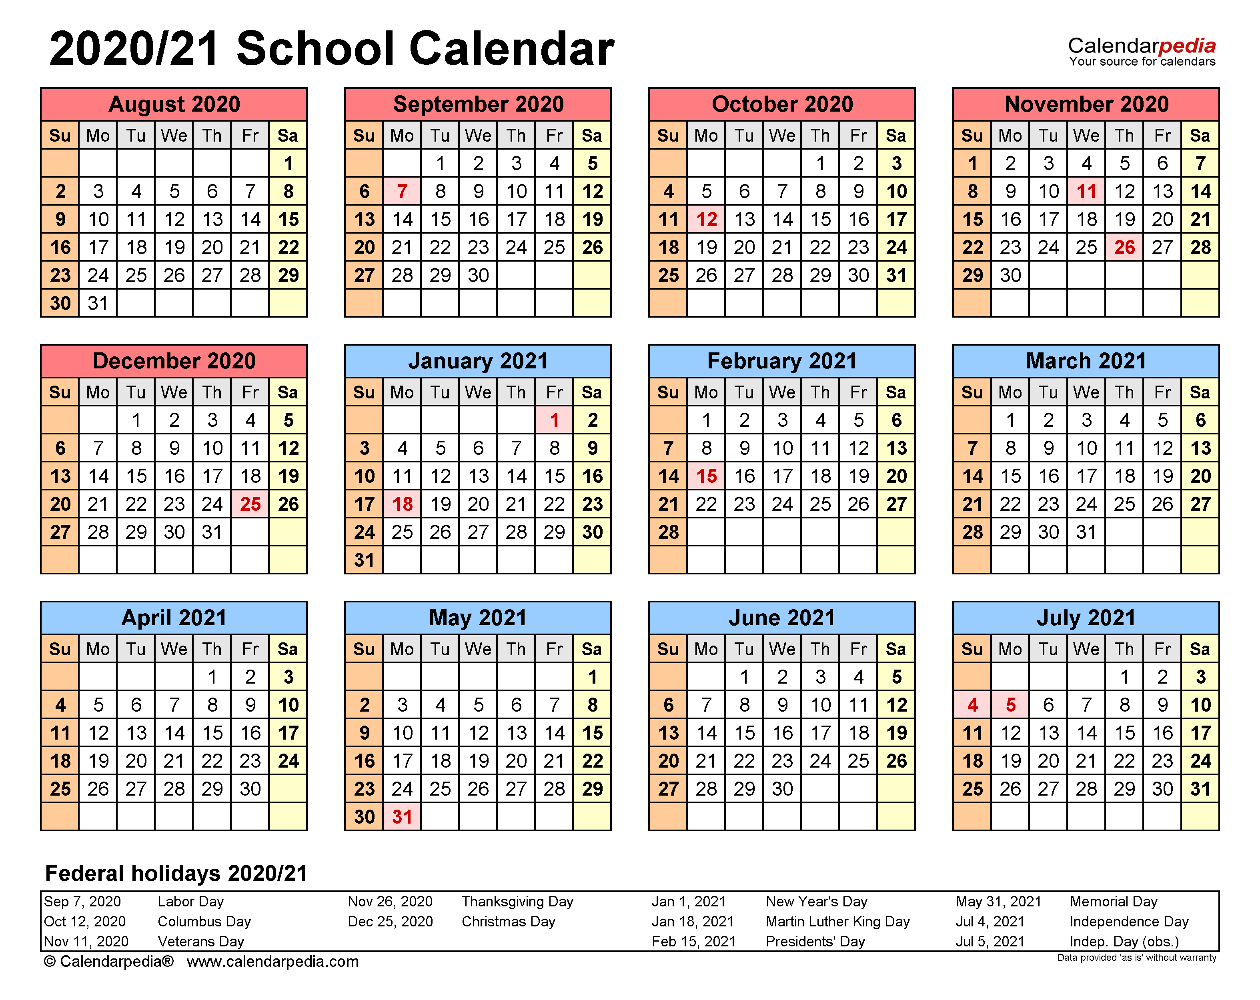

Slide 13
Link to an editable school calendar:
https://www.calendarlabs.com/school-calendar/

Slide 14
School Year Instructional Plans
Class Title | August |  |  |  | September |  |  |  | October |  |  |  | November |  |  |  | December
Class Title | January |  |  |  | February |  |  |  | March |  |  |  | April |  |  |  | May

Slide 15
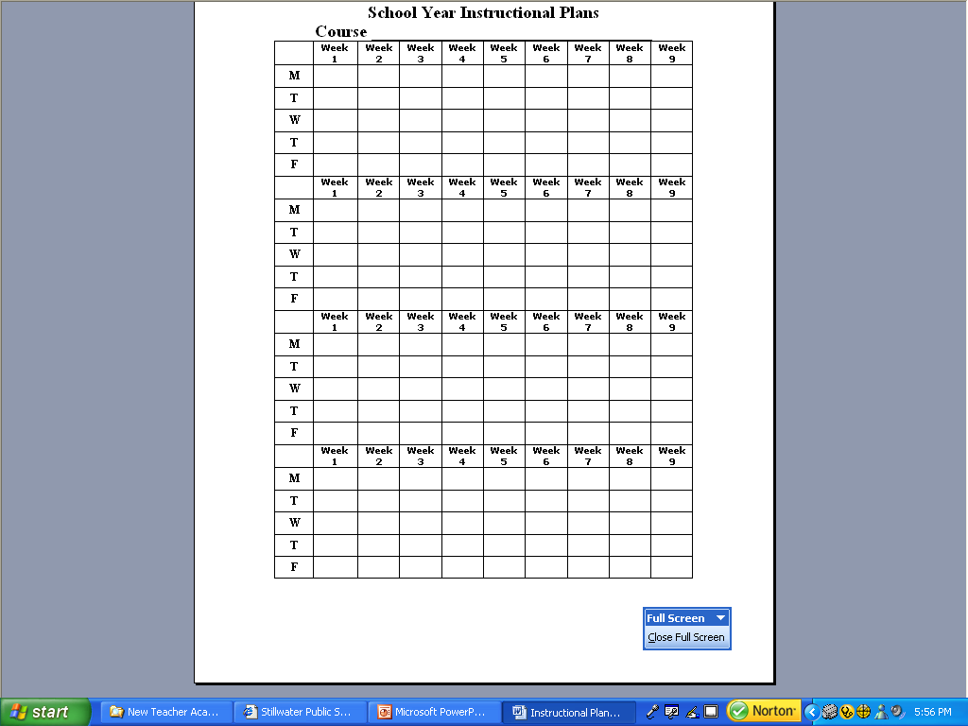

Slide 16
Other important information to assist in lesson planning:

Slide 17
How do I use the curriculum?

Slide 18
Organize it!
Supplement it!
Localize it!
Personalize it!

Slide 19
Supplement it!
Textbooks
Videos
Websites
Assignment sheets
Unit projects

Slide 20
Localize it!
Relate topic to your community
Use persons within your community as
guest speakers
Help students to connect local jobs or
careers with current subject area
Relate to current events - newspapers, Internet, TV

Slide 21
Personalize it!
“Hook and hold”
(Integration of Learning Styles and Multiple Intelligences)
Tell a story
Share an appropriate incident
from your life

Slide 22
Discovery
Encourage students to discover or seek the answers on their own
Encourage/offer assignment choices

Slide 23
Must have a DAILY lesson plan:
Recommendations to include:
Bell Ringers
Activities
Assignments
Group projects
Discovery /exploration
Technology
Learning games

Slide 24
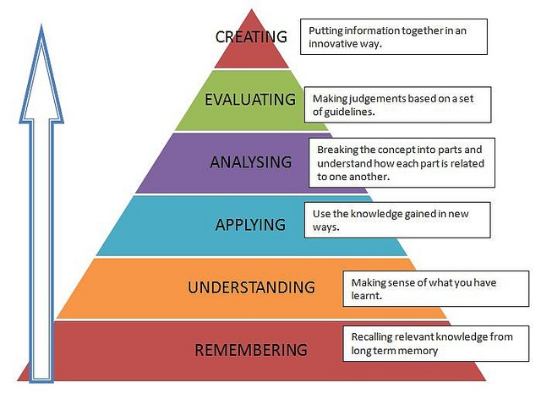

Slide 25
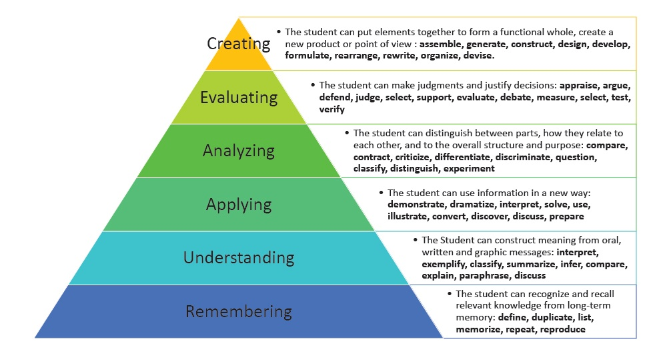

Slide 26
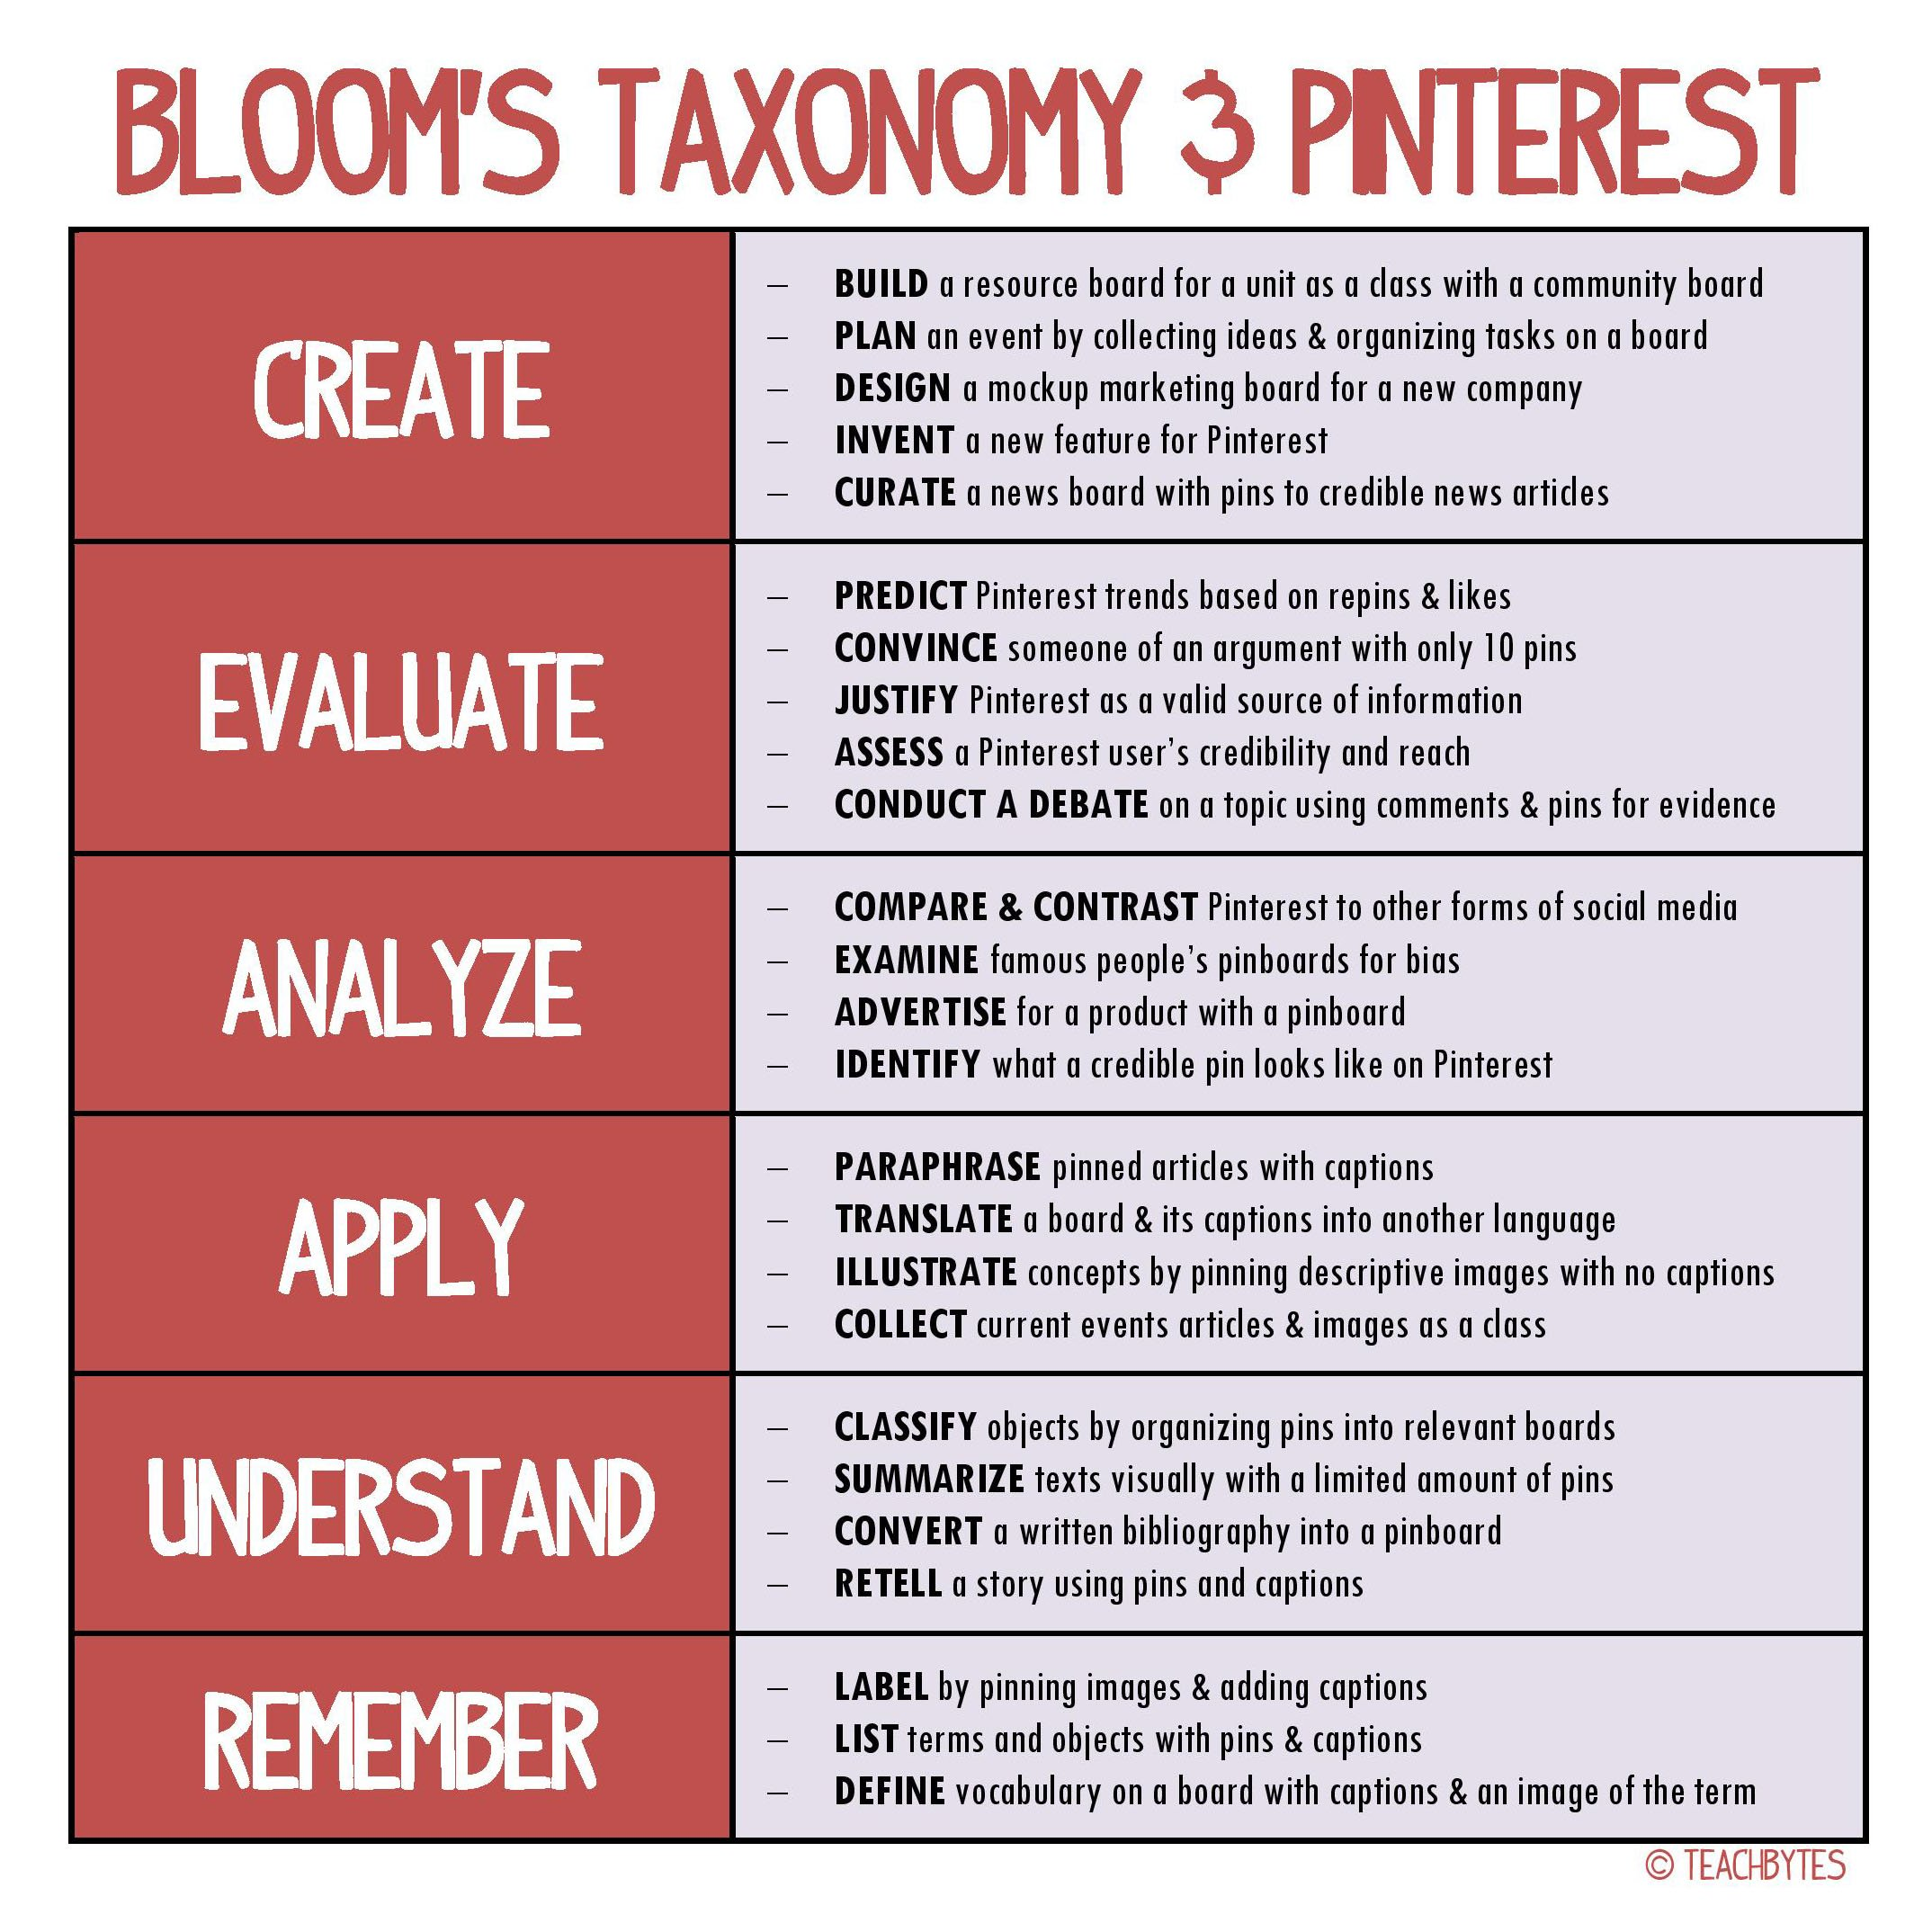

Slide 27
Website for the above Bloom’s taxonomy charts:
https://search.yahoo.com/yhs/search?p=bloom%27s+taxonomy&ei=UTF-8&hspart=mozilla&hsimp=yhs-001

Slide 28

maryjane.grayson@careertech.ok.gov
405.743.5469

Slide 29
SAMPLE:

Slide 30
SAMPLE:

