Slide 1
Teaching Adult Learners
Susie mceachern, odcte
HCE Program specialist

Slide 2
Objectives
Positive learning environment
Techniques to “Sell it”
Meaningful and engaging place to learn
Fun and games for instruction

Slide 3
Questions to ask yourself…

Slide 4
Positive Learning Environment
The habits and behaviors your students develop in your classroom will translate to the workplace.
The greater the challenge, the more meaningful the reward.
Learning can be fun, fun can be motivating, and you are responsible for creating that environment.
Students learn best when they are active participants in the learning process.
It takes creativity!

Slide 5
Techniques to “Sell It”
The atmosphere you create for students is key.
Have clear goals and high expectations.
Create lesson plans that are fresh and involve a variety of learning styles.
Short bursts of information.
Be passionate about the success of your students.

Slide 7
A Meaningful and Engaging Place to Learn
Students can learn.
Motivation has the greatest impact on student learning.
It’s more than just delivering content.
You are the expert and prime motivator.
Create challenges that make students believe they can learn.

Slide 8
Fun and Games for Instruction
Content/motivation/teamwork

Slide 9
Content
Must have a clear connection to the curriculum.
Can be used to introduce a lesson.
Can be used as an instructional strategy.
Can be used for review.

Slide 10
Motivation
Students want to participate in fun activities.
Enjoyment and engagement are vital to the learning process.
The attitude of the instructor can convey enjoyment.
Fun is contagious!!!

Slide 11
Teamwork
Develops personal characteristics for success.
Being a team member is one of the many employability “soft skills” students will experience.
Involves collaboration.
Provides opportunities for teachable moments.
Real world simulation.
Energy, motivation and engagement.

Slide 12
Using the A,B,C,D cards on your table, answer the following questions by holding the letter up you believe is the correct answer.

Slide 13
The answer is…
Multiple Choice Quiz
What do state and local agencies often use to help develop their health science education curricula?
a. HOPE curriculum
b. Federal Education Act
c. National Health Science Standards
d. School Health Policy and Programs Study
C

Slide 14
The answer is…
Multiple Choice Quiz
What kind of knowledge is critical for students in health promotion and disease prevention?
a. Standards-based
b. Goal driven
c. Functional
d. Instructional
C

Slide 15
The answer is…
Multiple Choice Quiz
3. Which of the following National Health Science Standards would include positive self-talk, personal health care, and stress management?
a. Health Maintenance
b. Goal setting
c. Core Concepts
d. Advocacy
A

Slide 16
The answer is…
Multiple Choice Quiz
All of the following are examples of interpersonal communication skills EXCEPT?
a. “I”statements
b. Peer resistance skills
c. Listening skills
d. Anger management
A

Slide 17
The answer is…
Multiple Choice Quiz
5. Taking a stand to make a difference on a health-related issue describes?
a. Communication
b. Advocacy
c. Outreach
d. Debate
B

Slide 18
The answer is…
Multiple Choice Quiz
6. According to the text, health education lessons should show students how concepts and skills they learn
a. Benefit the community
b. Make them stronger students
c. Connect to their lives
d. Can make a difference today
C

Slide 19
The answer is…
Multiple Choice Quiz
7. Which of the following is NOT one of the National Health Science Standards?
a. Academic Foundation
b. Communication
c. Evaluation
d. Ethics
C

Slide 20
The answer is…
Multiple Choice Quiz
8. Which of the following correctly orders the five steps of the decision making process?
a. problem, alternatives, pros/cons, choice, evaluate
b. choice, pros/cons, evaluate, alternatives, problem
c. problem, evaluate, pros/cons, alternatives, choice
d. alternatives, problem, evaluate, pros/cons, choice
A

Slide 21
The answer is…
Multiple Choice Quiz
9. Which of the following would include making a plan for improving health, identifying desired health practices, and making a commitment to improve health?
a. Self-management
b. Goal setting
c. Analyzing influences
d. Advocacy
B

Slide 22
The answer is…
Multiple Choice Quiz
10. Behavioral rehearsals are a key component of successfully learning the skills associated with which standard?
a. Core concepts
b. Accessing valid information
c. Decision Making
d. Self-management
D

Slide 23
Rolling for clues
Roll the dice for a clue
You have 20 seconds to discuss/guess the topic
If the team answers incorrectly, the next team rolls the dice and gets a clue
You earn a point for correctly guessing the topic
Each topic has at least 4 clues…

Slide 24
Teaching Cranial Nerves (Pinterest)
Draw this image on a piece of paper

Slide 25
Number your image 1-12

Slide 26
Olfactory
Optic
Oculomotor
Trochlear
Trigeminal
Abducens
Facial
Vestibulocochlear
Glossopharyngeal
Vagus
Accessory
Hypoglossal
List the 12 cranial nerves
6 on each side of the paper

Slide 27
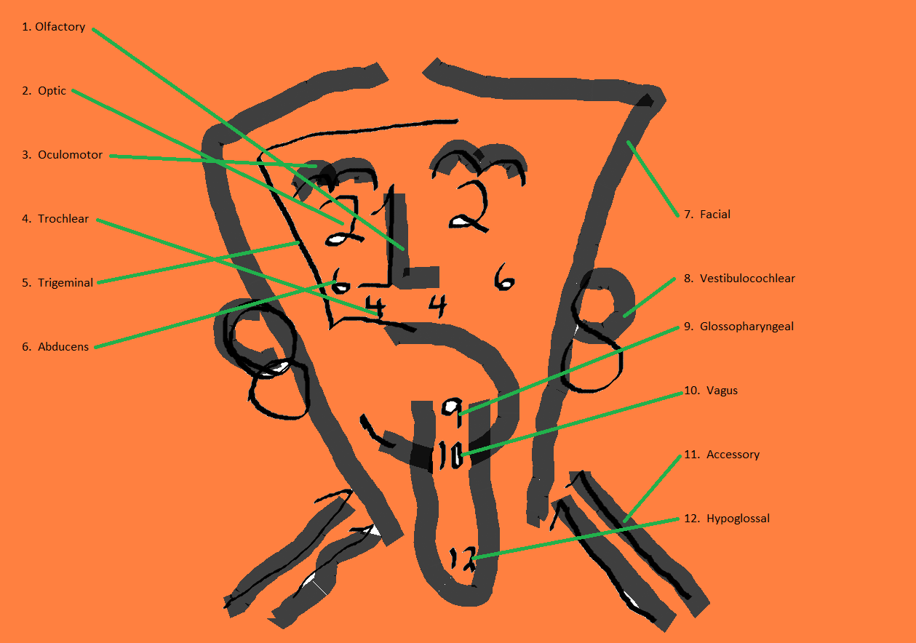
Discussion
What is the function of each nerve?
What is the type of each nerve?
Is it a sensory nerve?
Is it a motor nerve?
Or is it a combination of both (mixed)?

Slide 28
Nerve | Type | Function
Olfactory | Sensory | Sense of smell
2. Optic | Sensory | Vision
3. Oculomotor | Motor | Raise eyelids, move eyes, regulate the size of pupils, focus of lenses
4. Trochlear | Motor | Eye movements, proprioception
5. Trigeminal | Mixed | Sensations of the head & face, chewing movements, & muscle sense
6. Abducens | Motor | Produce movements of the eye

Slide 29
Nerve | Type | Function
7. Facial | Mixed | Facial expressions, secretion of saliva, taste
8. Vestibulocochlear | Sensory | Balance or equilibrium sense, hearing
9. Glossopharyngeal | Mixed | Taste & other sensations of tongue, swallowing, secretion of saliva, aid in reflex control of blood pressure & respirations
10. Vagus | Mixed | Transmit impulses to muscles associated w/speech, swallowing, the heart, smooth muscles of visceral organs in the thorax & abdomen
11. Accessory | Motor | Turning movements of the head, movements of the shoulder & viscera, voice production
12. Hypoglossal | Motor | Tongue movements

Slide 30
Category Walk Blood Composition
Flip charts in four corners
Each has its own category
Red, White, Plasma, Platelets
Find folded paper with “blood” written on it
Take a folded slip of paper off your table…

Slide 31
Blood Composition
Each team member takes 2 slips of paper.
Tape it under the category that best fits the information on your paper.
Repeat the process until all blood composition words/phrases are on a chart
Category Walk

Slide 32
Answer Key for Blood Cells
Erythrocyte
No nucleus
Doughnut-shaped
Oxyhemoglobin
Carbon dioxide
Rh antigen
Life expectancy 120 days
2.5 million produced every second
Red Blood Cells

Slide 33
Answer Key for Blood Cells
Leukocyte
Phagocytosis
Basophils
Antibody production
Neutrophils
Diapedesis
White Blood Cells

Slide 34
Answer Key for Blood Cells
Thrombocyte
Clotting
Sticky when busted
Serotonin
Smallest formed element
From megakaryocyte
Platelets

Slide 35
Answer Key for Blood Cells
Water
Albumin
Fibrinogen
Hormones
Anti-A antibodies
Prothrombin
55% blood volume
Straw-colored
Plasma

Slide 36
PPE
Groups of five
Find the PPE slips with a “D” on your table.
Choose five team members to compete
DO NOT open the slips of paper
Each team member needs 1 slip of paper.
Line up on the tape on the floor
Donning and Removing

Slide 37
Answer Key for PPE
Washed hands using antiseptic soap
Slipped arms into the sleeves of a gown, being careful to touch only the inside of gown.
Secured gown at neck and back of waist, covering clothing completely.
Donned mask.
Donned sterile gloves.
Donning

Slide 38
PPE
Groups of six
Find the PPE slips with a “R” on your table.
Choose six team members to compete
DO NOT open the slips of paper
Each team member needs 1 slip of paper.
Line up on the tape on the floor
Donning and Removing

Slide 39
Answer Key for PPE
Removed the gloves by folding them down and turning them inside out, avoiding touching the outside of the gloves.
Discarded gloves in biohazard container.
Untied gown ties at neck and waist.
Removed gown by pulling down from the neck and slipping hands back into gown sleeve, touching only the inside of the gown.
Folded the gown down over the arms inside-out and discarded in biohazard container.
Removed mask, touching only the ties and discarded in the biohazard receptacle.
Removing

Slide 40
Medical Terminology
Fold a sheet of paper in half vertically
Number your paper from 1-10,
Label it Prefix
Number your paper from 1-10,
Label it Root Word
Dicey

Slide 41
Rules of the game
In teams of 5-10 (by table)
Each team should have 1 dice
When I say go…
One person rolls the dice until they get the number 3
Everyone else is writing as many answers as possible on their page
When the dice hits a 3, you pass it to the right and the same process repeats
Medical Terminology

Slide 42
Stand for True
A review question will be asked.
If you believe the answer is True, stand up.
If you believe the answer is False, stay seated.
If the answer is False, your table will give an explanation.
True/False Review

Slide 43
Match the description to the Profession
On an index card write…
Dental Hygienist
EMT-P
Podiatrist
Nurse Midwife
Audiologist
Athletic Trainer
Optometrist

Slide 44
Dental Hygienist
Fluoride application
Remove stains and deposits
Takes radiographs
Does preliminary exam of the teeth

Slide 45
EMT-P
ACLS
Endotracheal Intubation
Transports victims
ECG interpretation

Slide 46
Podiatrist
Can diagnose athlete’s foot
DPM
Plantar fasciitis treatment
Treats ingrown toenails

Slide 47
Nurse Midwife
Total care for normal pregnancy
Newborn delivery
CNM
Teaches childbirth classes

Slide 48
Audiologist
Can you hear me?
Adjusts hearing aids
Develops hearing protection programs
Tests noise levels in work places

Slide 49
Athletic Trainer
ATC
Applies tape to protect body parts
Teaches proper sports nutrition
Gives strength and conditioning advice

Slide 50
Optometrist
Visual acuity
Prescribes contact lenses
Measures intraocular pressure
Treats conjunctivitis

Slide 51
References
Adult Learners, PowerPoint by Kari Gibson
Learning Games Health Science, 2nd Edition by Kim Smith
Pinterest, Cranial Nerves

Slide 52
Thank you for your participation!
Certificates may be picked up on your way out.
1500 W 7th Ave
Stillwater, OK 74074
405-377-2000

