Slide 1
Adult Learning Principles
Susie McEachern, Health Program Specialist
ODCTE
11/3/2020

Slide 2
I Wonder…

Slide 3
Objectives:
How do we create a positive learning environment through
classroom modification?
How do we create interest through adapting assignments and
changing teaching strategies?
How do we move short-term knowledge into long-term memory through student engagement?

Slide 4
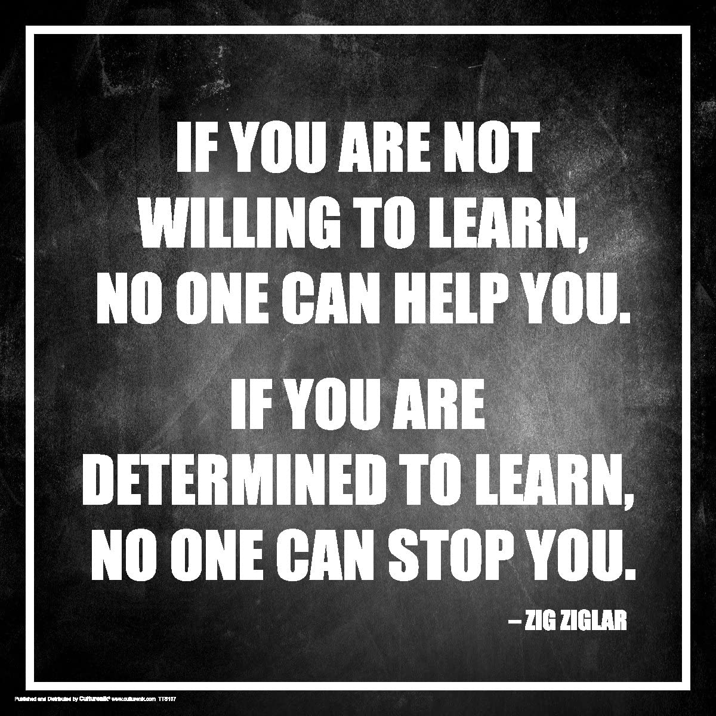
_Zig Ziglar once said:_

Slide 5
Adapting
Modifying
ACTIVITIES
&

Slide 6
W
L
K

Slide 7
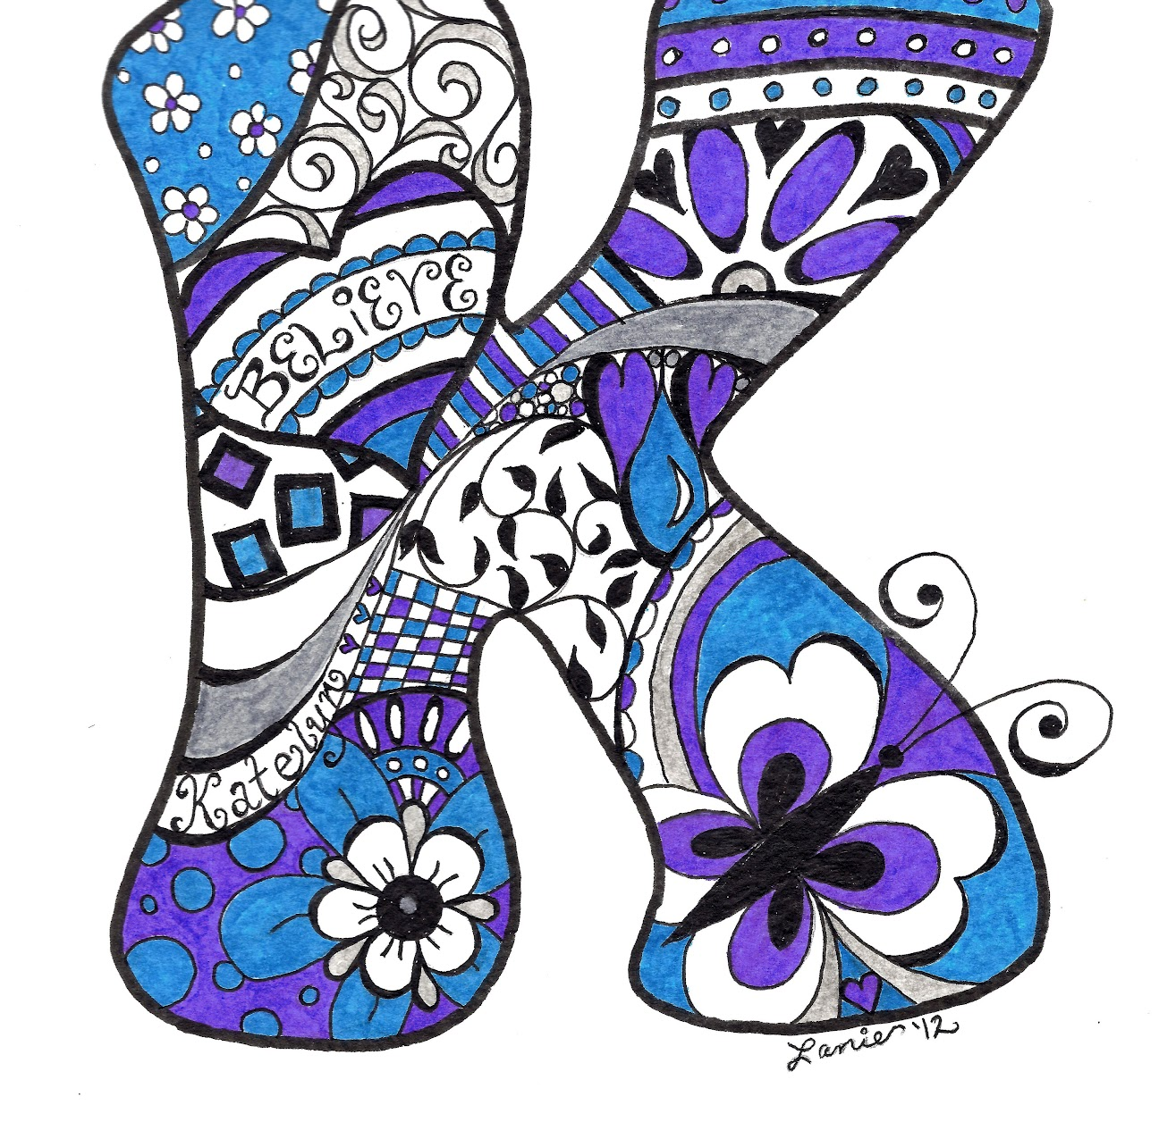
What do you KNOW
about adapting and modifying activities?

Slide 8
Modification/Adaptation Strategies
Assignments | Classroom Environment | Teaching Strategies

Slide 9
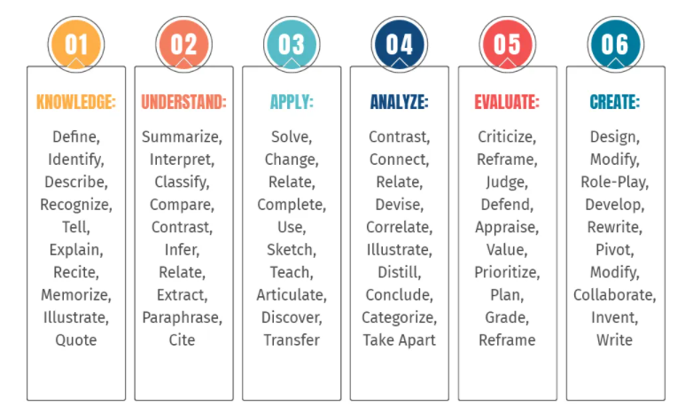
Bloom’s Taxonomy Verbs For Critical Thinking

Slide 10
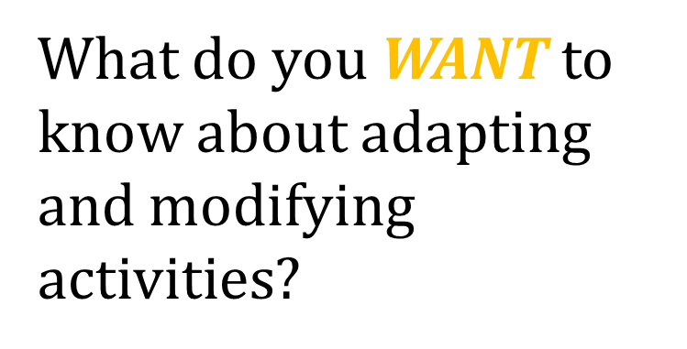

Slide 12
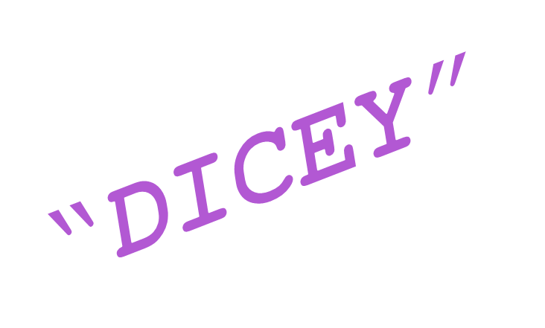
A CRAZY, FUN FAMILY GAME GETS…

Slide 13
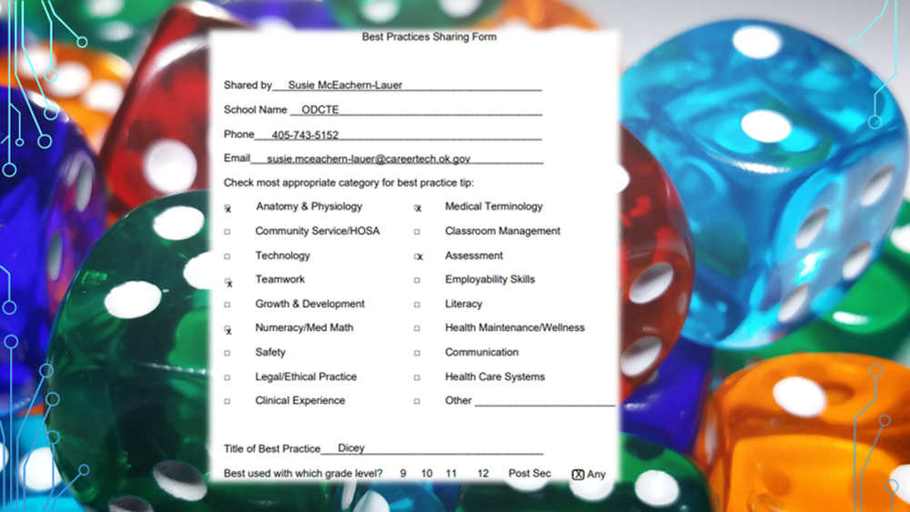

Slide 16
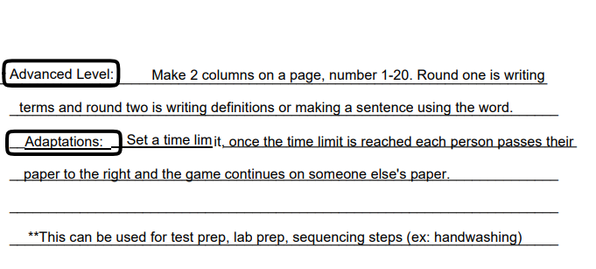

Slide 17
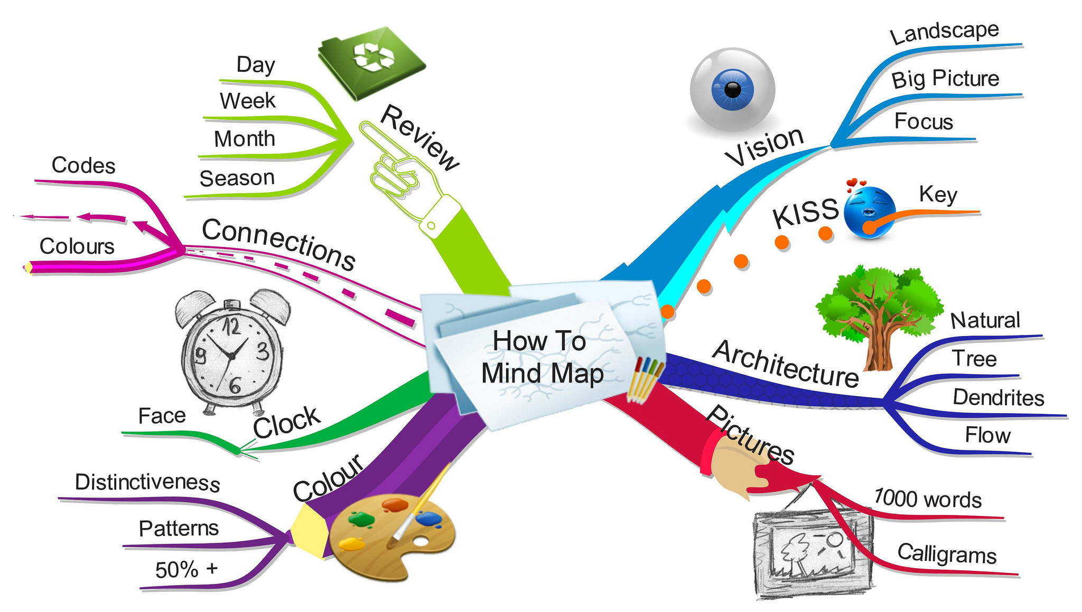

Slide 18
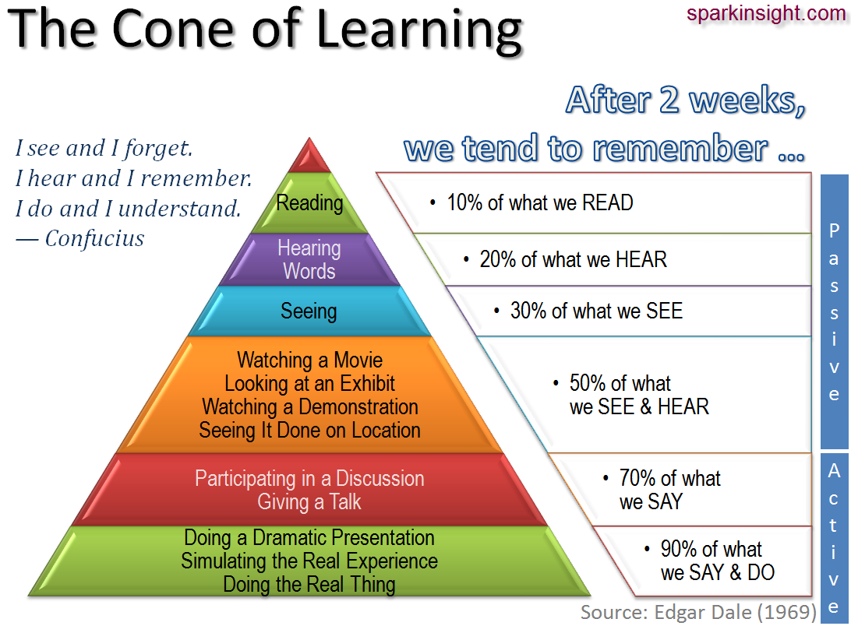

Slide 19
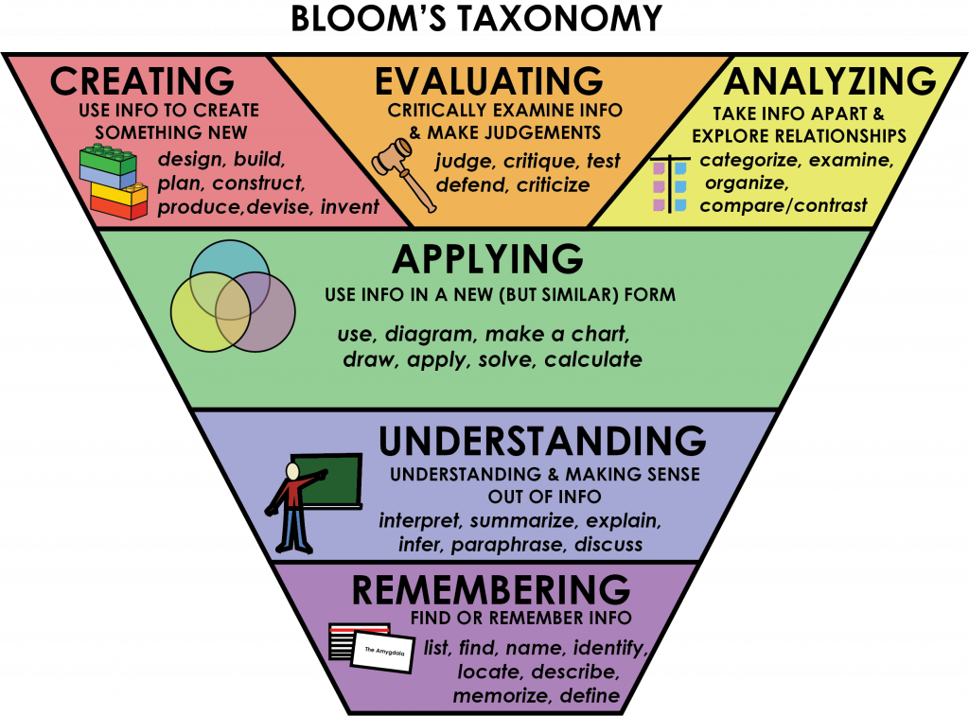

Slide 22
Adaptation:
New vocab
BEFORE lesson
assignments
Detailed drawings with labels
Need to know vs
nice to know

Slide 23
ASSIGNMENTS
Shorter tasks
Provide suggestions for a task
Multiple forms of directions given
MODIFICATION

Slide 24
adaptation:
Classroom environment
Vary pace
FUN
Design & play simulation games
Assign note taking buddies
Change task(20 min)

Slide 25
MODIFICATION
CLASSROOM ENVIRONMENT
Movement opportunities
Set time limits
Change seating
Visually pleasing classroom

Slide 26
Adaptation:
Key points
Re-state concepts
Teaching strategies
Signal to focus
Chunk material
Teach mnemonic devices

Slide 27
MODIFICATION
TEACHING STRATEGIES
Cue students
Hands-on activities
Advance warning of transition
Daily routine
Check progress often

Slide 28
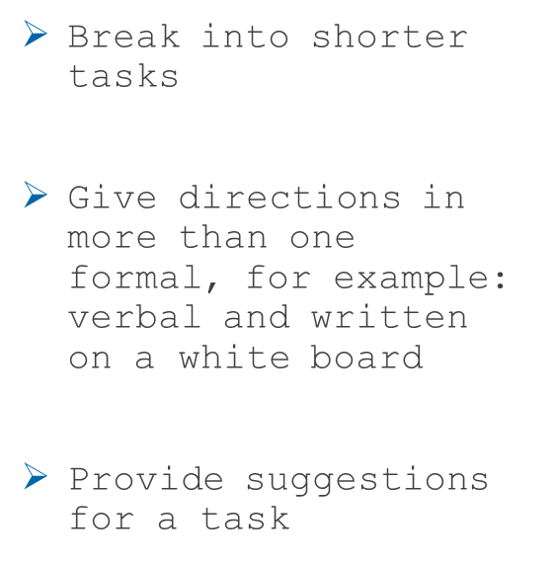
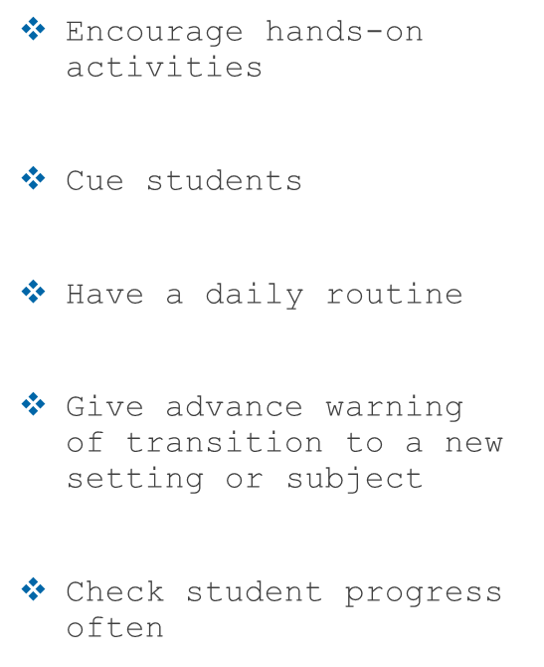
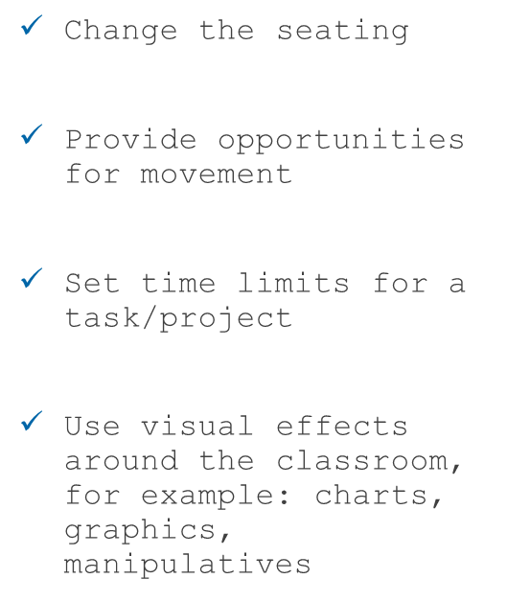

Slide 29
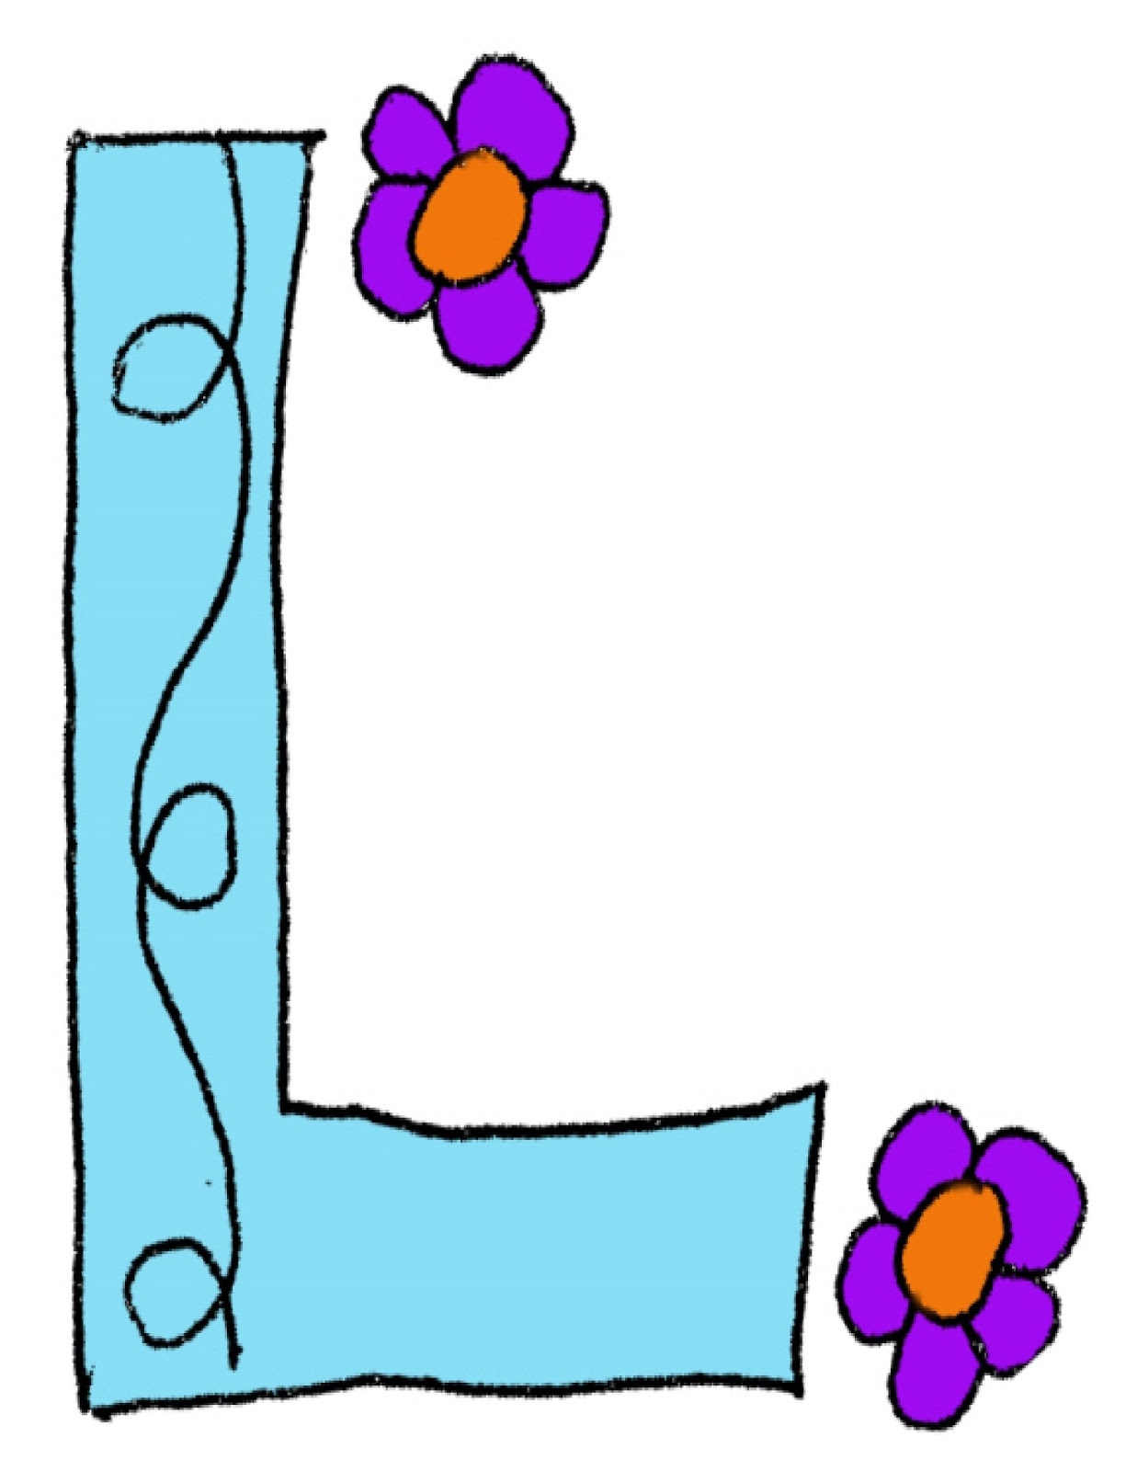
What have you learned?
This Photo by Unknown Author is licensed under CC BY

