Slide 1
Adult Learning Principles
Susie McEachern, Health Program Specialist
ODCTE
11/3/2020

Slide 3
Objectives:
How do we create a positive learning environment
How do we create interest
How do we link cognition into engagement
What ideas can we share

Slide 8
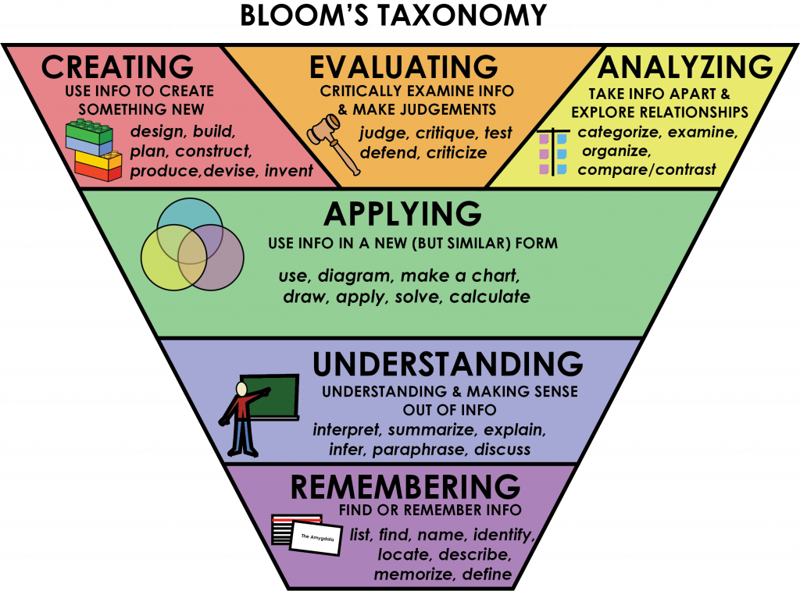

Slide 9
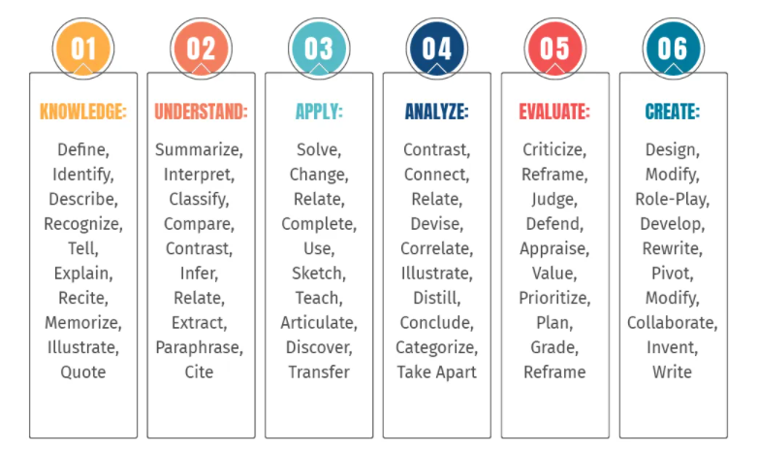
Bloom’s Taxonomy Verbs For Critical Thinking

Slide 10
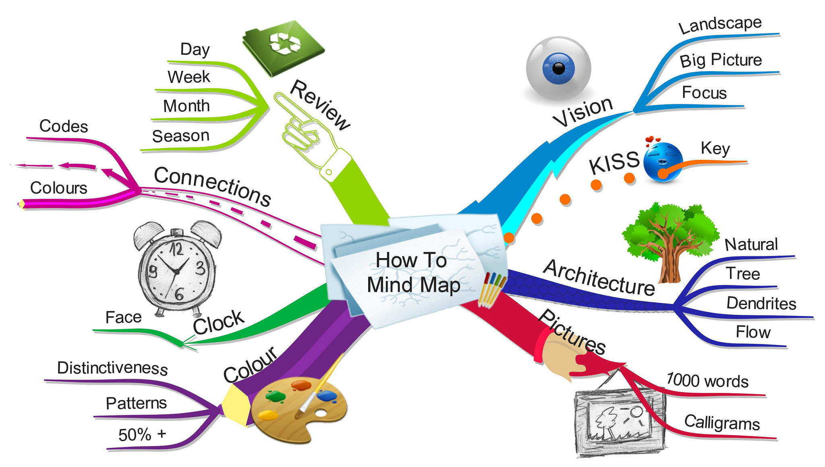

Slide 11
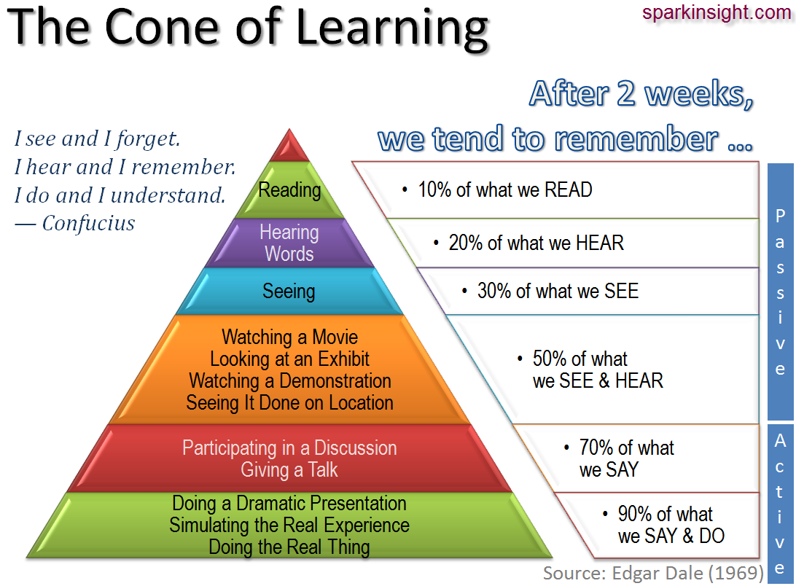

Slide 13
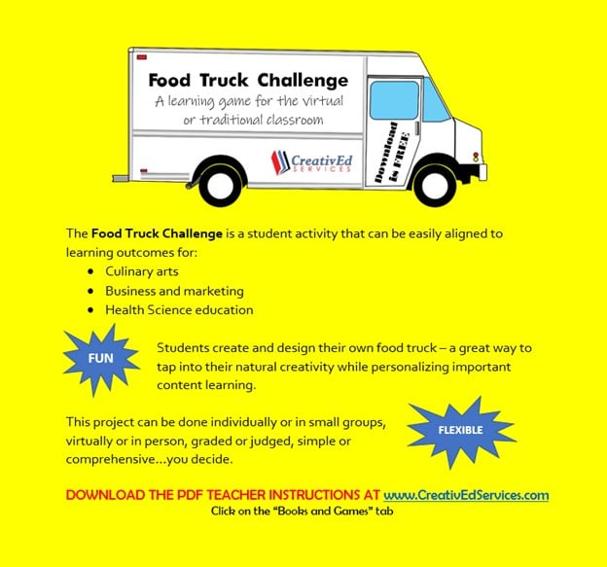
Download this FUN and FREE Learning Game with teacher information and student instructions by going to CreativEdServices.com and selecting the "Books & Games" tab. While you're there, check out the exciting bundle pricing on all our Health Science tools for teachers!

Slide 14
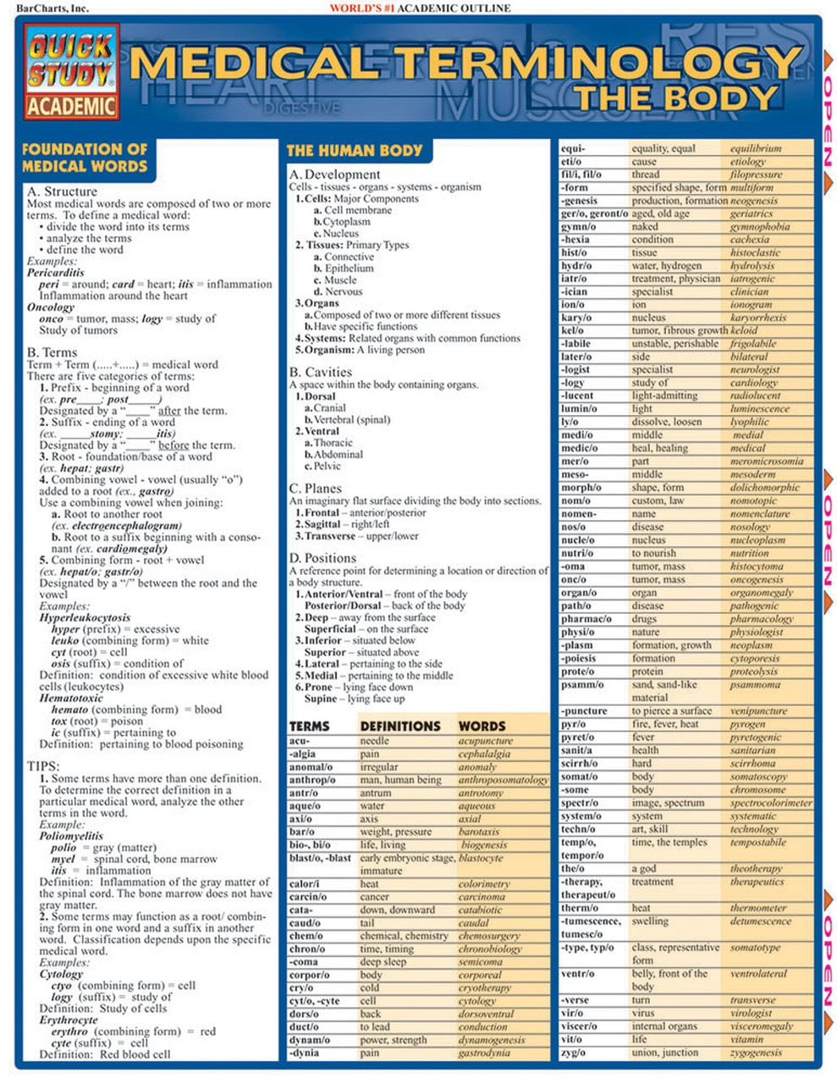

Slide 15
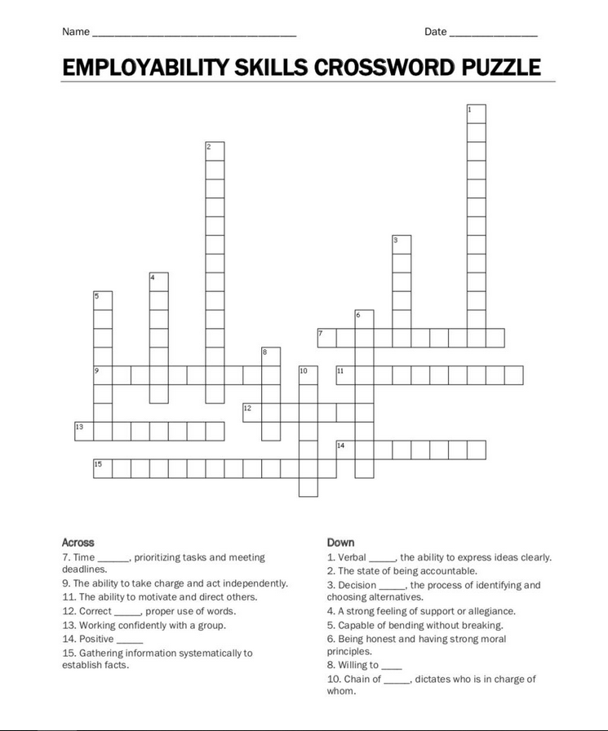

Slide 17
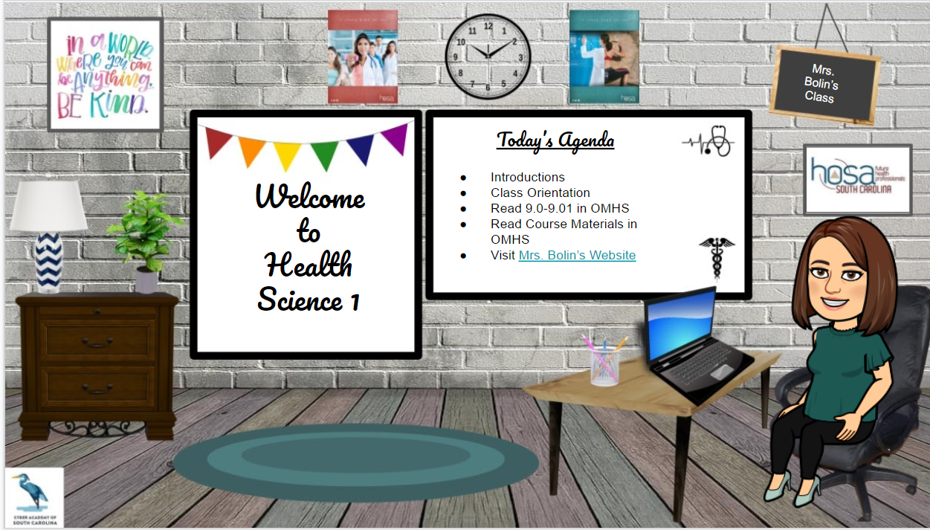

Slide 18
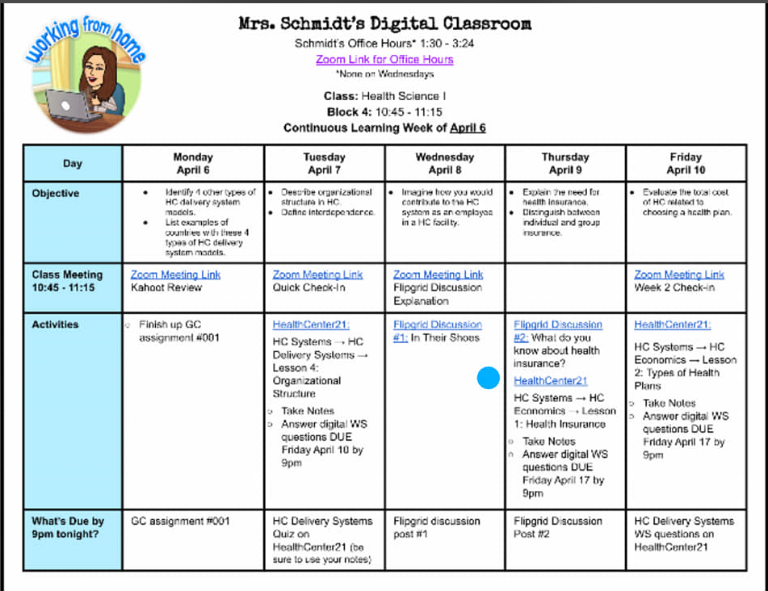

Slide 19
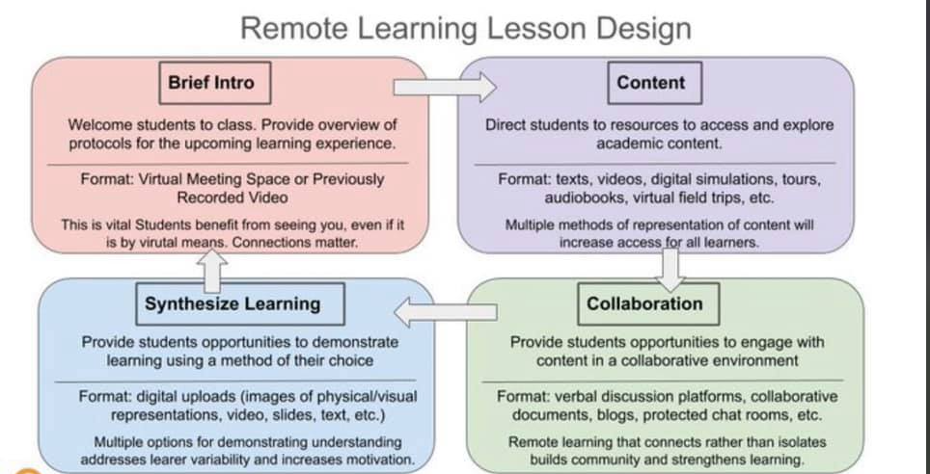

Slide 20
Hello from Hartman Publishing!
We offer free samples of our textbooks to train-the-trainer program attendees. We can easily share information regarding price, copyright year, and popularity with approved training programs in your state. We also provide curriculum crosswalks, which take the curriculum objectives from Oklahoma’s introduction to long-term care assistant and show you where to find that content in our books.
Please consider registering for our instructor’s website at https://instructors.hartmanonline.com. It is free to register and once approved, usually within one business day, you will have access to the most recently updated instructor’s materials (lesson plans, test banks, PowerPoint presentations, etc.) for all our books. Please enter “Train the Trainer” in the “Your Facility’s Name” field of the online request form so we know why you registered.
If you’d like to preview our 29 skills videos, you may do so at https://videos.hartmanonline.com
using the following temporary school code (expires 1/04/2020): 2020hpivids.
We’d love to know what you think of our book and skills videos once you’ve had some time to look them over. Your feedback helps us make better books!
Warm Regards,
Deborah M Rinker Wildey
Customer Sales Representative
deb@hartmanonline.com

