Slide 1
Adult Learning Principles
Oklahoma Department of Career Tech
Susie McEachern-Lauer, Health Program Specialist 06/09/2021

Slide 3
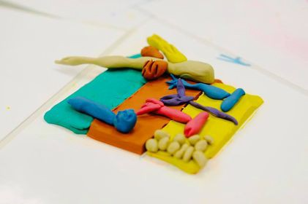
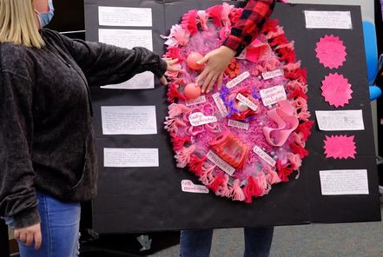
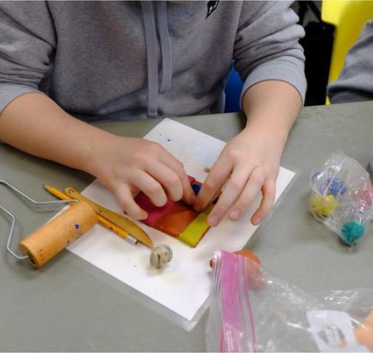
Objectives:
How do we create wonder?
How do we create a positive learning environment?
How do we link cognition into engagement
What ideas can we share

Slide 4
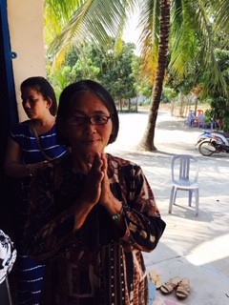
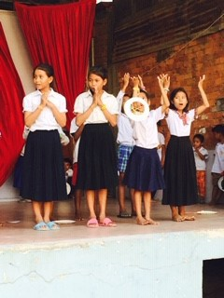
CAMBODIA 2015
LEARNIN·G IS THE RESIDUE OF THOUGHT

Slide 7
Positive Learning Environment
The habits and behaviors your students develop in your classroom will translate to the workplace.

Slide 10
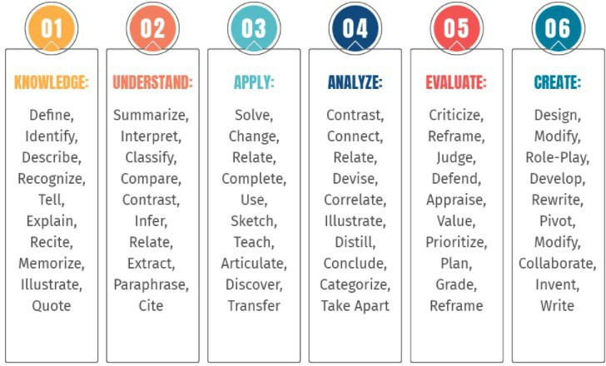
Bloom’s Taxonomy Verbs For Critical Thinking

Slide 11
Techniques to “Sell It”
The atmosphere you create for students is key.
Have clear goals and high expectations.
Create lesson plans that are fresh and involve a variety of learning styles.
Short bursts of information.
Be passionate about the success of your students.

Slide 12
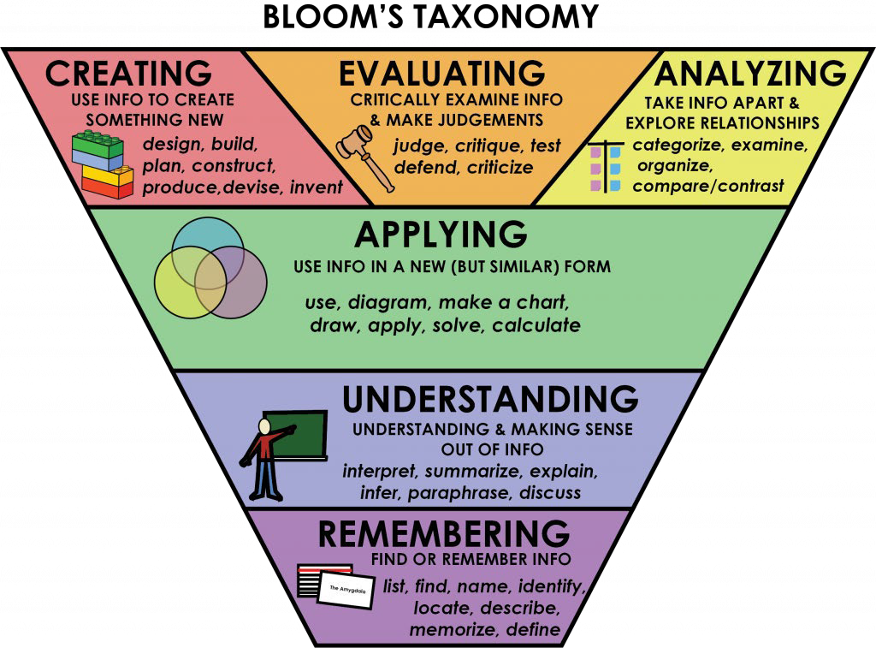

Slide 13
A Meaningful and Engaging Place to Learn
Students can learn.
Motivation has the greatest impact on student learning.
It’s more than just delivering content.
You are the expert and prime motivator.
Create challenges that make students believe they can learn.

Slide 14
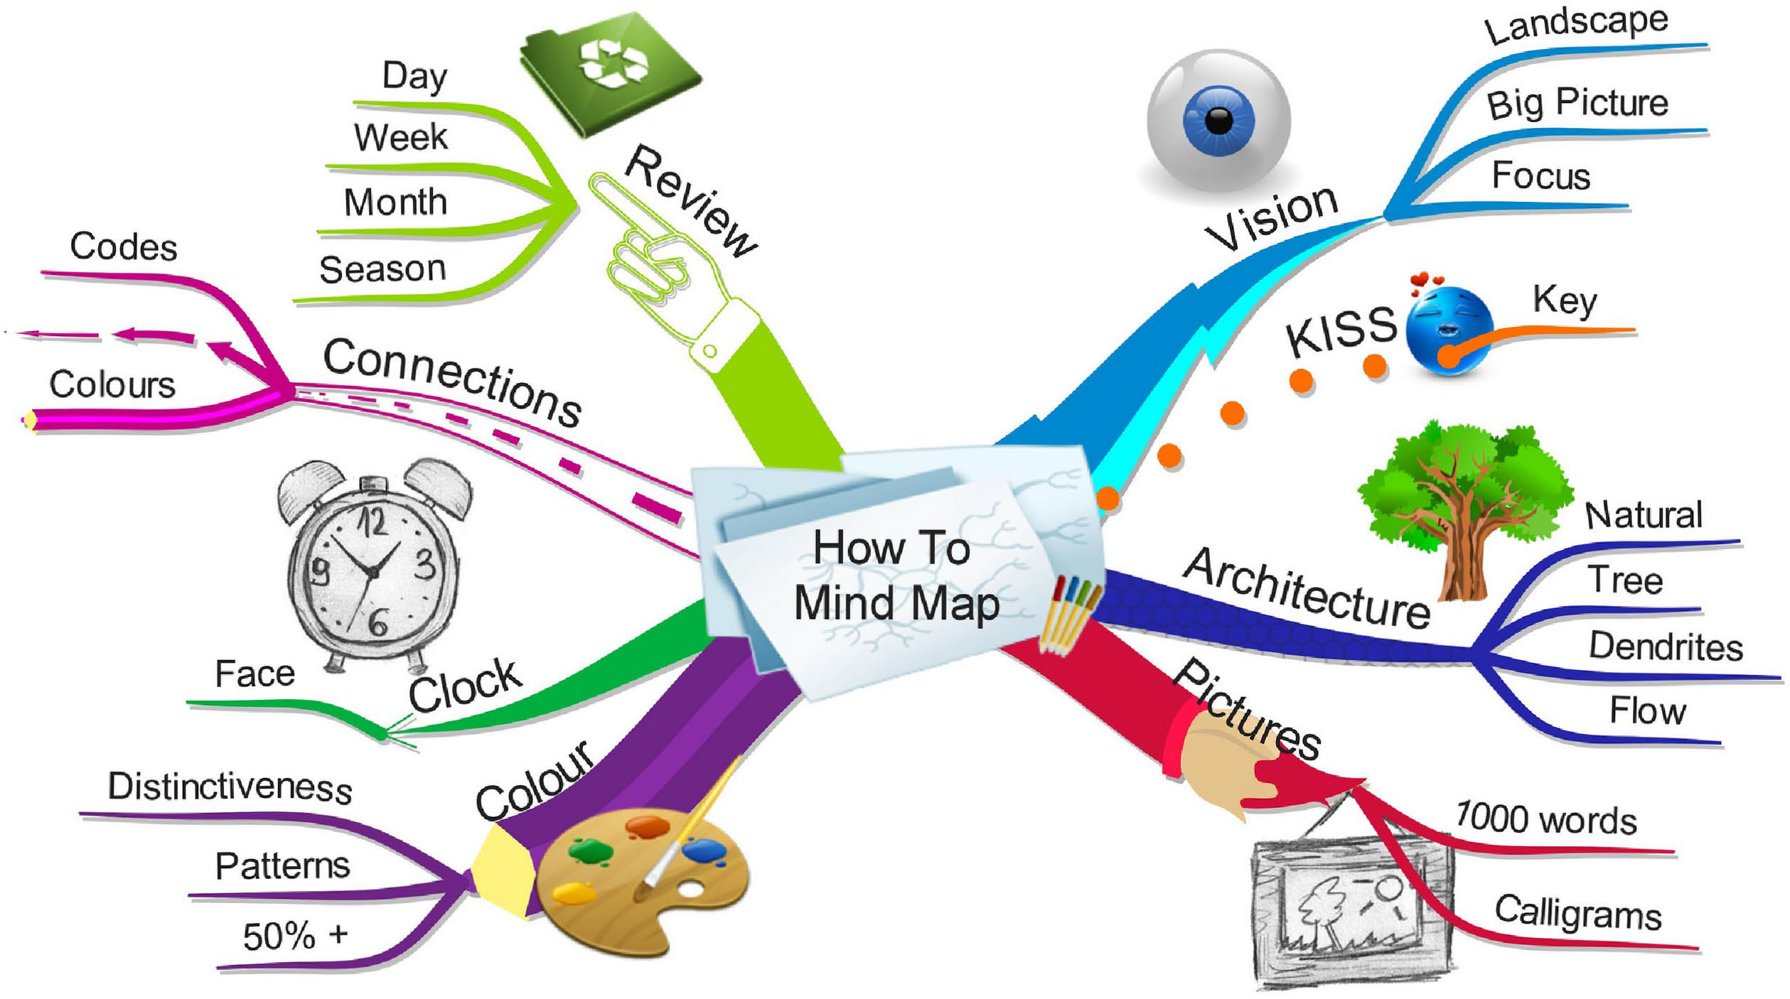

Slide 15
Flipped Classroom
Definition: A flipped classroom is an instructional strategy and a type of blended classroom, which aims to increase student engagement and learning by having student’s complete readings at their home and work on live problem-solving during class time.

Slide 16
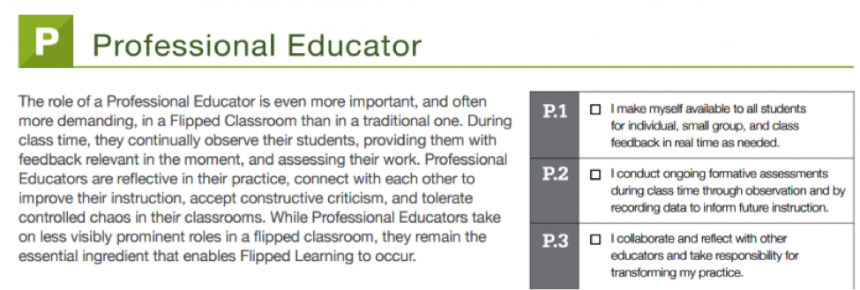
The Four Pillars of F-L-I-P™

Slide 17
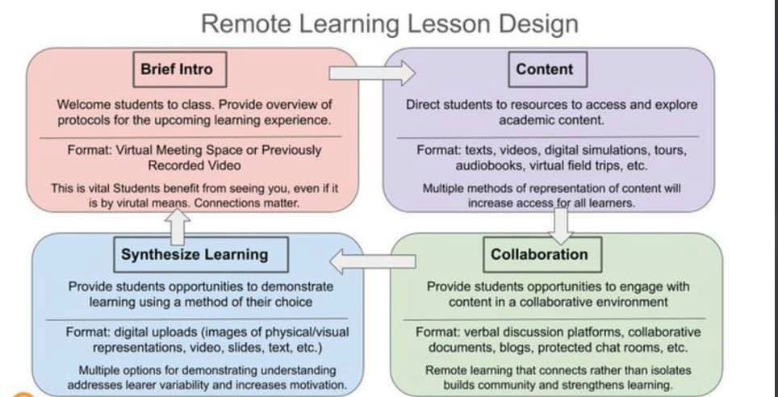

Slide 18
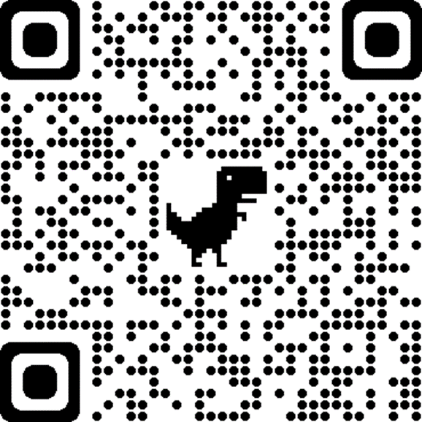
CTYOU.ORG
Create an account (first time users)
Verify your email (first time users)
Scroll to HEALTH
Scroll to Health Teacher Resources
Scroll to Long-Term Care Resources
Put in the enrollment code health2014 (first time users)
Call Susie if you need help! 405-743-5152
Scan QR Code

Slide 19
