Slide 1
Health & Professional Certification Testing – LTC Workshop Update
Jennifer Palacio
Assessment Manager

Slide 2
HPCP Test Site Coordinator (HPCP Testing Manual)
Train/monitor local test site personnel (including CSOs if
applicable)
Ensure the security of testing materials & verifies
all policies/procedures are followed
Coordinate HPCP test registration, collecting fees, &
administration
Score clinical skills examinations (if applicable)
Distribute results to candidates
Maintain testing records

Slide 3
TRAINING/MONITORING LOCAL TEST SITE PERSONNEL
All test site personnel associated w/ the HPCP certification process:
Must be listed on the HPCP Test Site Directory
Attend training on HPCP processes and procedures
Complete a Testing Personnel Training Requirement Form
Sign a Confidentiality Agreement (not required for CSOs – agreement is part of request form)
*New Process – complete all new paperwork with FY MOU agreement
Only need to be updated when new staff added
Can send an email to remove staff w/out completing new forms

Slide 4
TRAINING/MONITORING LOCAL TEST SITE PERSONNEL
Clinical Skills Observers (CSOs)
Test Site Coordinator is responsible for requesting/training CSOs
CSO must complete: (manual & video on website)
  Orientation on administering scenarios
  Review CSO Manual
  Review CSO training video
  Complete shadowing experience with approved CSO
Current list on sFTP system
Request form on website - must include resume

Slide 5
TRAINING/MONITORING LOCAL TEST SITE PERSONNEL
Clinical Skills Observers (CSOs)
CSO Qualifications – verified on OK Bd of Nursing & Multi-state compact
Prefer CSOs not be instructors – if so, cannot observe own students
Must administer 2 clinical skills exams per Fiscal Year
Certification Test | Minimum Qualifications
Home Health Care, Long Term Care | Registered Nurse with an unrestricted license One year experience
Developmentally Disabled Direct Care | Licensed or Registered Nurse with an unrestricted license OR Qualified Intellectual Disabilities Professional (QID) One year experience
Adult Day Care, Residential Care | Licensed or Registered Nurse with an unrestricted license One year experience
Advanced Unlicensed Assistant | Registered Nurse with an unrestricted license 2 years experience as staff nurse in an acute care setting
Notes:
Reasons for removal in Test Site Coordinator Manual for CNA & CMA

Slide 6
COORDINATING TEST REGISTRATION AND ADMINISTRATION
Administration – Clinical Skills Scenarios
  Clinical Skills Scenarios – schedule extra 15 minutes for preparing volunteer/providing instructions/answer questions (only time candidate can ask questions)
      Time Limits
        HHA/LTC – 60 minutes for 7 clinical skills
        DDCA/RCA/ADCA/SHA – 45 minutes for 4 clinical skills (3 for SHA)
      Administered in actual care-giving situation or in a laboratory setting that resembles environment in which candidates will function on the job – access to running water
      All equipment and supplies provided by test site – CSO must make sure that everything is accessible & candidate knows where to retrieve items listed
      Volunteers/Residents
        Cannot be another student in CNA or be a CNA
        Prefer non-medical person & need to be 18

Slide 7
COORDINATING TEST REGISTRATION AND ADMINISTRATION
Administration – Clinical Skills Scenarios
      Scenario consists of: - some sites color code sections – volunteer, candidate,etc
        Cover Sheet – Candidate Info to be completed by Coordinator prior to the exam
        Candidate Information – Scenario, Instructions, Document Sheet
        Volunteer/Resident Info – instructions, consent form
        CSO Information – equipment list, CSO Instructions, Scenario, Candidate Instructions, Documentation Sheet
        Evaluation Grid – marked by CSO as the candidate performs task
        Score Sheet – completed by Coordinator (or designee) – nurse aide only
      Scenarios include both critical, non-critical tasks, and vitals (nurse aide only)
        Critical tasks – usually deal with safety & infection control – must perform all with 100% accuracy
        - (hand-washing, donning/removing gloves & other PPE, handling biohazardous materials, etc…
        Non-Critical tasks – associated with performing tasks correctly – 80%
        Vitals, Input/Output – measure w/in acceptable limits – see scoring sheet

Slide 8
Maintain Test Records
Testing & Training records need to be separate (instructors have access to training information, but should not have access to testing records)
  provides credibility – no other testing site would have them together
All testing records should only be accessible to individuals listed on test site directory
Keep records no less than 4 calendar years (current, plus 3 previous)
Documentation requirements outlined in Cheat Sheet Supplement

Slide 9
COORDINATING TEST REGISTRATION AND ADMINISTRATION
Request for Accommodations – must complete required form on
Coordinator Resources page on website with supporting docs
  Provide 2 business days for HPCP office to respond to request
Administration
  Candidates who have completed an approved training program have 3
  attempts to pass both the clinical skills exam & written exam.
  Candidates who do not pass the clinical skills examination or the written exam
  must wait at least 3 days before retesting.
  Candidates who are unable to pass either exam after 3 attempts must retrain in order to be eligible for additional testing.
  Candidates who fail any portion of the clinical skills examination must retake the exam in its entirety.
    not allowed to only retest the tasks or skills that were not performed correctly in previous administrations.

Slide 10
Nurse Aide Information
Coordinating Registration & Scheduling (HCP Coordinator Manual & CSO Manual)
  Coordinate # of clinicals performed in a day
    7 – LTC, HHA, AUA
    10 – DDCA, RCA, ADCA
  Coordinate/verify required documentation for testing
  Nurse Aide –
    Training verification form or Approval Letter from OSDH (only last 1 year) – verify matches candidate info
    Original proof of social security # (must be printed)
      Social security card or Letter from SS Administration
    Photo ID issued by government entity w/in the U.S.
    Affidavit of Lawful Presence – see info sheet for requirements
      Retain original & supporting docs for non-citizens in candidate testing folder
Notes:
Verification form – signature at the top can match the second area if RN Supervisor is also instructor. Verify with Jason regarding LPN’s teaching up to 16 hours (should they sign?)
It is important to get the social security # correct because state will not issue certs/licensure to someone that is not current on taxpayer/other obligations
Affidavit – US citizens do not have to complete a new form when deeming or retesting. For non-citizens, if more than a month have them sign another one because required documentation does have expiration dates. They must have a SS#.

Slide 11
Nurse Aide Information (cont.)
Coordinate/verify required documentation for testing
  CMA – 3 years from completion of training to finishing testing (CMA Testing File Documentation Checklist -yellow)
    Training verification form (light pink copy) or Approval Letter from OSDH
    Original proof of social security # (must be printed)
      Social security card or Letter from SS Administration – even Registered Aliens
      Tax return
    Photo ID issued by government entity w/in the U.S. (no foreign passports)
    Affidavit of Lawful Presence – see info sheet for requirements
      Retain original & supporting docs for non-citizens in candidate testing folder
    Verification of current LTC/HHA/DDCA certification
  Advanced CMA – Insulin Administration
    All required documents listed above for CMA
    OSDH Form 504 documenting completion of training req’s
    Verification of current CMA certification
Notes:
Advanced CMA – Gastro/Inhaler – same requirements for documentation – differ form because no written – OSDH Form 506
CMA – may see a reference to skills exam on letter from OSDH – this refers to the Med Pass. Person who signs Med Pass should not sign off on training verification form

Slide 12
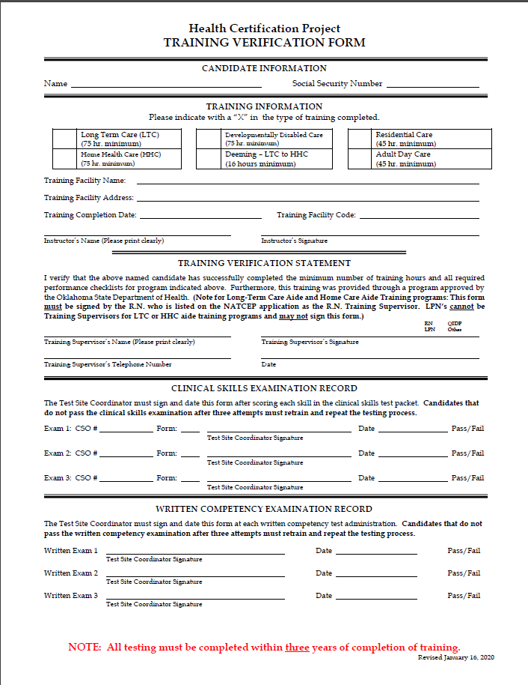
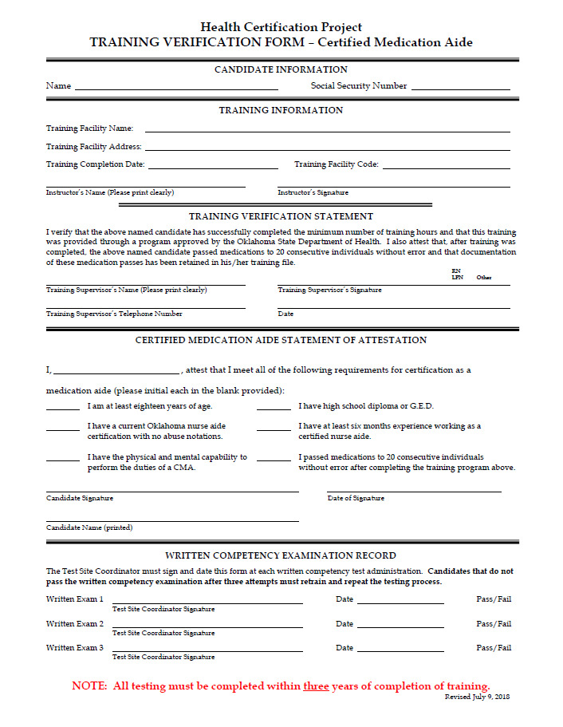

Slide 13
Nurse Aide Information (cont.)
Coordinate/verify required documentation for testing (CONT.)
  Waiver Candidates – LTC & CMA
  Training Facility Code – 7777777 (No training verification form)
  Candidate must submit documentation to NAR to receive a training exception waiver letter before testing. Candidate provided 3 attempts to pass – if unable, must retrain with traditional training program
    LTC ONLY – Skills Performance Checklist, Affirmation of 16 hours of Training, and 10 hours of Alzheimer’s disease training (application & forms - LTC Forms)
    CMA ONLY (Must first have LTC, HHA, or DDCA) – Medication Skills Performance Checklist (Signed & Dated) and Medication Pass Worksheet (application & forms - CMA Forms)
    HHA, DDCA, ADC, and RCA – Skills Performance Checklist (Signed & Dated) and documentation of any additional training (i.e. Alzheimer’s disease Training, Oklahoma Core Curriculum, etc.)
    A Non-Refundable $15.00 processing fee for HHA, DDDCA, ADCA, RCA, and CMA OAC 310:677-1-3(f)(3)

Slide 14
Activity Reports
Activity Reports
  Summarized Price Sheet showing Candidate amount & amount invoiced to each Test Site located on sFTP
  Usually provided the week after the end-of-the-month after HCP office reconciles monthly report with daily uploads
  Information included on report:
    TR Code – Training facility Code
    REF – score
    Assessment Title
    Date/Time Completed
    Candidate First Name
    Candidate Last Name
    Charges
    Counts
  We are now sending the reports in Excel with the TR Code & Score to allow each of the sites to keep a running log of assessments
    Why you may ask? – so you can always figure your own pass rates, average scores, etc…by training facility code
    We will still provide one at the end of the calendar year because we provide that information to our agency partners – but it takes some time to complete

Slide 15
Statistics
Provided to NAR & tests sites based on calendar year – not fiscal year
Listed by Training Facility Code
Overall Statistics – CY2020
Long Term Care | Number of Unique Testers | # Passed - All Written Attempts | Pass Rate - All Written Attempts | Avg Score Written - All Attempts
STATEWIDE TOTALS/AVERAGES | 3549 | 3248 | 86% | 79%
Certified Medication Aide | Number of Unique Testers | # Passed - All Written Attempts | Pass Rate - All Written Attempts | Avg Score Written - All Attempts
STATEWIDE TOTALS/AVERAGES | 1399 | 1245 | 77% | 77%

Slide 16
Any other Questions?

