Slide 1
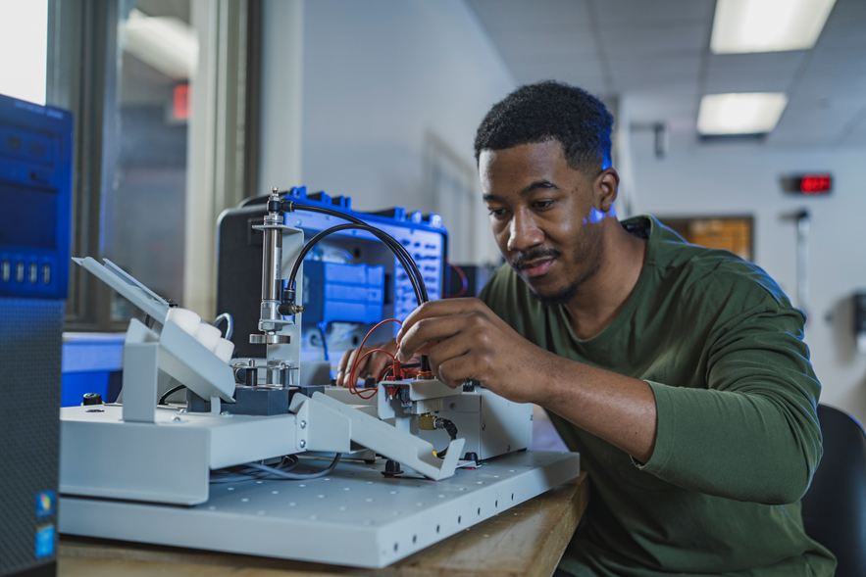
Oklahoma CareerTech Education that WORKS for YOU!
CareerTech is built for the workforce.
We deliver educational experiences through:
391 PK-12 School Districts
29 Technology Center Districts
15 Skills Centers Sites
32 Adult Education and Family Literacy Providers
6,671 Businesses Served

Slide 2
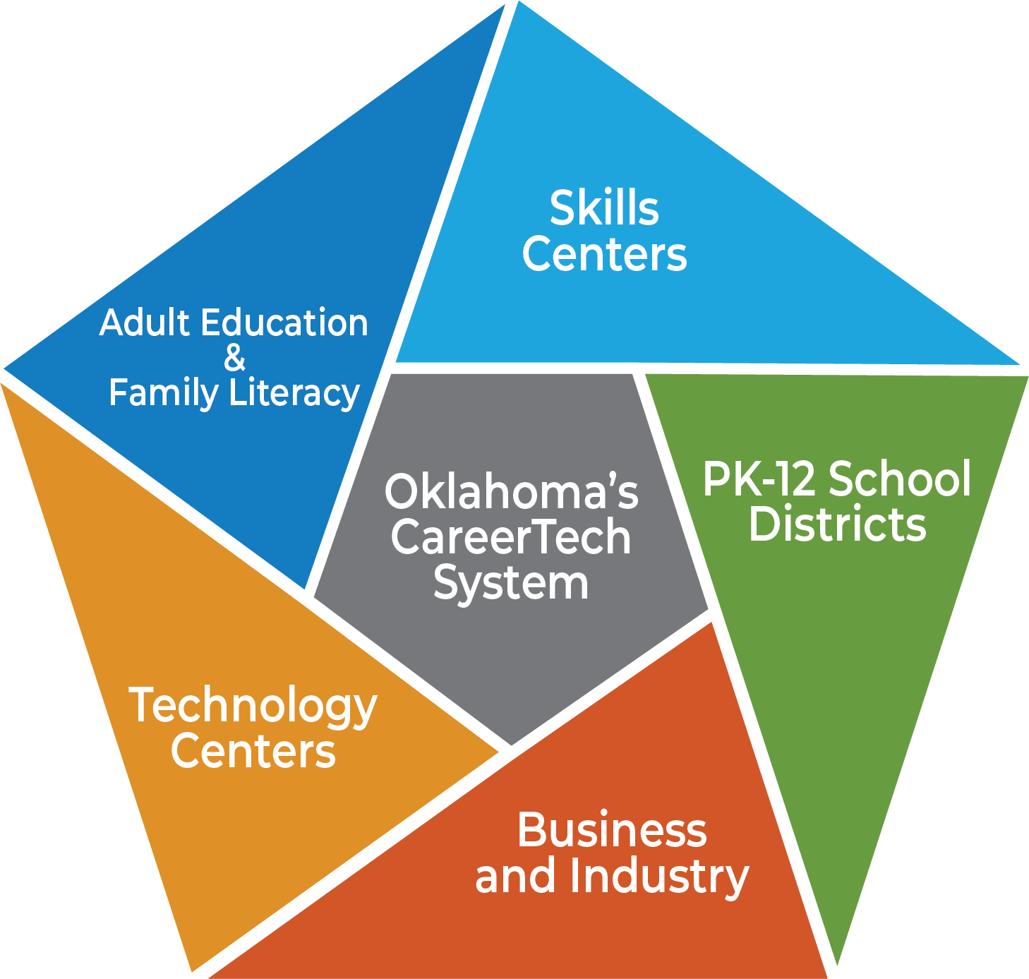
ACCESSIBILITY
Business and Industry.
5th-12th grade students.
Non-diploma-holding adults.
Employed adults.
Unemployed adults.
Senior citizens.
Law offenders.

Slide 3
PK-12 School District Programs

Slide 4
PK-12 Comprehensive School Programs
138,295 Enrollments
Funding Sources
Comprehensive schools funding stream – primary source
Oklahoma Department of CareerTech state appropriated program funds – supplemental source
Equipment/facilities/instructional support
Local school district
Teacher salaries for comprehensive school CTE programs
State Department of Education
State contributions such as FBA, pay increases, etc.
Currently OkCareerTech is not funding 181 programs that schools desire

Slide 5
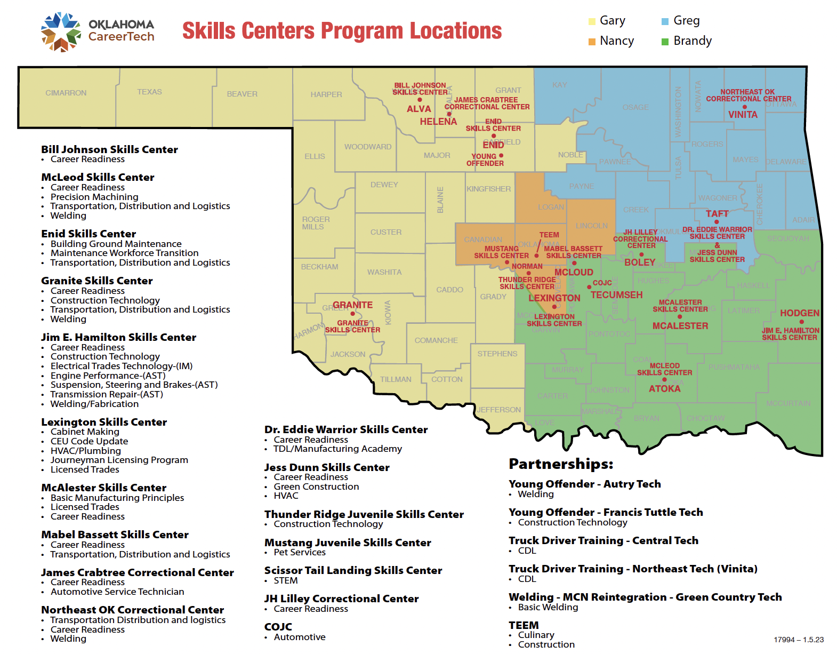
CareerTech Skills Center Programs

Slide 6
Skills Center Programs
1,045 Enrollments
Administered through the Oklahoma Department of CareerTech
15 locations 17 programs planned to be 20 next year
98% positive placement rate
5% recidivism rate

Slide 7
Adult Basic Education Sites in each Workforce Development Board Area
Main Sites
Other sites where classes are held

Slide 8
Adult Education and Family Literacy
9,507 students served
30 Providers
461 classes
4,740 high school equivalency
2,125 correctional center
2,094 English Literacy/Civics
Administered through Oklahoma Department of CareerTech
Awards contracts based upon regional locations through RFP process
Programs often based at local TC, K-12 schools or college campuses

Slide 9
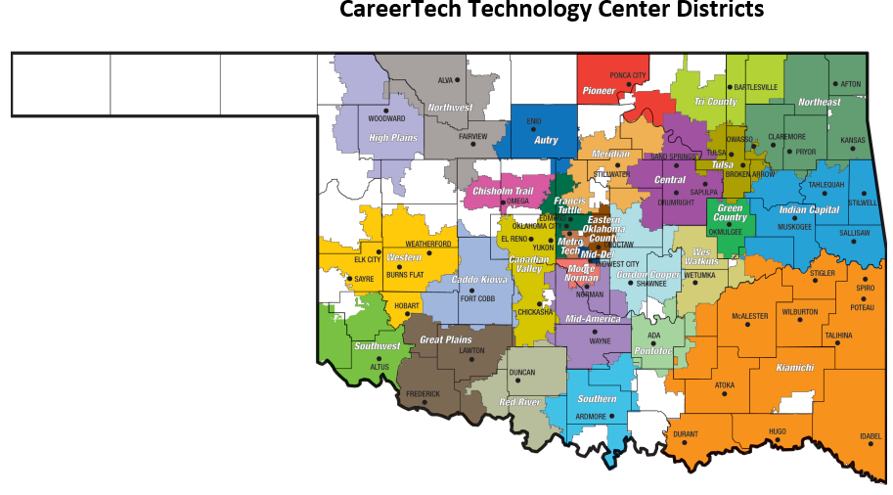
CareerTech Technology Center Districts

Slide 10
Technology Centers a Demand focused Education
298,675 Enrollments (29,754 are full time)
Tech center district boundaries decided by local vote
Programs offered based upon local demographics and employers
Customized training offered to businesses/entrepreneurs
High school-age students living within the Tech Center district:
attend tuition-free
transportation provided
includes home-school and private school students
Adult students living within district pay nominal tuition

Slide 11
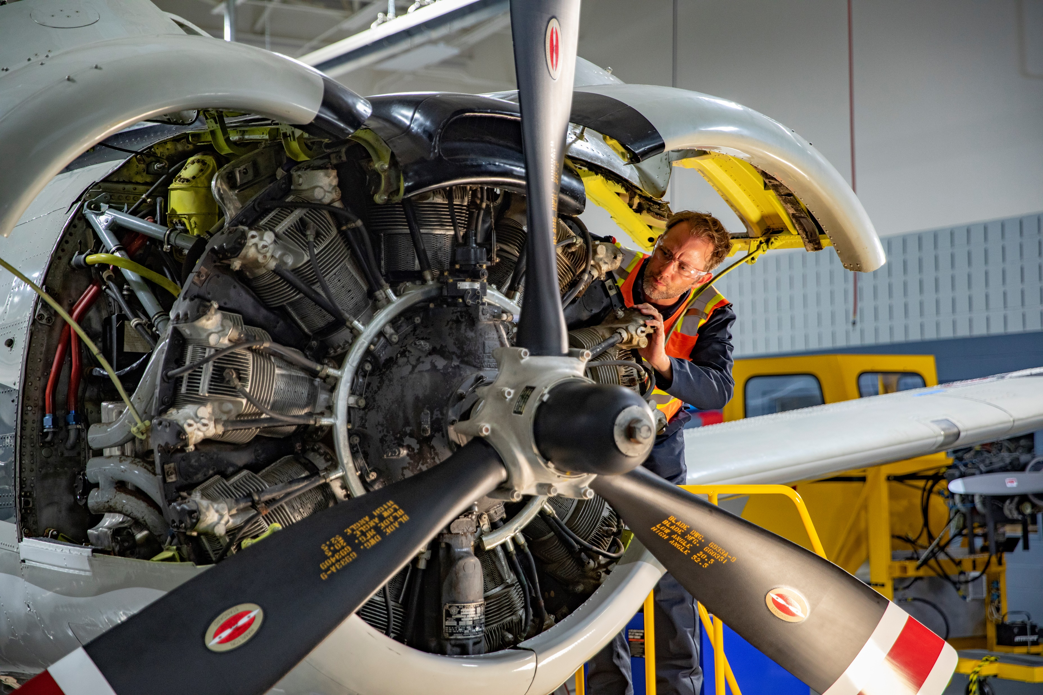
Business and Industry Programs
6,671 Companies Served
Offered jointly by ODCTE and local technology centers (TC)
Each local (TC) works with the business and industry in their district
Staffing varies based upon need

Slide 12
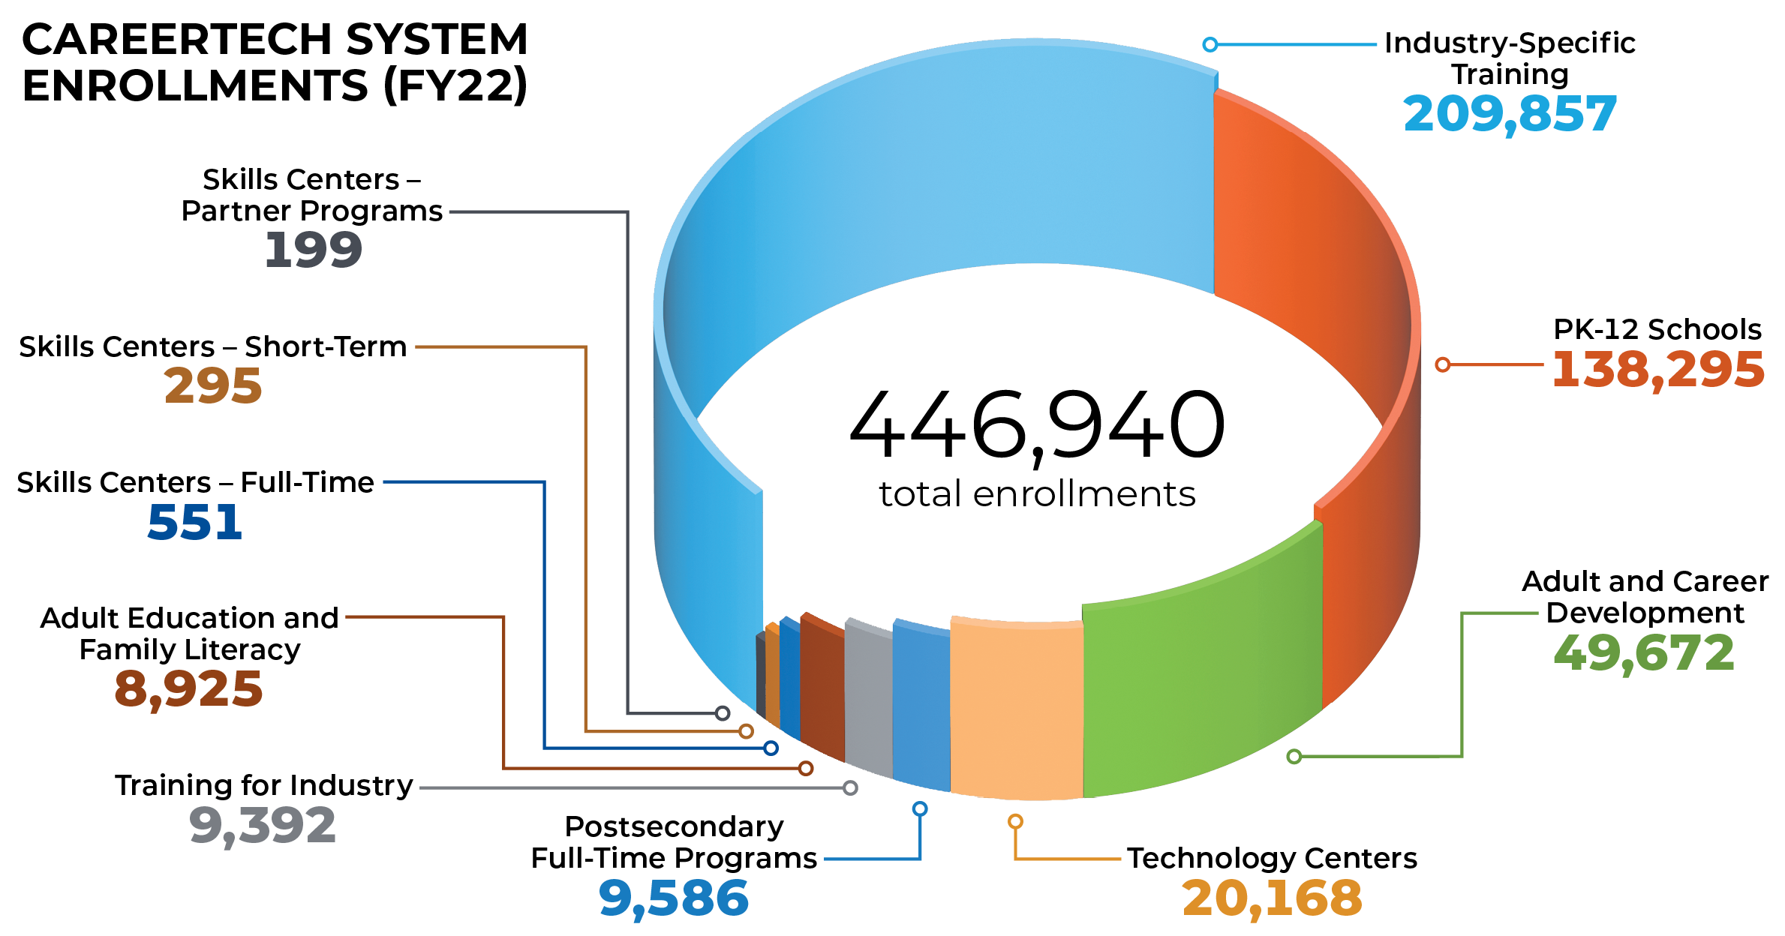

Slide 13
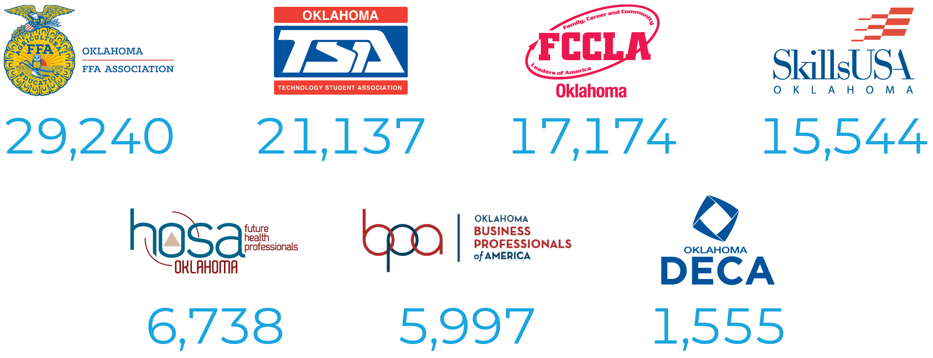
CareerTech Student Organizations (CTSOs)

Slide 14
Oklahoma CareerTech Education that WORKS for YOU!
CareerTech is built for the workforce.
We deliver:
Oklahoma’s 100 most critical jobs annual openings amount currently sits at 47,000
Over 30,000 we train for with certificates for right at 29,000 per year

Slide 15
What is Coming? 5 year growth!!
K12 Programs Currently 138,000
to 150,000
Technology Center Service Growth
Full Time 30,000 to 40,000
Apprentice WBL options for eligible learners 28 to 1000
Hybrid Programs offered by Tech Centers with K12 Partners (Woodward TAP, Tulsa Extensions)
Unknown to 6000
Skill Center Expansion 1045 completions per year to 1750

Slide 16
CareerTech Appropriations Compared to Other Educational Entities
Department of Education
Regents for Higher Education
Career and Technology Education

Slide 17
Agency Funding For CareerTech
Revenue (FY22)
State $ 134,641,723
Revenue (FY20)
State $ 139,479,185
Revenue (FY21)
State $ 133,470,382
Federal $25,878,905
Revolving $4,444,423
State-Lottery $3,477,624
Total $175,295,375
Federal $26,071,324
Revolving $4,210,292
State-Lottery $4,138,501
Fund Balance Required $ 0
Total $169,061,840
Federal $27,985,686
Revolving $5,739,844
State-Lottery $3,929,986
Fund Balance Required $0
Total $171,125,898
Fund Balance Required $2,015,238

Slide 18
Tech Center Funding
Funding for Tech Centers is a combination of Local, State, and Federal sources
State Average:
Sources
Local: Ad Valorem, Tuition, Rents
State: Program Support, Business and Industry, Lottery Grants, Special Program Funding (ABE, Truck Driver Training, etc.)
Federal: Carl Perkins, TANF, ABE. etc.

Slide 19
Funding Sources by Technology Center
Local
State
Federal

Slide 20
Questions??

