Slide 1

STUDENT SERVICES
AND
SPECIAL POPULATIONS
New Student Services Academy
2026

Slide 2
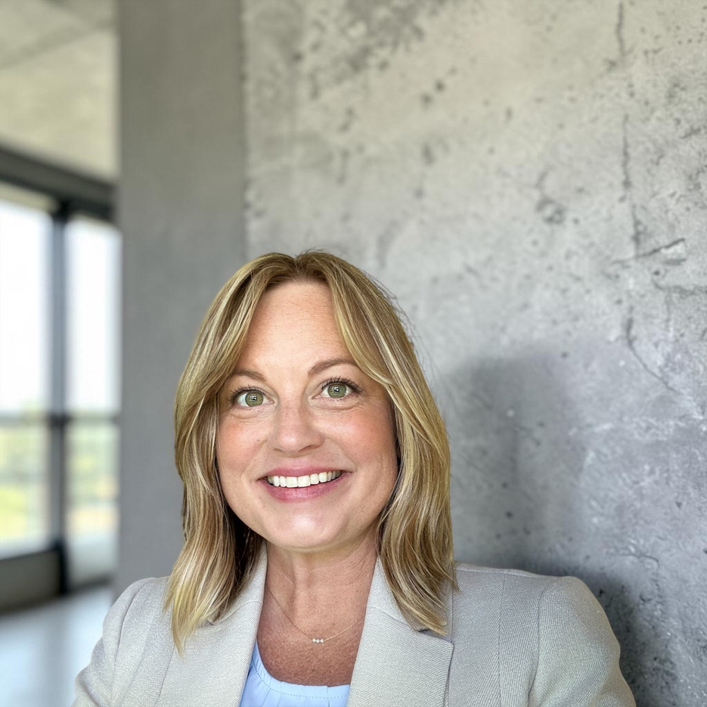
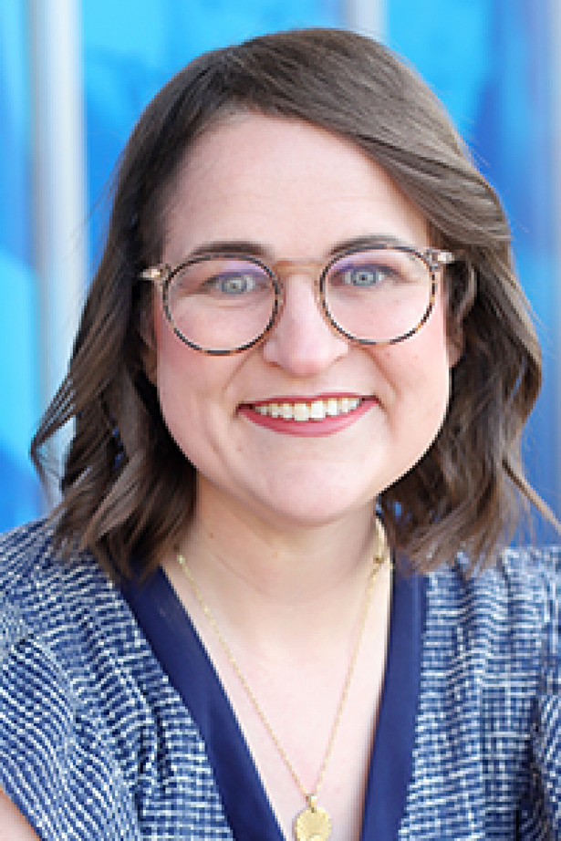
MEET YOUR SPECIAL POPULATIONS
COORDINATORS!
AMBER
MEEKS
KATLYN HUDGINS

Slide 3
Nontraditional
Learners
Students with
Disabilities
Military-Connected
Students
Economically Disadvantaged
Students
CARL PERKINS IV
SPECIAL POPULATIONS
Single Parent/
Pregnant Students
Out-of-Work
Individuals
Homeless
Students
Students in
Foster Care
English
Learners

Slide 4
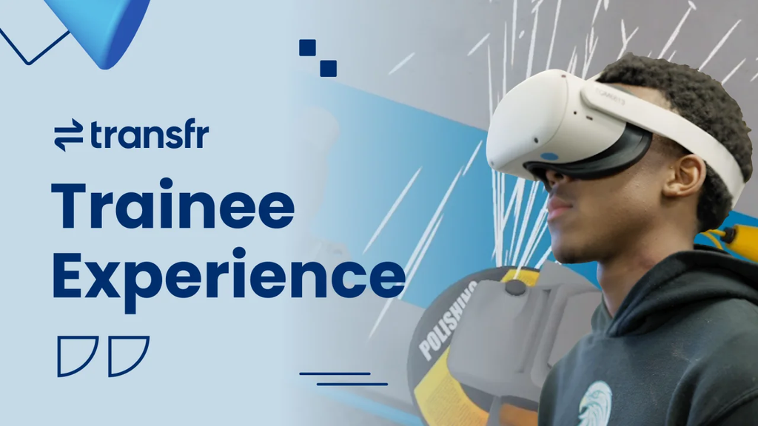
NONTRADITIONAL STUDENTS
Definition: Students who enroll in a program for a field where their gender is underrepresented (less than 25%). (Source)
Carl D. Perkins Grant provides funding to recruit and fund activities that support exposing students to careers they may not have access to otherwise.
We will come to your school to support any efforts to provides exposure to
nontraditional prospective students!

Slide 5


Transfr VR Overview

Slide 6
Examples of Simulations
  Diesel Farm Equipment Mechanic -Repair Diesel Farm Equipment
  Steelworker -Build a Warehouse Structure
  Plumber - Repair a Pool Filtering System
  Graphic Designer - Redesign a Restaurant Brand Kit
  Surgical Technologist (ST) - Assist with Knee Surgery
  Certified Nursing Assistant (CNA) - Help Family Members Connect
  Emergency Medical Technician (EMT) - Help at a Car Crash
  Chef - Prepare and Plate a Signature Dish
  Cosmetologist - Perform Facial Treatments
  Cybersecurity Analyst - Stop a Cyber attack
  Welder - Fix a Broken Assembly Line
  Automotive Services Technician - Change the Oil in an Automobile
  Market Research Analyst - Conduct Research for a New Product

Slide 7



















IEPs & 504s
Understanding Plans, Providing Support, Creating Success for Every Learner!

Slide 8
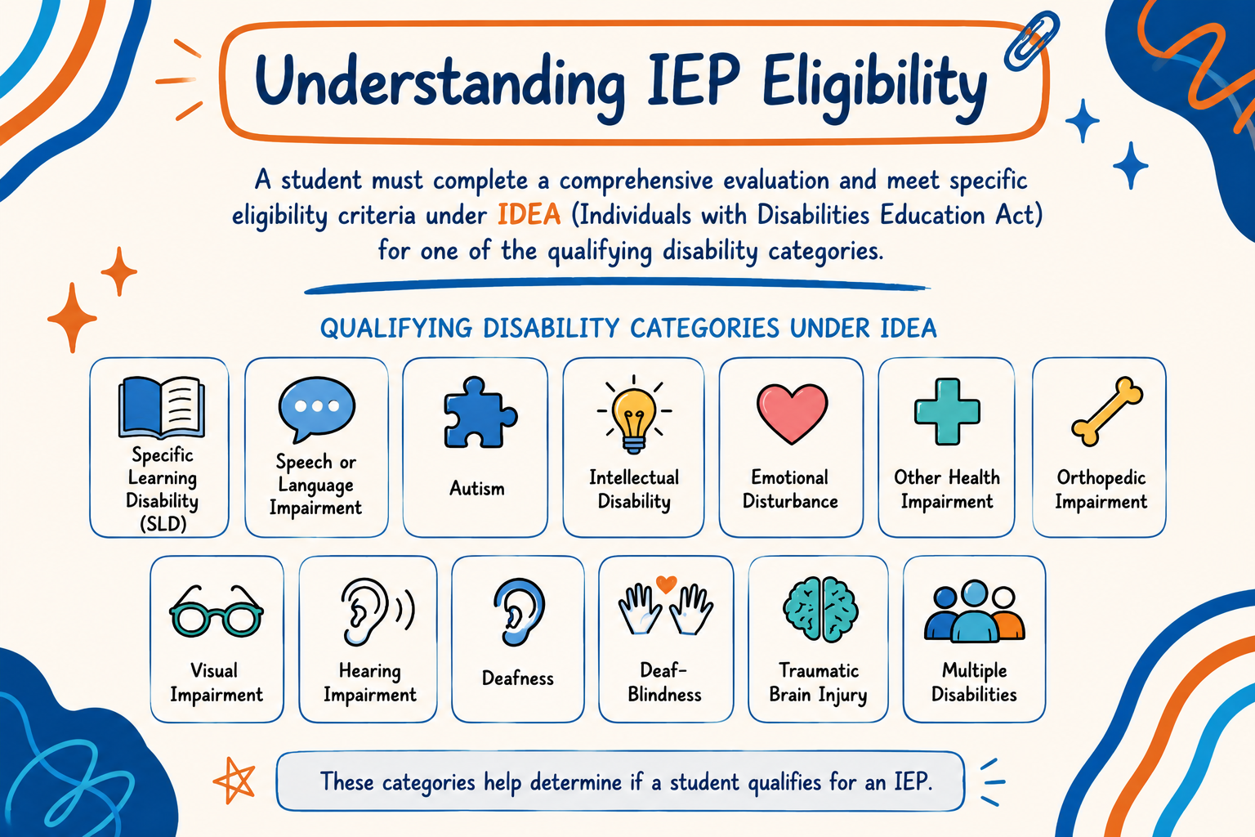

Slide 9










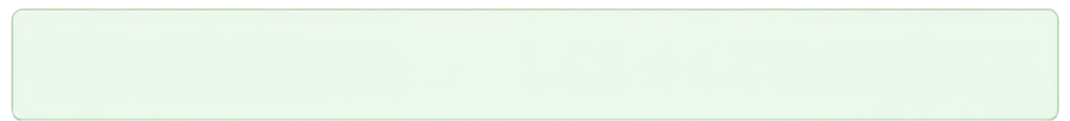
The IEP Team
Local Educational Agency (LEA) Representative-Typically an administrator
Parent or Guardian
General Education Teacher
Special Education Teacher
Additional members may be invited to the IEP team as needed based on the student’s individual needs and services required.
Student
Evaluation Interpreter (when needed)

Slide 10
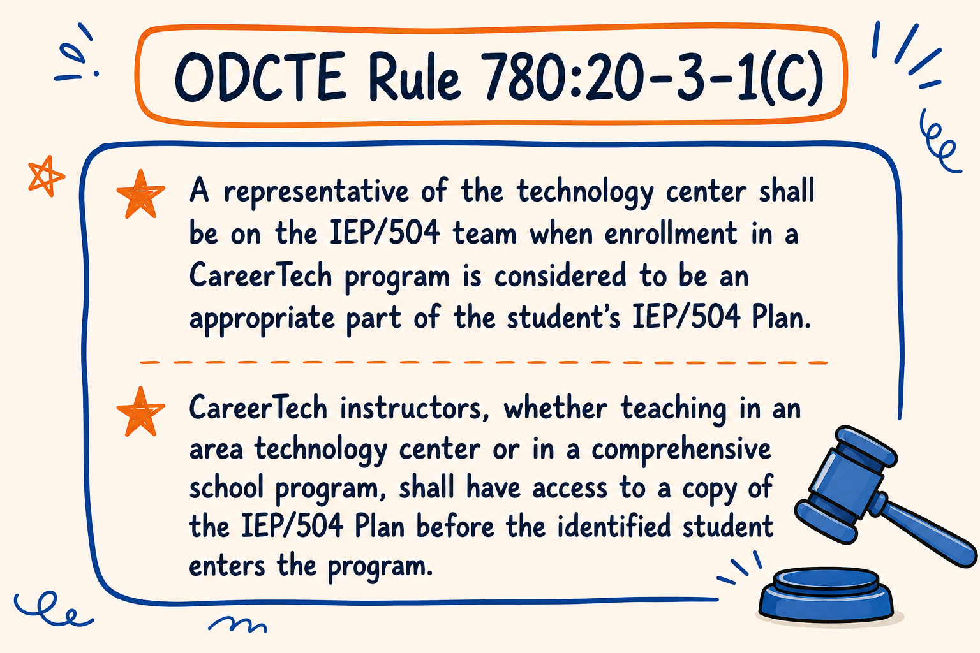

Slide 11
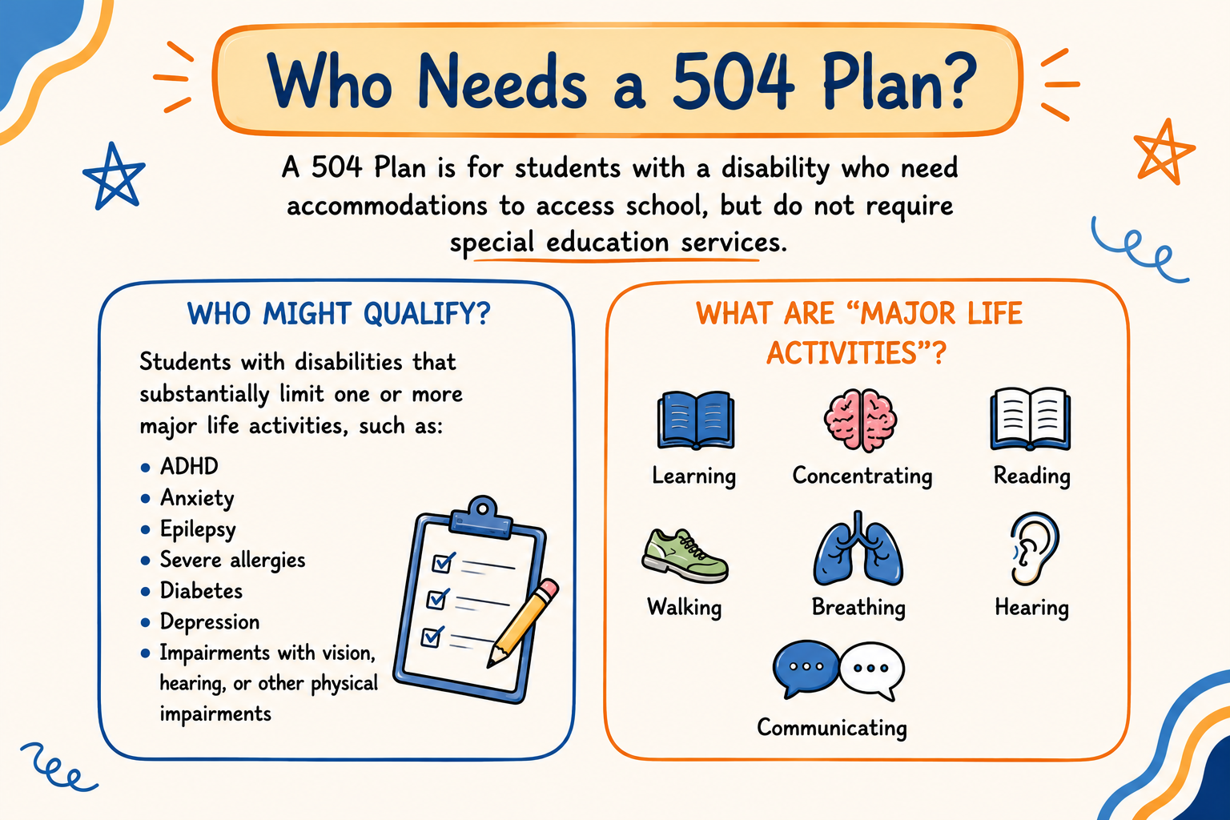

Slide 12
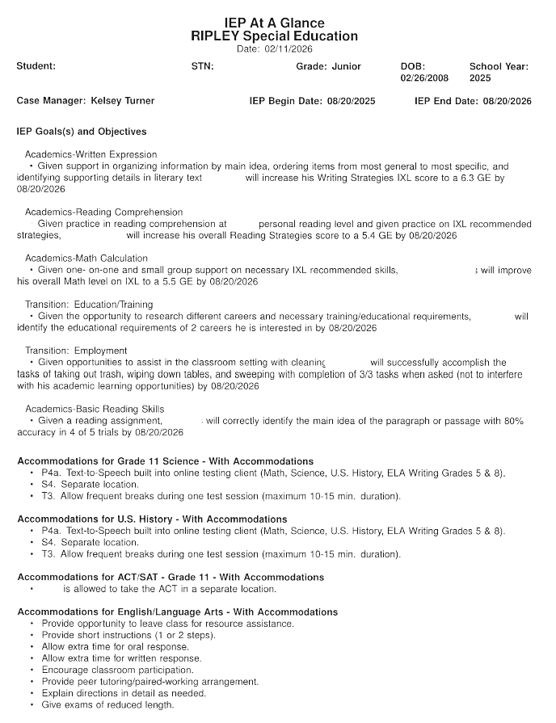

Slide 13
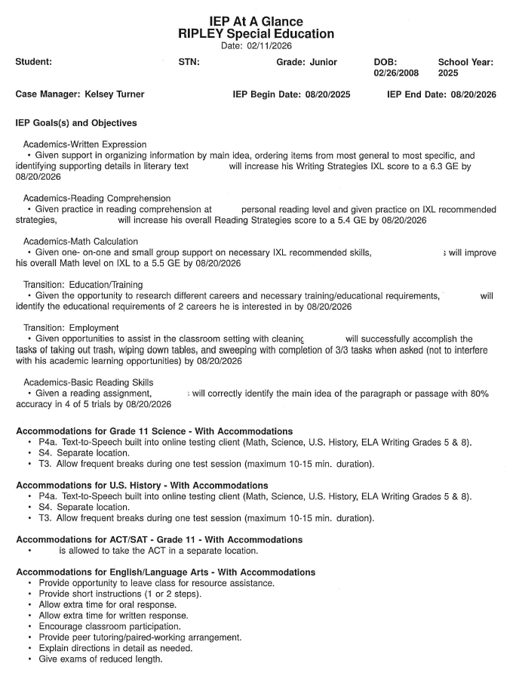

Slide 14
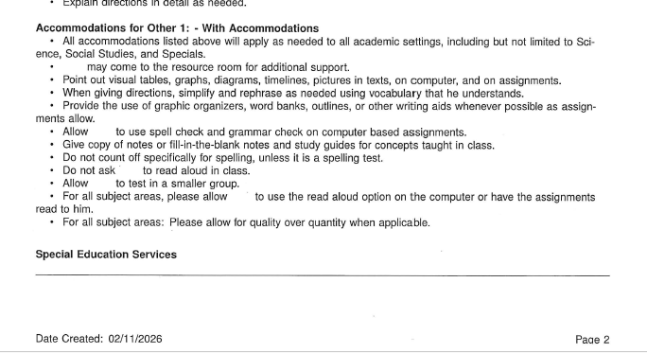

Slide 15
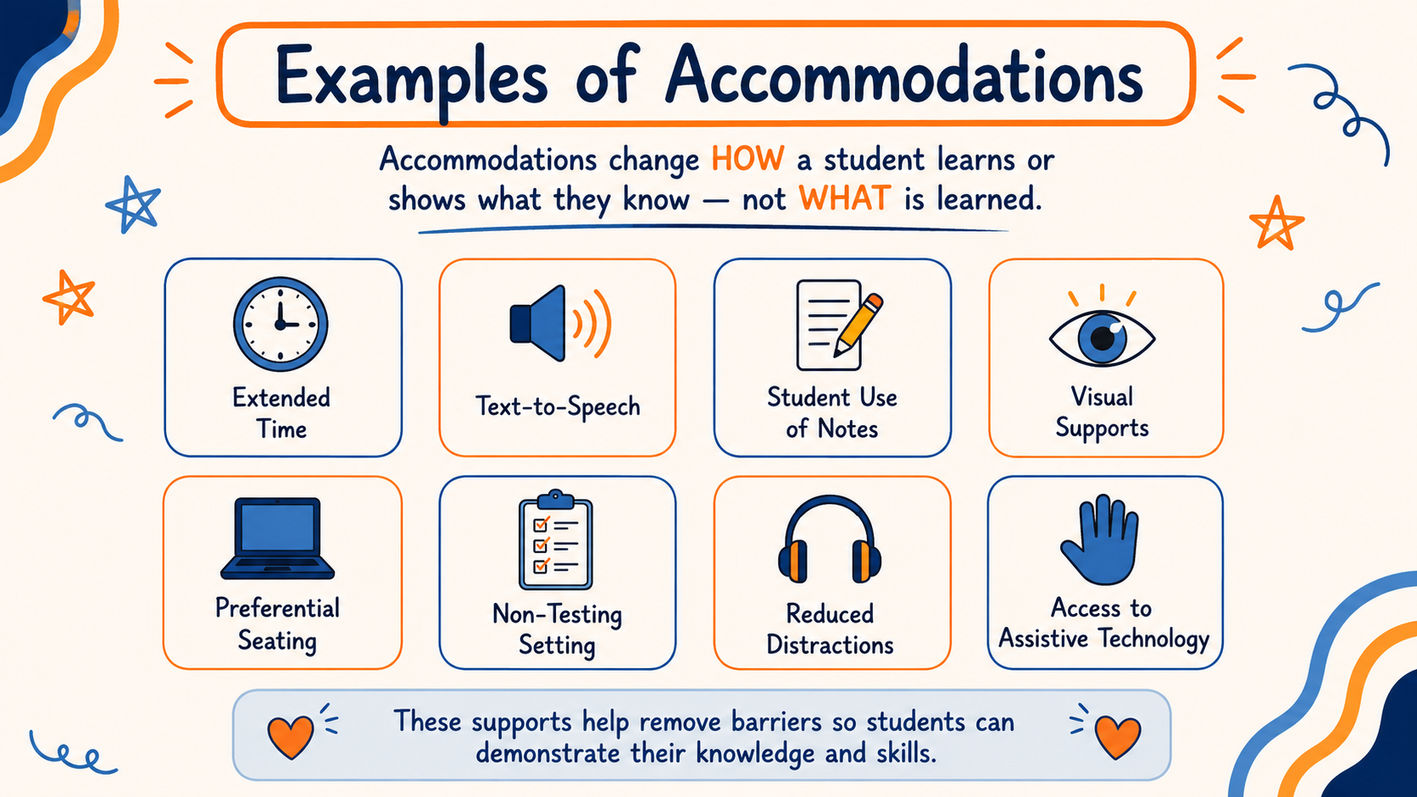

Slide 16

ASSISTIVE TECHNOLOGY
• Digital Accessibility
• Device Demonstrations
• Device Short-Term Loans
• Device Reutilization
• Financial Loans
ABLE Tech’s mission is to improve the lives of all Oklahomans by providing assistive technology (AT) devices and services, financing opportunities, digital accessibility services, advocacy, and education.

Slide 17


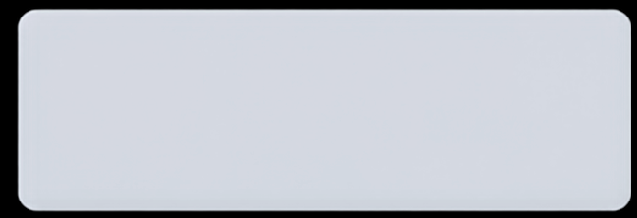
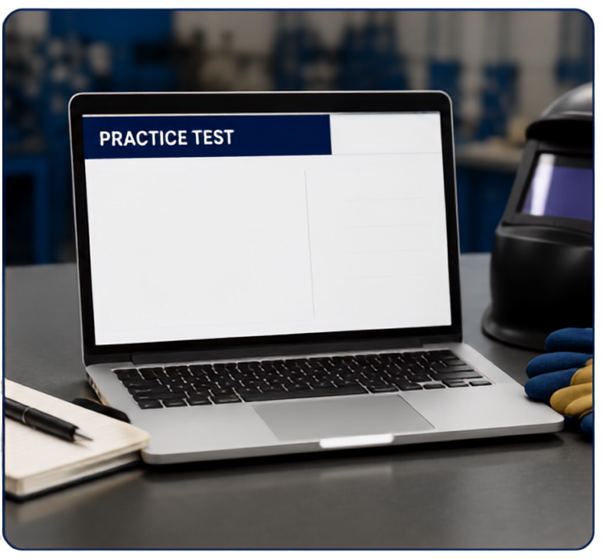









certification testing
practice tests
a
plan early
b
c
Get information on the roster ASAP.
d
next

Slide 18





FERPA & Confidentiality
Protecting Student Information
FERPA stands for
Family Educational Rights and Privacy Act
Student records are confidential.
Share only with a “need to know basis.”
Verify before you share.
When in doubt, ask for help.

Slide 19
“Honestly, I don’t think John needs these accommodations anymore. He finishes his work and seems to understand everything. I haven’t been giving him extra time because I don’t think he needs it.”

Slide 20
Is a student with epilepsy required to share information with their instructor?

Slide 21
A 20-year-old student comes to you and says,
"I'd like accommodations for my certification test."

Slide 22
“I haven't received any IEP’s or 504's for my students. Can you email them to me?"

Slide 23
The instructor is going to be absent. Can the instructor tell the sub who needs accommodations?

Slide 24
Professional Development
Offerings
IEP/504 Guidance
FERPA/Confidentiality
Implementation of Effective Career Development
Mental Health/Suicide
Wellness for Staff
Special Populations Webinars

Slide 25
Special Populations Day
Save the Date!
September 15th
at Oklahoma CareerTech

Slide 26


Slide 27
Contact Us!
AMBER
MEEKS
KATLYN HUDGINS
Career Development Coordinator –
Special Populations
amber.meeks@careertech.ok.gov
405-743-5180
Career Development Coordinator -
Special Populations
Katlyn.Hudgins@careertech.ok.gov
405-743-5596

