Slide 1
New Student Services Academy
Academic Overview for FY2024

Slide 2
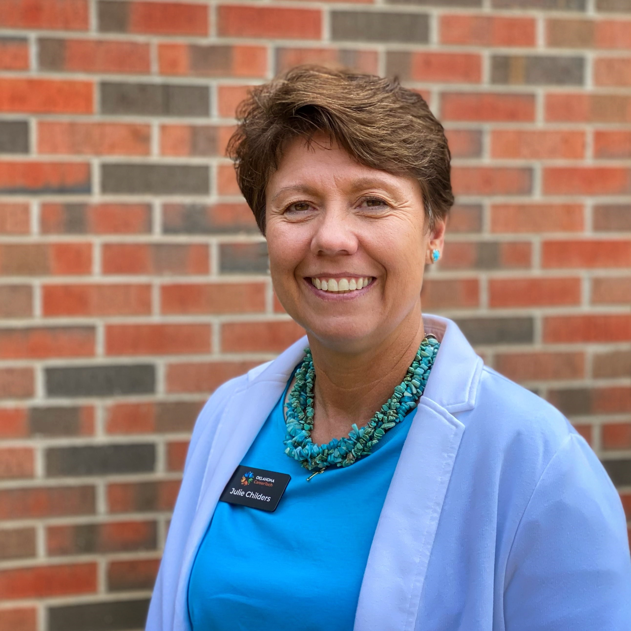
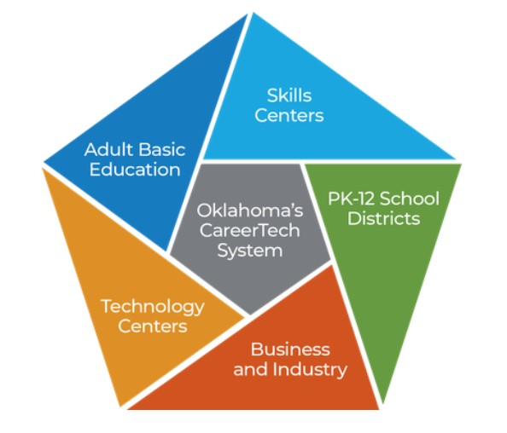
Oklahoma CareerTech has 5 Delivery Arms!
Today's focus is PK-12 and Technology Centers.
Julie Childers, Academic Coordinator
27 Years in Public Education
24 Years as a School Counselor
School Size: Class B to 4A
Bachelors: Oklahoma State University
Masters: University of Central Oklahoma
Notes:
Good Morning I am Julie Childers and I am the academic coordinator at the Oklahoma department of career and technology education, CareerTech. This first slide has just a little information about the delivery arms of careertech. Through our arms of delivery we service Oklahomans from PK through adulthood. So careertech is not just your local technology center or a set of great classes at your school, it is a large organization serving Oklahoma. Today we will focus on the K-12 courses and our technology center programs.

Slide 3
Technology Centers live in 2 Worlds!
High school students earning credits toward graduation:
A Carnegie Unit is 120 hours of class = 1 unit of credit
Adults (not in high school) earning skills, certifications, etc.
Financial Aid Eligible Hours
A uniqueness that makes us better!
A uniqueness that sometimes makes
CareerTech seem complicated.

Slide 4
What is an OCAS Code?
The common name in K-12 Education is “Subject Codes”.
On the student support page of SDE website you will find the link to “High School Subject Codes”
On the Oklahoma Department of CareerTech Website you will find the CTE OCAS Codes for Course and OCAS Codes for Program Codes.
CTE Codes for Courses can be used for classes at the high school or courses within a program at a technology center.

Slide 5
Full-Time Programs Vs. Courses
Full-Time Programs, as defined by “3rd Math Credit on Core” and eligibility for “PSO Points”, are a 3 hour long 9000 coded program ending in the ability to gain industry recognized certification. Programs are always transcripted as electives.
Courses (8000) are 120-hour classes and can be worth .5 or 1 unit of credit toward graduation. Courses can be worth elective, math, science, or computers credit.

Slide 6
Why is this information important?
Important: The official name of the program or course is what should be recorded by the high school on the transcript, not the technology center’s common name. Using the unofficial name could lead to a student not getting the correct credit toward graduation, OK Promise, or in some cases hours toward completion of a degree.

Slide 7
Where do I find the official name and number of the courses and programs at a technology center?
Where do I look when someone from the sending high school is asking a question about academic credit?

Slide 8
This years OCAS documents?
This year 2 very different looking documents.

Slide 9
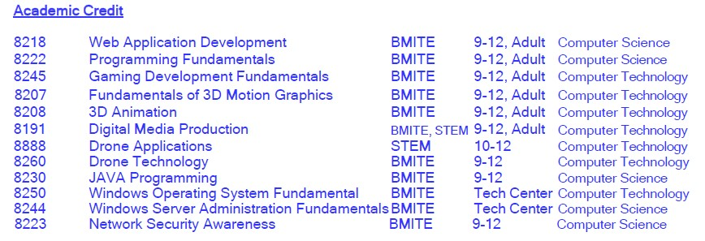
Let’s look at some changes and the inside of the documents.
Here are new courses and programs for 23-24.
Here are the courses that will now receive credit other than elective.

Slide 10
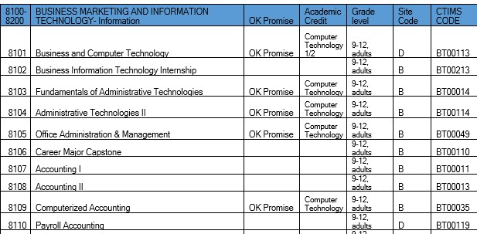
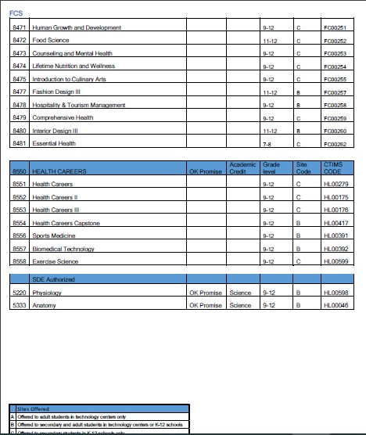
Examples from Courses
8000 numbers can be taught at K-12 schools or as part of a program at a technology center.

Slide 11
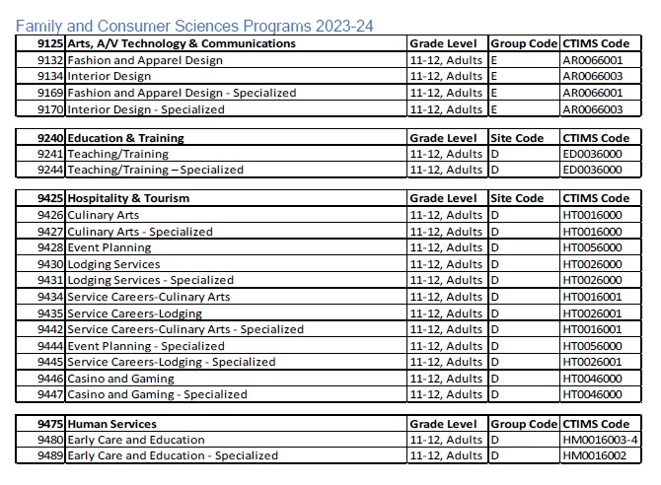
Example from Programs
The programs are now organized by the divisions. This is a new format.
FCS is the easiest example. Here you see in FCS there are 4 pathways.

Slide 12
Here is the next level for those responsible for curriculum or reports.
These documents are a sample of the programs or courses for STEM.
A teacher should only be teaching from their division.

Slide 13
Technology centers send grades to high schools.
Because Oklahoma is a local control educational state, there are many ways to send grades to high schools. What is important is what information you send.
Best Practice would always include the OCAS code.
Here is a version where the student gets only elective credit.
Student Name, 9057 Electricity, S1- 96 A, 1.5 credits
Here is a version where the credit is not all elective.
Student Name, 9202 Administrative Support, S1- 88 B, .5 credit
Same Student, 8103 Fundamentals of Administrative Technology, S1- 96 A, .5 credit
Same Student, 8109 Computerized Accounting, S1- 80 B, .5 Credit

Slide 14
Sending Certifications for High School Students
A Common Question on Certifications:
What Certification do technology centers send to high schools?
The statute is any certification that is “Nationally Recognized”.
The best practice is sending any certification test a student has taken and passed.
Let the K-12 school decide if they want to add the additional certifications or accomplishments.

Slide 15
Schools ask questions we can not always answer.
How does a high school put those certifications on their transcripts?
Because K-12 schools have individual “student information systems”, it is very difficult to give them assistance. But they have resources available to assist them, the network of other sending schools in your technology center district and the vendor of their SIS.

Slide 16
A Wrap-up Thought:
Be a relationship builders!
One way people think technology centers are successful is to be the communication hub of your sending schools. How?
Get your sending schools in the habit of calling you when they have a question.
Set up a network for the schools on the same SIS to call or email each other.
If you can, be the meeting and eating place.
Thank you! You are going to do so many good things this year.

