Slide 1


CAREER
EXPLORATION
Brittany Crane and
Nathan Brubaker

Slide 2



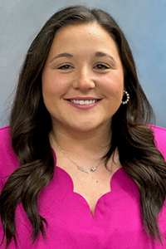
OUR TEAM
Nathan Brubaker
Brittany Crane

Slide 3

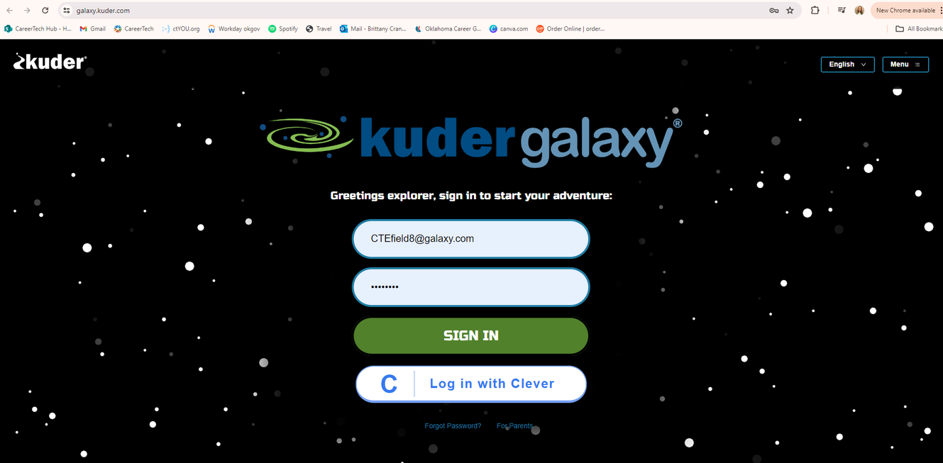
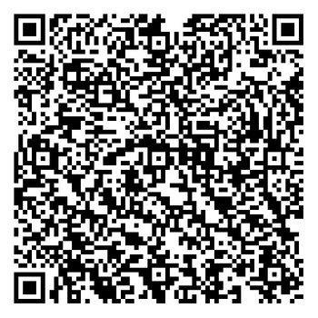
GALAXY
Galaxy is a powerful game-based career awareness and exploration platform for elementary students. Galaxy engages students with interactive and game based activities that help them identify their personal interest while exploring the uniqueness of workplace opportunities. Benefits include:
  Bias-Free Career Awareness
  Meaningful Self-Discovery
  Student Motivation with Badges
  Grade-Specific Activities
Want more information, customized Galaxy training or curriculum? Scan the QR code and fill out the CCD request form!

Slide 4


OKCAREERGUIDE
OkCareerGuide is an easy online resource available for all Oklahomans to explore and guide their future. Individuals can take assessments, identity occupations, establish education plans, and, ultimately connect to employers. Whether you are a student searching for career and college options or an adult looking for a new career path, OKCareerGuide is a powerful tool to provide all the career and education resources you will need to chart your course for the future! Benefits include:
  Fulfills Oklahoma ICAP Standards
  Job Search Tools
  Trackable Reports and Insights
Want more information, customized OKCG training or curriculum? Scan the QR code and fill out the CCD request form!

Slide 5


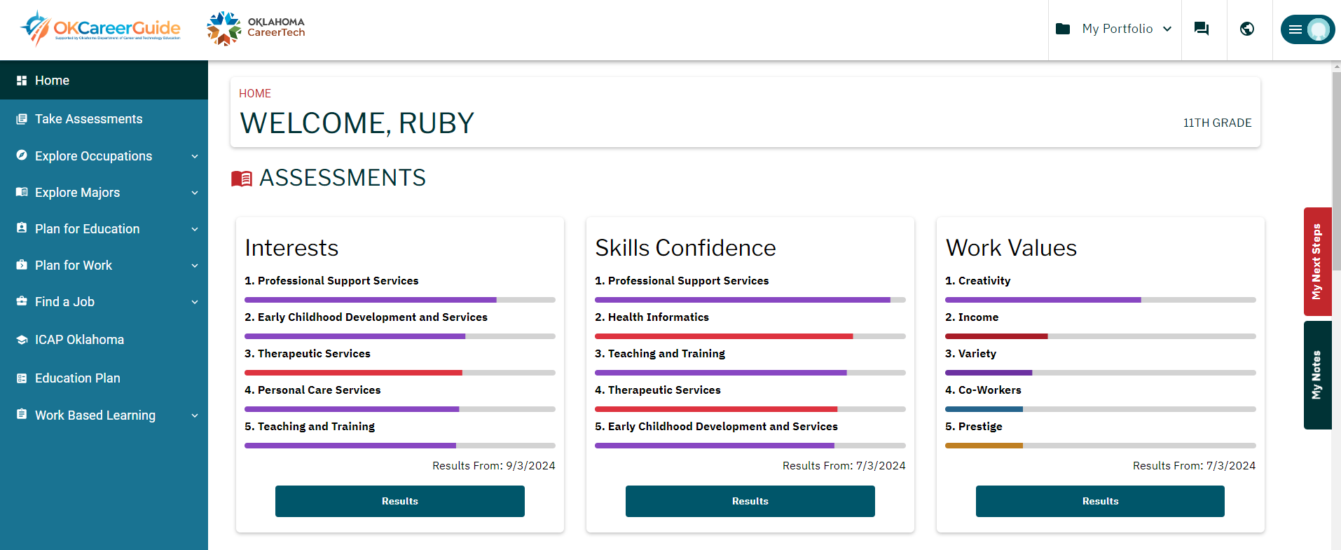
JOURNEY
Journey is a powerful tool that helps postsecondary students and adults by providing career readiness tools, helping for a smooth transition and removing any barriers that might exist. Benefits include:
  Interest and Aptitude Assessments
  Job Search Tools
  Robust Administrative Reports
Want more information, customized OKCG training or curriculum? Scan the QR code and fill out the CCD request form!

Slide 6
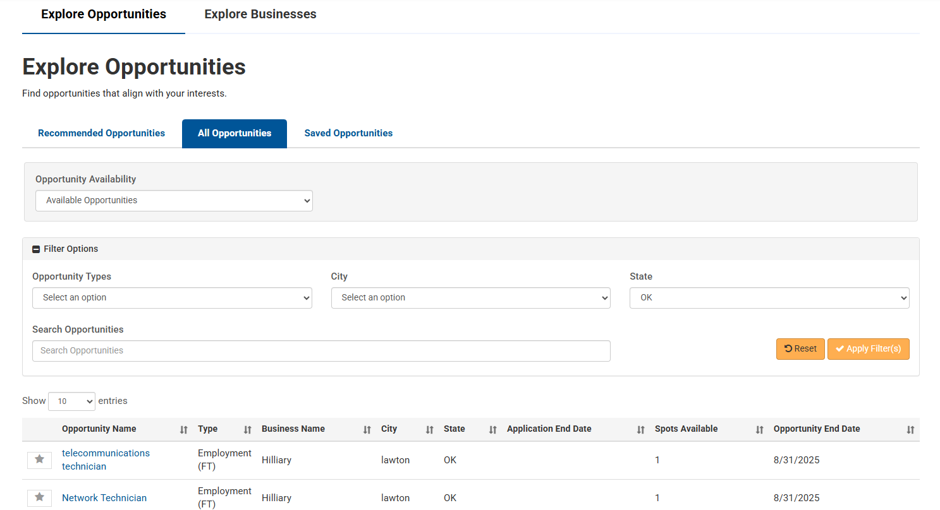
CONNECT 2 BUSINESS
Connect 2 Business (C2B) provides a connection between individuals in Oklahoma and Work-Based Learning (WBL) opportunities aligned to their career interest, skills and work values.School districts and businesses partner to provide individuals with invaluable experiences while growing the local workforce and strengthening community relationships. Benefits Include:
  Relationship Building Between Individuals and Businesses
  Fulfills WBL Standards
  Access to Action-Oriented Reporting
Want more information, customized OKCG training or curriculum? Scan the QR code and fill out the CCD request form!

Slide 7

QUESTIONS?
Nathan Brubaker
Brittany Crane
nathan.brubaker@careertech.ok.gov
brittany.crane@careertech.ok.gov

