Slide 1



Background
11 Public Colleges Collaborate to Offer Statewide Applied Technology Program (2021,June). 11 Public colleges collaborate to offer statewide applied technology program. https://okhighered.org/2021/06/aas-applied-tech-2021/
JUNE 7, 2021
The State Regents recently approved a request from 10 more state system colleges to offer the Associate in Applied Science in Applied Technology as a statewide pilot collaborative program to provide a degree completion mechanism for adult learners who have received an industry recognized credential, earned previous college credit in a technical field, or require specialized interdisciplinary training.
Carl Albert State College, Eastern Oklahoma State College, Murray State College, Northern Oklahoma College, Oklahoma State University Institute of Technology, Redlands Community College, Rogers State University, Rose State College, Seminole State College, and Western Oklahoma State College will join Tulsa Community College to offer the new program, which will be available via traditional and electronic delivery statewide. TCC’s pilot AAS in Applied Technology program was approved by the State Regents at their April 22, 2020, meeting.
“For many adult learners, family commitments, work responsibilities and financial pressures have been barriers to college degree completion in the past, and this collaborative program will allow them to finish the college degrees they started while using industry credentials earned in their previous work,” said Chancellor Glen D. Johnson. “The new AAS in Applied Technology partnership will provide specific technical knowledge and skills to prepare these students for employment, career advancement, or entry into a bachelor of technology program. This collaboration reflects public higher education’s continuing efforts to increase college degree completion and expand academic innovations as recommended by the 2018 Task Force on the Future of Higher Education.”
The Chief Academic Officers from each of the 11 colleges worked to develop pathways to complete an applied associate’s degree for students who have earned an industry recognized credential through the completion of a program at an Oklahoma technology center or other entity, to award a block of technical credit for industry recognized credentials earned, and to combine general education
coursework with specific technical knowledge and skills in preparation for employment or career advancement.
AAS in Applied Technology approved in 2020
Initially piloted at Tulsa Community College
Expanded to 11 public institutions by 2021
Designed for:
  Working adults
  CareerTech completers
Converts technical training into college credit

Slide 2
Purpose: CareerTech credit articulation at OSUIT/OKC
Establish a standardized process for awarding college credit within the Associate in Applied Science (AAS) in Applied Technology degree at OSUIT/OKC based on:
    CareerTech program completion
    Industry credential attainment
Ensure:
  Consistency
  Transparency
  Auditability
  Accreditation compliance
.

Slide 3
Eligibility Criteria
A student is eligible to receive CareerTech block credit toward the AAS in Applied Technology when all of the following conditions are met:
1. Industry Credential Attainment. The student holds a current, valid industry certification or licensure from the approved credential inventory. The credential must be on the institution’s approved list at the time of application.
2. CareerTech Program Completion. The student has successfully completed an Oklahoma CareerTech program in the subject area associated with the credential, as documented by an official technology center transcript.
3. Alignment. The credential and CareerTech program are in the same occupational area (e.g., a welding certification paired with a welding technology program, not an unrelated program).
4. Admission. The student is admitted to the institution and has declared the AAS in Applied Technology as their degree program.

Slide 4
How it Works: Three Examples
Completed Program: Computer Repair Technology (480 instructional hours)
CompTIA A+
+
Credit Calculation: 480 / 40 = 12 credits
Industry standard IT credential, recognized at 13 Oklahoma institutions
Completed Program: Paramedicine (1,250 instructional hours)
NREMT Paramedic (NRP)
+
Credit Calculation: 1,250 / 40 = 31 credits
National registry licensure, already awarded up to 42 credits at TCC
Completed Program: Medical Assisting (600 instructional hours)
CMA-AAMA
+
Credit Calculation: 600 / 40 = 15 credits
National certification from the American Association of Medical Assistants
In each case: student combines block credit (up to 42) with 18 hours of general education = 60-hour AAS degree in Applied Technology

Slide 5
Required Documentation:
Before credit is posted to the student’s transcript, the following documentation must be on file:
Official CareerTech Transcript. Issued by the Oklahoma technology center where the student completed their program. Must include State program name, dates of enrollment, completion status, and documented contact hours.
Proof of Industry Credential. A copy of the current certificate, license, or digital badge (e.g.Credly) demonstrating attainment of the approved industry credential. If the credential has an expiration date, it must be current at the time of application.
Credit Award Request Form. A standardized institutional form documenting the credential earned, associated CareerTech program, contact hours and credits to be awarded. Signed by the student and reviewed by the designated evaluator.
Credential Verification. Staff verification that the credential appears on the current approved credential inventory and that the CareerTech program aligns with the credential area.

Slide 6


Slide 7
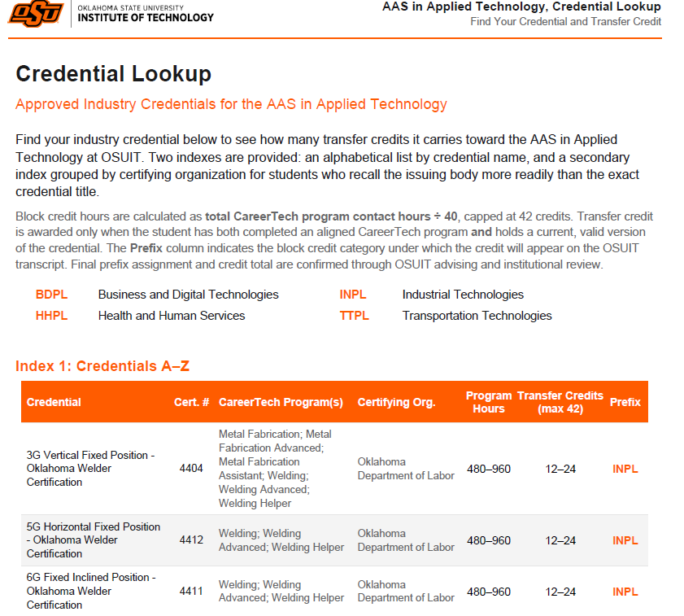
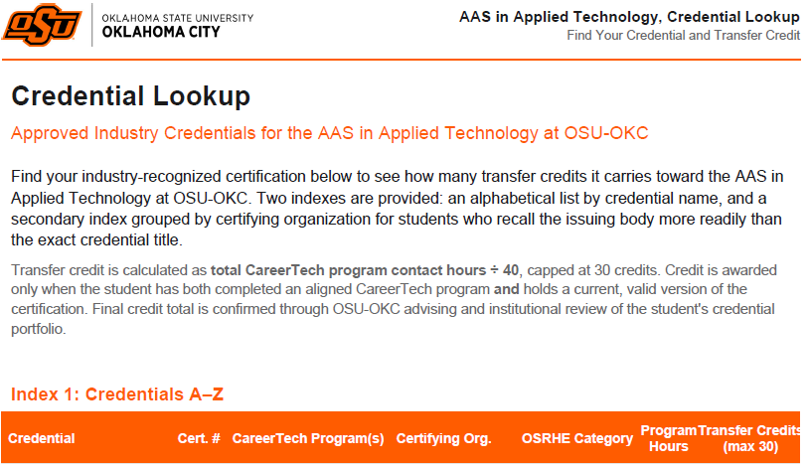
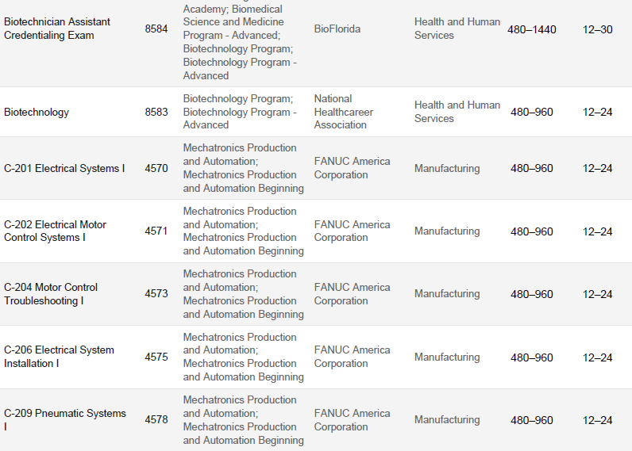
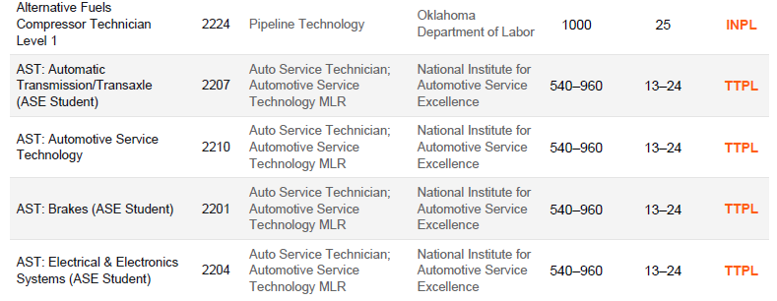

Slide 8

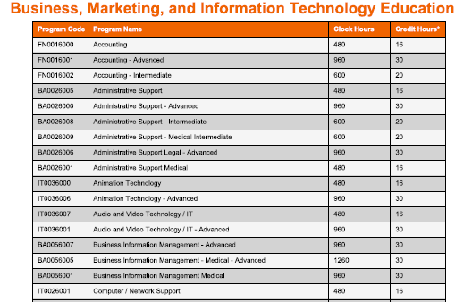
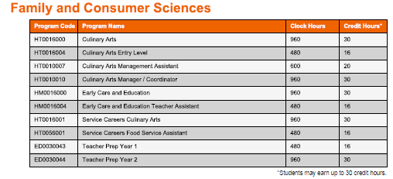
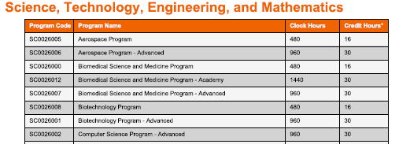

Slide 9
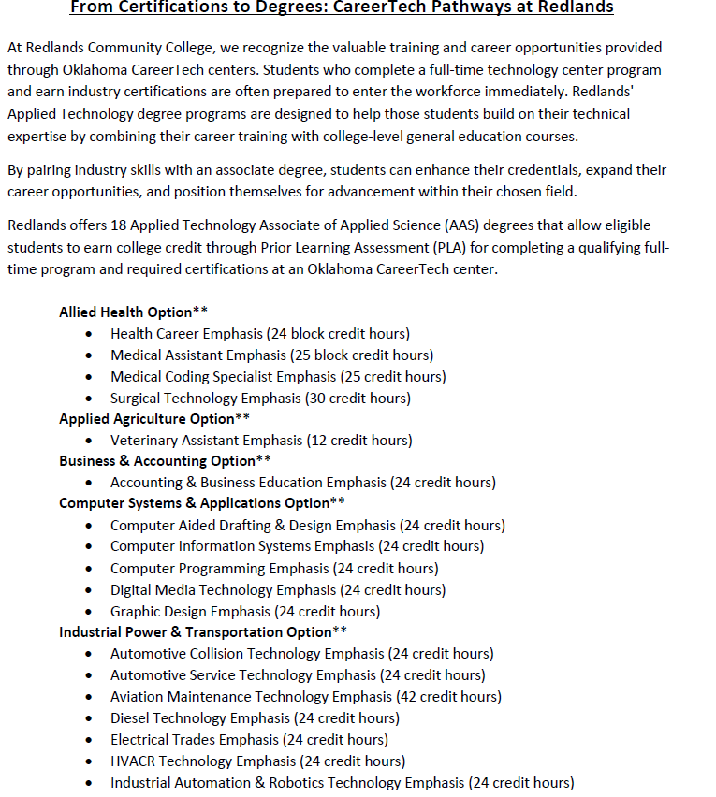
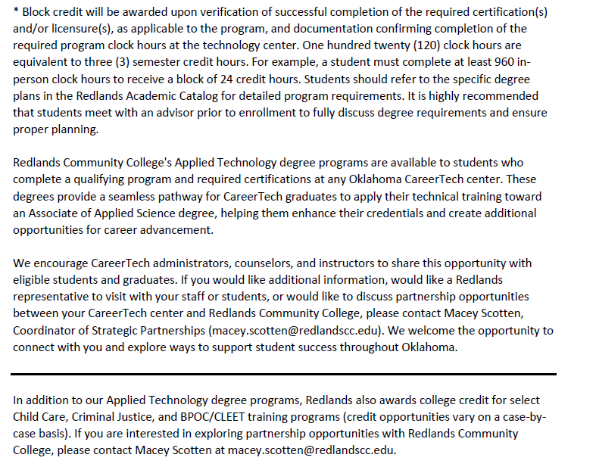

Slide 10
