Slide 1

The online academic and career development system available to all Oklahomans at no cost.

Slide 2


Today’s Objectives
Introduction to OKCareerGuide.org
Introduction to Connect2Business
Q&A/ctYOU.org

Slide 3

HB 2155 – Individual Career Academic Plan (ICAP)
Beginning with students entering the ninth grade in the 2019-2020 school year, each student shall be required to complete the process of an ICAP in order to graduate from a public high school with a standard diploma. Each year thereafter, students shall annually update their ICAP.
70 O.S. §1210.508-4 (OSCN 2019), Oklahoma School Testing Program Act

Slide 4
Individual Career and Academic Plan (ICAP)
College & Career Interest Surveys | Written Postsecondary & Workforce Goals | Intentional Sequence of Courses
Academic Progress | Scores on College & Career Readiness Assessments | Work-Based Learning or Service Learning

Slide 5
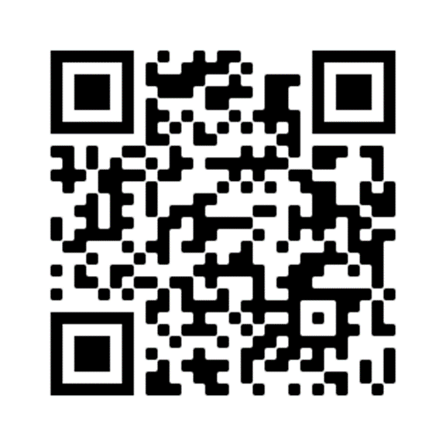
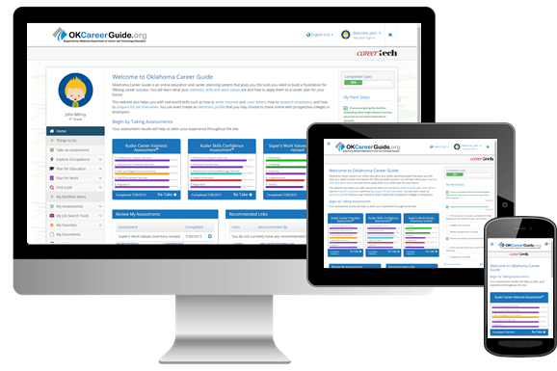
What is OKCareerGuide and what is its purpose?
  OKCareerGuide.org is a FREE online platform available for grades 6th – 12th AND adults. OKCareerGuide provides:
    3 Career Assessments
    Explore Occupations/Explore Majors
    Plan for Education/Plan for Work
    My Job Search Tools (Resume, Cover Letter, References templates)
    Finance 101
    Connect2Business
  OKCareerGuide ALSO provides ICAP support/solutions for middle and high school:
    3 Career assessments for 6th-12th grades
    My Goals
    My Ed Plans
    ICAP Oklahoma

Slide 6

OKCareerguide FEATURES
Notes:
Transition to looking inside the system at the main ICAP features

Slide 7
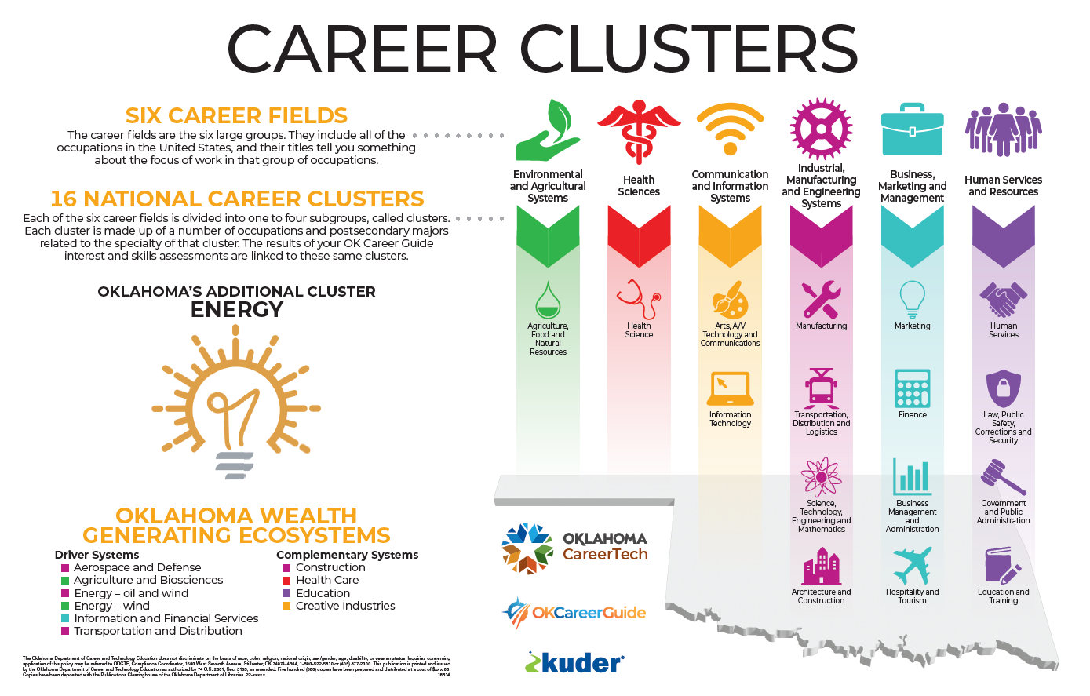

Slide 8
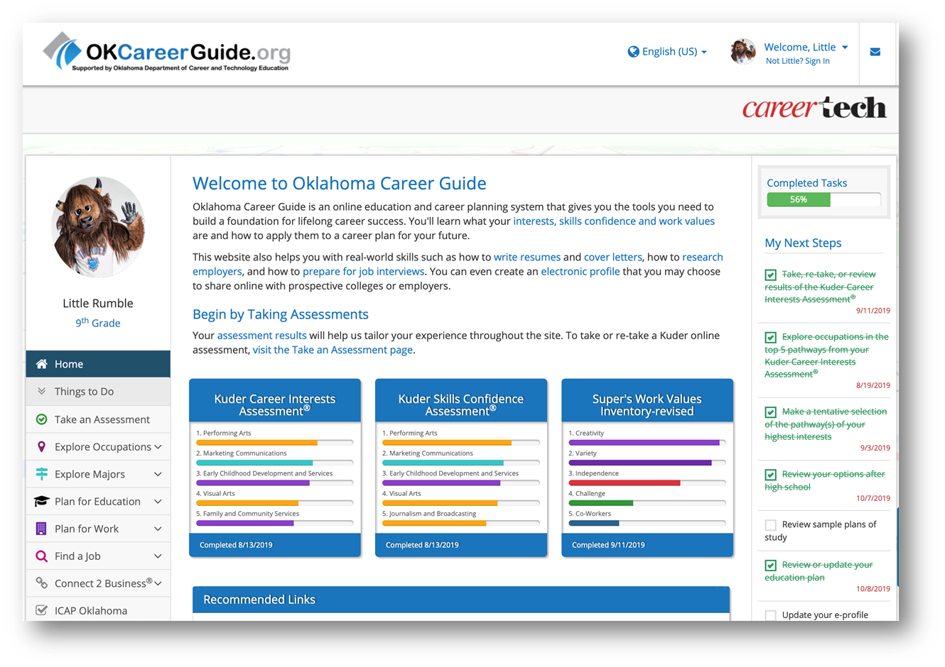

Three Career Assessments

Slide 9
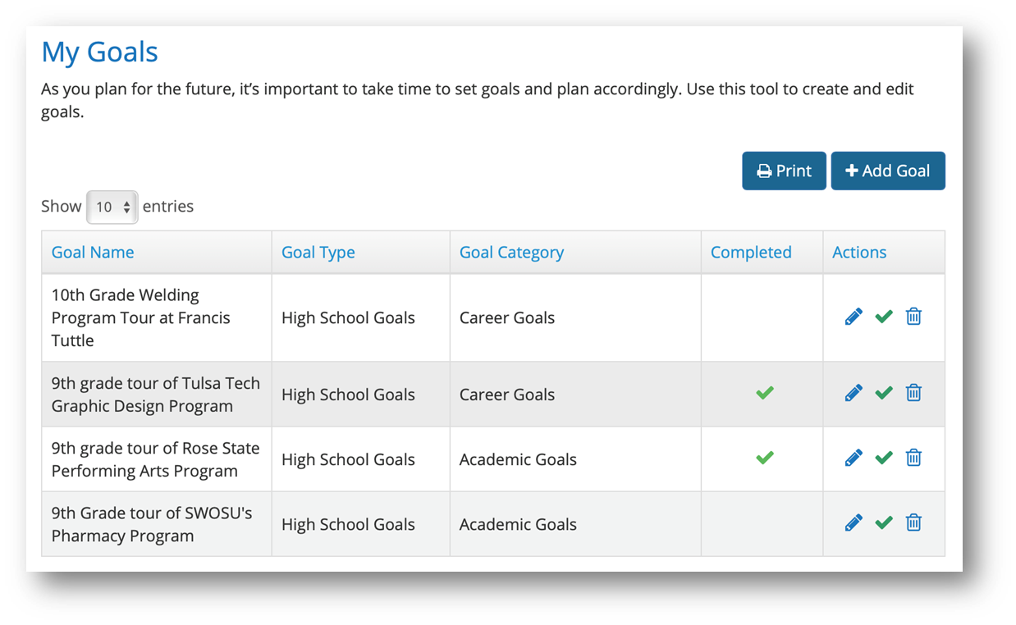
Set and Track Goals

Slide 10
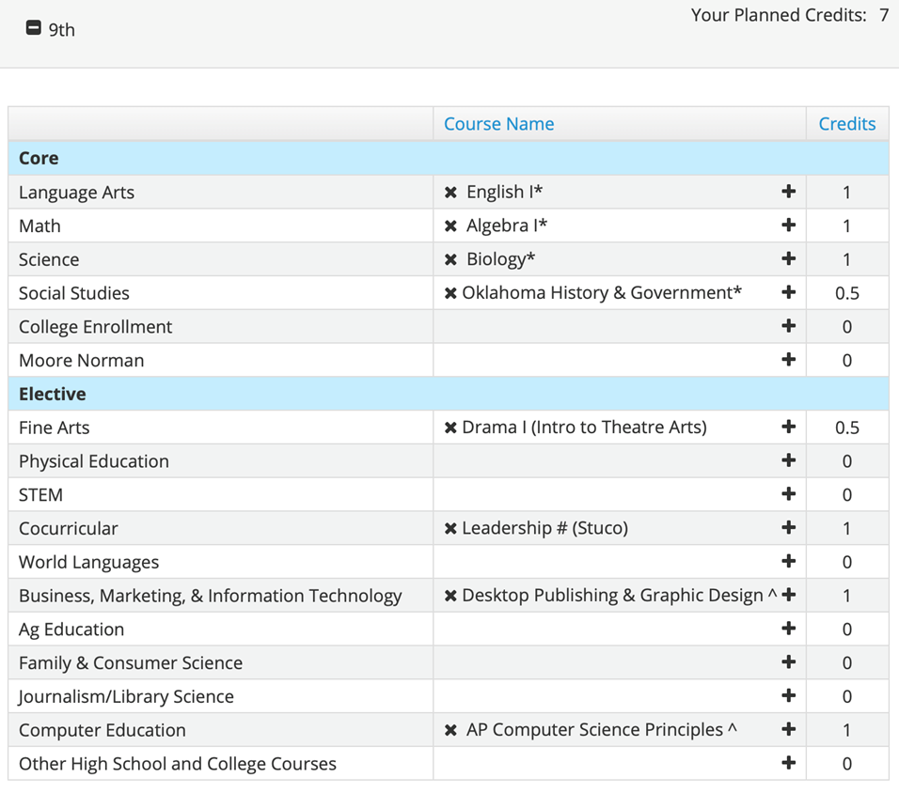
Create Customized Education Plans

Slide 11
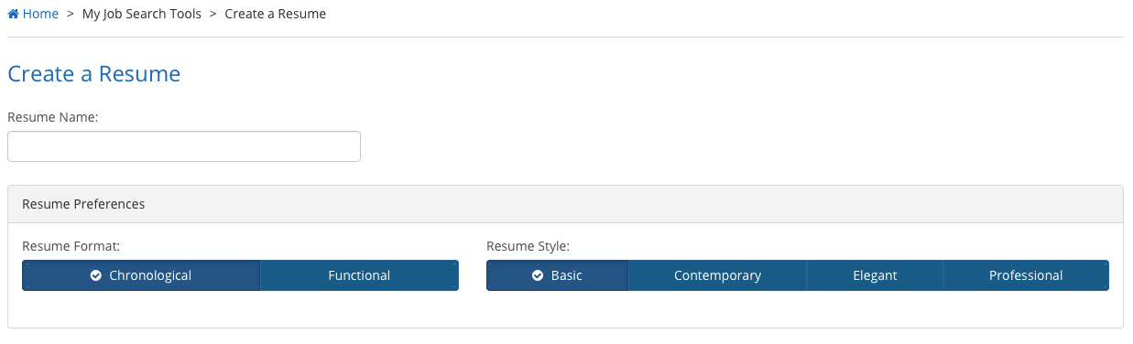
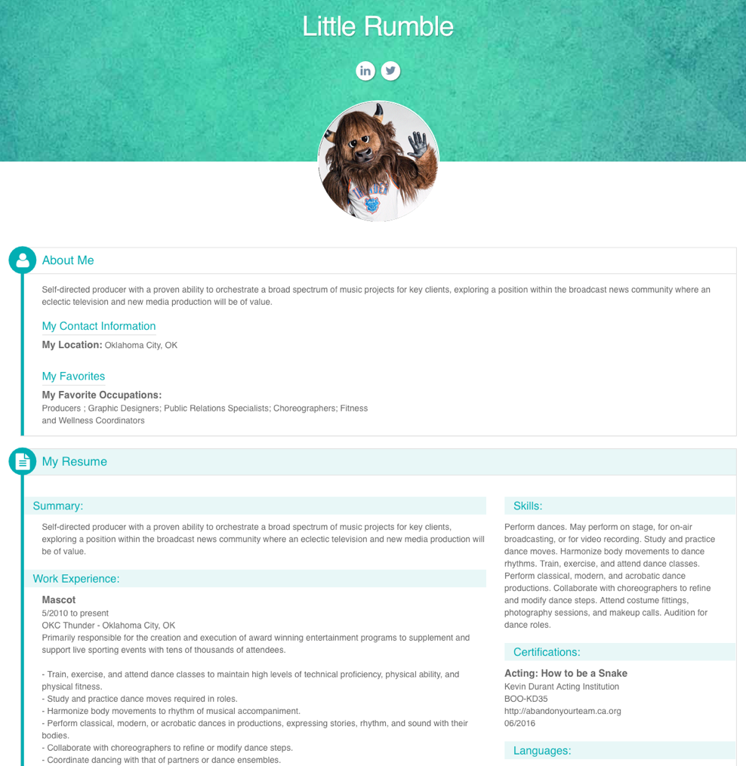
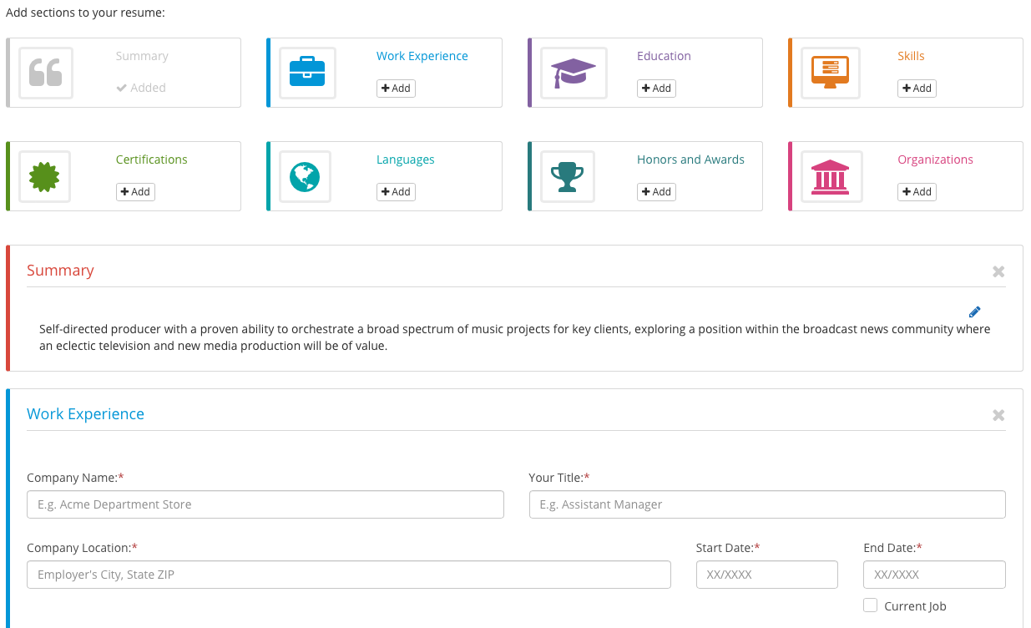

Job Readiness Features

Slide 12
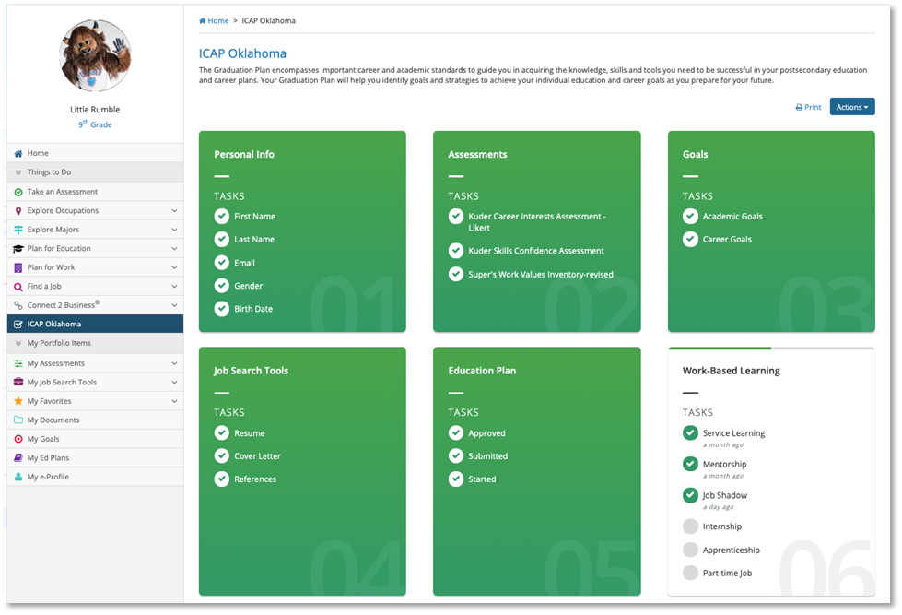
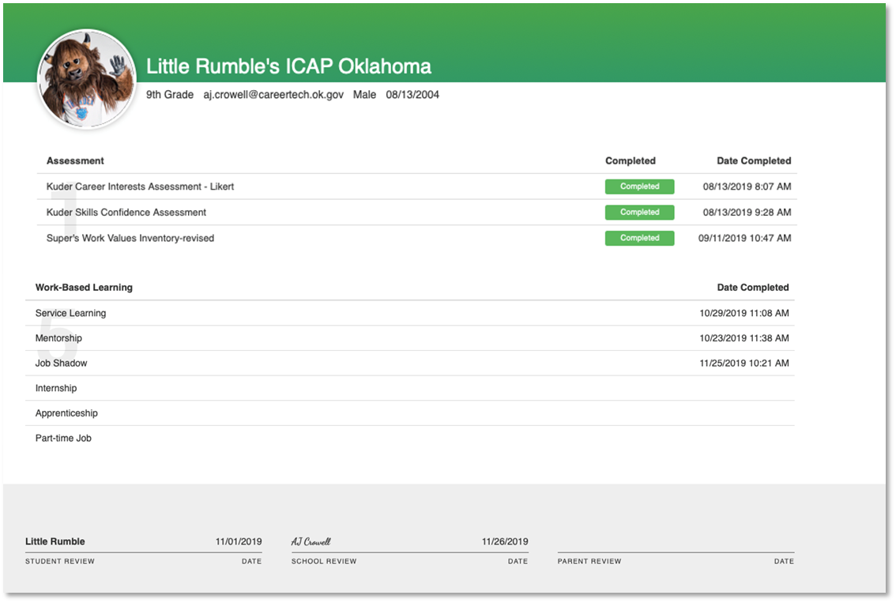
Track it all on the ICAP Report
(Student View)

Slide 13
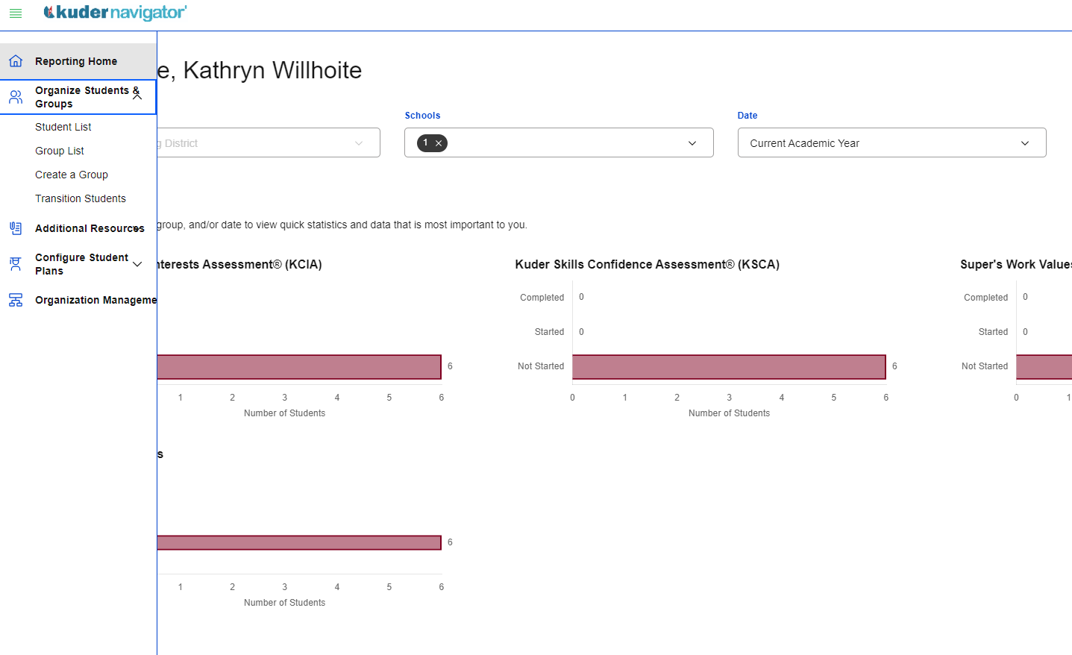
ADMS: Reports
Notes:
There will be four options of reports to run:
Individual Report: Select Actions > shows Top Career Pathways and National Cluster Ranking for individual student; you can also export as a CSV doc
One Page Summaries: Must select to filter students by number (example: Students 1 through 40) > will show one page summary of assessment results for each student
To print, be sure to select More settings > Background graphics
Aggregate Report: Will show top clusters that pulls from all student data
Top Three Report: You can select Actions, but it shows the same page as Individual Report; instead, the recommendation is to export as a CSV file – this file will show you the top 3 clusters for each student

Slide 14


Slide 15



DELIVERS
a seamless connection between career interests and local opportunities.
SERVES
students, working adults, educators, businesses, and workforce communities.
PROVIDES
meaningful work experiences for students, job seekers, and seasoned professionals.
Notes:
Connect 2 Business offers students a chance to learn more about local businesses and work opportunities tied to their interest assessments.
Features apprenticeships, internships, job shadows and full/part time work
Educators can use it to find businesses interested in career fairs, guest speaking, or business tours. This is another way to promote your advisory committee members and build a network of support.

Slide 16

OKCareerGuide leads Oklahomans through
a proven career development process
Take an Assessment
Explore Occupations & Majors
Plan for Education
Plan for Work
Find a Job
and connects them with local industry using Connect2Business.
C2B can be seen by OKCareerGuide users 9th – adult.
  9th – 12th: Career Exploration and Planning
  Post-Secondary & Adults: Post-Secondary Transition and Career Management

Slide 17



CONNECT2BUSINESS: Engagement
Create a profile to represent your industry
Opportunities include:
Full & part-time job openings
Internships
Job Shadowing
Apprenticeships
Connect with students and educators to participate in job fairs, business tours, guest speaking, and more
Post work opportunities that support your business and the local talent pipeline

Slide 18
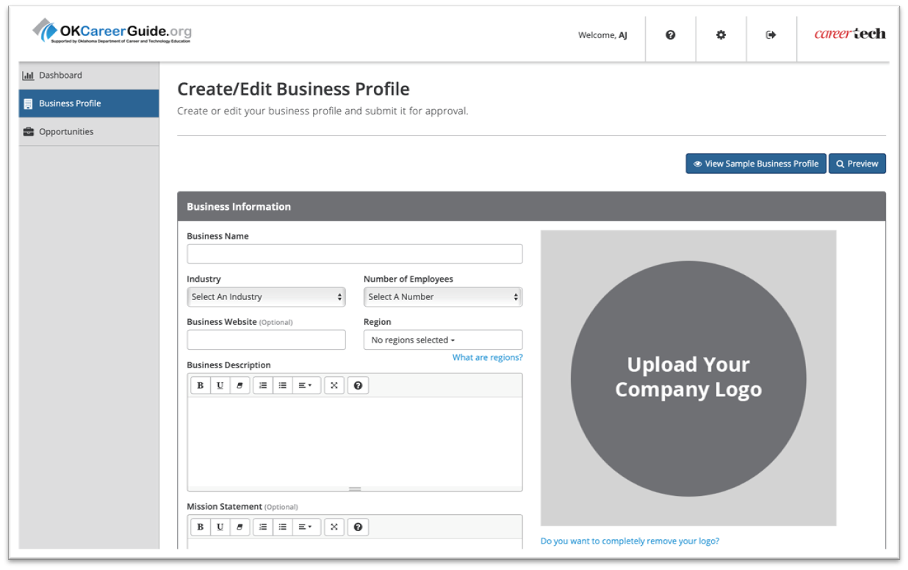
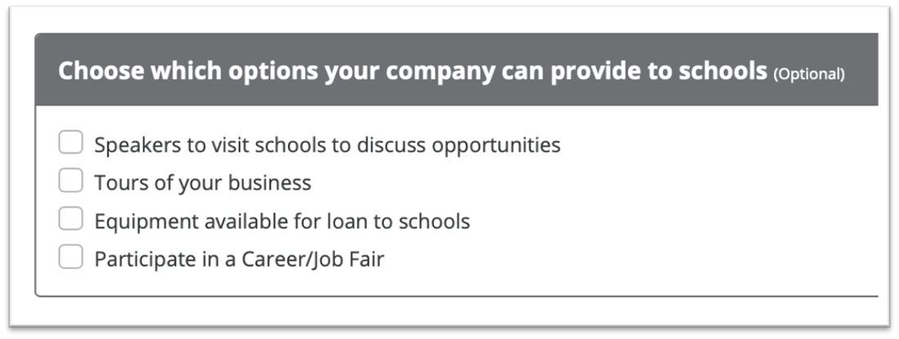
CONNECT2BUSINESS: New Account

Slide 19
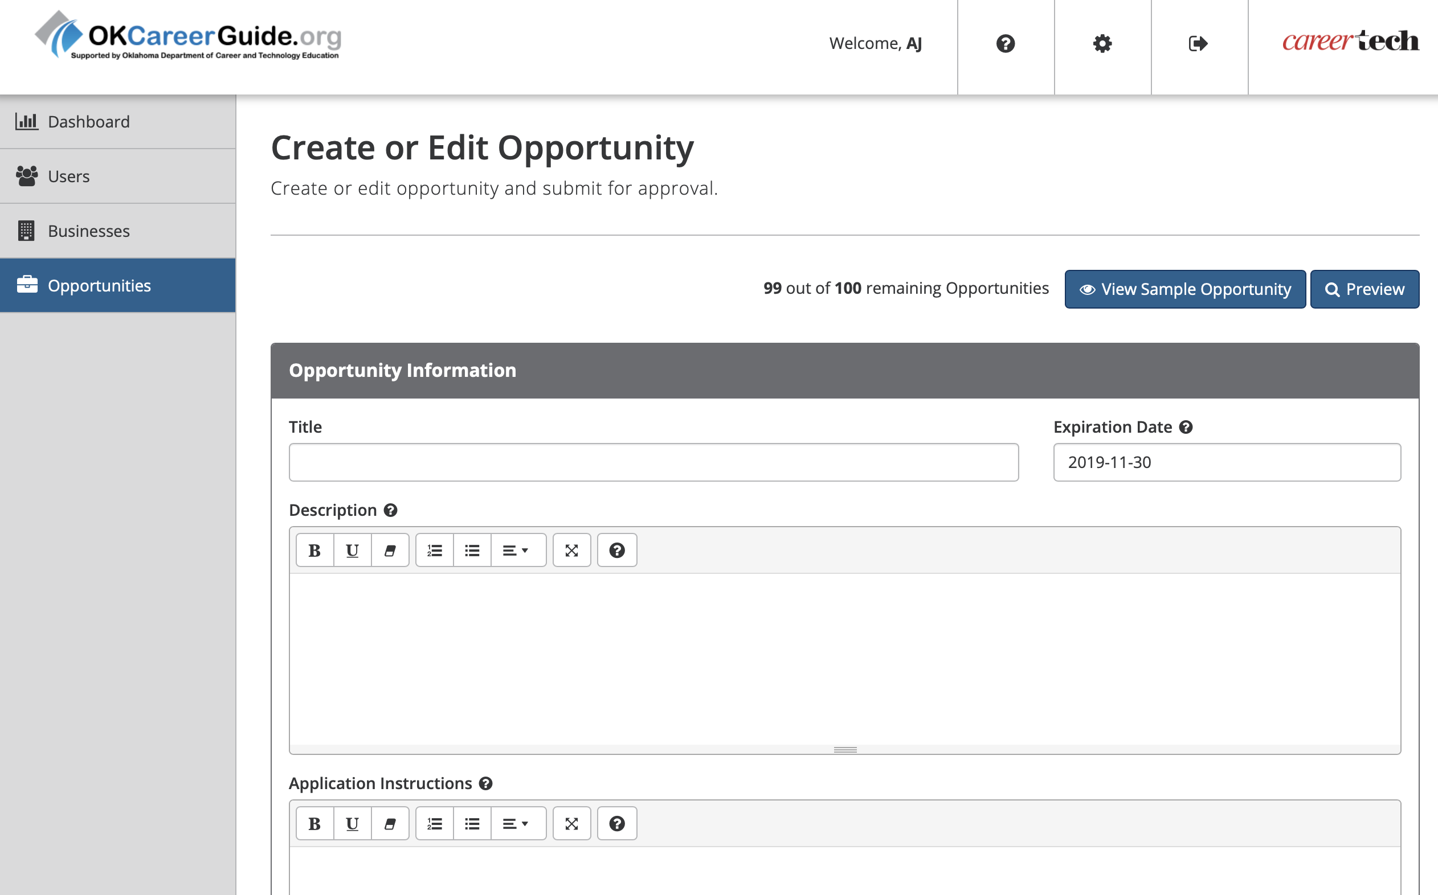
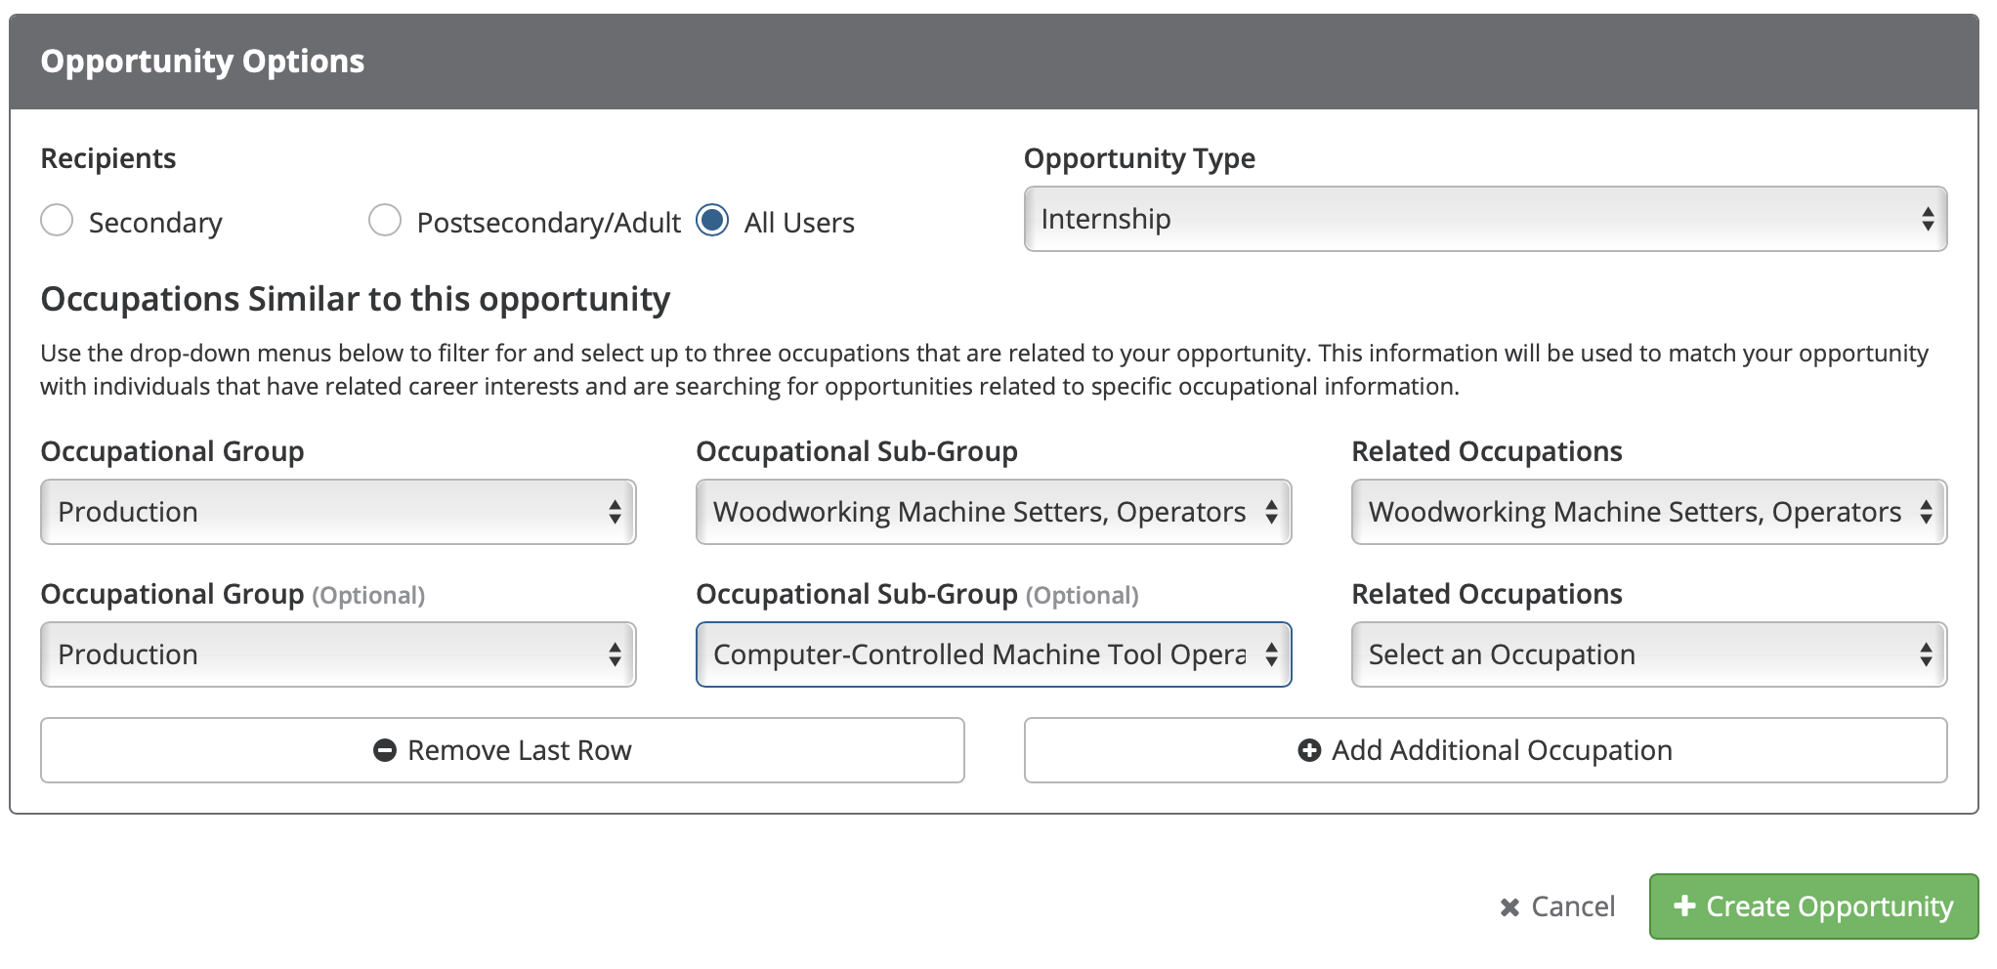
CONNECT2BUSINESS: New Opportunity

Slide 20
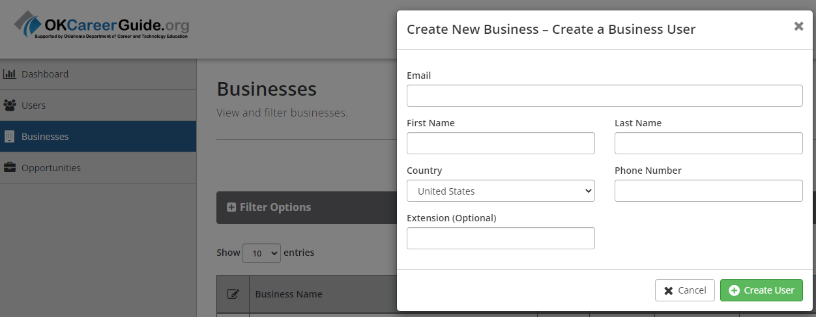
CONNECT2BUSINESS: New Business Profile

Slide 21
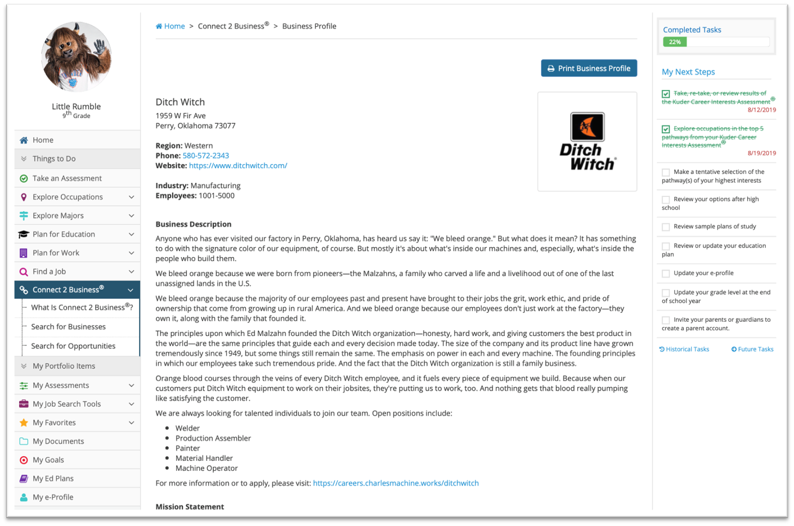
CONNECT2BUSINESS: Student View Business Profile

Slide 22
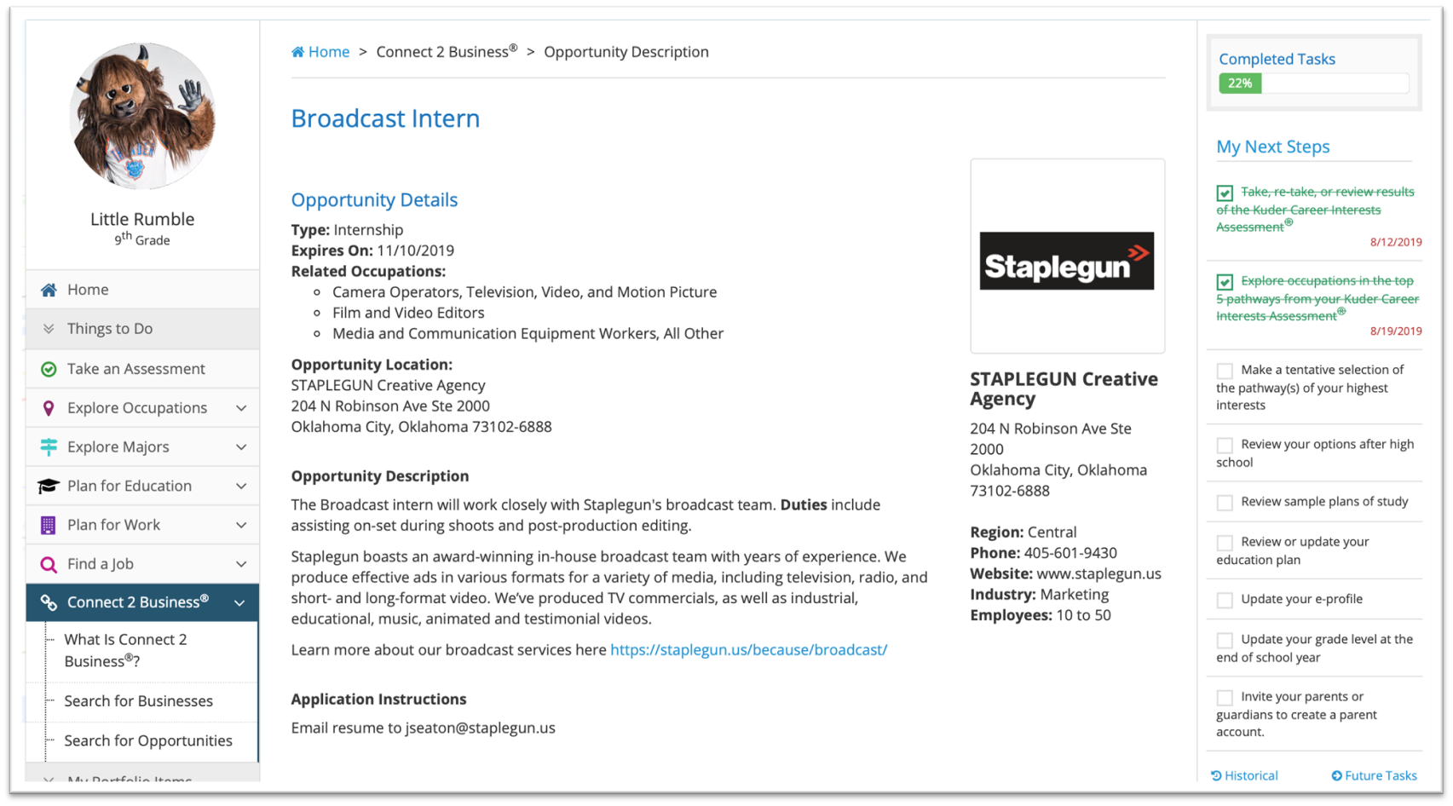
CONNECT2BUSINESS: Student View Opportunity

Slide 23
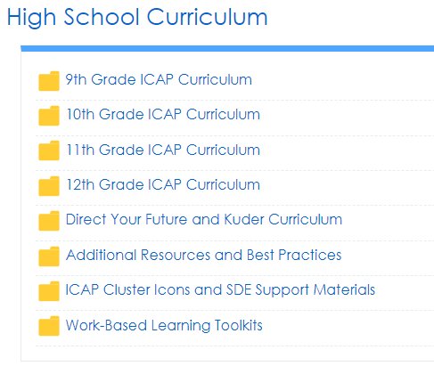
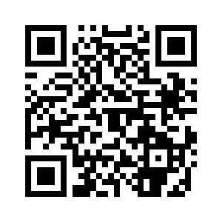
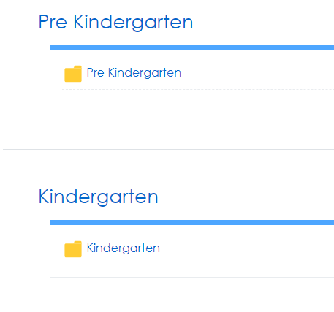
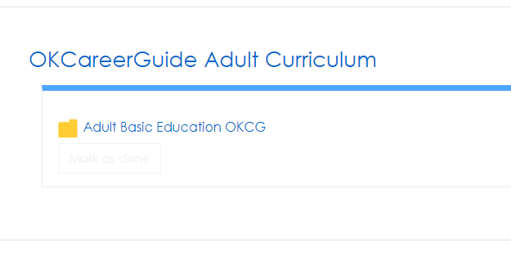
CTYOU.ORG Curriculum
If a login pages comes up, please click “Guest” or re-enter ctyou.org – you do not need a login to access our materials
Scroll down and find “Counseling and Career Development”
See available courses such as:
  OKCareerGuide Curriculum (MS/HS)
  OKCareerGuide Adult Curriculum
  Galaxy Curriculum (Elementary)

Slide 24
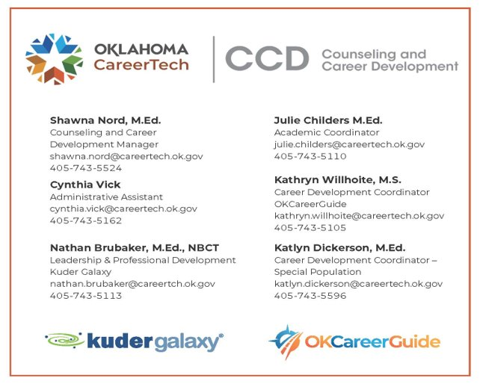
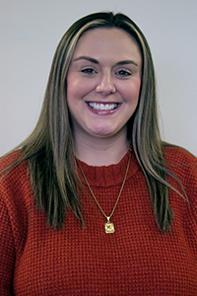
OKCareerGuide Team
Questions?
Kathryn Willhoite
405.743.5105
kathryn.willhoite@careertech.ok.gov

